Slide 1
Reasoning systems & uncertainty
Chap 5
CONTENTS
1. Reasoning over stored knowledge , types of reasoning
2. Rule based systems
3. Case based systems
4. Reasoning under uncertainty
  Symbolic reasoning
  Statistical reasoning

Slide 2
Motivation
Without reasoning, knowledge-based systems would be practically worthless
  derivation of new knowledge
  examination of the consistency or validity of existing knowledge
Reasoning in KBS can perform certain tasks better than humans
  reliability, availability, speed
  also some limitations
    common-sense reasoning
    complex inferences

Slide 3
What is reasoning?
Reasoning is the act of driving a conclusion from certain premises using a given methodology.
Reasoning is a process of thinking; reasoning is logically arguing; reasoning is drawing inference.
Any knowledge system must reason, if it is required to do something, which has not been told explicitly .
For reasoning, the system must figure(find) out what it needs to know from what it already knows.
Example
If we know: Robins are birds.
All birds have wings.
Then we ask : Do Robins have wings?
To answer this question- some reasoning must go.

Slide 4
Human reasoning
Humans reason in a variety of ways:
Reasoning by analogy: relating one concept to another
Formal reasoning: using deductive or inductive methods
Case-based reasoning: reasoning from relevant past cases

Slide 5
Human reasoning
Human reasoning capabilities are divided in to three areas:
  Mathematical reasoning:- axioms, definitions, theorems, proofs
  Logical reasoning- deductive, inductive, abductive
  Non-Logical reasoning-Linguistic, language
These three are areas of reasoning, are in every human being, but the ability level depends on education, environment and genetics.
The IQ(Intelligence Quotient) is the summation of mathematical reasoning skill and the logical reasoning.
The EQ(Emotional Quotient) depends mostly on non-logical reasoning capabilities.
Note: The logical Reasoning is of our concern in AI.

Slide 6
Logical reasoning
Logic is a language for reasoning. It is a collection of rules called Logic arguments, we use when doing logical reasoning.
Logic reasoning is the process of drawing conclusions from premises using rules of inference.
The study of logic is divided into formal and informal logic. The formal logic is sometimes called symbolic logic.

Slide 7
Logical reasoning...
Symbolic logic is the study of abstractions (construct) that capture the formal features of logical inference by a formal system.
Formal system consists of two components, a formal language plus a set of inference rules. The formal system has axioms.
Axiom is a sentence that is always true within the system.
Sentences are derived using the system’s axioms and rules of derivation are called theorems.

Slide 8
Logical reasoning...
Formal Logic
The formal logic is the study of inference with purely formal content, i.e. where content is made explicit.
Examples- propositional logic and predicate logic
  Here the logical arguments are a set of rules for manipulating symbols. The rules are of two types
    Syntax rules: say how to build meaningful expressions
    Inference rules: say how to obtain true formulas from other true formulas.
  Logic also needs semantics , which says how to assign meaning to expressions.

Slide 9
Logical reasoning...
Informal Logic
The informal logic is the study of natural languages arguments.
  The analysis of the argument structures in ordinary language is part of the informal logic.
  The focus lies in distinguishing good arguments (valid) from arguments or fallacies (invalid).

Slide 10
Logical reasoning ....
Formal systems
Formal systems can have the following three properties:
  Consistency: systems theorem's do not contradict
  Soundness: System’s rules of derivation will never anything false, so long as start is with only true premises.
  Completeness: three are no true sentences in the system that cannot be proved using the derivation rules of the system.

Slide 11
Logical reasoning ....
Formal language
A formal language may be viewed as being analogous to a collection of words or a collection of sentences.
  In computer science, a formal language is defined by precise mathematical or machine process able formulas.
  monotonic logic- logical reasoning in which a consequence cannot be retracted by adding new sentences
  non-monotonic logic-when the consequence can be retracted by adding new sentences

Slide 12
Monotonic vs. non-monotonic logic
Monotonic logic - a logic is monotonic if the truth of a preposition does not change when new information are added.
Non-monotonic logic - a logic is monotonic if the truth of a preposition may change when new information are added.
  Conclusion of non-monotonic logic may not be correct.
  Example:
  Birds typically fly.
  X is a bird
  X (presumably) fly
  Avoids inconsistency
  Human reasoning is non-monotonic in nature- this means, we reach a conclusion from premises that we would not reach if other premises are included in our premises.
  Non-monotonic reasoning is a focus of AI systems

Slide 13
Methods of reasoning
Deduction: exact reasoning.
  It deals with exact facts and exact conclusions
  conclusions must follow from their premises; prototype of logical reasoning
  Example: “ When it rains, the grass gets wet. It rains. Thus, the grass is wet.”
  This means in determining the conclusion; it is using rule and its precondition to make a conclusion.
  Applying a general principle to a special case.
  Using theory to make predictions.
  Usage: inference engines, theorem provers, planning.

Slide 14
Methods of reasoning...
Deduction: example
  Reason from facts and general principles to other facts
  Guarantees that the conclusion is true.
    Modus ponens: a valid form of argument affirming that antecedent.
      If it is rainy, Jhon carries an umbrella.
      It is rainy
      ........................................(threrefore)
      Jhon carries an umbrella.
    Modus tollens: a valid form argument denying the consequence.
      If it is rainy, Jhon carries an umbrella.
      Jhon doesn’t carry un umbrella.
      .................................(because)
      It is not rainy.
If P then Q
P
---------
Q
If P then Q
Not Q
---------
Not P

Slide 15
Methods of reasoning..
Induction:
  reasoning from a set of facts or individual cases to a general conclusion
  inference from specific cases (examples) to the general
  Example: “ the grass has been wet every time it has rained. Thus, when it rains, the grass gets wet.”
  This means in determining the rule, it is learning the rule after numerous examples of conclusion following the precondition.
  Deriving a general principle from special cases.
  From observations to generalizations to knowledge.
  Usage: Neural nets, Bayesian nets, pattern recognition

Slide 16
Methods of reasoning...
Induction: Example
Reasoning from many instances to all instances
  Good Movie
  Fact: You have liked all movies starring Mery.
  Inference: You will like her next movie.
  Birds
  Facts: woodpeckers, swifts, eagles, finches have 4 toes on each foot
  Inference: All birds have four toes on each foot.
  (Note : partridges have only 3).
  Problem : sometimes inference is correct, sometimes not correct.
  Advantage : inductive inference may be useful even if not correct.
  It generates a proposition which may be validated deductively.

Slide 17
Methods of reasoning....
Abduction:
  reasoning from a true conclusion to premises that may have caused the conclusion
  Example: “When it rains, the grass gets wet. The grass is wet, it must have rained.”
Means determining the precondition; it is using the conclusion and the rule to support that the precondition could explain the conclusion.
  Guessing that some general principle can relate a given pattern of cases.
  Extract hypothesis to form a tentative theory.
  Usage: knowledge discovery, statistical methods, data mining.

Slide 18
Methods of reasoning...
Abduction: Example
  Common form human reasoning-” inference to the best explanation”.
  In Abductive reasoning you make an assumption which, if true, together with your general knowledge, will explain facts.
  Dating:
    Fact: Mary asks Jhon to a party.
    Abd. Inferences: Mary likes Jhon.
  Jhon is Mary’s last choice
  Mary wants to make someone else jealous
  Problem: Not always correct, many explanations possible.
  Advantage: understandable conclusions.

Slide 19
Methods of reasoning....
Analogy:
  Example: “An atom, with its nucleolus and electrons, is like the solar system, with its sun and planets”.
  Means analogous; it is an illustration of an idea by means of a more familiar idea that is similar to it in some significant features, and thus said to be analogous to it.
  Finding a common pattern in different cases.
  Usage: matching labels, matching sub-graphs, matching transformations.

Slide 20
Methods of reasoning....
Analogy : Example
  Analogical reasoning yields conjectures, possibilities.
  If A is like B in some ways, the infer A is like B in other ways.
    Statements: an atom, with its nucleus and electrons, is like the solar system, with its sun and planets.
    Inferences: Electrons travel around the nucleus
          Orbits are circular
  Problems: few analogical inferences are correct.
  Advantage: suggests novel possibilities. Helps to organize information

Slide 21
Methods of reasoning
Note:
deductive reasoning and inductive reasoning are the two commonly used explicit methods of reasoning to reach conclusion.

Slide 22
Uncertainty in reasoning (overview)
The world is in an uncertain place; often the knowledge is imperfect which causes uncertainty. Therefore reasoning must be able to operate under uncertainty.
AI systems must have the ability to reason under conditions of uncertainty.
Uncertainties Desired action
  Incompleteness knge : Compensate for lack of knge.
  Inconsistencies knge : resolve ambiguities and contradictions
  Changing knowledge : update the knge base over time

Slide 23
Reasoning and KR
To certain extent, the reasoning depends on the way the knowledge is represented or chosen.
  a good knowledge representation scheme allows easy, natural and plausible (credible) reasoning.
  Reasoning methods are broadly identified as:
    Formal reasoning: using basic rules of inference with logic knowledge representations
    Procedural reasoning: uses procedures that that specify how to perhaps solve sub problems
    Reasoning by analogy: this is as human do, but more difficult for AI systems
    Generalization and abstraction : this is also as human do; are basically learning and understanding methods.
    Meta-level reasoning : uses knowledge about what we know ordering them as per importance.

Slide 24
Rule-based Reasoning -
Production-rule(Rule-based) systems

Slide 25
Rule-Based Expert Systems
Work with
  a set of facts describing the current world state
  a set of rules describing the expert knowledge
  inference mechanisms for combining facts and rules in reasoning
  Knowledge modelling is in the form of production-rule (IF---Then) form.

Slide 26
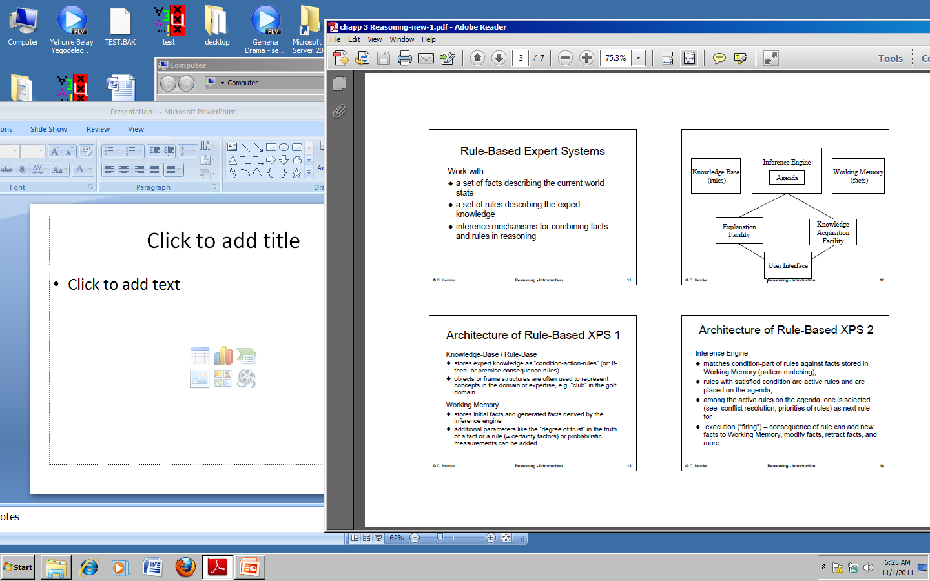
Architecture of Rule-Based ES

Slide 27
Architecture of Rule-Based ES
Knowledge-Base / Rule-Base
  stores expert knowledge as “condition-action-rules” (or: if -then- or premise-consequence-rules)
  objects or frame structures are often used to represent concepts in the domain of expertise, e.g. “club” in the golf domain.
Working Memory
  stores initial facts and generated facts derived by the inference engine

Slide 28
Architecture of Rule-Based ES
Inference Engine
  matches condition-part of rules against facts stored in Working Memory (pattern matching);
  rules with satisfied condition are active rules and are placed on the agenda;
  among the active rules on the agenda, one is selected (see conflict resolution, priorities of rules) as next rule for
  execution (“firing”) – consequence of rule can add new facts to Working Memory, modify facts, retract facts, and more

Slide 29
Architecture of Rule-Based ES
Inference Engine + additional components
might be necessary for other functions, like
  calculation of certainty values,
  determining priorities of rules,
  conflict resolution mechanisms,
  a truth maintenance system (TMS) if reasoning with defaults and beliefs is requested

Slide 30
Rule-Based Systems
-Example ‘Grades’ -
Rules to determine ‘grade’
  study → good_grade
  not_study → bad_grade
  sun_shines → go_out
  go_out → not_study
  stay_home → study
  awful_weather → stay_home

Slide 31
Example ‘Grades’
Rule-Base to determine the ‘grade’:
Q1: If the weather is awful, do you get a good or bad grade?
Q2: When do you get a good grade?
  study → good_grade
  not_study → bad_grade
  sun_shines → go_out
  go_out → not_study
  stay_home → study
  awful_weather → stay_home

Slide 32
Forward and Backward Reasoning
Forward reasoning
  Facts are given. What is the conclusion?
    A set of known facts is given (in WM); apply rules to derive new facts as conclusions (forward chaining of rules) until you come up with a requested final goal fact.
Backward reasoning
  Hypothesis (goal) is given. Is it supported by facts?
    A hypothesis (goal fact) is given; try to derive it based on a set of given initial facts using sub-goals (backward chaining of rules) until goal is grounded in initial facts.

Slide 33
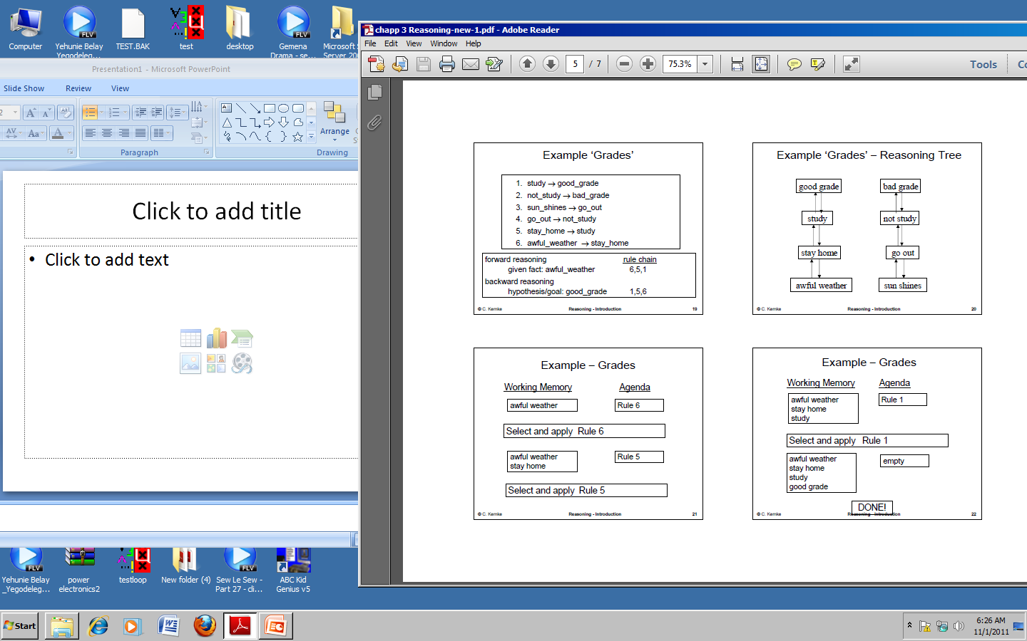
Forward and Backward Reasoning

Slide 34
Forward and Backward Reasoning
Done!

Slide 35
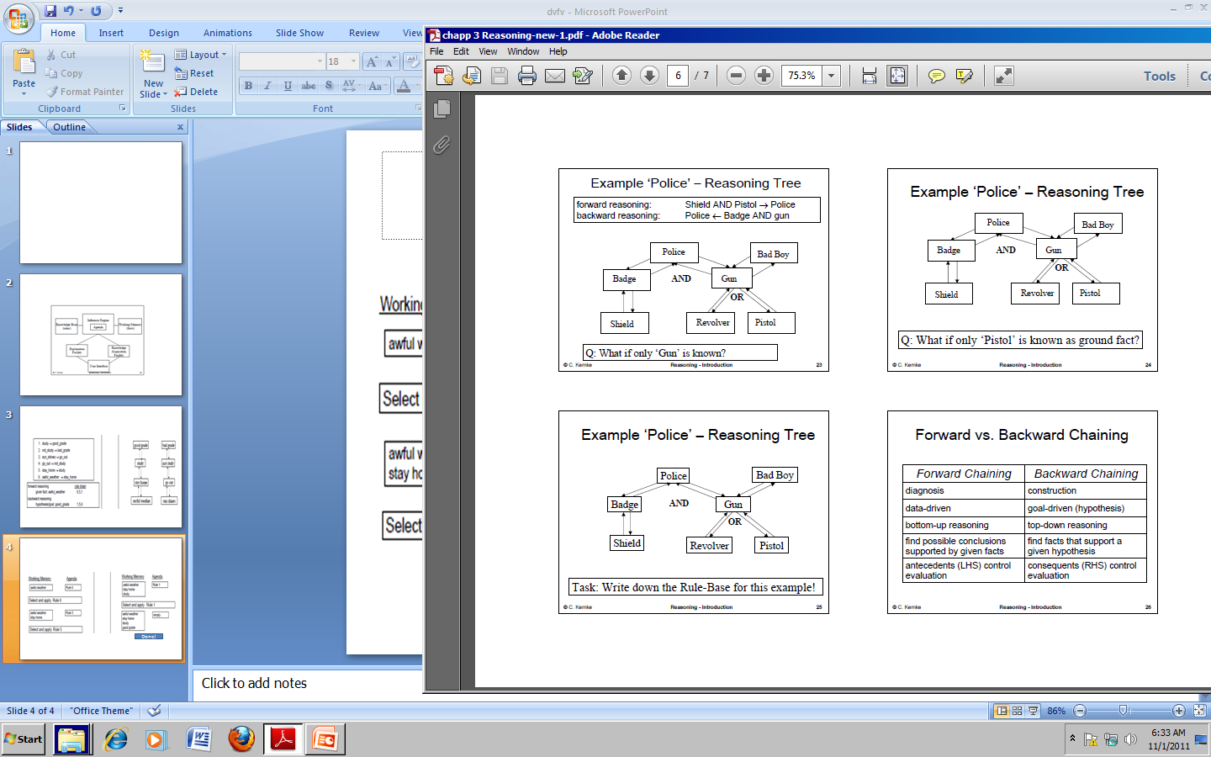

Slide 36
Case Based Reasoning

Slide 37
Faced this situation before?
Oops the car stopped.
  What could have gone wrong?
Aah.. Last time it happened, there was no petrol.
  Is there petrol?
    Yes.
  Oh but wait I remember the tyre was punctured
This is the normal thought process of a human when faced with a problem which is similar to a problem he/she had faced before.

Slide 38
How do we solve problems?
By knowing the steps to apply
  from symptoms to a plausible diagnosis
But not always applying causal knowledge
How does an expert solve problems?
  uses same “book learning” as a novice
  but quickly selects the right knowledge to apply
Heuristic knowledge (“rules of thumb”)
  “I don’t know why this works but it does and so I’ll use it again!”
  difficult to elicit

Slide 39
So what?
Reuse the solution experience when faced with a similar problem.
This is Case Based Reasoning (CBR)!
  memory-based problem-solving
  re-using past experiences
Experts often find it easier to relate stories about past cases than to formulate rules

Slide 40
What’s CBR?
To solve a new problem by remembering a previous similar situation and by reusing information and knowledge of that situation
Ex: Medicine
  doctor remembers previous patients especially for rare combinations of symptoms
Ex: Law
  English/US law depends on precedence
  case histories are consulted
Ex: Management
  decisions are often based on past rulings
Ex: Financial
  performance is predicted by past results

Slide 41
Definitions of CBR
Case-based reasoning is […] reasoning by remembering - Leake, 1996
A case-based reasoner solves new problems by adapting solutions that were used to solve old problems - Riesbeck & Schank, 1989
Case-based reasoning is a recent approach to problem solving and learning […] - Aamodt & Plaza, 1994

Slide 42
History
Roots of CBR is found in the works of Roger Shank on dynamic memory.
Other trails into the CBR field has come from
  Analogical reasoning
  Problem solving and experimental learning within philosophy and psychology
The first CBR system, CYRUS developed by Janet Kolodner at Yale university.

Slide 43
The Limitations of Rules
The success of rule-based expert systems is due to several factors:
  They can mimic some human problem-solving strategies
  Rules are a part of everyday life, so people can relate to them
However, a significant limitation is the knowledge elicitation bottleneck
  Experts may be unable to articulate their expertise
    Heuristic knowledge is particularly difficult
  Experts may be too busy…

Slide 44
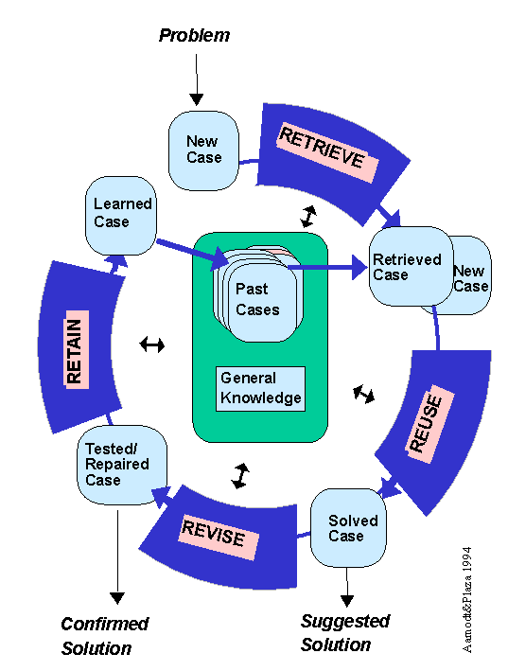
CBR Cycle

Slide 45
R⁴ Cycle
RETRIEVE
find similar
problems
RETAIN
integrate in
case-base
CBR
REUSE
propose solutions
from retrieved cases
REVISE
adapt and repair
proposed solution

Slide 46
CBR System Components
Case-base
  database of previous cases (experience)
Retrieval of relevant cases
  index for cases in library
  matching most similar case(s)
  retrieving the solution(s) from these case(s)
Adaptation of solution
  alter the retrieved solution(s) to reflect differences between new case and retrieved case(s)

Slide 47
CBR Assumption(s)
The main assumption is that:
  Similar problems have similar solutions:
    e.g., an aspirin can be taken for any mild pain
Two other assumptions:
  The world is a regular place: what holds true today will probably hold true tomorrow
    (e.g., if you have a headache, you take aspirin, because it has always helped)
  Situations repeat: if they do not, there is no point in remembering them
    (e.g., it helps to remember how you found a parking space near that restaurant)

Slide 48
How CBR solves problems
New problem can be solved by
  retrieving similar problems
  adapting retrieved solutions
Similar problems have similar solutions
P
P
P
P
?
P
P
P
P
P
S
S
S
X
S
S
S
S
S
S

Slide 49
CBR Knowledge Containers
Cases
  lesson to be learned
  context in which lesson applies
Description Language
  features and values of problem/solution
Retrieval Knowledge
  features used to index cases
  relative importance of features used for similarity
Adaptation Knowledge
  circumstances when adaptation is needed
  alteration to apply

Slide 50
Pros & Cons of CBR
Advantages
  solutions are quickly proposed
    derivation from scratch is avoided
  domains do not need to be completely understood
  cases useful for open-ended/ill-defined concepts
  highlights important features
Disadvantages
  old cases may be poor
  library may be biased
  most appropriate cases may not be retrieved
  retrieval/adaptation knowledge still needed

Slide 51
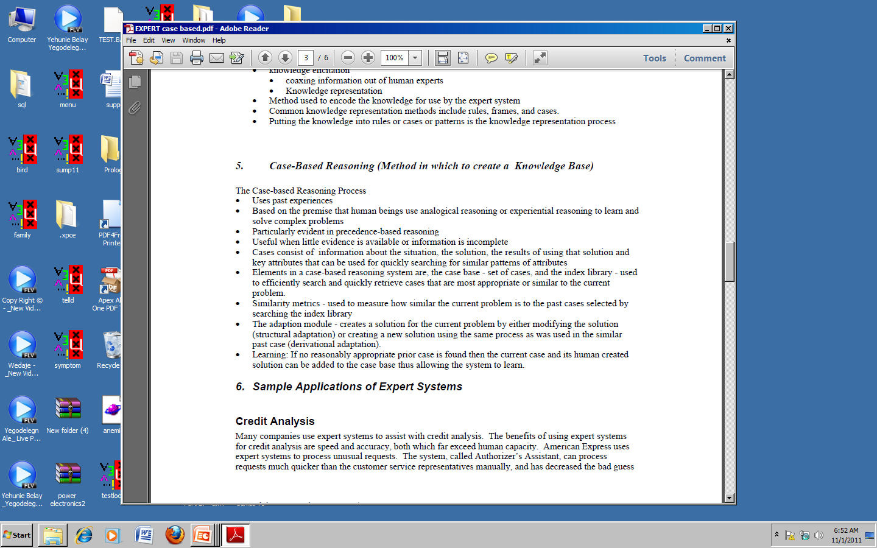
Summary
The case-based reasoning process

Slide 52
Reasoning under Uncertainty
(inexact reasoning)

Slide 53
Uncertainty
Search and Planning Agents
  Assume fully observable, deterministic, static
Real World:
  Probabilities capture “Ignorance & Laziness”
    Lack relevant facts, conditions
    Failure to enumerate all conditions, exceptions
  Partially observable, stochastic, extremely complex
  Can't be sure of success, agent will maximize
  Bayesian (subjective) probabilities relate to knowledge

Slide 54
Motivation
Uncertainty in medical diagnosis
  Diseases produce symptoms
  In diagnosis, observed symptoms => disease ID
  Uncertainties
    Symptoms may not occur
    Symptoms may not be reported
    Diagnostic tests not perfect
      False positive, false negative
How do we estimate confidence?

Slide 55
Motivation II
Uncertainty in medical decision-making
  Physicians, patients must decide on treatments
  Treatments may not be successful
  Treatments may have unpleasant side effects
Choosing treatments
  Weigh risks of adverse outcomes
People are BAD at reasoning intuitively about probabilities
  Provide systematic analysis

Slide 56
Challenges
The available knowledge about the real world is inherently uncertain.
We usually make decisions based on incomplete and partially inaccurate data.

Slide 57
Challenges
Representation of uncertainty
Fast reasoning based on uncertain knowledge
Elicitation of critical additional data
Learning of reasonable default assumptions
Contingency reasoning

Slide 58
Uncertainty
Unfortunately the world is an uncertain place.
  Uncertainty is inherently part of most human decision making.
Any AI system that seeks to model and reasoning in such a world must be able to deal with this.
  Expert systems which seek to model human expertise in specific domains have to take care of uncertain information.
  They, therefore, need methods to represent uncertainty in knowledge and data and should be able to reason with such uncertain information.

Slide 59
Uncertain agent
sensors
?
?
environment
?
agent
?
actuators
model

Slide 60
Types of Uncertainty
Uncertainty in prior knowledge
E.g., some causes of a disease are unknown
and are not represented in the background
knowledge of a medical-assistant agent

Slide 61
Types of Uncertainty
Uncertainty in actions
E.g., to deliver this lecture:
I must be able to come to school
the heating system must be working
my computer must be working
the LCD projector must be working
I must not have become paralytic or blind
As we will discuss with planning, actions are
represented with relatively short lists of preconditions, while these lists are in fact arbitrary long. It is not efficient (or even possible) to list all the possibilities.

Slide 62
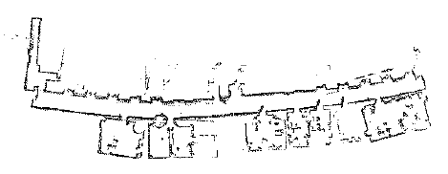
Types of Uncertainty
Uncertainty in perception
E.g., sensors do not return exact or complete information about the world; a robot never knows exactly its position.

Slide 63
Sources of uncertainty
Laziness (efficiency)
Ignorance
What we call uncertainty is a summary of all that is not explicitly taken into account in the agent’s knowledge base (KB).

Slide 64
Sources of uncertainty
Domain knowledge used is not always reliable.
  Expert systems typically use shallow reasoning using thumb rules or heuristics provided by the expert.
  These rules are not guaranteed to be correct always.
    Heuristic – “it works most of the time".
    Heuristic knowledge will hold in most of the cases (say, 90% of the cases).
    Weak implications of rules
  The standard form of an if-then rule, If A,B,C then D, is not usually sufficient to represent domain knowledge.
    Rules will have to take the more general form: If A,B, C then D with certainty X where the quantity X represents the degree of belief or confidence in the rule.

Slide 65
Sources of uncertainty
Inaccuracy of instruments used to measure parameter values
  Inaccuracy measure of sensor values may leads to uncertainty in the data obtained, which in turn affects the conclusions.
  For example, consider the question “Do you have chest-pain?".
  Given the observation that, occurrences of chest pain can vary :
    in intensity from very mild to very severe
    in frequency occasional to almost continuous
    a simple yes-or-no answer
      A patient may even answer “I think so".
        This answer has to be treated as a partial yes.
will be difficult to comprehend.

Slide 66
Sources of uncertainty
The inherent imprecision of the language in which the information is conveyed.
For example,
Q: is the person is tall?
How much is tall?

Slide 67
Sources of uncertainty
Incomplete knowledge.
  In most complex decision making processes, all the required information may not be accessible when required. Decisions have to be taken without knowing all the relevant parameters.
  For example,
  A doctor cannot wait till all test results are available to treat a patient complaining of severe abdominal pain.
    Experts, and hence expert systems, will have to make at least tentative decisions based on available (partial) information.
    Decisions might not be similar, if, later on, more evidence is obtained against them.

Slide 68
Sources of uncertainty
Inconsistent knowledge
  Possibly caused by:
    Multiple knowledge sources.
    Multiple sensors measuring related quantities
      A combination of which, In turn, causes problems:
        Conflict- arises when the conclusions from two sources are inconsistent with each other.
        Redundancy- When both give the same information.
        Subsumption - When the conclusions of one source are a special case of the conclusions of another
Change - it must be able to update its world knowledge base over time

Slide 69
Approaches to Handling Uncertainty
  Approaches to handling uncertainty vary from system to system, depending on the type and cause of uncertainty in the domain of application.
    There is no single universal method yet to handle all forms of uncertainty.
These approaches can be divided into two broad categories based on their characteristics representing uncertainty using:
  numerical quantities and ,
  symbolic methods
    There are pros and cons for both approaches.

Slide 70
Approaches to Handling Uncertainty...
In numerical /statistical approaches, one models the uncertainty in data and knowledge by numbers and provides some algebraic formulae to propagate these uncertainty values to the conclusions. These approaches have been widely used in expert system applications.
  Bayesian reasoning, Confirmation theory , Evidence theory and Fuzzy set
  Numerical approaches are suitable for addressing problems related to unreliable or inaccurate knowledge.
Symbolic characterization of uncertainty is mostly aimed at handling incomplete information.
  Assumption Based Reasoning
  Default Reasoning
  Non-monotonic Logic
  Circumscription

Slide 71
Symbolic Reasoning

Slide 72
Default Reasoning
Rationale: The world is fairly normal. Abnormalities are rare.
So, an agent assumes normality, until there is evidence of the contrary.
    E.g., if an agent sees a bird X, it assumes that X can fly, unless it has evidence that X is a penguin, an ostrich, a dead bird, a bird with broken wings, …
Default logic is a common form non-monotonic logic and is based on Non-monotonic logic and default logic.

Slide 73
Modifying logic to support non-monotonic inference
p(X) ∧ unless q(X) → r(X)
If we
believe p(X) is true, and
do not believe q(X) is true (either unknown or believed to be false)
then we
can infer r(X)
later if we find out that q(X) is true, r(X) must be retracted
“unless” is a modal operator: deals with belief rather than truth

Slide 74
Modifying logic to support non-monotonic inference …
p(X) ∧ unless q(X) → r(X) in KB
p(Z) in KB
r(W) → s(W) in KB
- - - - - -
¬ q(X) ?? q(X) is not in KB
r(X) inferred
s(X) inferred

Slide 75
Example
If there is a competition and unless there is an exam tomorrow, I can go to the game competition.
There is a competition.
Whenever I go to the game competition, I have fun.
- - - - - -
I did not check my calendar but I don’t remember an exam scheduled for tomorrow, Conclude: I’ll go to the game competition.
Then conclude: I’ll have fun.

Slide 76
Abnormality
p(X) ∧ unless ab p(X) → q(X)
ab: abnormal
Examples: If X is a bird, it will fly unless it is
abnormal.
(abnormal: broken wing, sick,
trapped, ostrich, ...)
If X is a car, it will run unless it is
abnormal.
(abnormal: flat tire, broken engine, no gas, …)

Slide 77
Another modal operator: M
p(X) ∧ M q(X) → r(X)
If
we believe p(X) is true, and
q(X) is consistent with everything else,
then we
can infer r(X)
“M” is a modal operator for “is consistent.”

Slide 78
Example
∀X good_student(X) ∧ M study_hard(X) →
graduates (X)
How to make sure that study_hard(X) is consistent?
Negation as failure proof: Try to prove ¬study_hard(X), if not possible assume X does study.
Tried but failed proof: Try to prove study_hard(X), but use a heuristic or a time/memory limit. When the limit expires, if no evidence to the contrary is found, declare as proven.

Slide 79
Reading assignment
Circumscription
Truth maintenance systems

Slide 80
Statistical reasoning
Methods:
  Probabilistic reasoning
      Bayes’ Theorem
  Certainty factors
Read: lecture note

