Slide 1
Expert System

Slide 2
What is an Expert system?
Definition (1):
An experts system is a computer program that contains stored knowledge and solves problems in a specified field in much the same way that human expert would.
The knowledge typically comes from a series of conversations between the developer of the expert and one or more experts.
The completed system applies the konwledge to problems specified by the user.

Slide 3
What is an Expert system?
Definition (2):
An expert system is a computer program that is designed to hold the accumulated knowledge of one or more domain experts
A computer program that represents and reasons with knowledge of some specialist subject with a view to solving problems or giving advice.
An expert system is a computer program that simulates the reasoning of a human expert in a certain domain. To do this, it uses a knowledge base containing facts and heuristic and some inference procedure for utilizing its knowledge.
Expert systems are computer programs that attempt to replicate the performance of a human expert on some specialised reasoning task.
Also called knowledge based systems, they are able to store and manipulate knowledge so that they can help a user to solve a problem or make a decision.

Slide 4
What is an Expert system?
The main features of an expert system are:
It is limited to a specific domain (area of expertise)
It is typically rule based
It can reason with uncertain data
It can represent heuristics and uncertain information.
It delivers advice
It explains its reasoning and results to the user.

Slide 5
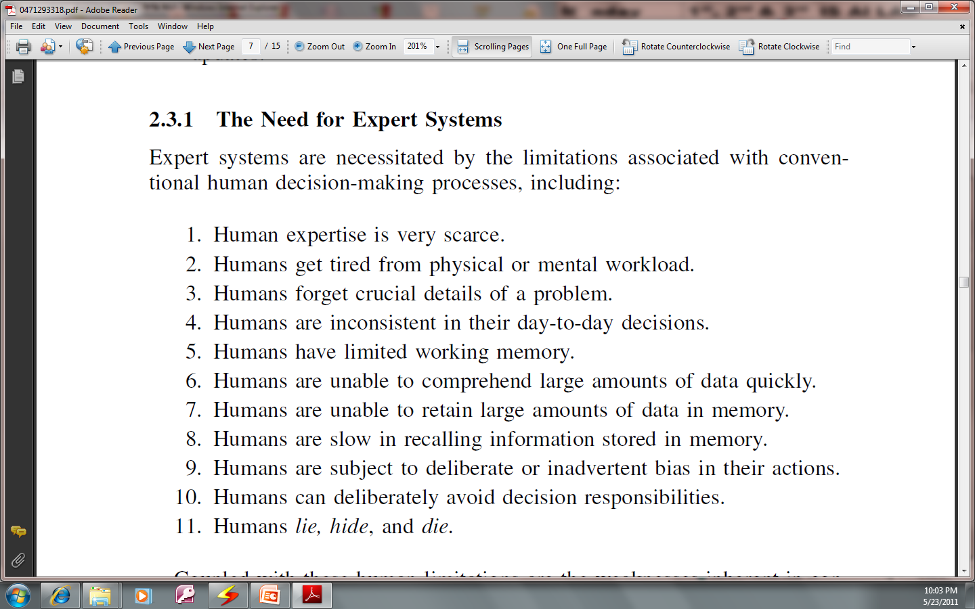
Why we need Expert Systems?

Slide 6
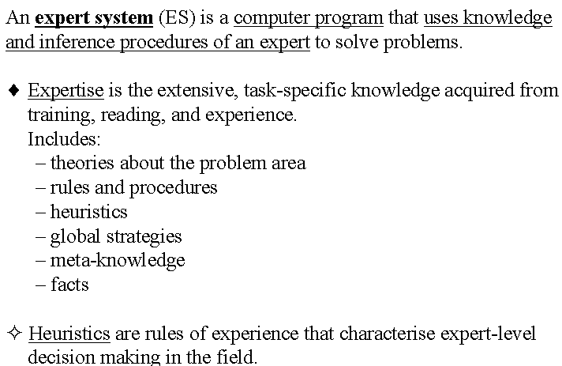
Basic concepts
Some concepts about Expert System (1)

Slide 7
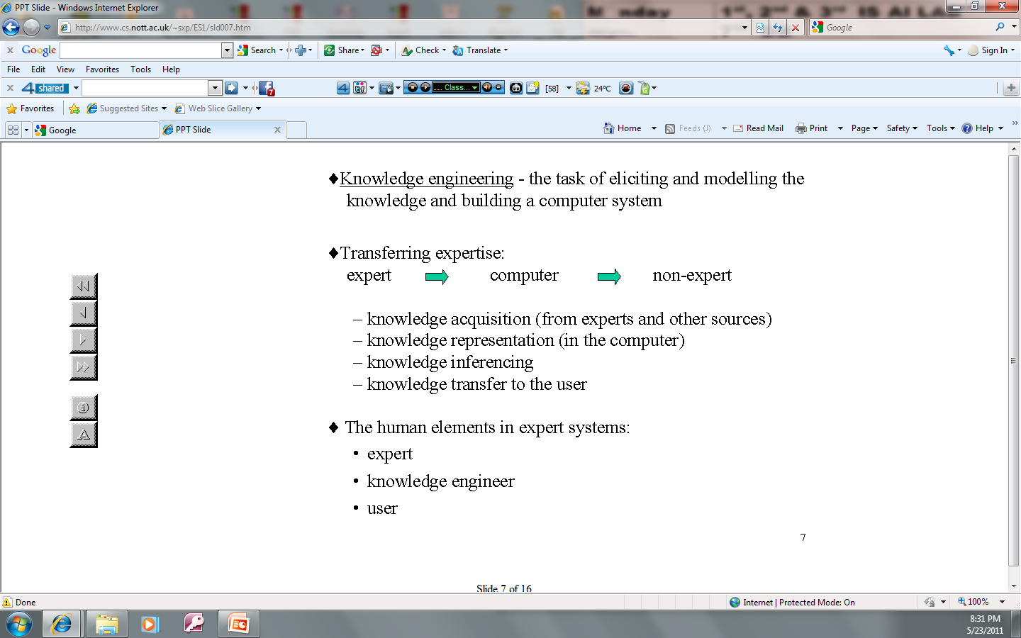
Basic concepts…
Some concepts about Expert System (2)

Slide 8
Basic concepts…
Some concepts about Expert System (3)
Knowledge Engineers – the people who build the system
Knowledge Representation – the symbols used to represent the knowledge
Factual Knowledge – knowledge of a particular task domain that is widely shared
Heuristic Knowledge – more judgmental knowledge of performance in a task domain.

Slide 9
Characteristics of Expert system
Domain specificity: ES operates in a micro-world where particular kind of problem solving is required.
Special Programming Languages: declarative languages such as LISP and Prolog
Efficient mix of integer and real variables
Good memory-management procedures
Extensive data-manipulation routines
Incremental compilation
Tagged memory architecture
Optimization of the systems environment
Efficient search procedures

Slide 10
Characteristics…
ES reasons over representation of human knowledge.
ES solves problems of genuine scientific or commercial interest through application of heuristic or approximate methods.
ES, unlike ‘algorithmic’ methods, are not guaranteed to succeed.
ES presents solutions in a reasonable time.
ES provide correct solutions most of the time-equal to or better than accuracy rate expected from a human expert.
Es follow difficult programs as good as or better than human experts.
ES posses vast quantities of domain specific knowledge to the minute details.
ES communicates with users in its own natural language.
ES provides extensive facilities for symbolic process rather than numeric process

Slide 11
Advantages of Expert Systems
Increase the availability of the expert
Increase the probability, frequency, and consistency of making good decisions.
Reduce cost and improve decision making: facilitate real-time, low-cost expert-level decisions by the non-expert.
Enhance the utilization of most of the available data
Permit objectivity by weighing evidence without bias and without regard for the user’s personal and emotional reactions
Permit dynamism through modularity of structure
Reduce danger
Provides better performance
Multiple expertise: help distribute human expertise

Slide 12
Advantages …
Increase reliability
Free up the mind and time of the human expert to enable him or her to concentrate on more creative activities
Provides good explanation to the user
Fast response
Steady, unemotional, and complete responses at all times
Intelligent tutor
Intelligent database
Encourage investigations into the subtle areas of a problem

Slide 13
Expert systems Vs conventional programs

Slide 14
Expert systems Vs conventional programs…

Slide 15
Expert systems Vs conventional programs…

Slide 16
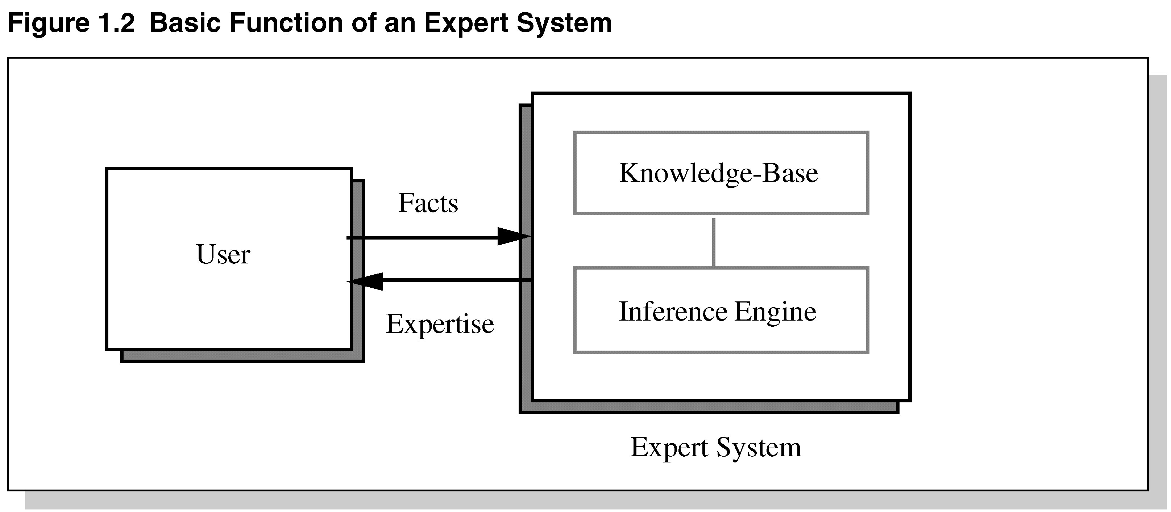
Basic components of Expert systems

Slide 17
Components of an Expert System
The knowledge base is the collection of facts and rules which describe all the knowledge about the problem domain
The inference engine is the part of the system that chooses which facts and rules to apply when trying to solve the user’s query
The user interface is the part of the system which takes in the user’s query in a readable form and passes it to the inference engine. It then displays the results to the user.

Slide 18
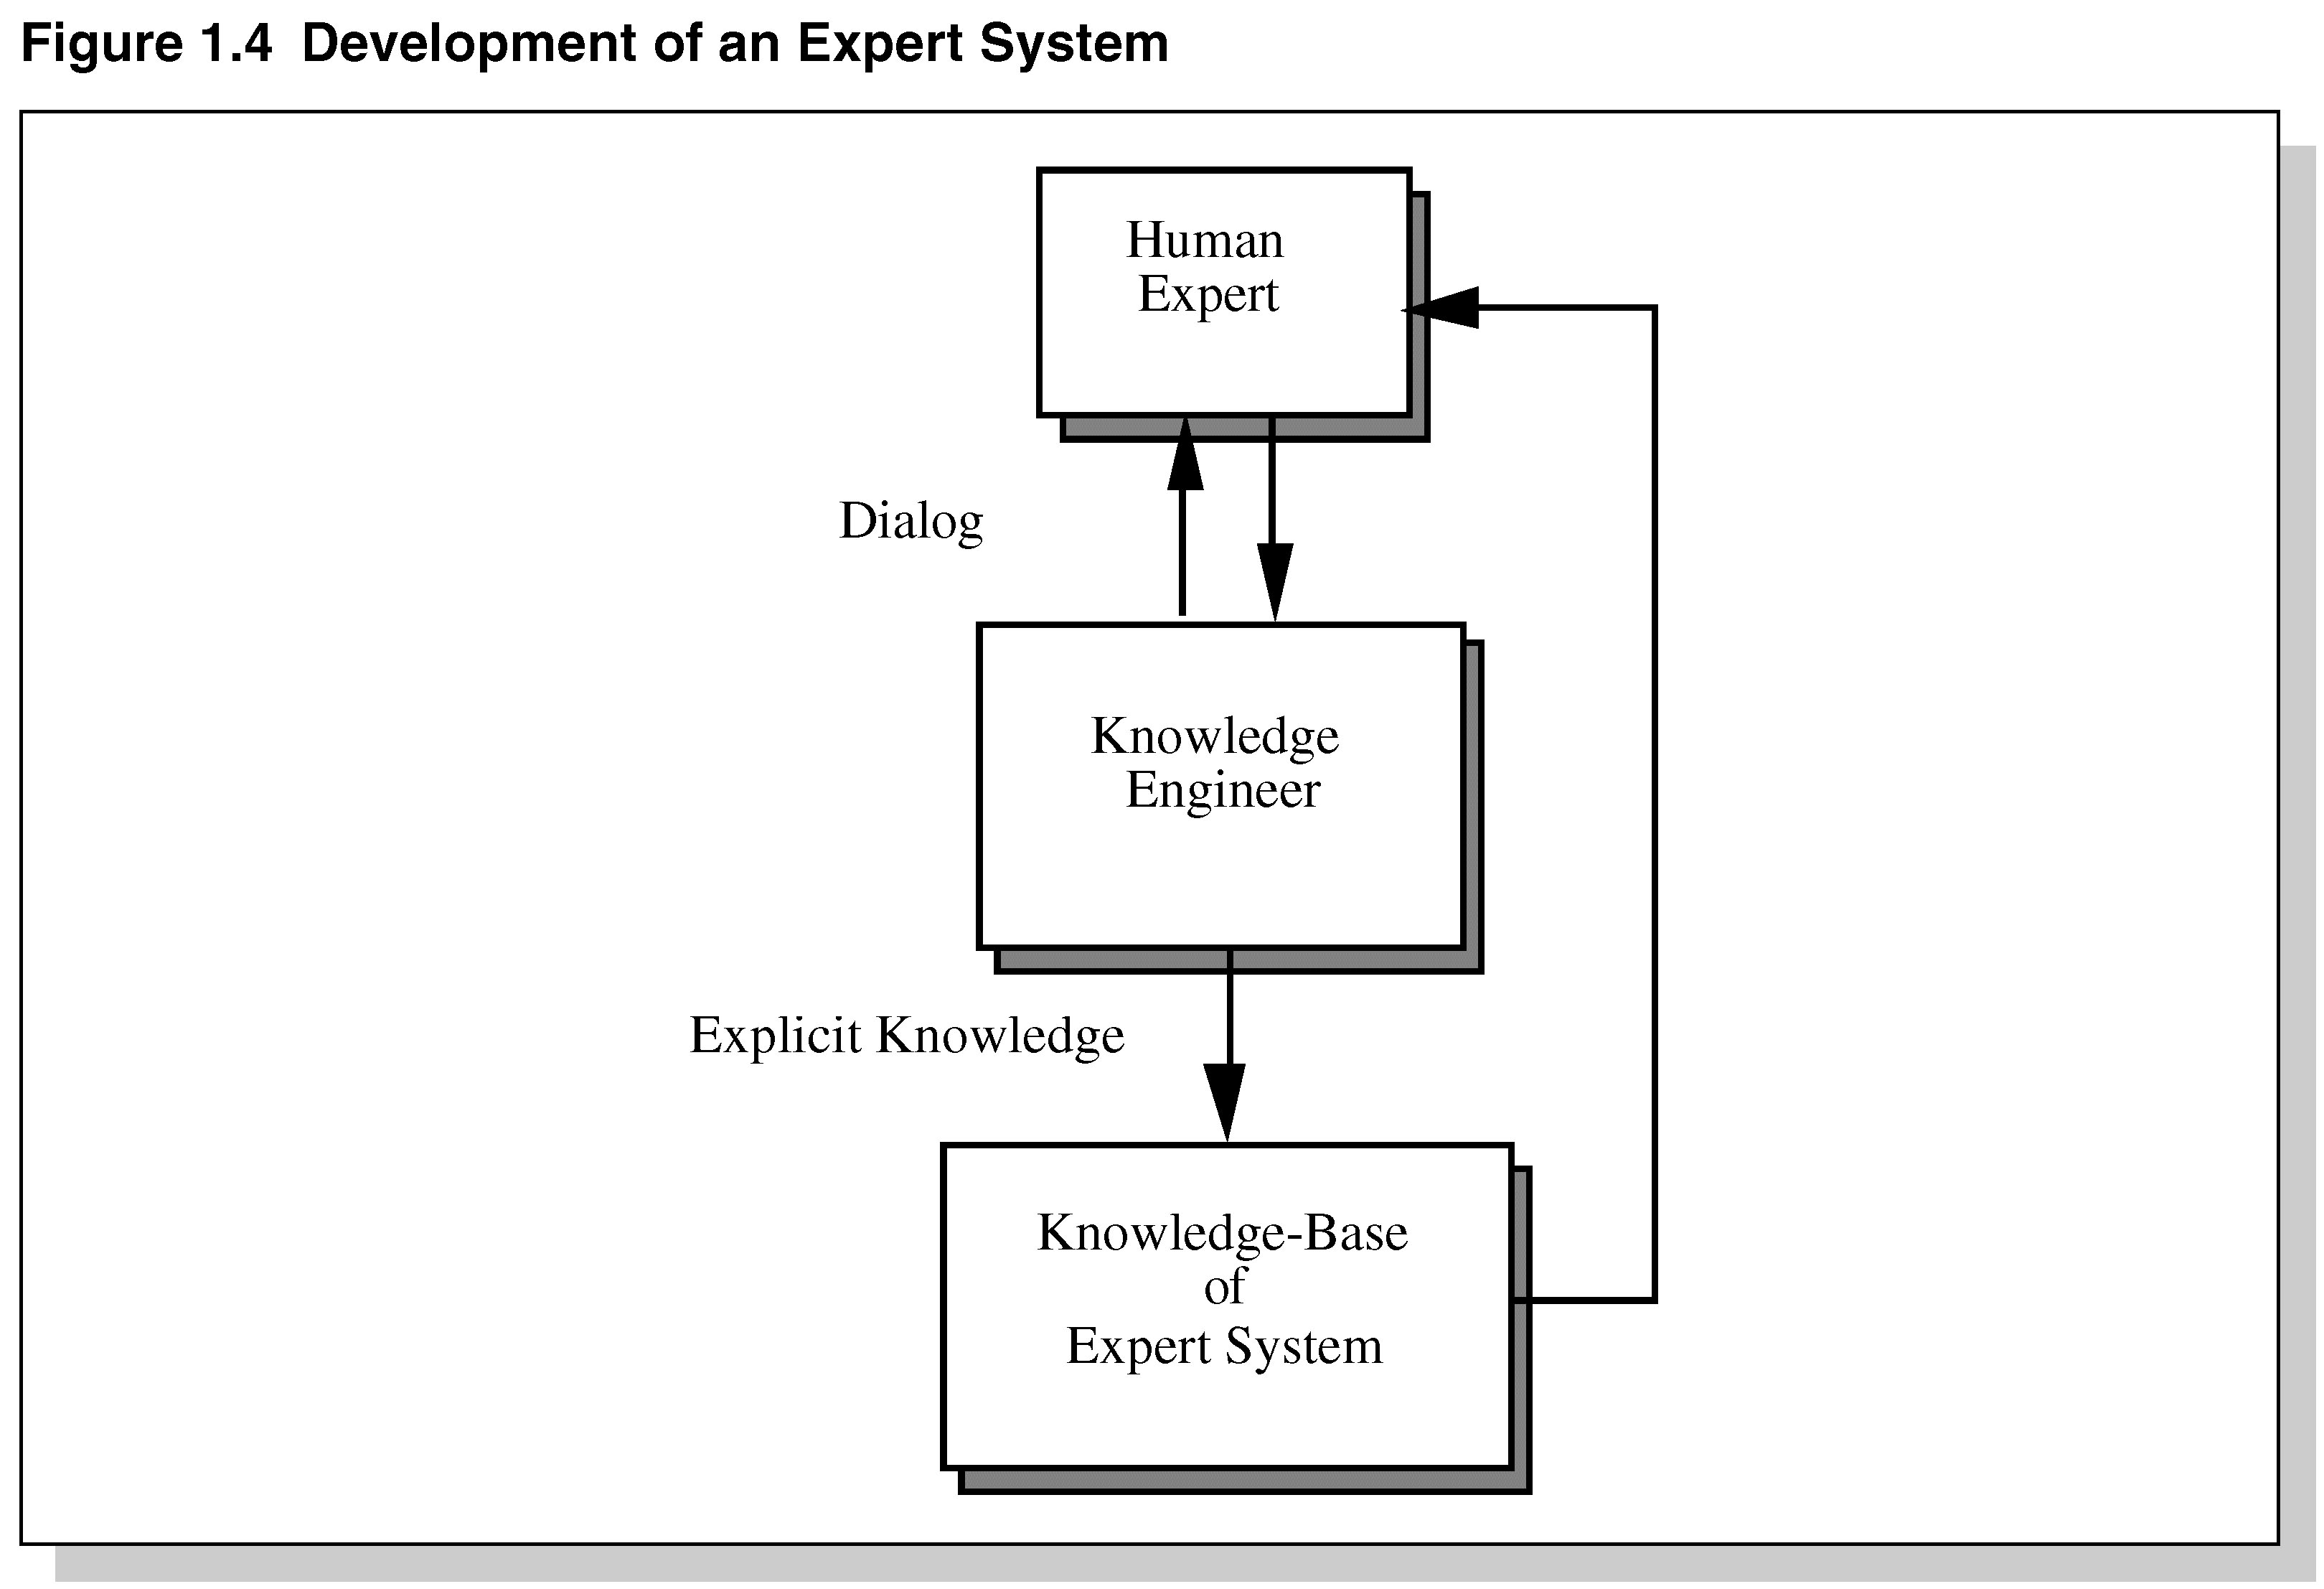
Development of an Expert System

Slide 19
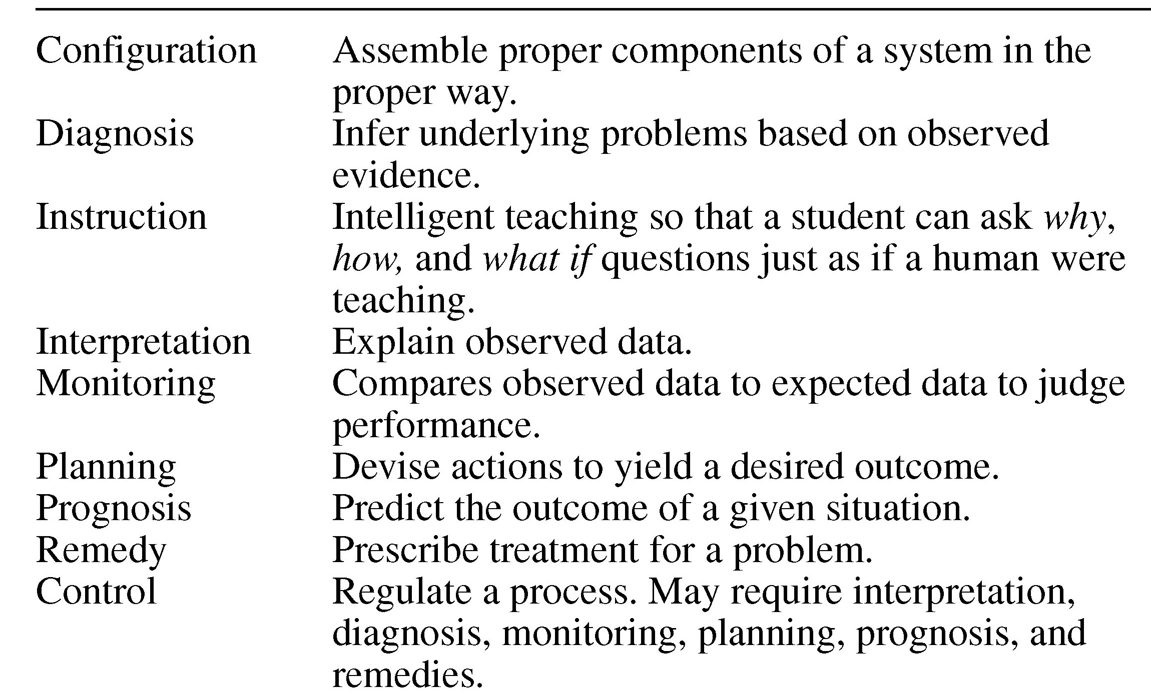
Expert system-applications
Area
Problems addressed

Slide 20
Limitations of Expert system
Not widely used or tested
Limited to relatively narrow problems
Cannot readily deal with “mixed” knowledge
Possibility of error
Cannot refine own knowledge base
Difficult to maintain
May have high development costs
Raise legal and ethical concerns

Slide 21
Legal and Ethical Issues
Who is responsible if the advice is wrong?
The user?
The domain expert?
The knowledge engineer?
The programmer of the expert system shell?
The company selling the software?

