Slide 1
Chapter 4: Architectural patterns/Style
By Esubalew A.

Slide 2
Contents
Introduction
Types of Architectural styles
Layered Architecture
Pipe and Filter Architecture
Model-View-Controller (MVC) Architecture
Shared (Central) Data Store Architecture
Event Driven Architecture
Client-Server Architecture
Call-return model Architecture
Application Integration patterns: E.g. Broker
Architectural Patterns vs Tactics
Examples: Key Word In Context

Slide 3
Introduction
Architecture is a high level description of a solution to a problem
Architectural Style is a high level design pattern
Architectural Patterns or styles are a primary way of characterizing lessons from experience in software system design.
It Consists of
a set of component types (e.g., process, procedure) that perform some function at runtime
a set of connectors (e.g., data streams, sockets) that mediate communication among components
a topological layout of the components showing their runtime relationships
a set of semantic constraints

Slide 4
Introduction…
These styles (or patterns) offer multiple benefits:
Achieve design principles
Promotes communications among the designers because the pattern names are used as a shorthand for a lengthy description
Streamlines documentation for the same reason above
Supports high level of reuse if the pattern is applicable
Improves development efficiency and productivity for above reasons and not having to profile or prototype all the existing patterns
Provide a starting point for additional and new design ideas.
There are various types of architectural styles:
Most common ones are:-
Layered, Pipe and Filter, Pipes and filters, Repository-centric, Blackboard, Client/server, Model-View-Controller, …

Slide 5
Layered architecture
The high level design solution is decomposed into Layers:
Structurally, each layer provides a related set of services
Dynamically, each layer may only use the layers below it
Using and evoking is not necessarily the same (subtle difference))
Layer A may use layer B because it depends on something B does (e.g. data written to a database by B to be used by A), but never call upon it.
Layer A evokes layer B says Layer A passes control or data or both directly to B.
If any layer only uses the layer directly below it, then it is a Strict Layered Style.
If a layer may use any of the layers below it, then it is a Relaxed Layer Style
This pattern adheres to all design patterns discussed in chapter one

Slide 6
Layered architecture: Examples
Example1: Simple Example with “Mailing Address” Processing
Example 2: “Sample” Layered Communications Architecture
Country
Application layer
State
Presentation layer
City
Session layer
Street
Transport layer
Network layer
Recipient Name
Data Link layer
Mail processing to establish which delivery plane/truck to distribute the Postal mail
The sequence is from top layer to the lower layer.
Physical layer

Slide 7
Three-Layered Business Pattern
Used to organize a business application to reuse business logic, provide deployment flexibility and conserve valuable resource connections.
The three layers: presentation, business logic and data access.
Locate all database-related code, including database clients access and utility components, in the data access layer.
Require the data access layer to be responsible for connection pooling when accessing resources.
Eliminate dependencies between business layer components and data access components (using, for instance, Façade design pattern).
Either reduce the dependencies between the business layer and the presentation layer or manage them using the observer design pattern.

Slide 8
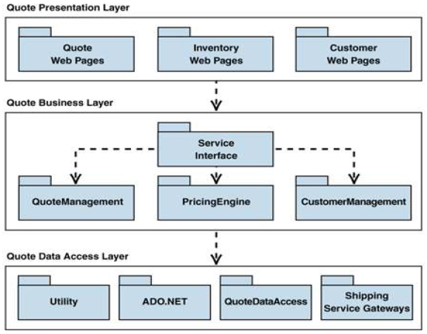
Three-Layered Business Pattern…
Example: You built a quote application for a successful enterprise that is rapidly expanding. Now you want to extend the application by exposing your quote engine to business partners and integrating additional partner services (such as shipping) into the quote application. How do you structure your business application to provide and consume service?

Slide 9
Layered architecture: pros & Cons
Advantages:
Each layer is selected to be a set of related services; thus the architecture provides high degree of cohesion within the layer.
Each layer may hide private information from other layers
Layers may use only lower layers, constraining the amount of coupling.
Easier for reuse by others and easier to be replaced or interchanged
Disadvantages:
Strict layered style may cause performance problem depending on the number of layers
Debugging in strict layered style may be complex
May be difficult to decide on the number of layers

Slide 10
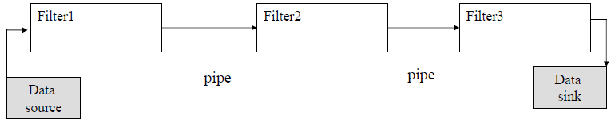
Pipe and Filter Architecture
Incremental transformation of data by successive components
Filter is a service that transforms a stream of input data into a stream of output data
Pipe is a mechanism or conduit through which the data flows from one filter to another
The combination of filters and pipes forms what is called a processing pipeline.
This architecture style focuses on the dynamic interaction rather than the structural

Slide 11
Pipe and Filter architecture: Example
UNIX command line processing of the pipe symbol, |
The output from the command to the left of the symbol, |, is to be sent as input to the command to the right of the pipe;
This mechanism got rid of specifying a file as std output of a command and then specifying that same file as the std input to another command, including possibly removing this intermediate file afterwards
Example : Assume that in the file called my.txt is the following:
I live in the city of Bahir Dar
Example ( UNIX commands) :
$ cat my.txt → I live in the city of Atlanta
$ cat my.txt | sed “s/i/o/g” I love on the coty of Bahor Dar $
First cat command outputs my.txt to screen. The second cat command reads my.txt and sends it to sed command which “search” for “i’ and “globally” replace it with “o.”

Slide 12
Pipe and Filter architecture : pros & Cons
Advantages:
Filters are self containing processing service that performs a specific function thus it is fairly cohesive
Filters communicate (pass data most of the time) through pipes only, thus it is “somewhat” constrained in coupling
Disadvantages:
Filters processes and sends streams of data over pipes is a solution that fits well with heavy batch processing, but may not do well with any kind of user-interaction.
Anything that requires quick and short error processing is still restricted to sending data through the pipes, possibly making it difficult to interactively react to error- events.

Slide 13
Shared Data architecture: pros & Cons
The high level design solution is based on a shared data-store which acts as the “central command” with 2 variations:
Blackboard style: the data-store alerts the participating parties whenever there is a data-store change (trigger)
Repository style: the participating parties check the data-store for changes
Lab testing
Problems that fit this style such as patient processing, tax processing system, inventory control system; etc. have the following properties:
physician
diagnosis
Patient
database
accounting
& administration
pharmacy &
drug processing
All the functionalities work off a single data-store.
Any change to the data-store may affect all or some of the functions
All the functionalities need the information from the data-store

Slide 14
Shared data architecture : pros & Cons
Advantages:
The independent functions are cohesive within itself and the coupling is restricted to the shared data
Single data-store makes the maintenance of data in terms of back-up recovery and security easier to manage
Disadvantages:
Common coupling through data
Any data format change in the shared data requires agreement and, potentially, changes in all or some the functional areas - - this becomes a bigger problem as more functionalities are introduced that have dependency on the shared data.
If the data-store fails, all parties are affected and possibly all functions have to stop. Remedies:
Redundant database
Good back up and recovery procedures

Slide 15
Event-Driven (Real time)
The high level design solution is based on an event dispatcher which manages events and the functionalities which depends on those events.
These have the following characteristics: Events may
be a simple notification or may include associated data
be prioritized or be based on constraints such as time
require synchronous or asynchronous processing
be “registered” or “unregistered” by components
Problems that fit this architecture includes real-time systems such as: airplane control; medical equipment monitor; home monitor; embedded device controller; game; etc…
voice
call
Phone
processing
text
msg
Personal (device)
dispatcher
Txt
processing
Image
keypad
Image
processing

Slide 16
Event-Driven Architectures: pros & Cons
Advantages:
The event sensors and the event processors are separate, providing decoupled and individual functionalities.
The replacement and additions are independent and thus easier to perform
Any sensor or processing malfunction will not affect the other sensors and processors
Disadvantages:
It is difficult for the dispatcher to react to a myriad of sensor inputs and respond in time (especially on simultaneous inputs)- - - the dispatcher is the “single grand connector”
A dispatcher malfunction will bring the whole system down !!
Dispatcher is very much performance gated (must be fast --- may be able to use a queue in some cases)

Slide 17
Model-View-Controller (MVC)
An architectural pattern used to help separate the user interface layer from other parts of the system
The model contains the underlying classes whose instances are to be viewed and manipulated
The view contains objects used to render the appearance of the data from the model in the user interface
The controller contains the objects that control and handle the user’s interaction with the view and the model
Example of MVC in Web architecture
The View component generates the HTML code to be displayed by the browser.
The Controller is the component that interprets ‘HTTP post’ transmissions coming back from the browser.
The Model is the underlying system that manages the information.
E.g.2 Swing GUI components of the Java API are based on the MVC pattern

Slide 18
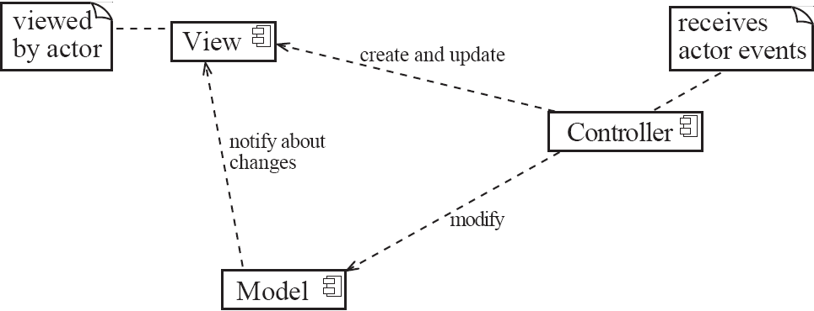
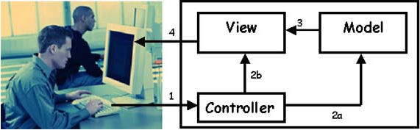
Model-View-Controller (MVC)…
Controllers typically implement event-handling mechanisms that are executed when corresponding events occur.
Changes made to the model by the user via controllers are directly propagated to corresponding views. The change propagation mechanism can be implemented using the observer design pattern.
Generally, the MVC pattern separates the functional layer of the system(the model) from two aspects of user interface, the view & the Controller

Slide 19
Model-View-Controller : pros & Cons
Advantages:
Decouple the underlying computation from the information presentation
Possibility to associate multiple views to a single data model
Increased flexibility, and reusability
The View-Controller can keep on partially functioning even if the model component is down.
Disadvantages:
Increased complexity
Intimate connection between view and controller
Difficulty of using MVC with modern user-interface tools
Heavily dependent on the development and production system environment and tools that match the MVC architecture (e.g. TomCat, .Net, Rail, etc.)

Slide 20
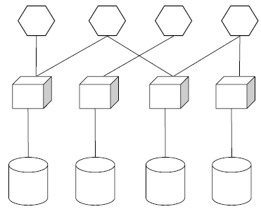
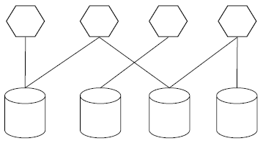
Client-Server / N-Tier Systems
A Client-Server system is one in which the server performs some kind of service that is used by many clients. The clients take the lead in the communication.
The basic Client-Server architecture has 2 tiers (Client and Server).
Client-server architecture could also be three tier or multitier.
Client tier - User System Interface
+ Some Processing Management
Server tier - Database Management
+ Some Processing Management
User System Interface
Processing Management
Database Management
Two Tier Client Server Architecture
3 Tier Client Server Architecture

Slide 21
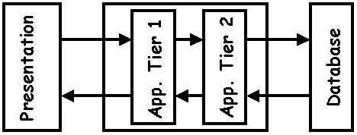
Client-Server / N-Tier Systems….
An N-tier architecture (with N more than 3) is really 3 tier architectures in which the middle tier is split up into new tiers.
The application tier is broken down into separate parts. What these parts are differs from system to system.
The following picture shows it:

Slide 22
Client-Server architecture: Pros & Cons
Advantages
Distribution of data is straightforward
Makes effective use of networked systems with many distributed processors.
Easy to add new servers or upgrade existing servers
Disadvantages
No shared data model so sub-systems use different data organization - data interchange may be inefficient
Redundant management in each server
No central register of names and services - it may be hard to find out what servers and services are available

Slide 23
Call-return model
Goal: achieve modifiability and scalability
Information hiding
ADT, object, naive client/server
Sub-styles:
Main-program-and-subroutine
Decompose program hierarchically. Each component gets control from its parent.
Object-oriented
Main-program-and-subroutine
Classic style since 60s - pre-OO.
Hierarchical decomposition into subroutines (Components) each solving a well defined task/function.
Data passed around as parameters.
Main driver provides a control loop for sequencing through subroutines.

Slide 24
Call-return model….
Object-oriented sub-style
Widely used architectural style
Components:
Objects or abstract data types
Connections:
Messages or function/procedure invocations
Key aspects:
Object preserves integrity of representation - no direct access
Representation is hidden from objects
Objects help achieve modifiability by encapsulating internal secrets from environment
Access to objects is only through methods (constrained forms of procedure calls)

Slide 25
Call-return model-OO: Pros & Cons
Advantages
Change implementation without affecting clients (assuming interface doesn’t change)
Can break problems into interacting agents (distributed across multiple machine / networks).
Disadvantages
To interact objects must know each other’s identity (in contrast to Pipe and Filter).
When identity changes, objects that explicitly invoke it must change (Java interfaces help though).
Side effect problems: if A uses B and C uses B, then C effects on B can be unexpected to A (and vice-versa).
Complex dynamic interactions – distributed functionality.

Slide 26
Application Integration patterns
The application integration pattern serves to integrate multiple business patterns or to integrate applications and data within an individual Business pattern.
At its highest level, application integration can be divided into two essentially different approaches:
Process integration, which is the integration of the functional flow of processing between applications. The process integration subset of the application integration pattern is the most relevant pattern to an SOA.
Data integration, which is the integration of the information that is used by applications.
Broker (Service oriented architecture)
You just want the job to be done. You don't care who performs it, but you may have some demands. Tell your broker. He will take care of it.

Slide 27
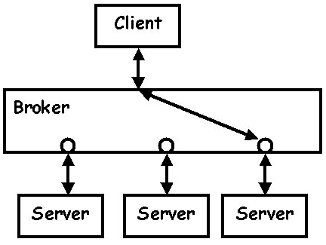
Broker pattern
The Broker application pattern is based on a one-to-N topology that separates distribution rules from the applications. It allows a single interaction from the source application to be distributed to multiple target applications concurrently.
Uses broker rules to separate the distribution logic from the application logic.
Broker rules are also used to handle the decomposition and recomposition of the interaction.
Broker rules should also support transformations (of protocols/data) so as to minimize the impact to existing software assets.
CORBA is a well-known open standard that allows you to build this kind of architecture.
The client requests a specific service. It formats its request in a specific format and sends it to its broker. The broker then selects the most suitable server to process the request.

Slide 28
Architectural Patterns vs Tactics
Architects use architectural patterns and tactics to improve software architectural decisions and simplify the design process
Patterns are solutions that resolve multiple forces, whereas tactics focus on specific quality attributes.
To more effectively apply both tactics and patterns, architects need to understand how architectural tactics and patterns relate and how to use them effectively.
Architects are advised
to choose a pattern if they can find one and then adjust the pattern based on tactics.
to use tactics when they need help coming up with a pattern, when an existing pattern isn’t quite right and they need to tailor it, or when they want to validate the choice of a pattern.

Slide 29
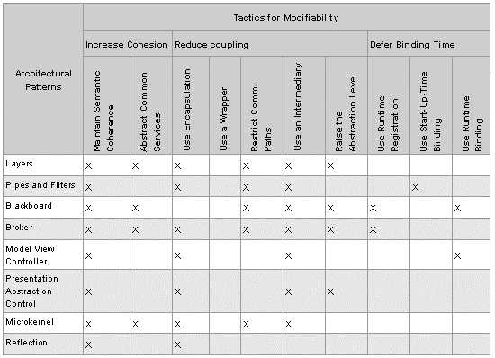
Architectural Patterns vs Tactics …
Architectural Patterns and Corresponding Tactics for Modifiability

Slide 30
Example System: Key Word In Context
Used to contrast different criteria for decomposing a system into modules - “On the Criteria To Be Used in Decomposing Systems into Modules” –David Parnas
KWIC
The system accepts an ordered set of lines
Each line is an ordered set of words
Each word is an ordered set of char
Lines can be “circularly shifted” by removing the first word and appending it at the end of the line
System outputs a listing of all circular shifts of all line in alphabetical order
Example
inputs: bar sock, car dog, town fog.
Output: bar sock, car dog, dog car, fog town, sock bar, town fog
Four steps: Input, Circular shift, Alphabetize, Output
A KWIC index system is primarily used to create an index that is quickly searchable because every keyword can be looked up alphabetically even if it does not appear at the beginning of the original index phrase.

Slide 31
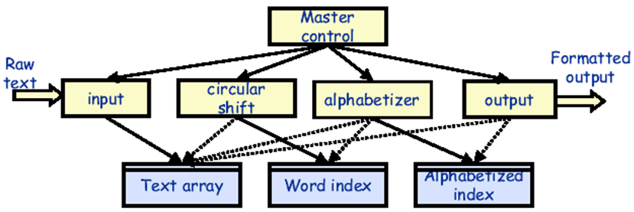
Shared data store architecture
Input: read lines and stores them in Text array (buffer), index records starting position of each line
Circular shift: Creates an index of starting positions for circular shifts, stores these in Word index
Alphabetizer: Takes the input from Text array and Word index, creates an index of shifts which are alphabetized

Slide 32
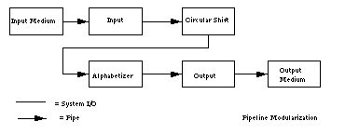
Pipe-and-Filter Architecture
Each component creates actual text representation for output to passes to next component
Simple design, easy to understand

