Slide 1
Chapter 4: Understanding Quality Attributes
By Esubalew

Slide 2
Contents
Functionality and Architecture
Architecture and Quality Attributes
A Tour of Quality Attributes
  Qualities of the system
    Availability
    Modifiability
    Performance
    Security
    Testability
    usability.
  Business quality
  Architectural Qualities
For each quality attributes
  Quality specific
  Scenario
  General Scenario Generation

Slide 3
Functionality and Architecture
Functionality:
  The ability of the system to do the work for which it was intended
Functionality and quality attributes are orthogonal.
  If functionality and quality attributes were not orthogonal, the choice of function would dictate the level of security or performance or availability or usability.
Functionality can be achieved through any number of structures; it is largely independent of structure.
  If functionality is the only requirement, a single monolithic module works!
It is the quality attributes that constrain the structure.
  For example, systems are frequently divided so that several people can cooperatively build them - time-to-market issue

Slide 4
Architecture and Quality Attributes
Achieving quality attributes must be considered throughout all phases: design, implementation, and deployment.
  Architecture is often critical and the first stage in software creation in which quality requirements could be addressed
For example:
  Usability involves both architectural and non-architectural aspects. Making the user interface easy to use (checkbox or button) is non-architectural, but providing the user with undo operations is architectural.
  Modifiability is determined by how functionality is divided (architectural) and by coding techniques within a module (non-architectural).
  Performance depends partially on how much communication is necessary among components and how shared resources are allocated (architectural) and partially on the choice of algorithms and how they are coded (non-architectural)

Slide 5
Architecture and Quality Attributes…
  So, no quality attribute is entirely dependent on design, nor is it entirely dependent on implementation or deployment.
The message is:
  Architecture is critical to the realization of many qualities of interest in a system, and these qualities should be designed in and can be evaluated at the architectural level.
  Architecture, by itself, is unable to achieve qualities. It provides the foundation for achieving quality, but this foundation will be to no avail if attention is not paid to the details.
Quality attributes can never be achieved in isolation (especially true for complex systems)
  The achievement of any one will have an effect on the achievement of others - Sometimes the effect is positive and sometimes negative.
  For example:
    Security and reliability often exist in a state of mutual tension
    Almost every quality attribute negatively affects performance (e.g. for achieving portability isolate system dependencies which introduces overhead into the system's execution)

Slide 6
A Tour of Quality Attributes
Three classes of quality attributes
  Qualities of the system.
    Availability
    Modifiability
    Performance
    Security
    Testability
    usability.
  Business qualities (such as time to market) that are affected by the architecture.
  Architectural qualities - these are about the architecture itself although they indirectly affect other qualities, such as modifiability.
    Conceptual integrity

Slide 7
System Quality Attributes
Problems (from the architect’s perspective) with the way quality attributes are characterized.
  The definitions are not operational.
    E.g. "The system should be modifiable” - With respect to which set of changes?
  The focus is often on which quality a particular aspect belongs to.
    E.g. is a system failure an aspect of availability, security, or usability.
  Each attribute community has its own vocabulary. Example
      Performance → event
      Security → attack
      Availability → failure
      Usability → user input
Solution
  Use quality attribute scenarios for nonoperational definitions and overlapping attribute concerns problems
  Provide a brief discussion of each attribute for the third problem
All of these may actually refer to the same occurrence, but are described using different terms.

Slide 8
Quality Attribute Scenarios
Quality is often in the eye of the beholder - Quality attribute scenarios are the means by which quality moves from the eye of the beholder to a more objective basis.
A quality attribute scenario is means of characterizing quality attributes
It consists of six parts.
  Source of stimulus – the entity (a human, a computer system, or any other actuator) that generated the stimulus
  Stimulus – a condition that needs to be considered when it arrives at a system.
  Environment – the particular conditions in which the stimulus occurs. The system may be in an overload condition or may be running when the stimulus occurs, or some other condition may be true.
  Artifact – the system or the parts of it that are stimulated
  Response – the activity undertaken after the arrival of the stimulus
  Response measure – when the response occurs, it should be measurable in some fashion so that the requirement can be tested.

Slide 9
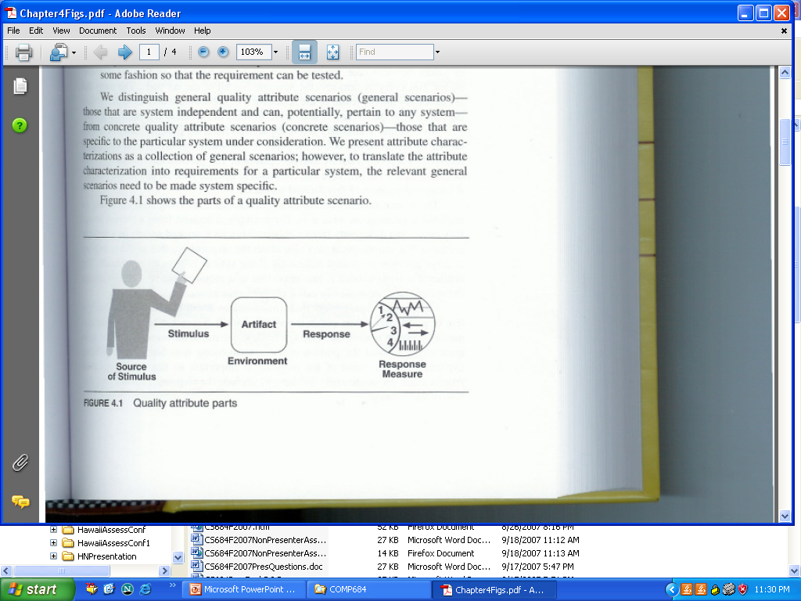
Quality Attribute parts
The quality attribute scenarios can be general or concrete
  A general scenario is system independent and can, potentially, pertain to any system.
  A concrete scenario is specific to the particular system under consideration.
  Concrete scenarios are needed to make the quality requirements operational.

Slide 10
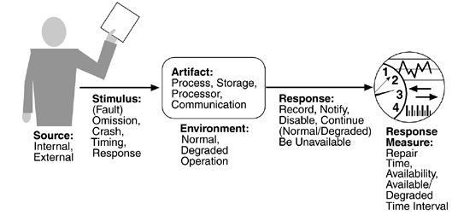
Availability Scenarios: General
From this we can derive concrete, system-specific, scenarios. Not every system-specific scenario has all of the six parts. The parts that are necessary are the result of the application of the scenario and the types of testing that will be performed to determine whether the scenario has been achieved.

Slide 11
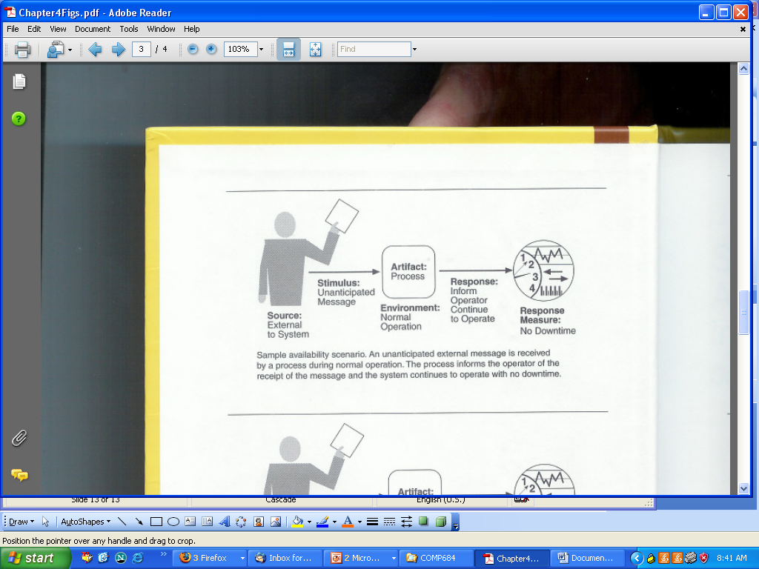
Availability Scenarios: Specific

Slide 12
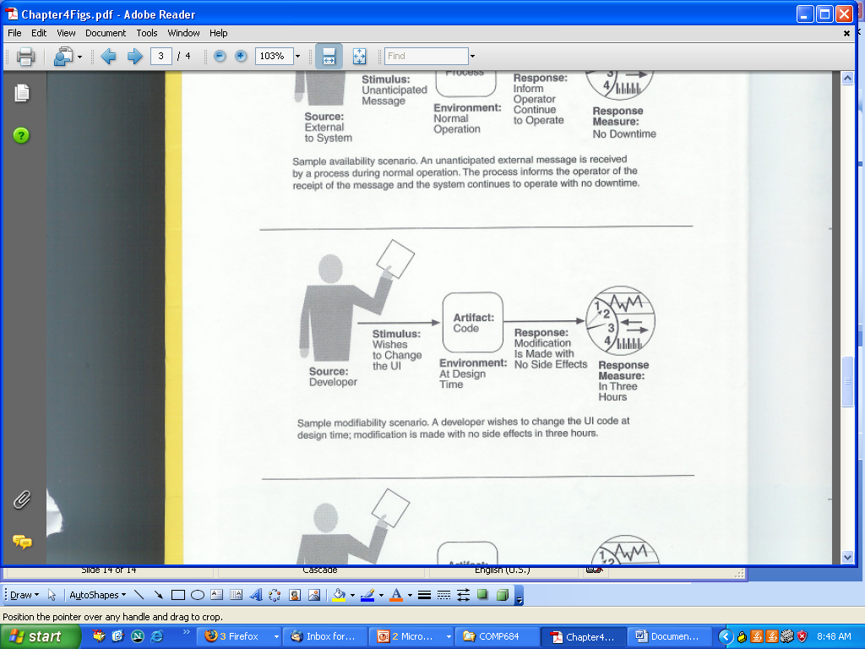
Sample Modifiability Scenario

Slide 13
Features of Concrete Scenarios
A collection of concrete scenarios can be used as the quality attribute requirements of a system.
Each scenario is concrete enough to be meaningful to the architect and,
The details of the responses are meaningful enough so that it is possible to test whether the system has achieved the response.
When eliciting requirements, discussions of general scenarios are organized by quality attributes; if the same scenario is generated by two different attributes, one can be eliminated.
Concrete scenarios play the same role in the specification of quality attributes that use cases play in the specification of functional requirements

Slide 14
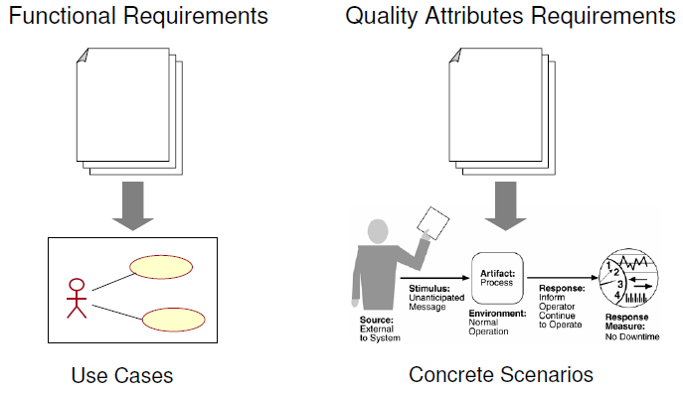
Features of Concrete Scenarios…

Slide 15
Quality Attribute Scenario Generation
Theoretically quality attribute requirements should be obtained during requirements elicitation, but in practice it is seldom done.
It is the architect’s task to ensure that this is accomplished by generating concrete quality attribute scenarios.
Quality-attribute-specific tables are used to create general scenarios, as appropriate, and from them concrete scenarios are specified.
The tables serve as checklist to ensure that all possibilities have been considered.
We are unconcerned about generating the same or similar scenarios from different quality attributes as the redundancies can easily be removed.
What is important is that we do not omit any important requirements because the consequences may be more serious.

Slide 16
Quality Attribute Scenarios in Practice
The general scenario approach provides a framework for generating a large number of system-independent, quality-attribute-specific scenarios.
Each is potentially, but not necessarily, relevant for the system under consideration.
To make the general scenarios useful, you must make them system specific - making a general scenario system specific means translating it into concrete terms for the particular system.
Example
  General scenario - "A request arrives for a change in functionality, and the change must be made at a particular time within the development process within a specified period."
  Specific scenario - "A request arrives to add support for a new browser to a Web-based system, and the change must be made within two weeks."

Slide 17
Availability
Availability is concerned with system failure and its consequences.
Areas of concern:
  How the system failure is detected?
  How frequently system failures occur?
  What happens when a failure occurs?
  How long a system is allowed to be out of operation?
  When failures may occur safely?
  How failures can be prevented?
  What kinds of notifications are required when a failure occurs?
Differentiate between failures and faults. A fault may become a failure if not corrected or masked.
Once a system fails, we must consider the time it takes to repair it.
Availability is defined as the probability that it will be operational when needed, typically, (mean time to failure) / (mean time to failure + mean time to repair)

Slide 18
Availability General Scenario Generation
Portion of Scenario | Possible Values
Source | Internal to the system; external to the system
Stimulus | Fault; omission, crash, timing, response
Artifact | System’s processors, communication channels, persistent storage processes
Environment | Normal operation; degraded mode (i.e., fewer features, a fall-back solution.
Response | System should detect event and do one or more of the following: record it; notify appropriate parties, including the user and other systems; disable sources of events that cause fault or failure; be unavailable for a prespecified interval; continue to operate in normal or degraded mode
Response Measure | Time interval when the system must be available; availability time duration; time interval in which system can be in degraded mode; repair time

Slide 19
Modifiability
Modifiability is about the cost of change.
We must address:
  What can change?
    the functions that the system computes
    the platform the system exists on(the hardware, OS, middleware, ...)
    the environment within which the system operates
    the qualities the system exhibits (its performance, its reliability,…. )
  When is the change made and who makes it (the environment)?
    To the implementation (by modifying the source code), during compile (using compile-time switches), during build (by choice of libraries), during configuration setup (by a range of techniques, including parameter setting) or during execution (by parameter setting).
    by a developer, an end user, or a system administrator.
Once a change has been specified, the new implementation must be designed, implemented, tested, and deployed.

Slide 20
Modifiability General Scenario Generation
Portion of Scenario | Possible Values
Source | End user, developer, system administrator
Stimulus | Wishes to add/delete/modify/vary functionality, quality attribute, capacity
Artifact | System user interface, platform, environment; system that inter-operates with target system
Environment | At runtime, compile time, build time, design time
Response | Locates places in architecture to be modified; makes modification without affecting other functionality; tests modification; deploys modification
Response Measure | Cost in terms of number of elements affected, effort, money; extent to which this affects other functions or quality attributes

Slide 21
Performance
Performance is about timing - how long it takes the system to respond when an event occurs.
That is events (interrupts, messages, requests from users, or the passage of time) occur, and the system must respond to them in a reasonable time.
Performance is complicated because of the number of event sources and arrival patterns.
  Events can arrive from user requests, from other systems, or from within the system.
  An arrival pattern can be
    Periodic – a periodic event may arrive every 10 milliseconds
    Stochastic - events arrive according to some probabilistic distribution
    Sporadic – events recurring in scattered and irregular or unpredictable instances

Slide 22
Performance General Scenario Generation
Portion of Scenario | Possible Values
Source | One of a number of independent sources, possibly from within system
Stimulus | Periodic events arrive; sporadic events arrive; stochastic events arrive
Artifact | System
Environment | Normal mode; overload mode
Response | Processes stimuli; changes level of service
Response Measure | Latency, deadline, throughput, jitter, miss rate, data loss
Notice that this formulation does not consider whether the system is networked or standalone. Nor does it (yet) consider the configuration of the system or the consumption of resources. These issues are dependent on architectural solutions

Slide 23
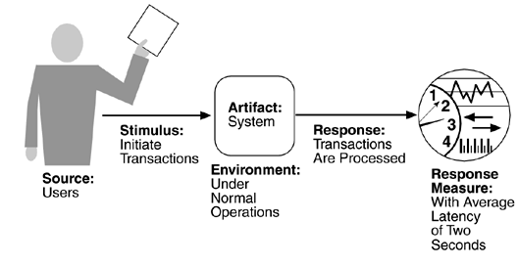
Sample performance scenario
A sample scenario for
"Users initiate 1,000 transactions per minute stochastically under normal operations, and these transactions are processed with an average latency of two seconds."

Slide 24
Security
Security is a measure of the system’s ability to resist unauthorized usage while providing its services to legitimate users.
An attempt to breach security is an attack and can take a number of forms – it could be to gain access to data or services or to deny service to others.
Security can be characterized as a system providing:
  Nonrepudiation – the property that a transaction cannot be denied by any of the parties to it(you cannot deny that you ordered that item over the Internet)
  Confidentiality – the property that data or services are protected from unauthorized access (a hacker cannot access your income tax returns on a computer)
  Integrity – the property that data or services are being delivered as intended(your grade has not been changed since your instructor assigned it)
  Assurance – the property that the parties to a transaction are who they purport to be. (when a customer sends a credit card number to an Internet merchant, the merchant is who the customer thinks they are)

Slide 25
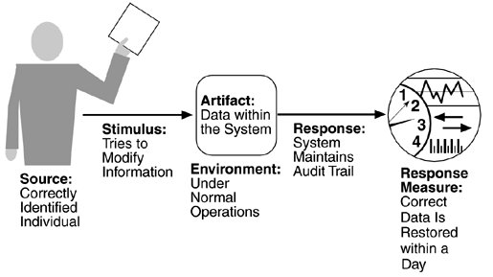
Security
Availability – the property that the system will be available for legitimate use. (means a denial-of-service attack won't prevent your ordering this book.)
Auditing – the property that the system tracks activities within it at levels sufficient to reconstruct them. (if you transfer money out of one account to another account, the system will maintain a record of that transfer.)
A sample scenario for
“A correctly identified individual tries to modify system data from an external site; system maintains an audit trail and the correct data is restored within one day”

Slide 26
Security General Scenario Generation
Portion of Scenario | Possible Values
Source | Individual or system that is correctly identified, identified incorrectly, of unknown identity who is internal/external, authorized/not authorized with access to limited resources, vast resources
Stimulus | Tries to display data, change/delete data, access system services, reduce availability to system services
Artifact | System services; data within system
Environment | Either online or offline, connected or disconnected, firewalled or open
Response | Authenticates user; hides identity of the user; blocks access to data and/or services; allows access to data and/or services; grants or withdraws permission to access data and/or services; records access/modifications or attempts to access/modify data/services by identity; stores data in an unreadable format; recognizes an unexplainable high demand for services, and informs a user or another system, and restricts availability of services
Response Measure | Time/effort/resources required to circumvent security measures with probability of success; probability of detecting attack; probability of identifying individual responsible for attack or access/modification of data and/or services; percentage of services still available under denial-of-services attack; restore data/services; extent to which data/services damaged and/or legitimate access denied

Slide 27
Testability
At least 40% of the cost of developing well-engineered systems is taken up by testing. If the software architect can reduce this cost, the payoff is large.
Testability refers to the ease with which software can be made to demonstrate its faults through testing.
To be properly testable, it must be possible to control each component’s internal state and to observe its outputs.
Testing is done by various developers, testers, verifiers, or users and is the last step of various parts of the software life cycle. Portions of the code, the design, or the complete system may be tested.
The response measures for testability deal with how effective the tests are in discovering faults and how long it takes to perform the tests to some desired level of coverage.

Slide 28
Testability General Scenario Generation
Portion of Scenario | Possible Values
Source | Unit developer, increment integrator, system verifier, client acceptance tester, system user
Stimulus | Analysis, architecture, design, class, subsystem integration completed; system delivered
Artifact | Piece of design, piece of code, complete application
Environment | At design time, at development time, at compile time, at deployment time
Response | Provides access to state values; provides computed values; prepares test environment
Response Measure | Percent executable statements executed; probability of failure if fault exists; time to perform tests; length of longest dependency chain in a test; length of time to prepare test environment

Slide 29
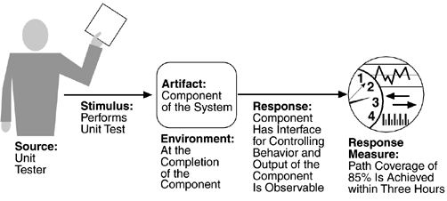
A sample Testability Scenario
A sample Testability Scenario
  A unit tester performs a unit test on a completed system component that provides an interface For controlling its behavior and observing its output; 85% path coverage is achieved within three hours

Slide 30
Usability
Usability is concerned with how easy it is for the user to accomplish a desired task and the kind of user support provided.
Areas of usability:
  Learning system features. If the user is unfamiliar with a particular system or a particular aspect of it, what can the system do to make the task of learning easier?
  Using a system efficiently. What can the system do to make the user more efficient in its operation?
  Minimizing the impact of errors. What can the system do so that a user error has minimal impact?
  Adapting the system to user needs. How can the user (or the system itself) adapt to make the user's task easier?
  Increasing confidence and satisfaction. What does the system do to give the user confidence that the correct action is being taken
The normal development process detects usability problems through building prototypes and user testing. Here we focus on aspects of usability that have a major impact on the architecture

Slide 31
Usability General Scenario Generation
Portion of Scenario | Possible Values
Source | End user
Stimulus | Wants to learn system features; use system efficiently; minimize impact of errors; adapt system; feel comfortable
Artifact | System
Environment | At runtime or configuration time
Response | System provides one or more of the following responses: →to support “learn system features” – help system is sensitive to context; interface is familiar to user; interface is usable in an unfamiliar context → to support “use system efficiently” – aggregation of data and/or commands; re-use of already entered data and/or commands; support for efficient navigation within a screen; distinct views with consistent operations; comprehensive searching; multiple simultaneous activities → to minimize “impact of errors” – undo, cancel, recover from system failure, recognize and correct user error, retrieve forgotten password, verify system resources →to “adapt system” – customizability; internationalization → to “feel comfortable” – display system state; work at the user’s pace
Response Measure | Task time, number of errors, number of problems solved, user satisfaction, gain of user knowledge, ration of successful operations to total operations; amount of time/data lost

Slide 32
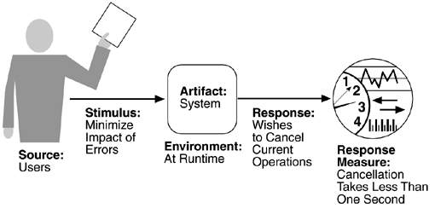
Sample Usability Scenario
Sample usability Scenario.
  A user, wanting to minimize the impact of an error, wishes to cancel a system operation at runtime; cancellation takes place in less than one second

Slide 33
Using General Scenarios to Communicate Concepts
General scenarios can facilitate communication between stakeholders.
Facilitating this kind of understanding aids discussions about architectural decisions, particularly about tradeoffs.
Quality Attribute | Stimulus
Availability | Unexpected event, nonoccurrence of expected event
Modifiability | Request to add/delete/change/vary functionality, platform, quality, attribute, or capacity
Performance | Periodic, stochastic, or sporadic
Security | Tries to display, modify, change/delete information, access or reduce availability to system services
Testability | Completion of phase of system development
Usability | Wants to learn system, use a system efficiently, minimize the impact of errors, adapt the system, feel comfortable
The problem for the architect is to understand which of these stimuli represent the same occurrence, which are aggregates of other stimuli, and which are independent. Once the relations are clear, the architect can communicate them to the various stakeholders using language that each comprehends.

Slide 34
Other System Quality Attributes
In preceding slides quality attributes in a general fashion are discussed.
Many authors have developed quality attribute taxonomies.
The ones just discussed cover most of them. E.g., scalability is captured as a modification of system capacity.
If some quality attribute—say interoperability—is important to your organization, it is reasonable to create your own general scenario for it and this can be done readily
This simply involves filling out the six parts of the scenario generation framework:
  For interoperability, a stimulus might be a request to interoperate with another system, a response might be a new interface or set of interfaces for the interoperation, and a response measure might be the difficulty in terms of time, the number of interfaces to be modified, and so forth.

Slide 35
Business quality
In addition to the qualities that apply directly to a system, a number of business quality goals frequently shape a system's architecture. These goals center on cost, schedule, market, and marketing considerations.
Business Qualities
  Time to market
  Cost and benefit
  Projected lifetime of the system
  Targeted market
  Rollout schedule
  Integration with legacy systems
Reading Assignment
Detail of each quality

Slide 36
Architectural Qualities
In addition to qualities of the system and qualities related to the business environment in which the system is being developed, there are also qualities directly related to the architecture itself.
It includes
  Conceptual integrity – is the principle that anywhere you look in your system, you can tell that the design is part of the same overall design. This includes low-level issues such as formatting and identifier naming, but also issues such as how modules and classes are designed, etc. The architecture should do similar things in similar ways.
  Correctness and completeness – essential to insure all requirements and constraints are met.
  Buildability – allows the system to be completed by the available team in a timely manner and be open to changes.
    Because buildability is usually measured in terms of cost and time, there is a relationship between it and various cost models.

