Slide 1
Chapter 3: Envisioning Architecture
By Esubalew

Slide 2
Contents
Introduction
What is Software Architecture?
  Architectural Patterns, Reference Models, and Reference
  Why is architecture important?
The Architectural Business Cycle
  Factors that influence architecture
  Factors affected by architecture
  Software Processes and the ABC
  What makes a “Good” architecture?
Architectural structures and views

Slide 3
Introduction
Architecture
  Old art and ancient engineering discipline
  The Swedish Ship Vasa…
Software
  The industry begun in late 40s
Software architecture
  Much less mature than computer hardware architecture
Common excuses
  Software industry is young and unique
  Software architecture is even younger
Yet: our economy relies on software products

Slide 4
Introduction…
Over the past years, software architecture has emerged as the prominent paradigm in large-system development.
There are:
  worldwide conferences devoted to it
  books devoted to it
  defined “architect” roles in organizations
  courses and training for it
And yet
  It is still not well understood in some circles.
  Some organizations have no “architect” position. Others have the position but it is informally defined.
  Some organizations are still proceeding to development without an architecture in place.
  The tools of the trade -- styles and patterns, views, evaluation are used sparingly if at all.

Slide 5
What does SA address?
Complexity of software systems increased
  Developing software: hundreds/ thousands person-years
  Many of the software systems as complex as skyscrapers
Designing software
  Beyond algorithms/ data structures of the computation
  New kind of problem: overall system structure
Criteria have changed
  Computer hardware improved, affordable
  Need for software applications exploded
  How to specify requirements for new products and implement the software quickly, cheaply
  Earliest software product on market
    Quality?
  New criterion: does it have a good SA, understood by stakeholders and developers?

Slide 6
What is software architecture?
Software architecture has no single, accepted definition - it is a growing but still young discipline
Some of the definitions are
  Architecture is high-level design.
  Architecture is the overall structure of the system.
  Architecture is components and connectors.
  Architecture is the structure of the components of a program or system, their interrelationships, and the principles and guidelines governing their design and evolution over time.
Generally, we can define software architecture as
  Software architecture is the structure or structures of the system, which comprise software elements, the externally visible properties of these elements, and the relationships among them.

Slide 7
What is software architecture?...
Implications of the definition
  A software architecture is an abstraction of a system.
    Architecture defines elements and how they interact.
    Architecture suppresses purely local information about elements; private details are not architectural.
  Externally-visible properties of elements are assumptions that one elements can make about another
    provided services, required services, performance characteristics, fault handling, resource usage, etc
  Every system has an architecture
    Every system is composed of elements and there are relationships among them.
    In the simplest case, a system is composed of a single elements, related only to itself.

Slide 8
What is software architecture?...
    Just having an architecture is different from having an architecture that is known to everyone: The architecture versus specification of the architecture.
    Notice this means that - box-and-line drawings alone are not architectures, but a starting point.
Architectural design has some intermediate stages - box-and-line drawings being the starting point.
Each stage represents the outcome of a set of architectural decisions, the binding of architectural choices.
Some of these intermediate stages are very useful in their own right: Architectural patterns, Reference models, reference architectures
They are useful concepts that capture elements of an architecture.

Slide 9
Architectural Patterns
Architectural patterns/ Architectural styles
  are descriptions of elements and relation types together with a set of constraints on how they may be used.
  are a set of canonical architectural solutions to problems.
  patterns /Styles are underspecified architectures - they suggest patterns of runtime interaction, and topologies of components.
    Example architectural pattern: Client server, cooperating process, data-centered, layered
  Importance of patterns:
    they exhibit known quality attributes
      Some patterns represent known solutions to performance problems,
      others lend themselves well to high-security systems,
      still others have been used successfully in high-availability systems
    This is why the architect chooses a particular pattern and not one at random.

Slide 10
Reference Models and Reference Architectures
A Reference model is a division of functionality together with data flow between the pieces.
  A reference model is a standard decomposition of a known problem into parts that cooperatively solve the problem.
  Reference models are a characteristic of mature domains.
  Can you name the standard parts of a compiler or a database management system?
Reference Architectures is a reference model mapped onto software elements and the data flows between them.
  Whereas a reference model divides the functionality, a reference architecture is the mapping of that functionality onto a system decomposition.
  The mapping may be, but by no means necessarily is, one to one.
  A software element may implement part of a function or several functions.

Slide 11
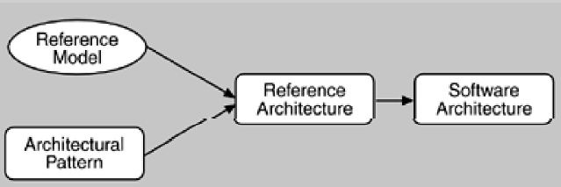
Architectural Patterns, Reference Models, and Reference Architectures
Reference models, architectural patterns, and reference architectures are not architectures;
  they are useful concepts that capture elements of an architecture.
  Each is the outcome of early design decisions.
  The relationship among these design elements is shown below

Slide 12
Why is architecture important?
Architecture is important for three primary reasons.
  It provides a vehicle for communication among stakeholders.
  It is the manifestation of the earliest design decisions about a system.
  It is a transferable, reusable abstraction of a system.
Communication Vehicle
  Each stakeholder of a software system - customer, user, project manager, coder, tester, and so on - is concerned with different system characteristics that are affected by the architecture.
  For example:
    the user is concerned that the system is reliable and available when needed;
    the customer is concerned that the architecture can be implemented on schedule and to budget;

Slide 13
Why is architecture important?...
    the manager is worried (as well as about cost and schedule) that the architecture will allow teams to work largely independently, interacting in disciplined and controlled ways.
  The architect is worried about strategies to achieve all of those goals.
  Architecture provides a common language in which different concerns can be expressed, negotiated, and resolved at a level that is intellectually manageable even for large, complex systems
  Without such a language, it is difficult to understand large systems sufficiently to make the early decisions that influence both quality and usefulness.

Slide 14
Why is architecture important?...
Early Design Decisions
  Software architecture represents a system's earliest set of design decisions. The decision include
    Defines Constraints on Implementation
    Dictates Organizational Structure
    Inhibits or Enables a System's Quality Attributes
    Predicting System Qualities by Studying the Architecture
    Makes It Easier to Reason about and Manage Change
    Helps in Evolutionary Prototyping
    Enables More Accurate Cost and Schedule Estimates
  It is also the earliest point at which design decisions governing the system to be built can be analyzed.

Slide 15
Why is architecture important?...
Reusable Model
  The earlier in the life cycle re-use is applied, the greater the benefit that can be achieved
  An architecture is an abstraction: a one-to-many mapping (one architecture, many systems).
  Architecture is the basis for product (system) commonality.
  Entire product lines can share a single architecture.
  Systems can be built from large, externally developed components that are tied together via architecture.
  Architectural reuse examples
    Software Product Lines Share a Common Architecture
    Systems Can Be Built Using Large, Externally Developed Elements
    Less Is More: It Pays to Restrict the Vocabulary of Design Alternatives
    An Architecture Permits Template-Based Development
    An Architecture Can Be the Basis for Training

Slide 16
The Architectural Business Cycle(ABC)
What do you suppose would happen if two different architects, working in two different organizations, were given the same requirements specification for a system?
Software architecture is a result of technical, business, and social influences.
Its existence in turn affects the technical, business, and social environments that subsequently influence future architectures.
This cycle of influences, from the environment to the architecture and back to the environment is said to be Architecture Business Cycle (ABC).

Slide 17
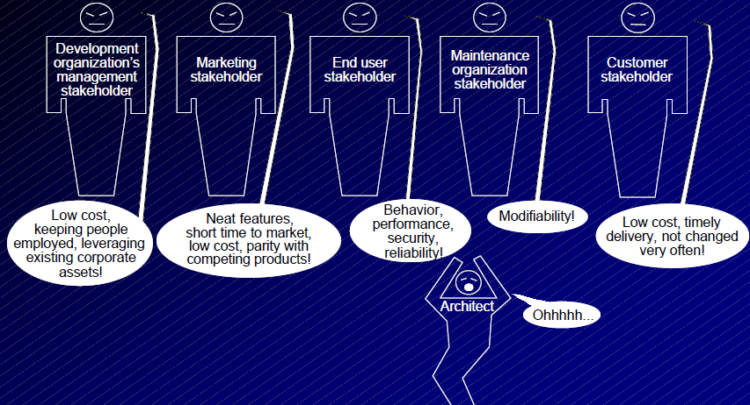
  Factors Influencing Architectures: stakeholders of a system

Slide 18
Development Organization Concerns
In addition to the organizational goals expressed through requirements, an architecture is influenced by the structure or nature of the development organization.
Example
  if the organization has an abundance of idle programmers skilled in client-server communications, then a client-server architecture might be the approach supported by management
  Staff skills are one additional influence, but so are the development schedule and budget
There are three classes of influence that come from the developing organization:

Slide 19
Development Organization Concerns…
Immediate business
  existing architectures and products
  proposed system may be “next” in a product family so cost estimates assume high degree of reuse
Long-term business
  desire an infrastructure to pursue strategic goals
  this product seen as the way to fund that
Organizational structure
  For example, lack of certain expertise may require design that allows a subsystem to be subcontracted
  4 strong personalities = 4 major components
  Or ... groups responsible for maintaining individual portions of the product family want the next generation product to require those groups

Slide 20
  Factors Influencing Architectures…
  Background and Experience of Architects
  Architects develop their mindset from their past experiences.
    Prior good experiences will lead to replication of prior designs.
    Prior bad experiences will be avoided in the new design
  Architectural choices may also come from: the architect’s education and training, exposure to successful styles, exposure to systems that worked well or didn’t, desire to experiment
Technical Environment
  Special case of the architect’s background and experience
  The technical environment that is current (popular) when the architecture is designed will influence that architecture
  Might include
    industry standard practices
    software engineering techniques prevalent in the architect’s professional community

Slide 21
Ramifications of influences on architectures
Influences on an architecture come from a wide variety of sources. Some are only implied, while others are explicitly in conflict.
Often not consciously understood.
Rarely fully articulated
However, architects need to know and understand the nature, source, and priority of constraints on the project as early as possible and actively engage the stakeholders to solicit their needs and expectations as early as possible
  discover constraints and additional requirements
  avoid false starts by managing expectations and negotiating priorities
  Vision document helps to reveal and engage
  Architectural reviews also engage
  Iterative development helps to engage

Slide 22
Factors Influenced by Architectures
The architecture affects the factors that influence them
  Development Organization Structure
    Short term: work units are organized around architectural units for a particular system under construction.
    Long term: when company constructs a collection of similar systems, organizational units reflect common components (e.g., operating system unit or database unit).
  Enterprise goals of the development organization
    Development of a system may establish a foothold in the market niche.
    Being known for developing particular kinds of systems becomes a marketing device.
    Architecture becomes a leveraging point for additional market opportunities and networking.

Slide 23
Factors Influenced by Architectures…
  Customer requirements
    Knowledge of similar fielded systems leads customers to ask for particular features.
    Customers will alter their requirements on the basis of the availability of existing systems
  Architect’s experience
    Creation of a system affects the architect’s background
  Technical environment
    Occasionally, a system or an architecture will affect the technical environment.
    the WWW for information systems
    the three-tier architecture for database systems
  The architecture itself - obvious

Slide 24
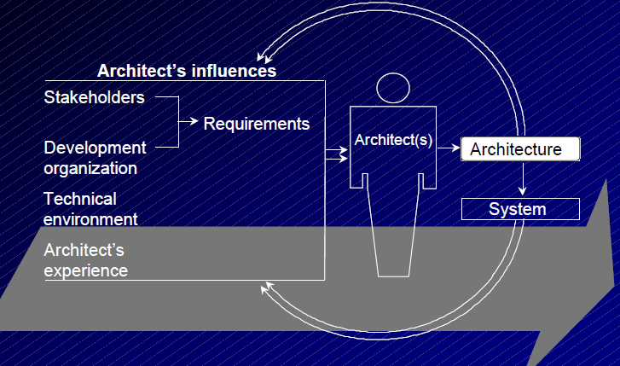
ABC
..
The feedback loops

Slide 25
Software Processes and the ABC
Software process is the term given to the organization, ritualization, and management of software development activities.
What activities are involved in creating a software architecture?
  Creating the business case for the system
  Understanding the requirements
  Creating or selecting the architecture
  Documenting and communicating the architecture
  Analyzing or evaluating the architecture
  Implementing the system based on the architecture
  Ensuring that the implementation conforms to the architecture

Slide 26
What Makes a Good Architect?
People skills: must be able to
  negotiate competing interests of stakeholders
  promote inter-team collaboration
Technical skills: must understand
  the relationships between qualities and structures current technology
  that most requirements for an architecture are not written down in any requirements document
Communication skills: must be able to
  clearly convey the architecture to teams (both verbally and in writing)
  listen to and understand multiple viewpoints

Slide 27
Architectural structures and views
A view is a representation of a coherent set of architectural elements, as written by and read by system stakeholders.
It consists of a representation of a set of elements and the relations among them.
A structure is the set of elements itself, as they exist in software or hardware.
  For example
    A module structure is the set of the system's modules and their organization.
    A module view is the representation of that structure, as documented by and used by some system stakeholders.
An architecture is composed of many structures, documented as views, which are software components and their relationships.
Architectural structures can be divided into three groups

Slide 28
Architectural structures and views...
Module structures.
  Here the elements are modules, which are units of implementation.
  Modules represent a code-based way of considering the system.
  They are assigned areas of functional responsibility.
  There is less emphasis on how the resulting software manifests itself at runtime.
  Module structures allow us to answer questions such as
    What is the primary functional responsibility assigned to each module?
    What other software elements is a module allowed to use?
    What other software does it actually use?
    What modules are related to other modules by generalization or specialization (i.e., inheritance) relationships?

Slide 29
Architectural structures and views...
Component-and-connector structures.
  Here the elements are runtime components (which are the principal units of computation) and connectors (which are the communication vehicles among components).
  Component-and-connector structures help answer questions such as
    What are the major executing components and how do they interact?
    What are the major shared data stores?
    Which parts of the system are replicated?
    How does data progress through the system?
    What parts of the system can run in parallel?
    How can the system's structure change as it executes?

Slide 30
Architectural structures and views...
Allocation structures.
  Allocation structures show the relationship between the software elements and the elements in one or more external environments in which the software is created and executed.
  They answer questions such as
    What processor does each software element execute on?
    In what files is each element stored during development, testing, and system building?
    What is the assignment of software elements to development teams?

Slide 31
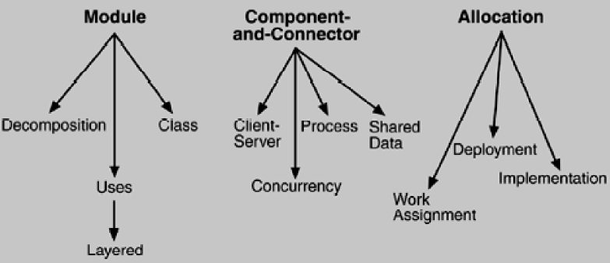
Architectural structures and views...
..
Common software architecture structures

Slide 32
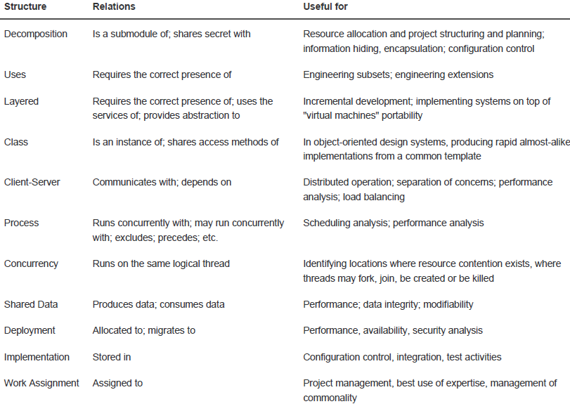
..

Slide 33
Architectural structures and views...
..

