Slide 1

Chapter 2: Design Patterns
[Structural Patterns]
By Esubalew

Slide 2
Contents
Structural Patterns
  Adapter Pattern
  Bridge Pattern
  Composite Pattern
  Decorator Pattern
  Facade Pattern
  Flyweight Pattern
  Proxy Pattern

Slide 3
Structural Patterns
Structural patterns are concerned with how classes and objects are composed to form larger structures.
Structural class patterns use inheritance to compose interfaces or implementations.
Rather than composing interfaces or implementations, structural object patterns describe ways to compose objects to realize new functionality.
The added flexibility of object composition comes from the ability to change the composition at run-time, which is impossible with static class composition.
List of structural patterns: Adapter, Bridge, Composite, Decorator, Façade, Flyweight, Proxy

Slide 4
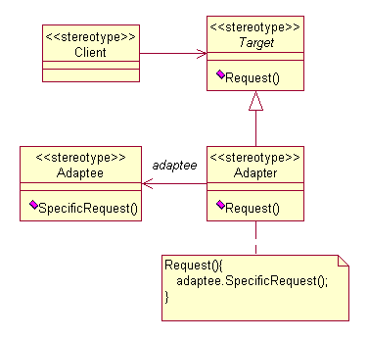
Adapter/wrapper Pattern
Intent - Convert the interface of a class into another interface clients expect. Adapter lets classes work together that couldn't otherwise because of incompatible interfaces.

Slide 5
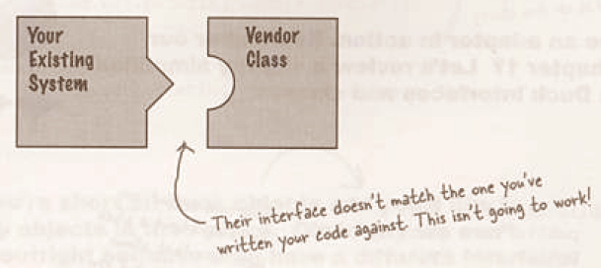
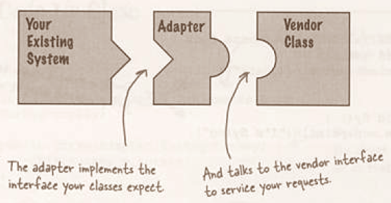
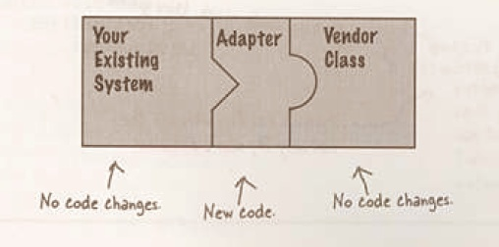

Slide 6
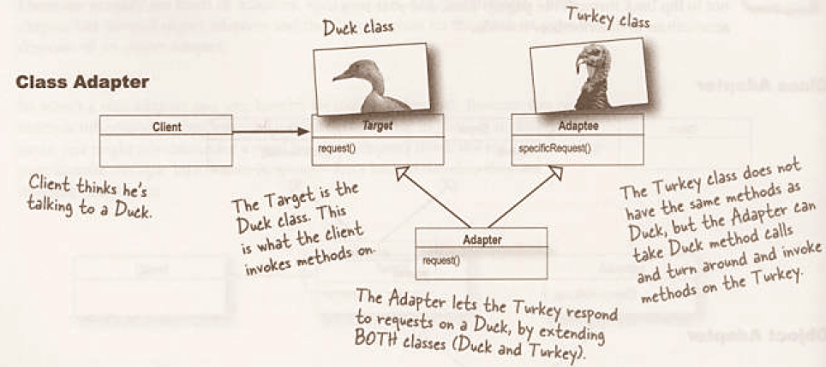
Derive a new class from the nonconforming one and add the methods we need to make the new derived class match the desired interface (inheritance)

Slide 7
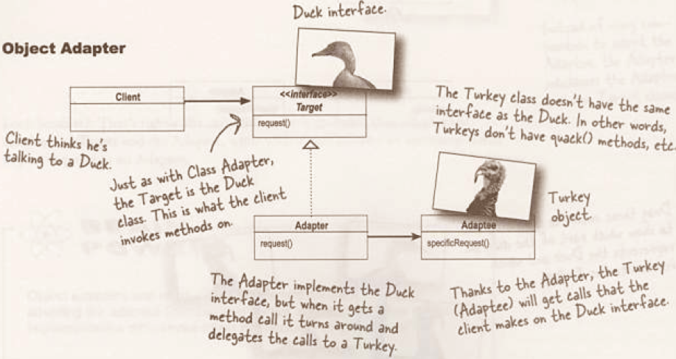
Include the original class inside the new one and create the methods to translate calls within the new class (Composition)

Slide 8
Adapter Pattern …
Use Adapter when you
  want to use an existing class, and its interface does not match the one you need.
  want to create a reusable class that cooperates with unrelated or unforeseen classes-classes that don't necessarily have compatible interfaces.
  need to use several existing subclasses, but it's impractical to adapt their interface by sub-classing every one. An object adapter can adapt the interface of its parent class.
Consequences:
  A class adapter
    lets Adapter override some of Adaptee's behavior, since Adapter is a subclass of Adaptee.
    introduces only one object, and no additional pointer indirection is needed to get to the adaptee.

Slide 9
Adapter Pattern…
  An object adapter
    lets a single Adapter work with many Adaptees
    makes it harder to override Adaptee behavior.
Known uses:
  WindowAdapter in AWT/Swing API,
  JDBC-ODBC API
Related patterns:
  Proxy - provides the same interface as its subject, whereas an adapter provides a different interface to the object it adapts.
  Decorator - focuses on adding new functions to an object, whereas an adapter coordinates two different objects.
  Bridge - tries to separate an interface from its implementation and make an object vary independently, whereas an adapter tries to change and cooperate the interface of an object.

Slide 10
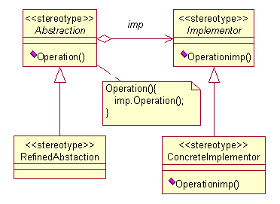
Bridge Pattern
Intent: Decouple an abstraction from its implementation so that the two can vary independently. The Bridge pattern is used to separate the interface of class from its implementation, so that either can be varied separately.
Abstraction defines the abstract interface and maintains the Implementor reference.
•Refined Abstraction extends the interface defined by Abstraction.
•Implementor defines the interface for implementation classes.
•ConcreteImplementor implements the Implementor interface.

Slide 11
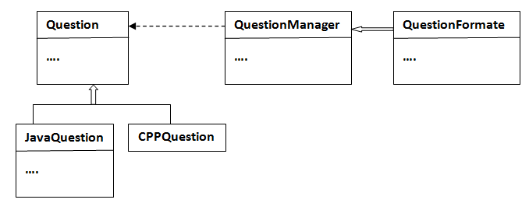
Bridge Pattern …
Source Code

Slide 12
Bridge Pattern…
Use Bridge when
  to avoid a permanent binding between an abstraction and its implementation
  both the abstractions and their implementation should be extensible by subclassing
  changes in the implementation of an abstraction should have no impact on clients
  to share an implementation among multiple objects
Consequences:
  Decoupling interface and implementation.
  Improved extensibility.
  Hiding implementation details from clients
Known uses: JDBC API in Java, Persistence Store implementation in J2EE Servers
Related patterns:
  Abstract Factor - can be used to create and configure a particular bridge.
  Adapter - makes unrelated classes work together, whereas a bridge makes a clear-cut between abstraction and implementation.

Slide 13
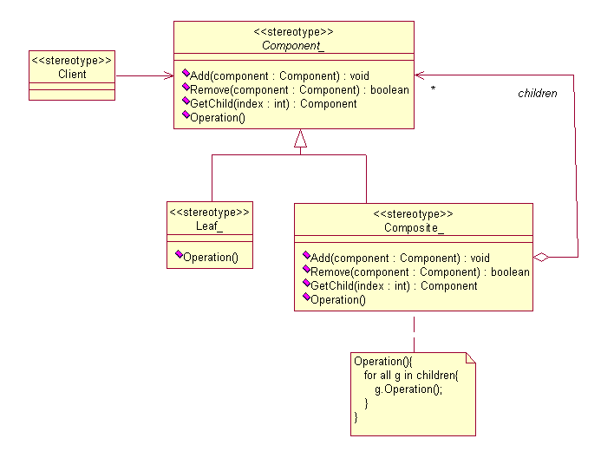
Composite Pattern
Intent: Compose objects into tree structures to represent part-whole hierarchies. Composite lets clients treat individual objects and compositions of objects uniformly.

Slide 14
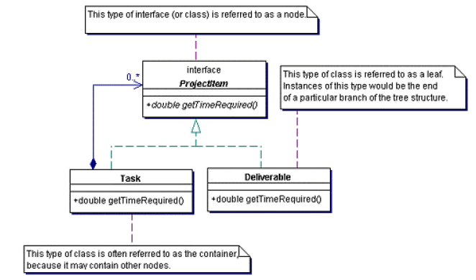
Composite Pattern…
…
Source Code

Slide 15
Composite Pattern…
User Composite when
  you want to represent part-whole hierarchies of objects.
  you want clients to be able to ignore the difference between compositions of objects and individual objects.
Consequences:
  defines class hierarchies consisting of primitive objects and composite objects.
  makes the client simple.
  makes it easier to add new kinds of components.
  can make your design overly general.
Known uses: Component in JSF and Swing API, Node in XML API
Related patterns:
  Decorator -often used with composite pattern and with the same parent class.
  Flyweight - used with composite pattern to share components.
  Iterator - which is used to traverse the composites.
  Visitor - localizes operations across composite and leaf classes.

Slide 16
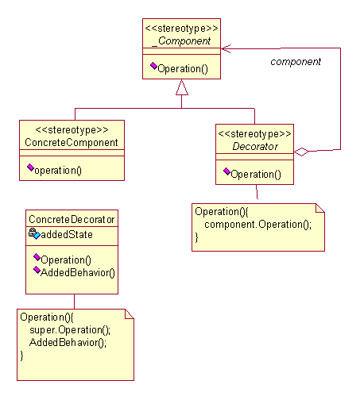
Decorator Pattern
Intent: Attach additional responsibilities to an object dynamically. Decorators provide a flexible alternative to sub-classing for extending functionality

Slide 17
Decorator Pattern : Example
A graphical user interface toolkitshould let you add properties like borders or behaviors like scrolling to any user interface component.
  Solution - way to add responsibilities is with inheritance. Inheriting a border from another class puts a border around every subclass instance.
  This is inflexible, however, because the choice of border is made statically. A client can't control how and when to decorate the component with a border.
A more flexible approach is to enclose the component in another object that adds the border. The enclosing object is called a decorator.
The decorator conforms to the interface of the component it decorates so that its presence is transparent to the component's clients.
The decorator forwards requests to the component and may perform additional actions (such as drawing a border) before or after forwarding.
Transparency lets you nest decorators recursively, thereby allowing an unlimited number of added responsibilities.

Slide 18
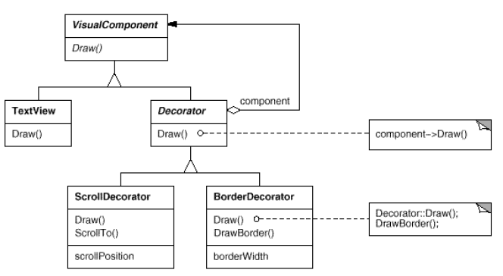
Decorator Pattern …
…

Slide 19
Decorator Pattern…
Use Decorator
  to add responsibilities to individual objects dynamically and transparently, that is, without affecting other objects.
  for responsibilities that can be withdrawn.
  when extension by sub-classing is impractical.
Consequences:
  More flexibility than static inheritance.
  Avoids feature-laden classes high up in the hierarchy.
  A decorator and its component aren't identical.
  Lots of little objects.

Slide 20
Decorator Pattern…
Known uses:
  IO API in Java
  Swing API in Java
Related patterns:
  Adapter pattern - provides a different interface to the object it adapts, whereas a decorator changes an object's responsibilities,
  Proxy pattern - controls access to the object, whereas a decorator focuses on adding new functions to an object,
  Composite pattern - aggregates an object, whereas a decorator adds additional responsibilities to an object, and
  Strategy pattern - changes the guts of an object, whereas a decorator changes the skin of an object.
  Facade pattern - provides a way of hiding a complex class, whereas a decorator adds function by wrapping a class.

Slide 21
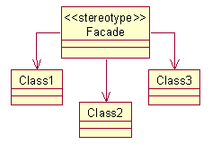
Facade Pattern
Intent: Provide a unified interface to a set of interfaces in a subsystem. Facade defines a higher-level interface that makes the subsystem easier to use.
Use Façade when
  you want to provide a simple interface to a complex subsystem.
  there are many dependencies between clients and the implementation classes of an abstraction.
  you want to layer your subsystems.
Make a complex system simpler by providing a unified or general interface, which is a higher layer to these subsystems.

Slide 22
Façade Pattern…
Consequences:
  It shields clients from subsystem components
  It promotes weak coupling between the subsystem and its clients.
  It doesn't prevent applications from using subsystem classes if they need to.
Known uses:
  Session in Hibernate API,
  Swing API for Windows and Dialogs..
Related patterns:
  Abstract Factory-often used to create an interface for a subsystem in an independent way, and can be used as an alternative way to a facade.
  Singleton - often used with a facade.
  Mediator - similar to facade, but a facade doesn't define new functionality to the subsystem.

Slide 23
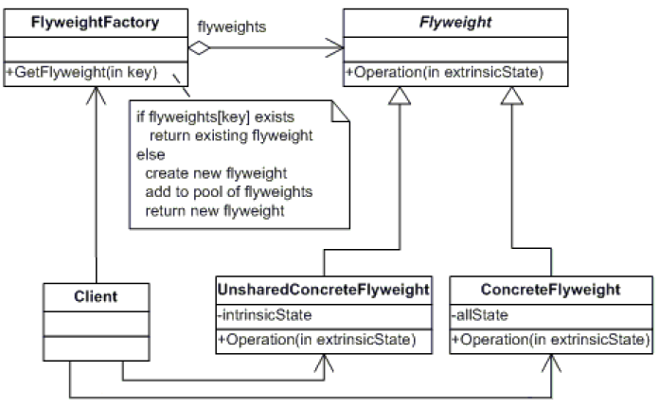
Flyweight Pattern
Intent: The Flyweight pattern provides a mechanism by which you can avoid creating a large number of 'expensive' objects and instead reuse existing instances to represent new ones.

Slide 24
Flyweight Pattern…
Use Flyweight when
  The application uses many identical, or nearly identical, objects.
  For each nearly identical object, the non-identical parts can be separated from the identical part allowing that identical part to be shared.
  Groups of nearly identical objects can be replaced by one shared object once the non-identical parts of the state have been removed.
  If the application needs to distinguish among the nearly identical objects in their original state.
Consequences
  Flyweights may introduce run-time costs associated with transferring, finding, and/or computing extrinsic state, especially if it was formerly stored as intrinsic state. However, such costs are offset by space savings, which increase as more flyweights are shared.

Slide 25
Flyweight Pattern…
  The obvious benefit of this pattern is the reduced number of objects to handle. This can save a lot of space, both in memory and on storage devices, if the objects are persisted.
Known uses: Connection Pooling in JDBC 2.0API
Related patterns:
  Composite - supports recursive structures, whereas an flyweight is often applied on it.
  Factory Method - produces specific object upon requirement, whereas an flyweight uses it to reduce objects.
  State - allows an object to alter its behavior when its internal state is changed, whereas a flyweight is best implemented on it.
  Strategy - allows an algorithm vary independently to suit its needs, whereas a flyweight is based on such strategy.

Slide 26
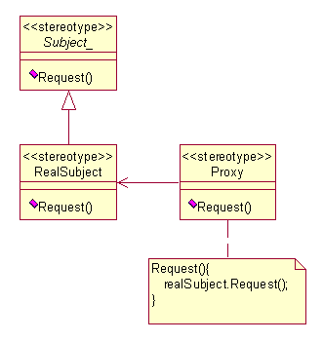
Proxy Pattern
Intent: Provide a surrogate (alternate) or placeholder for another object to control access to it.
  To provide a representative of another object, for reasons such as access, speed, or security.

Slide 27
Proxy Pattern…
Use Proxy when
  Remote proxy – When you need a local representative for an object in another address space (JVM).
  Virtual proxy – Acts as a placeholder and delays creating expensive objects.
  Protection proxy – Determines access rights to the real object.
Consequences
  Remote proxy – you can hide the network from the client.
    Drawback - you don’t realize you’re invoking network behavior, you might not be prepared for the time penalties that result.
  Virtual proxy – you don’t have to create the real product until you really need it.
  Protection proxy –allows access control to be determined.

Slide 28
Proxy Pattern…
Known uses:
  RMI stubs in Java Remoting API
  AOP Implementation in EJB
Related Patterns:
  Adapter pattern - provides a different interface to the object it adapts, whereas a proxy provides the same interface as its subject, and
  Decorator pattern - focuses on adding new functions to an object, whereas a proxy controls access to the object.

