Slide 1
Introduction to software design
By Esubalew A

Slide 2
Content
What is software design?
Objective of software design
Software Design Process
Design principles
Divide and conquer
Increase cohesion where possible
Decrease coupling where possible
Keep the level of abstraction as high as possible
Increase reusability where possible
Reuse existing designs and code where possible
Design for flexibility
Anticipate obsolesce
Design for Portability
Design for Testability
Design defensively

Slide 3
Software Design
Design is the highly significant phase in the software development where the designer plans “how” a software system should be produced in order to make it functional, reliable, and reasonably easy to understand, modify and maintain etc.
It is about solution of the problems mentioned requirement document.
Design is a creative activity - it determines the major characteristics of a system
Design has great impact on testing and maintenance
The output of this phase is a design document to be used for implementing the system

Slide 4
Software Design…
Definition: Design is a problem-solving process whose objective is to find and describe a way:
to implement the system’s functional requirements...
while respecting the constraints imposed by the quality, platform and process requirements including the budget and deadline
and while adhering to general principles of good design quality
In the process of software design a designer faces with a series of design issues
Design issues are sub-problems of the overall design problem.
Each issue normally has several alternative solutions: design options.

Slide 5
Software Design…
The designer makes a design decision to resolve each issue.
This process involves choosing the best option from among the alternatives.
often involving tradeoffs between the different qualities the designer is seeking to achieve in his solution.
To make each design decision, the software engineer uses
knowledge of the requirements
the design as created so far
the technology available
software design principles and ‘best practices’
what has worked well in the past

Slide 6
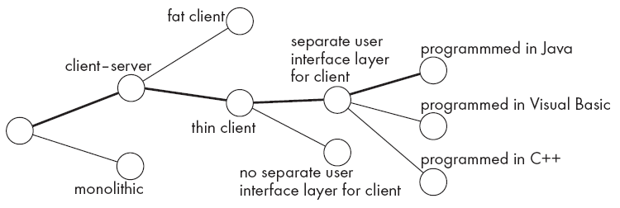
Software Design…
The space of possible designs that could be achieved by choosing different sets of alternatives is often called the design space
The diagram below show example of design space
Design space example

Slide 7
Objective of design
The objective of the design process is
to produce a set of detailed specifications that describe the intended form of implementation for the software system.
These specifications describe both
the form (structure) of the solution and
the way that the components are to fit together,
and so act as a set of “blueprints” that show how the system is to be constructed.
Design involves making choices - the ultimate criterion must be that of “fitness for purpose,” in that the solution should not only exhibit
the best possible structure, but must also
do the required job as well as possible.

Slide 8
Software Design Process
The design process may involve developing several models of the system at different levels of abstraction
The diagram in the next slide is a model of design process showing the design descriptions that may be produced at various stages of design.
As a design is decomposed, errors and omissions in earlier stages are discovered.
The feed back allow earlier model to be improved.
Design process is not sequential as it is indicated in the diagram – design process are interleaved

Slide 9
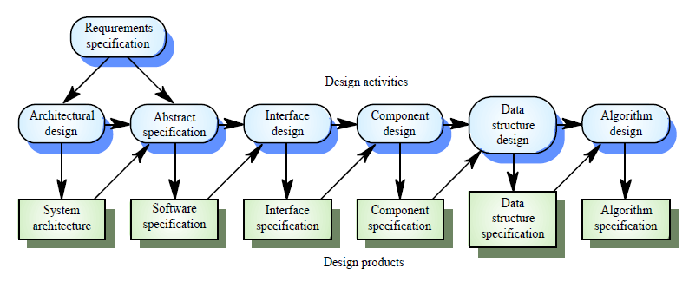
Software Design Process...
A general model of Design Process

Slide 10
Software Design Process...
This is a general model of the design process and real, practical processes may adapt it in different ways.
Possible adaptations are:
The last two stages of design-data structure and algorithm design-may be delayed until the implementation process.
If an explorer approach to design is used, the system interfaces may be designed after the data structures have been specified.
The abstract specification stage may be skipped, although it is usually an essential part of critical systems design

Slide 11
Software Design Process...
The specific design process activities are:
Architectural design
The subsystems making up the system and their relationships are identified and documented
Abstract specification
For each sub-system an abstract specification of its services and constraints under which it must operate is produced
Interface design
For each subsystem, its interface with other sub-systems is designed and documented
This interface specification must be unambiguous as it allows the subsystem to be used without knowledge of the sub-system operation.

Slide 12
Software Design Process...
Component design
Services are allocated to components and the interfaces of these components are designed
Data Structure design
The data structures used in the system implementation are designed in detail and specified
Algorithm Design
The algorithms used to provide services are designed in detail and specified

Slide 13
Design Principles
Principles of design are the laws of designing anything!
In other words, to have a good design, you should consider these principles for the best design possible
A design is said to be good design if
Ensuring that we actually conform with the requirements
Increasing qualities such as: Usability, Efficiency, Reliability, Maintainability, Reusability , etc
Increasing profit by reducing cost and increasing revenue
Accelerating development
In order to achieve the design goals we need to follow design principles mentioned in the following slides
The principles are especially applicable for object oriented systems

Slide 14
1: Divide and conquer (Modularity)
Trying to deal with something big all at once is normally much harder than dealing with a series of smaller things.
A system could be subdivided in the following way
A distributed system is divided up into clients and servers - a system is divided up into subsystems – a subsystem can be divided up into one or more packages - a package is divided up into classes - A class is divided up into methods
Some of the advantages of dividing and tackling a problem are:-
Separate people can work on each part.
An individual software engineer can specialize in his or her component, becoming expert at it.
Each individual component is smaller, and therefore easier to understand.
Parts can be replaced or changed without having to replace or extensively change other parts.
Opportunities arise for making the component reusable

Slide 15
2: Increase cohesion where possible
Cohesion is a measure of the degree to which the elements of a module are functionally related.
A subsystem or module has high cohesion if it keeps together things that are related to each other, and keeps out other things
This makes the system as a whole easier to understand and change
Type of cohesion:
Functional, Layer, Communicational, Sequential, Procedural, Temporal, Utility
Classification is often subjective yet gives us some idea about cohesiveness of a module.

Slide 16
Functional cohesion
This is achieved when all the code that computes a particular result is kept together - and everything else is kept out
i.e. when a module only performs a single computation, and returns a result, without having side-effects.
Modules that computes a mathematical function such as sine and cosine, a module that takes a set of equation and solves for the unknowns are examples of functionally cohesive modules.
Modules that update a database, create a new file or interact with the user are not functionally cohesive
Benefits to the system:
Easier to understand
More reusable
Easier to replace

Slide 17
Layer cohesion
All the facilities for providing or accessing a set of related services are kept together, and everything else is kept out
The layers should form a hierarchy
Higher layers can access services of lower layers,
Lower layers do not access higher layers
The set of procedures through which a layer provides its services is the application programming interface (API)
You can replace a layer without having any impact on the other layers
You just replicate the API
We will revisit the notion of layers when we discuss architectural patterns

Slide 18
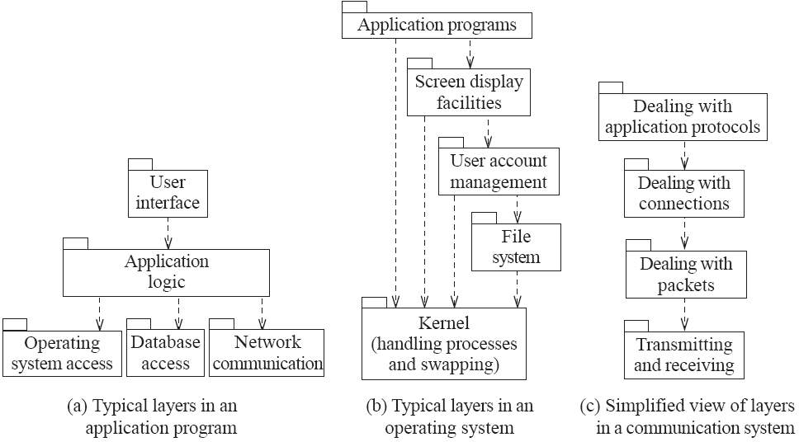
Example of the use of layers

Slide 19
Communicational & Sequential Cohesions
Communicational Cohesion : all the modules that access or manipulate certain data are kept together (e.g. in the same class) and everything else is kept out
A class would have good communicational cohesion
if all the system’s facilities for storing and manipulating its data are contained in this class and if the class does not do anything other than manage its data.
Main advantage: When you need to make changes to the data, you find all the code in one place.
Sequential Cohesion: Procedures, in which one procedure provides input to the next, are kept together and everything else is kept out
Example: a text recognition system

Slide 20
Procedural, Temporal & Utility Cohesion
Procedural Cohesion : Procedures that are used one after another are kept together, even if one does not necessarily provide input to the next.
Temporal Cohesion : operations that are performed during the same phase of the execution of the program are kept together, and everything else is kept out
For example, placing together the code used during system start-up or initialization.
Utility/Coincidental: When related utilities which cannot be logically placed in other cohesive units are kept together
A utility is a procedure or class that has wide applicability to many different subsystems and is designed to be reusable.
For example, the java.lang.Math class.

Slide 21
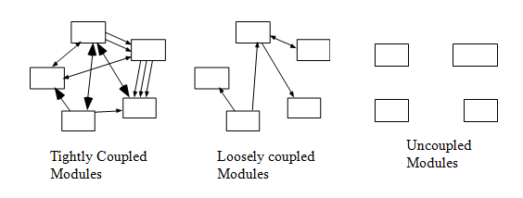
3:Reduce Coupling where possible
Coupling occurs when there are interdependencies between one module and another
When interdependencies exist, changes in one place will require changes somewhere else - ripple effect
A network of interdependencies makes it hard to see at a glance how some component works.

Slide 22
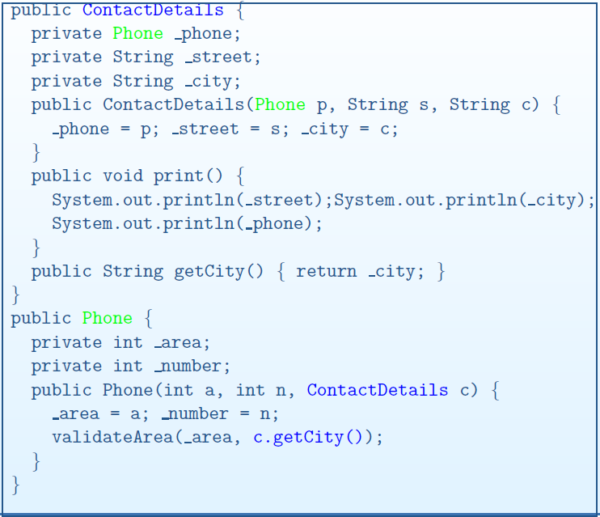
Example

Slide 23
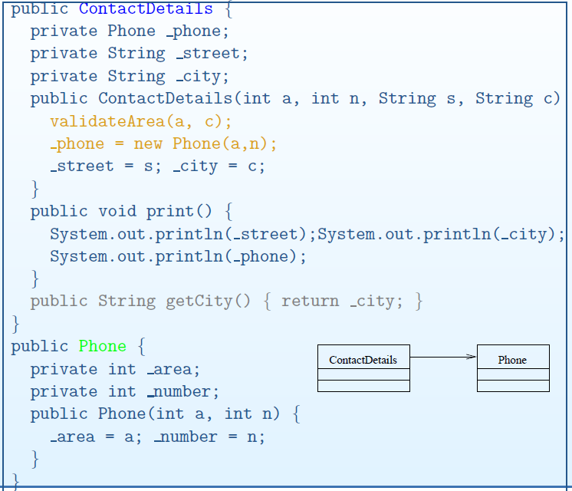
Example...

Slide 24
3:Reduce Coupling where possible...
Type of coupling:
Content Bad/unacceptable
Common
Control
Stamp
Data
Routine Call
Type use
Inclusion/Import
External good/acceptable
Coupling Principle
Create narrow connections
Create direct Connections
Create local connections
Create obvious connections
Create flexible connections

Slide 25
Content coupling
Occurs when one component surreptitiously modifies data that is internal to another component
To reduce content coupling you should therefore encapsulate all instance variables: declare them private, and provide get and set methods
A worse form of content coupling occurs when you directly modify an instance variable of an instance variable
Example
public class Arch{
private Line baseline;
...
void slant(int newY){
Point theEnd = baseline.getEnd();
theEnd.setLocation(theEnd.getX(),newY);
}
}
public class Line{
private Point start, end;
...
public Point getStart() {
return start;
}
public Point getEnd() {
return end;
}
}
*Make the Line class truly immutable
to avoid the coupling

Slide 26
Common & Control coupling
Common Coupling: occurs whenever you use a global variable
All the components using the global variable become coupled to each other
A weaker form of common coupling is when a variable can be accessed by a subset of the system’s classes - e.g. a Java package
The use of common coupling should be minimized
Can be acceptable for creating global variables that represent system-wide default values
Control Coupling: Occurs when one procedure calls another using a ‘flag’ or ‘command’ that explicitly controls what the second procedure does
To make a change you have to change both the calling and called method

Slide 27
Control coupling…
Example: public routineX(String command){
if (command.equals("drawCircle") {
drawCircle();
} else{
drawRectangle();
}
}
Common coupling can reduced by
Making the caller of routineX directly call drawCircle() & drawRectangle() methods
Using polymorphic operations ( the best way)
Using look-up table
commands are then mapped to a method that should be called when that command is issued

Slide 28
Stamp coupling
Occurs whenever one of your application classes is declared as the type of a method argument
Since one class now uses the other, changing the system becomes harder: Reusing one class requires reusing the other
Example : public class Emailer{
public void sendEmail(Employee e, String text)
{...}
...
}
The Emailer class is not reusable
Two ways to reduce stamp coupling are
using an interface as the argument type
passing simple variables.

Slide 29
Data & Routine coupling
Data coupling: occurs whenever the types of method arguments are either primitive or else simple library classes
The more arguments a method has, the higher the coupling : all methods that use the method must pass all the arguments
You should reduce coupling by not giving methods unnecessary arguments
There is a trade-off between data coupling and stamp coupling: Increasing one often decreases the other
Routine call coupling: occurs when one routine (or method in an object oriented system) calls another.
Routine call coupling is always present in any system.
If you repetitively use a sequence of two or more methods to compute something then you can reduce routine call coupling by writing a single routine that encapsulates the sequence.

Slide 30
Type, Inclusion (import) & External coupling
Type coupling: occurs when a module uses a data type defined in another module
It occurs any time a class declares an instance variable or a local variable as having another class for its type.
The consequence of type use coupling is that if the type definition changes, then the users of the type may have to change
Always declare the type of a variable to be the most general possible class or interface that contains the required operations
Inclusion Coupling: Occurs when one component imports a package or when one component includes another.
External Coupling: When a module has a dependency on such things as the operating system, shared libraries or the hardware.

Slide 31
4: Keep the level of abstraction as high as possible
Ensure that your designs allow you to hide or defer consideration of details, thus reducing complexity
A good abstraction is said to provide information hiding
Abstractions allow you to understand the essence of a subsystem without having to know unnecessary details
Abstraction and classes
Classes are data abstractions that contain procedural abstractions
Abstraction is increased by defining all variables as private.
The fewer public methods in a class, the better the abstraction
Superclasses and interfaces increase the level of abstraction
Attributes and associations are also data abstractions.
Methods are procedural abstractions: Better abstractions are achieved by giving methods fewer parameters

Slide 32
Design Principles 5 & 6
Increase reusability where possible
Design the various aspects of your system so that they can be used again in other contexts
Generalize your design as much as possible
Follow the preceding four design principles
Design your system to contain hooks
Simplify your design as much as possible
Reuse existing designs and code where possible
Design with reuse is complementary to design for reusability
Actively reusing designs or code allows you to take advantage of the investment you or others have made in reusable components
Cloning should not be seen as a form of reuse

Slide 33
Design Principles 7 & 8
Design for flexibility: actively anticipate changes that a design may have to undergo in the future, and prepare for them
Reduce coupling and increase cohesion
Create abstractions
Do not hard-code anything
Leave all options open - do not restrict the options of people who have to modify the system later
Use reusable code and make code reusable
Design for Portability: Have the software run on as many platforms as possible
Avoid the use of facilities that are specific to one particular environment
E.g. a library only available in Microsoft Windows

Slide 34
9: Anticipate obsolescence
Plan for changes in the technology or environment so the software will continue to run or can be easily changed
Avoid using early releases of technology
Avoid using software libraries that are specific to particular environments
Avoid using undocumented features or little-used features of software libraries
Avoid using software or special hardware from companies that are less likely to provide long-term support
Use standard languages and technologies that are supported by multiple vendors

Slide 35
Design principle 10 and 11
Design for Testability: Take steps to make testing easier
Design a program to automatically test the software
Ensure that all the functionality of the code can by driven by an external program, bypassing a graphical user interface
In Java, you can create a main() method in each class in order to exercise the other methods
Design defensively: Never trust how others will try to use a component you are designing
Handle all cases where other code might attempt to use your component inappropriately
Check that all of the inputs to your component are valid: the preconditions
Unfortunately, over-zealous defensive design can result in unnecessarily repetitive checking

Slide 36
Design Methods
There are a number of software design methods/approaches.
The two basic approaches that can be used to design a software are function-oriented and object-oriented.
These approaches are fundamentally different and are applicable at different stages in the design phase.
Reading Assignment
Design concepts
Next class: UID

