Slide 1
Use case Diagrams
By: Mulugeta Ayele

Slide 2
Contents at Glance
Use case definition
Use case models
Use cases from architectural point of view
Elements of use case diagram
Relationship in use case
Use case tools

Slide 3
Use Cases Definition
Use cases are high-level, user-centric requirements. [Fowler]
A use case specifies a sequence of actions, including variants, which the system can perform and that yields an observable result of value to a particular actor. [Jacobson]
In general, Use Cases are:
One of many techniques to elicit and elaborate user requirements.

Slide 4
Use Case Models
Use Case Diagram
Use Case Model
Use Case Specification/ Definition/Description

Slide 5
Use Case Diagrams as the Hub of Architectural Viewpoints

Slide 6
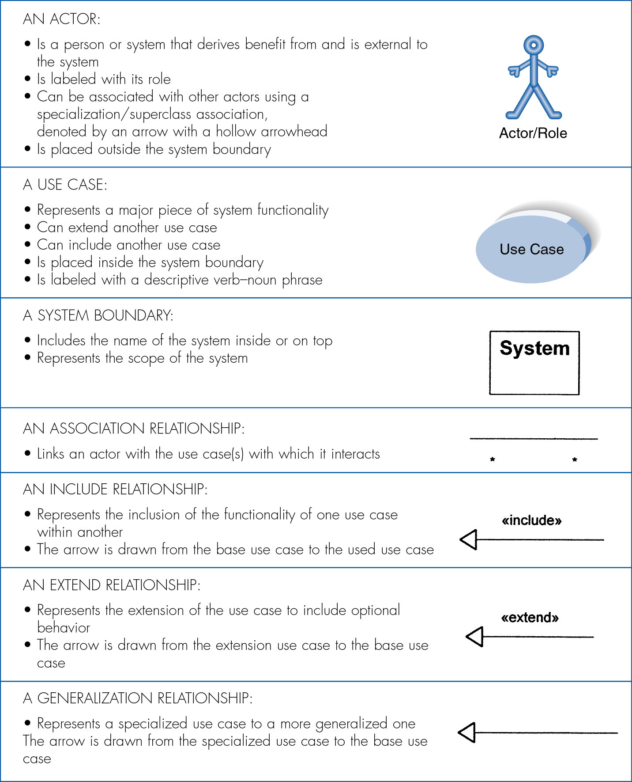
Elements of use case Diagram

Slide 7
Relationships
Generalization
Allows child use cases to inherit behavior from parent use cases
Inclusion
Inclusion enables to reuse one use case's steps inside another use case.
Extension
Allows creating a new use case by adding steps to existing use cases

Slide 8
1. Generalization
The child use case inherits the
behavior and meaning of the
parent use case.
The child may add to or
override the behavior of its parent.
parent
child
registration
non-graduate
registration
graduate
registration

Slide 9
2. Include
The base use case explicitly incorporates the behavior of another use case at a location specified in the base.
The included use case never stands alone. It only occurs as a part of some larger base that includes it.
base
<<include>>
included
updating
grades
<<include>>
verifying
student id
output
generating
<<include>>

Slide 10
3. Extend
base
<<extend>>
extending
The base use case implicitly incorporates the behavior of another use case at certain points called extension points.
The base use case may stand alone, but under certain conditions its behavior may be extended by the behavior of another use case.
Exam copy request
<<extend>>
Exam-grade appeal

Slide 11
Relationships between Actors
Generalization.
student
graduate
student
non-graduate
student

Slide 12
Relationships between Use Cases and Actors
Actors may be connected to use cases by associations, indicating that the actor and the use case communicate with one another using messages.
updating
grades
faculty

Slide 13
All in one
place
conference call
place
phone call
<<extend>>
cellular
network
receive
additional call
receive
phone call
<<extend>>
use
scheduler
user
Cellular Telephone

Slide 14
Use Case Diagram Tools
Use case tools
Software Ideas Modeler
Nevron Diagram Dersigner
QuickUML Window
Blueprint Software Modeler
Practical Example

