Slide 1
Requirement Management
Chapter 6
By Esubalew A.

Slide 2
  Contents
Introduction
  Stable and volatile requirements
  Types of volatile requirements
  Requirements change factors
  Requirements identification & Storing
  Requirements management activities
    Change control
    Version control
    Requirements status tracking
    Requirement tracing
Requirement Management planning
Next Class

Slide 3
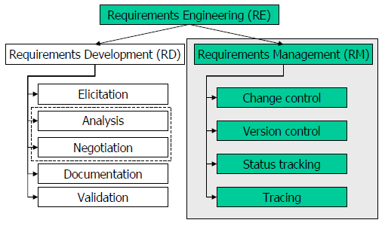
  Introduction
RD – often a separate stage in the project
RM – activities conducted in parallel with design and implementation

Slide 4
  Introduction…
Freezing requirements is unwise and unrealistic, changes are fate.
too early
freeze
requirements stability
requirements
creep
time

Slide 5
  Introduction…
Requirement management is hard problem because of continuous changes during development process
Signing off the requirements document by the customer means that a baseline of requirements agreement has been established. It does not mean that requirements have been finalized.
The subtext of a signature on a requirements specification sign-off page should read something like (Wiegers, 2003):
  “I agree that this document represents our best understanding of the requirements for this project today. I agree to make future changes in this baseline through the project’s defined change process. I realize that approved changes might require us to renegotiate cost, resource, and schedule commitments for this project.”

Slide 6
  Introduction…
“Requirements management is the process of documenting, analyzing, tracing, prioritizing and agreeing on requirements and then controlling change and communicating to relevant stakeholders. It is a continuous process throughout a project.”
The principal concerns in requirements management are
  Managing the relationships between requirements
  Managing priorities between requirements
  Managing the dependencies between different documents
    Requirements document
    Specification
    Documents produced in the systems engineering process
  Managing changes to agreed requirements

Slide 7
  Stable and volatile requirements
Requirements changes occur
  while the requirements are being elicited, analyzed and validated
  after the system has gone into service
Requirements change is unavoidable & doesn’t imply poor requirements engineering practice.
Some requirements are usually more subject to change than others
  Stable requirements: Are concerned with the essence of a system and its application domain
    E.g. Student detail in student information system
  Volatile requirements: Are specific to the instantiation of the system in a particular environment and for a particular customer
    E.g. In a hospital, requirements derived from health-care policy

Slide 8
  Types of volatile requirements
Mutable requirements
  Requirements change due to changes to the environment in which the system is operating
  Example
    The requirements for a system which computes tax deductions evolve as tax laws are changed
    In hospital system, the funding of patient care may change and thus require different treatment information to be collected.
Emergent requirements
  Requirements which cannot be completely defined when the system is specified
  Requirements emerge
    as the system is designed and implemented
    as users have contact with new system

Slide 9
  Types of volatile requirements…
Consequential requirements
  Requirements that result from the introduction of the computer system.
  Introducing the computer system may change the organizations processes and open up new ways of working which generate new system requirements
  May be based on wrong assumptions about how the system will be used and some may be wrong
Compatibility requirements
  Requirements which depend on the particular systems or business process within an organization.
  As these changes, the compatibility requirements on the commissioned or delivered system may also evolve.

Slide 10
  Requirements change factors
Requirements for complex systems are continuously changing (during requirement engineering process and after a system has gone into service) because of
  Requirements errors, conflicts and inconsistencies
    As the system development proceeds, some errors and inconsistencies may be discovered that were not revealed earlier (in validation) and must be corrected.
  Evolving customer/end-user knowledge of the system
    Customers and end-users may develop a better understanding of what they really require from a system.
  Technical, schedule or cost problems
    Problems may be encountered in implementing a requirement. It may be too expensive or take too long to implement certain requirements.
Better RD processes may contribute to reducing the effect of these factors

Slide 11
  Requirements change factors…
  Changing customer priorities
    Customer priorities change during system development as a result of a changing business environment, the emergence of new competitors, staff changes, etc.
  Environmental changes
    The environment in which the system is to be installed may change so that the system requirements have to change to maintain compatibility.
  Organizational changes
    The organization which intends to use the system may change its structure and processes resulting in new system requirements.
  New Technology
    technology push
RD processes cannot really help with these

Slide 12
  Requirements identification
Requirements need unique identification
  essential for requirements management
Basic approach: requirements are numbered based on chapter/section in the requirements document
Problems with this are:
  Numbers cannot be unambiguously assigned until the document is complete
  Assigning chapter/section numbers is an implicit classification of the requirement.
    Relationships between requirements due to their “neighborhood”?
    Misleading
  References are hard to handle

Slide 13
  Requirements identification techniques
Dynamic renumbering
  Some word processing systems allow for automatic renumbering (paragraphs, cross-references)
  As you re-organize your document and add new requirements, the system keeps track of the cross reference and automatically renumbers your requirement depending on its chapter, section and position within the section
Symbolic identification
  Requirements can be identified by giving them a symbolic name
  E.g. EFF-1, EFF-2, EFF-3 are requirements which relate to system efficiency
Database record identification
  Requirements are held as data in a database
  Unique identifier per item are assigned

Slide 14
  Storing requirements
Requirements have to be stored in such a way that they can be easily
  Accessed
  Changed
  linked (with other requirements)
  described (in text as well as in graphics…)
  enhanced (by adding external information)
Possible storage techniques are
  In one or more word processor files
    requirements are stored in the requirements document
  In a specially designed requirements database

Slide 15
  Storing requirements: Word processor documents
Advantages
  Easy to construct, maintain, cheap
  Requirements may be accessed by anyone with the right word processor
  Requirements can be described informaly, unstructured…
  It is easy to produce the final requirements document
Disadvantages
  Requirements dependencies must be externally maintained
  Search facilities are limited
  Not possible to link requirements with proposed requirements changes
  Not possible to have version control on individual requirements (only whole document)
  No automated navigation from one requirement to another (Improvement: Hypertext documents)

Slide 16
  Storing requirements: Requirements database
Each requirement is represented as one or more database entities
Database query language is used to access requirements
Advantages
  Good query and navigation facilities
  Support for change and version management
  Versioning of single requirements
Disadvantages
  Readers may not have the software/skills to access the requirements database
  Higher costs

Slide 17
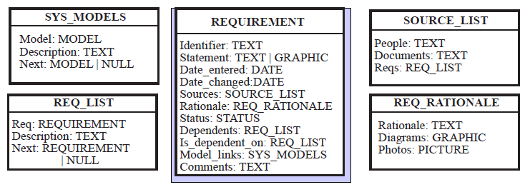
  Storing requirements: Requirements database

Slide 18
  Requirements DB: Choice factors
The statement of requirements ( text, graphics, photos and external linked storage or multimedia database)
The number of requirements
Teamwork, team distribution and computer support
  Distributed team of requirements engineers ( →Remote, multi-site access, →Browser interface)
CASE tool use
  The database should be the same as or compatible with CASE tool databases
  Interfaces to CASE tools needed in later process steps
Existing database usage
  If a database for software engineering support is already in use, this should be used for requirements management
    Costs of training, supporting staff, etc.

Slide 19
  Requirements management activities
Requirement management maintains the agreement between the stakeholders, in terms of the integrity and accuracy.
Involves:
  Change control – managing changes to the requirements baseline, through reviewing proposed changes and evaluating the likely impact of each change before approving it, and incorporating approved changes into the project in a controlled way.
  Version control – managing document versions and requirements revisions.
  Requirements status tracking – defining a set of status values for a requirement, and monitoring statuses throughout the project.
  Requirements tracing – managing dependency links between requirements, and tracing requirements up to their sources and down to corresponding design, source code, and test cases.

Slide 20
  Change control
Change control/management is concerned with procedures, processes and standards which are used to manage changes to system requirements
During the requirement development stage, changes to the requirements document can be made relatively freely.
After the document was approved
  Changes are to be made only by designated people
  Every change is to be documented
  Changes are to be communicated to all the affected stakeholders and developers
Requirements changes may also lead to overruns in project’s schedule, budget, negative impact on the product’s quality.
Therefore, there is need for change impact analysis, and decision making whether to approve a change request at all.

Slide 21
  Change control…
Change control is often seen as a barrier to change. However, it is not a barrier, it is structuring of change.
A very common condition in software project is scope creep, when stakeholders continue to propose (request) some additional features.
If every such a proposition is approved, the project will never get finished.
The most effective technique against the scope creep is ability to say “No”, or at least “Not now’”.
In general, change requests that are in fact ‘defect reports’ should all be satisfied, while change request which are just ‘extensions’ should all be taken with suspicion.

Slide 22
  Change control…
Change management policies (plan of action) may cover:
    Change request process
    The information required to process each change request
    The process used to analyze the impact and costs of change and the associated traceability information
    Change Request Board (should be independent)
    The software support (if any) for the change control process
Generally, the change management process has three main activities
  Identifying requirements problem
    caused by analysis of the requirements, new customer needs, or operational problems
    requirements changes are proposed (specified)

Slide 23
  Change control…
  Analyzing proposed changes
    check how many requirements (and, if necessary, system components) are affected
    time and money, to make the change.
  Implementing changes
    A set of modifications to the requirements document or a new document version
    has to be validated (quality checking procedures)
Requirement change requests may be rejected: reasons for rejection
  Change request is invalid: customer has misunderstood some requirements, proposed change isn’t necessary
  Too many dependent requirements: consequential changes are unacceptable to the user
  Costs are too high or take too long

Slide 24
  Change control process guidelines
There must be a standard channel through which stakeholders can submit their change requests.
  Examples are paper form, web form, designated email address.
  Change request forms may include: fields to document the change analysis, data fields, responsibility fields, status field, comments field
All requests must go through this channel.
No design or implementation work should be done on requests that have not been yet approved.
There must be a Change Control Board (CCB), approving changes.
  CCD is to have representatives of various stakeholders.
CCB should meet regularly, and also have some conditions defined that would trigger a special meeting.

Slide 25
  Change control process guidelines…
Impact analysis is to be performed on each change request, before it is considered at a CCB meeting.
There should be a ‘fast path’ for low-risk low-cost changes (not waiting for a CCB meeting).
The contents of change database should be visible to all the stakeholders.
Each incorporated change must be traceable to an approved change request.
For changes, what, when, who and why must be documented.
Keep removed and changed requirements, sometimes ‘undo’ is to be made.

Slide 26
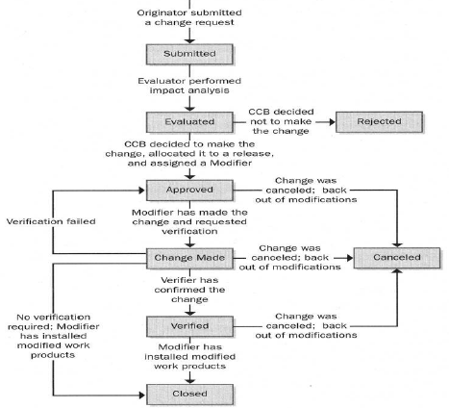
  Change request’s lifecycle
….

Slide 27
  Impact analysis
Change isn’t free.
Even seemingly minor changes may unexpectedly require lot of work
  In one project, a change in one of displayed error messages was requested. In English version of the system it required 1 minute of work. However, in Amharic version, the message exceeded the maximum allowed length, both in the message box and in the database.
Impact analysis:
  Attempts to understand the possible implications of the change. E.g. whether a quality attribute will be negatively affected?
  Identifies all the files, models and documents affected.
  Identifies the tasks required to implement the change.
  Estimates the effort needed to complete those tasks.
A change often produces a large ripple effect.

Slide 28
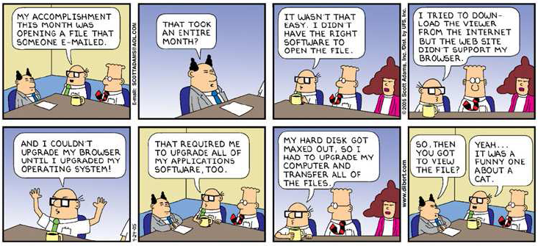
  Ripple Effect
….

Slide 29
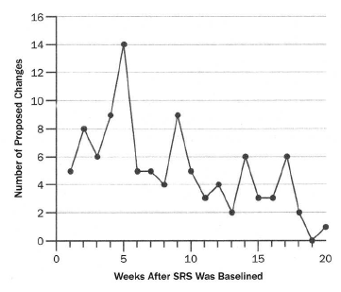
  Monitoring changes dynamics
It is useful to monitor the requirements change dynamics throughout the project

Slide 30
Key points
Requirements change is inevitable as customers develop a better understanding of their real needs and as the political, organizational and technical environment in which a system is to be installed changes.
Requirements which are concerned with the essence of a system are more likely to be stable than requirements which are more concerned with how the system is implemented in a particular environment.
Types of volatile requirement include mutable requirements, emergent requirements, consequential requirements and compatibility requirements.

Slide 31
Key points…
Requirements management requires that each requirement should be uniquely identified.
If a large number of requirements have to be managed, the requirements should be stored in a database and links between related requirements should be maintained.
Change management policies should define the processes used for change management and the information which should be associated with each change request. They should also define who is responsible for doing what in the change management process.

