Slide 1
Requirement Validation
Chapter 5
By Esubalew A.

Slide 2
Contents
Introduction
Analysis & negotiation Vs Validation
Inputs and Outputs of Requirement Validation
Validation framework – Activities
Review
Reading Techniques
Translating requirements to alternative forms
User manual
Visualizations, e.g. diagrams
Lightweight formal models
Prototypes
Test cases

Slide 3
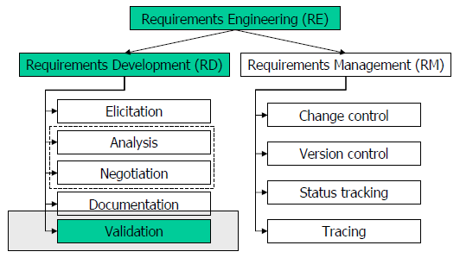
Introduction

Slide 4
Introduction
The goal of requirement validation is to check the requirements to certify that the requirements document is an acceptable description of the system to be implemented
Checks a requirements document for
Completeness and consistency
Conformance to standards
Requirements conflicts
Technical errors
Ambiguous requirements
etc
The aim here is to check and certify that the requirements represent the system that is to be implemented. It differs from the requirements analysis step and negotiation step (How?)

Slide 5
Analysis & negotiation Vs Validation
Analysis and Negotiations focus on ensuring that the requirements are correctly understood and reflect the needs of the stakeholders, rather than the details of correct articulation of the requirements.
Concerned with the “raw” requirements gathered from the stakeholders.
Analysis & Negotiation focus on “have we got the right requirements?”
Validation focuses on the documented requirements and how they are represented.
Concerned with checking the document that has already gone through analysis and negotiation.
Validation focuses on “have we represented requirements right (correctly)?”
Some stakeholder problems are inevitably discovered during requirements validation & and these must be corrected before the requirement document is approved & used as basis for development.
Problems that could be discovered during validation are
Documentation problems
Flaws in requirement elicitation, analysis & modeling

Slide 6
Inputs and Outputs of Requirement Validation
List of problems to be resolved
List of agreed actions
Requirements document
Organizational Standard
Organizational Knowledge
Some “typical” problems:
- conformance to standards
- ambiguous wording
- error in the actual model
- undetected conflicts
Inputs
Requirements
Validation
Outputs
Problem of requirement validation
The difficulty in validation lies in comparing the draft document to (what). There is no way to demonstrate that a requirement specification is correct with respect to some other system representation
So requirements validation asks 2 questions: (1) requirements meet stakeholders needs represented ? (2) requirements clear enough for others to use ?

Slide 7
Inputs and Outputs of Requirement Validation…
Requirements document
Should be a complete version of the document, not an unfinished draft.
Formatted and organized according to organizational standards
Organizational knowledge
Knowledge, often implicit, of the organization which may be used to judge the realism of the requirements
Organizational standards
Local standards e.g. for the organization of the requirements document
Problem list
List of discovered problems in the requirements document
Agreed actions
List of agreed actions in response to requirements problems. Some problems may have several corrective actions; some problems may have no associated actions

Slide 8
How long does validation take?
Validation is a prolonged processes it involves people reading and thinking about a lengthy document.
Meeting may have to be arranged and experiments carried out with prototype
So it may take several weeks or sometimes months for complex systems.
This is particularly likely if stakeholders from different organizations are involved
There is always a natural tendency to rush the validation process so that system development can be started with out further ado.
However this may result in rework because of requirement errors

Slide 9
Validation framework - Activities
Review - relies on human intelligence in hope that people might find some problems with requirements.
if the requirements document or some part of it is in a sufficiently formal language, some properties can be automatically checked by software.
Translation - translate requirements to an alternative form. This has a double advantage:
The translation process may fail (rewriting turns out to be partially impossible),thereby pointing to some ambiguity, completeness, consistency, etc. defects. Also, if two or more persons accomplish rewriting independently and the results are significantly different, this also points to problems (mainly ambiguity) in the document.
After rewriting, requirements in the new form are again reviewed. The idea is that this form is believed to be better understandable to a specific group of reviewers. Also, the rewritten form may be amenable to automated checking.

Slide 10
Requirements reviews
A group of people (excluding those who are involved in requirement document preparation) read and analyze the requirements, look for problems, meet and discuss the problems and agree on actions to address these problems
A widely used requirements validation technique – lots of evidence of effectiveness of the technique
Can be expensive
careful planning and preparation
Pre-review checking
use of checklists
There are different types of reviews with varying degree of formality
Reading and signing off: reading the document and signing of to endorse it

Slide 11
Requirements reviews
Walkthroughs
Informal, often high-level overview.
Can be led by author/expert to educate others on his/her work.
Formal inspections
Very structured and detailed review, defined roles for participants and preparation is needed
Focused inspections
reviewers have roles and each looks only for specific types of errors.
Active reviews
reviewer is asked to use the specification
the author poses questions for the reviewer to answer that can be answered only by reading the document.

Slide 12
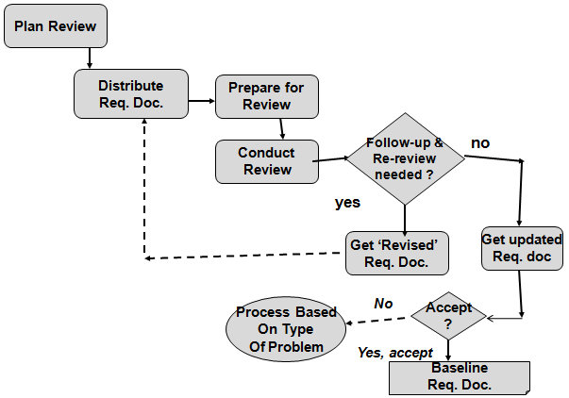
Requirements reviews process
..

Slide 13
Requirements reviews…
Plan the Review (with a moderator):
Selection of review team members
Selection of time and place
Gain agreement on problem definition and problem severity code
Determine the condition or criteria for “acceptance” or “rejection/re-review” of the document
Distribution of Requirements Document and any other information
Review Preparation
Review team members read the document for problems
Record down questions and suspected problem areas
Hold the Review “meeting
Discuss the discovered problems
Agree on the
1) severity of the problems and
2) action plan to resolve the problems

Slide 14
Requirements reviews…
Moderator (review chair) - follows up to ensure that the action plan items have been carried out
The revised Requirements Document - is either accepted or a re-review is conducted; a re-review just follow the above steps again.
Actions which might be decided for each problem are as follows
Requirements clarification - The requirement may be badly expressed or may have accidentally omitted information which has been collected during requirements elicitation.
Missing information - Some information is missing from the requirements document. It is the responsibility of the requirements engineers who are revising the document to discover this information from system stakeholders.
Requirements conflict - There is a significant conflict between requirements. The stakeholders involved must negotiate to resolve the conflict.

Slide 15
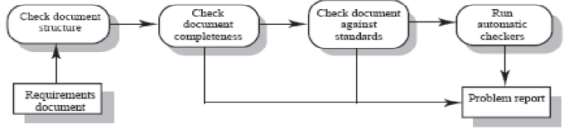
Requirements reviews…
Unrealistic requirement - The requirement does not appear to be implementable with the technology available or given other constraints on the system. Stakeholders must be consulted to decide how to make the requirement more realistic.
Pre-review checking
Reviews are expensive because they involve a number of people spending time reading and checking the requirements document
expense can be reduced by using pre-review checking
one person checks the document and looks for straightforward problems such as missing requirements, lack of conformance to standards, typographical errors, etc.

Slide 16
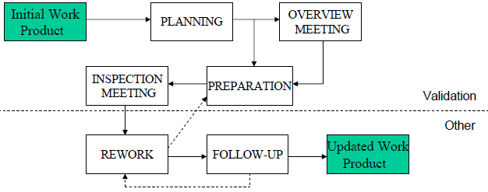
Requirements reviews: Inspection
Requirements inspection involves creating a team of inspectors that should represent different perspectives.
Therefore, a requirements inspection team should include requirements engineers (authors), design engineers (will do work based on requirements), and various other stakeholders (sources of requirements).
Inspection is a formal review because it proceeds in a sequence of well defined stages. E.g. Fagan's Inspection Process

Slide 17
Reading Techniques
In both formal and informal reviews, an important factor is the level of guidance the reviewers receive for accomplishing their task, or reading technique.
Reading techniques:
Ad-hoc
Checklist-based
Defect-based
Perspective-based
Scenario-based
Pattern-based
Ad-hoc reading – no guidance is provided, reviewers use only their own knowledge and experience to identify defects.
Perspective-based reading – each procedure is based on the viewpoint of a particular stakeholder.
Not only a list of review questions but also a collection of procedures to follow is provided, which describe the steps to be accomplished in order to answer the questions.

Slide 18
Reading Techniques: Checklist-based
Checklist-based reading – a list of questions is provided specifying what properties of the document must be checked and what specific problems should be searched for.
Essential tool for an effective review process – list common problem area and guide reviewers
Usually the only alternative that is discussed in requirements engineering books.
Every relevant requirements quality criterion is rewritten in the form of a question, or refined into two or more questions.
A checklist works just as a reminder for reviewers of those quality criteria.
Each organization should establish their own check list
A sample checklists are shown in the next 3 slides

Slide 19
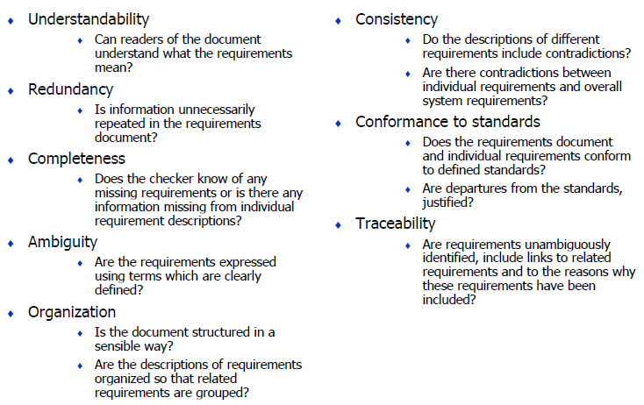
Reading Techniques: Checklist-based…

Slide 20
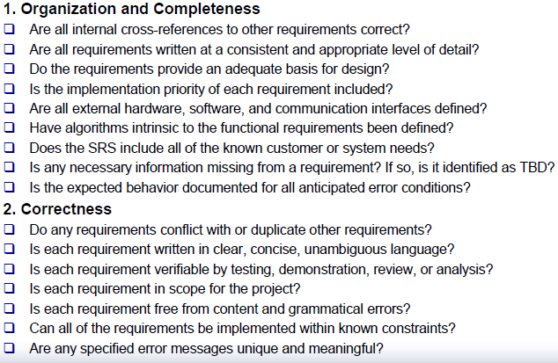
Reading Techniques: Checklist-based…
(Wiegers, 2003)

Slide 21
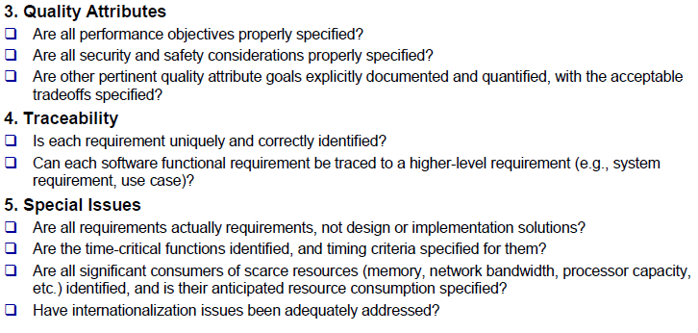
Reading Techniques: Checklist-based…
(Wiegers, 2003)

Slide 22
Reading Techniques: Defect-based reading
Each procedure is aiming for detecting a particular type of defects different procedures are usually assigned to different reviewers.
Examples of defects that could be detected includes data type consistencies, incorrect functionalities, ambiguities or missing functionality.
Defect-based reading is a technique which is less overlapping, more systematic and more distinct than ad-hoc & check list based reading techniques.
Some empirical evidence exists that this may outperform checklist-based and ad-hoc approaches.
“The defect detection rate of individuals and teams using defect based reading is superior to that obtained with ad-hoc or checklist methods.”

Slide 23
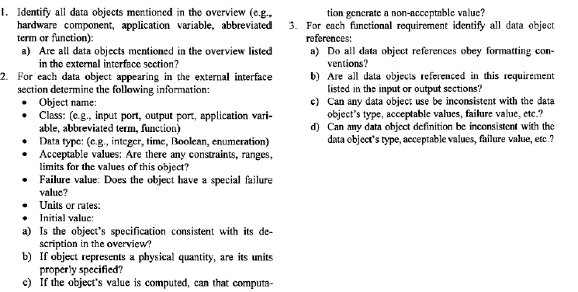
Reading Techniques: Defect-based reading…
Defect-based procedure example

Slide 24
Reading Techniques: Scenario-based reading
Scenario-based reading - a set of concrete scenarios are provided. Reviewers walk through the sequence of events in each scenario and examine the requirements document for presence, correctness, etc. of requirement statements that cover those.
scenarios may be usage scenarios, maintenance work scenarios, etc.
“Scenario-based validation” is often mentioned in books and other requirements literature as a separate validation technique.
McGregor and Sykes “guided inspection”: variant of scenario-based reading
Inspectors prepare scenarios, then
The authors of the reviewed document explain how the system described by the document is assumed to handle these cases
Inspectors follow explanations and look for problems:
Inappropriate system’s behavior,
Information has left in the head of the author and was not written down.

Slide 25

Reading Techniques: Pattern-based reading
a set of patterns is provided to reviewers that they can use when validating requirements against scenarios.
Examples of requirements patterns :
‘MACHINE-FUNCTION’ pattern – a good requirements document shall include at least one functional requirement statement for each action in which the software system is involved (essential facts about requirement documents).
Implementing the functional requirement will thus ensure that the system undertakes the action described in the scenario.
For example, consider a dealer who uses a financial foreign currencies trading system to record information about a currencies deal:

Slide 26

Reading Techniques: Pattern-based reading…
‘COLLECT-FIRST-OBJECTIVE-LAST’ pattern – a good mechanical device with which a person interacts using one or more personal items must ensure that the person will not go away leaving those personal items at the device.
E.g. Consider a passenger who uses a travel ticket to pass through automatic gates at the entrance to a London Underground station:
Each requirements pattern can be represented by a formal validation frame that describes what a part of a scenario should look like to make the pattern applicable, and what should then be searched for in the requirements document.

Slide 27
Translating requirements to alternative forms
In practice, requirements are usually documented in structured natural language.
All natural languages are inherently ambiguous.
The requirements are often written in English although many stakeholders are not fluent in it.
Presenting the requirements as a collection of separate statements is probably not the best understandable form for either customers or developers.
Three important observations:
There are also alternative forms for representing requirements and communicating them to stakeholders (although they usually allow only partial view of requirements).
A particular form may be understandable better than natural language description for a particular stakeholder.
When translating requirements from one form to another, this activity may succeed only if requirements are sufficiently complete, consistent, etc.

Slide 28
Translating requirements to alternative forms…
It is not considered feasible to maintain several concurrent representations of requirements because of modifiability problems.
However, for validating them, rewriting natural language into other forms is considered very useful.
Alternative forms for representing and communicating requirements:
User manual
Visualizations, e.g. diagrams
Lightweight formal models
Prototypes
Test cases

Slide 29
User manual
A good manual describes all user-visible functionality in easily understandable language.
It is still a natural language document, but with all ‘shall’ statements rewritten as if they were already implemented. It presents requirements in a more tangible and more coherent form than an SRS.
However, a user manual is obviously only a partial view of requirements since it presents only functionality (not performance or other characteristics) and only that functionality visible to end users of the software.
A quality SRS should provide enough information needed for drafting the user manual. If the writer finds this (partially) impossible, this points to some problems with the SRS that must be investigated.
After the draft is finished, it is to be reviewed by targeted stakeholders. Review can be informal or formal, be ad-hoc or use checklists, procedures or scenarios of type “suppose you want to do..”

Slide 30
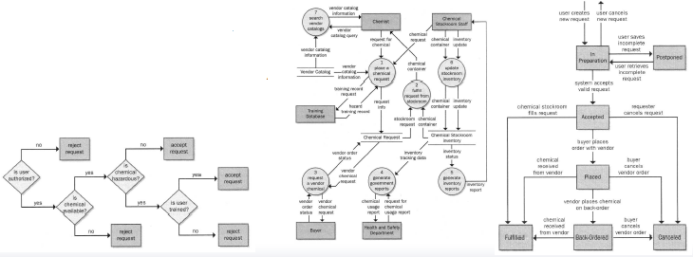
Visualizations
Visualization is often seen as a way to help people gain insight from large and complex data sets.
Graphical presentations link individual statements together and present a coherent picture of a slice of the system.
Decision trees, data flow
diagrams, state transition
diagrams, etc.

Slide 31
Lightweight formal models
Over years, scientific community had developed a set of so-called formal models, including, e.g. Vienna Development Method (VDM), Z, Software Cost Reduction (SCR) – expressing requirements in formal logic and mathematically.
They have not been widely accepted in RE practice.
More recently, it was proposed to use them in lightweight way. “Lightweight” indicates that the methods can be used for partial analysis on partial specifications, without a commitment to developing and baselining a complete, consistent formal specification.
I.e. some critical parts of a requirements specification are translated into a formal model for e.g. validation needs.
Sufficient empirical evidence exists that just the attempt to translate requirements into a formal model helps to reveal a lot of defects.
After translating, some properties of the partial formal specification can be automatically verified by software.

Slide 32
Prototyping
A prototype makes requirements tangible.
Users, managers, and other non-technical stakeholders usually find it very difficult to visualize how a written statement of requirements will translate into an executable software system.
If a prototype is developed to demonstrate requirements, they find it easier to discover problems and suggest how the requirements may be improved.
Prototyping based validation steps:
choose prototype testers
develop test scenarios
execute scenarios
document problems - using a problem reporting tool

Slide 33
Test cases
A desirable attribute of every requirement statement is that it should be verifiable, i.e. it should be possible to define one or more test cases that can check whether the requirement has been met.
Even though the tests will be applied to the system only after implementation, designing tests at an early stage is an effective way of revealing requirements defects.
A test case usually tests several related requirements, both functional and non-functional. Therefore, test cases may make the expected system behaviors clearer to all the stakeholders.
Test cases designed for validation of requirements may also be only theoretical, e.g. be too expensive to run in practice.

Slide 34
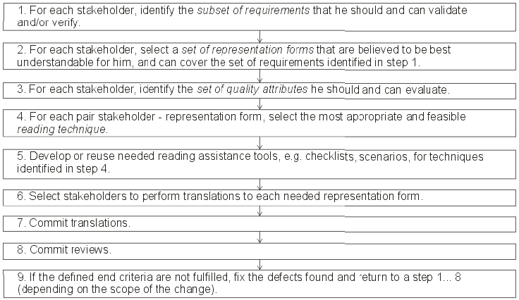
Validation procedure
…

