Slide 1
Requirement Engineering Tools
Chapter 7
By Esubalew A.

Slide 2
Contents
Automated process support: Introduction
Classifications of CASE Tools
Requirement Engineering Tools
RM Tools
Overview
Types
Capabilities & Benefits
Limitations
Selecting a Tool
Example RM tools
DOORS
RequisitePro
CaliberRM

Slide 3
Introduction : Automated process support (CASE)
Computer-aided software engineering (CASE) tool is software to support software development and evolution processes
CASE examples: Graphical editors for system model development, Data dictionary to manage design entities, GUI builder for user interface construction, Debuggers to support program fault finding, Automated translators to generate new versions of a program
CASE tools increase productive and quality of software products
Case technology has led to significant improvements in the software process though not the order of magnitude improvements that were once predicted.
Software engineering requires creative thought - this is not readily automatable
Software engineering is a team activity and, for large projects, much time is spent in team interactions. CASE technology does not really support these

Slide 4
CASE classification
Classification helps us understand the different types of CASE tools and their support for process activities
Functional perspective:
Tools are classified according to their specific function
Process perspective
Tools are classified according to process activities that are supported
Integration perspective
Tools are classified according to their organisation into integrated units
CASE Tools can also be classified into two
Upper-CASE: Tools to support the early process activities of requirements and design
Lower-CASE: Tools to support later activities such as programming, debugging and testing
However, nowadays CASE tools are integrated tools which offer extensive life cycle coverage

Slide 5
Functional tool classification

Slide 6
Process Activity-based classification

Slide 7
CASE integration
Tools - Support individual process tasks such as design consistency checking, text editing, etc.
Workbenches - Support a process phase such as specification or design
Environments - Support all or a substantial part of an entire software process. Normally include several integrated workbenches

Slide 8
Requirement Engineering Tools
Even though requirement engineering is variable and human intensive, requirement engineering process is supported by various tools
Essentially there are two types of tools which are available to support the requirements engineering process.
Modeling and validation tools
support the development of system models which can be used to specify the system and checking of these models for completeness and consistency.
The tools can check if the names are duplicate, if there are unlinked entities in a model, if the same entity at different levels always linked to the same thing, …
Management tools help manage a database of requirements and support the management of changes to these requirements.
Reasons for using management tools are
large amount of data which is collected during the RE process
volatility of the requirements

Slide 9
RM Tools: Overview
Functional and non-functional requirements can be specified using natural languages on documents.
However, a document-based approach to storing requirements has numerous limitations:
It's difficult to keep the documents current and synchronized.
Communicating changes to all affected team members is a manual process.
It's not easy to store supplementary information (attributes) about each requirement.
It's hard to define links between functional requirements and other system elements.
Tracking requirements status is cumbersome.
It's difficult for multiple project participants to modify the requirements, particularly if the participants are geographically separated.

Slide 10
RM Tools: Overview…
Concurrently managing sets of requirements that are planned for different releases or for related products is difficult. When a requirement is deferred from one release to another, an analyst needs to move it from one requirements specification to the other.
Reusing a requirement means that the analyst must copy the text from the original SRS into the SRS for each other system or product where the requirement is to be used.
There's no convenient place to store proposed requirements that were rejected and requirements that were deleted from a baseline
A requirements management tool that stores information in a multiuser database provides a robust solution to these restrictions.
Small projects can use spreadsheets or simple databases to manage their requirements
Larger projects need commercial requirements management tools

Slide 11
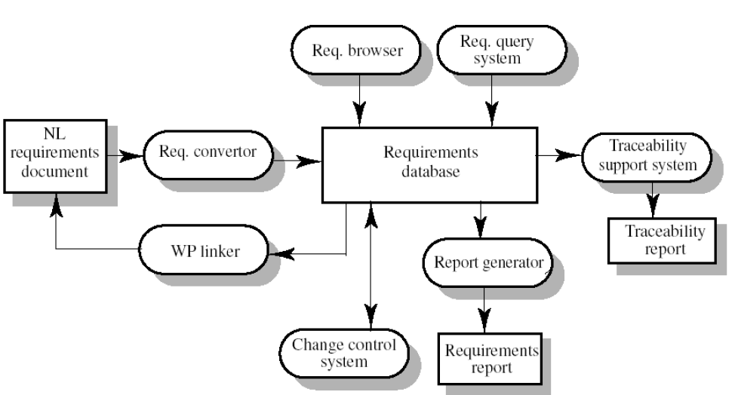
RM System
..

Slide 12
Components of RM System
Requirement browser - Readers of the requirements can browse the database
Requirement Query - Users can retrieve specific requirements or requirements which are related in some way
Traceability support - Can be used to generate tracibility information
Report generator - Generate various different types of reports about the requirements
Requirements converter and word processors - Convert requirements in a word processor document into the requirements database format and which can maintain links b/n the database and the natural language representation of the requirements
Change control systems - Can maintain information about requested requirements changes and links to the requirements affected by the changes

Slide 13
Types of RM Tools
One distinction between the tools is whether they are database-centric or document-centric.
Database-centric. Store all requirements, attributes and traceability information in a database. Requirements can be imported from various source documents, but then they reside in the database.
IBM Rational DOORS, Borland CaliberRM, Active! Focus, C.A.R.E., Slate, RTM Workshop
Document-centric. Treat a document created using a word processing program as the primary container for the requirements, while attributes and traceability information are stored in an additional database.
Rational RequisitePro, Vital Link, RMTrak

Slide 14
RM Tools: capabilities & Benefits
Store requirements in a database (statement +attributes)
Automatically control versions
Allow to add traceability information
Make some use of traceability information
at least marking suspected links
maybe also reporting on requirements that were not traced to anything else
Generate (or update) textual documents from the database
Provide some possibilities for importing requirements from text
Generate some other reports, e.g. about statuses of requirements
Put database online so different team members can access it easily, with no need of creating copies of data.
Provide means for discussion about requirements
Automatically send notifications
Enforce access control, e.g. changes are only by designated people

Slide 15
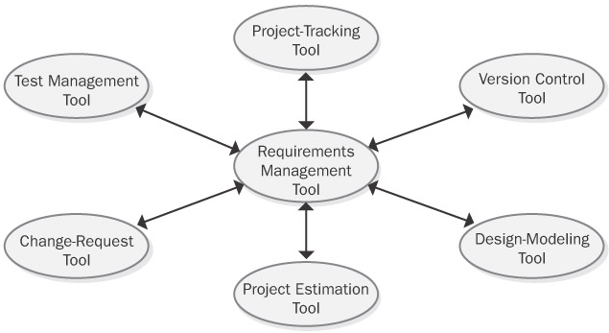
RM Tools: capabilities & Benefits…
let you incorporate non-textual objects such as graphics and spreadsheets into the requirements repository
include learning aids, such as tutorials or sample projects, to help users get up to speed.
Can integrate with other tools used in application development
Manage changes
Facilitate impact analysis
Track requirements status
Communicate with stakeholders
Reuse requirements

Slide 16
RM Tools: Limitations
Additional psychological advantage:
Both customers and developers may stop to consider requirements as “paper work”, and start to see them as the project asset.
Limitations:
Those tools are for requirements management, not for requirements development. They cannot help with elicitation, validations, or negotiating requirements.
Actually, it is not even recommended to capture requirements directly into the tool. Better only after they were baselined.
Do not expect tools to compensate for a lack of discipline, process or expertise.
Expensive (several thousands of USD).

Slide 17
Selecting a Tool
Tool selection is based on the combination of platform, pricing, access modes, and requirements paradigm—document-centric or database-centric—that best fits your development environment and culture.
Some companies contract tool evaluations to consultants,
who can assess a company's needs comprehensively and make recommendations from the available tool candidates.
If you do the evaluation yourself, the following procedure can help you select the right tool:
Define your organization's requirements for a requirements management tool
List 10 to 15 factors that will influence your selection decision.
Distribute 100 points among the selection factors that you listed in step 2, giving more points to the more important factors.

Slide 18
Selecting a Tool…
Obtain current information about the available requirements management tools, and rate the candidates against each of your selection factors.
Calculate the score for each candidate based on the weight you gave each factor to see which products appear to best fit your needs.
Solicit experience reports from other users of each candidate product, perhaps by posting queries in online discussion forums, to supplement your own evaluation and the vendor's literature, demo, and sales pitch.
Obtain evaluation copies from the vendors of your top-rated tools.
Evaluate the tools by using a real project, not just the tutorial project that comes with the product.
To make a decision, combine the ratings, licensing costs, and ongoing costs with information on vendor support, input from current users, and your team's subjective impressions of the products.

Slide 19
Example RM tool: DOORS
DOORS is a sophisticated product that can manage requirements on large products.
It treats individual requirements as objects, but presents them in a visual format that resembles a structured, hierarchical requirements document.
A printed report of requirements selected from the database looks like a table-structured SRS.
The requirements display also shows attribute values, indicators of links to other requirements, and colored bars that indicate a requirement’s change status.
DOORS stores the change history of individual objects, modules, and specific edit session, but objects are not given revision numbers.
DOORS includes a C-like scripting language for customizing or developing extensions to the basic product.

Slide 20
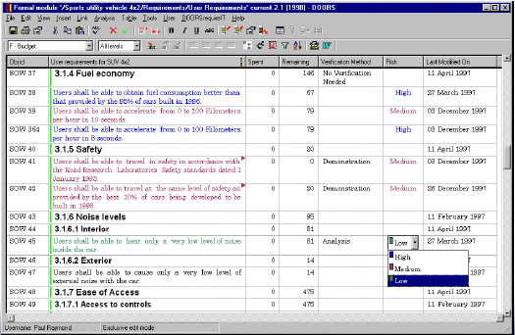
Example RM tool: DOORS…
It also includes direct interfaces to Microsoft Project, Teamwork, and Rational Rose, and you can create interfaces to many other tools through an open API.
The link to Word consists primarily of an import capability.
DOORS supports many import and export file formats.
An integrated change proposal system lets users review and comment on a project or a requirements module.
The heterogeneous client/server implementation will be attractive if your organization has a mixed Unix and Windows environment

Slide 21
Example RM tool: IBM Rational RequisitePro
RequisitePro takes a document-centric approach to requirements management, exhibiting the tightest integration with Word of the four tools.
In the Word workplace, you can mark selected blocks of text to include in the database as discrete requirements.
You can bring up a dialog box to access the requirement details, including its revision history, attributes, traceability, hierarchy, and discussions.
The mechanisms it uses for synchronizing the requirements in the database with the contents of the SRS are a bit clumsy.
RequisitePro handles the version history of each requirement nicely.
In the Views workplace, you can see the list of requirements in the database and view or modify requirement attributes.

Slide 22
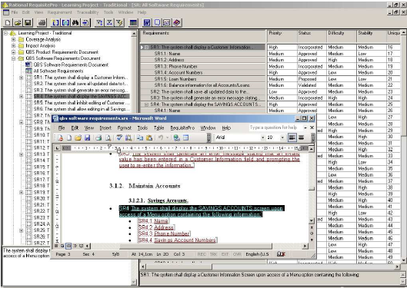
Example RM tool: IBM Rational RequisitePro
It also displays a traceability matrix in which you can easily set and change links.
You can archive RequisitePro projects in several configuration management tools or within RequisitePro, thereby managing multiple versions of the project.

Slide 23
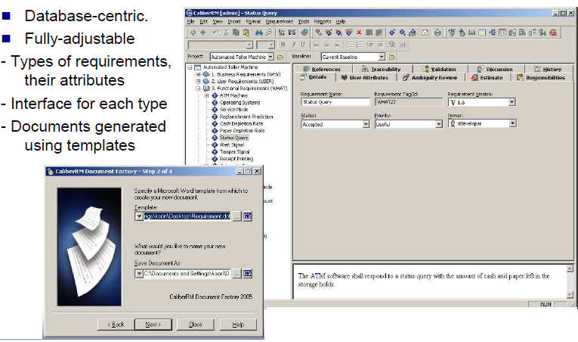
Example RM tool: CaliberRM
…

Slide 24
Example RM tool: DESIRe®
is an "expert system" tool for checking requirements. It is a free add-on to DOORS or Word.
supports authors writing or checking requirements in the quality assurance of requirements written in the natural language.
depending on the words used (e.g. ambiguous words and verbs etc.), displays predefined questions in a popup window. These are questions regarding possible weaknesses in the requirement. By mentally answering these questions, the idea is for the requirements author to then rework the wording of the requirement as necessary.
Good to ensure completeness, consistency, understandability etc., are followed and the quality of the requirement is improved.
To ensure that the expected benefits are more quickly realised, it is important that DESIRe is modified to reflect company- or project-specific questions and information

Slide 25
Browse for requirement tools
http://easyweb.easynet.co.uk/~iany/other/vendors.htm

