Slide 1
Requirement Management…
Chapter 6
By Esubalew A.

Slide 2
Contents
Requirements management activities
Change control (revision)
Version control
Requirements status tracking
Possible requirement statuses
Status tracking graph
Requirement tracing
Reasons for requirements tracing
Types of traceability information & traceability
Traceability tables & Traceability lists
Traceability policies
Requirement Management planning
Basic metrics for requirements management

Slide 3
Version control
A: I finally finished implementing the multivendor catalog query feature
B: Oh, the customers canceled that feature two weeks ago…
A: What do you mean? This feature is on the page 6 of my latest SRS.
B: It is not in my copy. I have version 1.5. What version do you have?
A: My says ‘version 1.5’ also. These documents should be identical, but obviously they are not. So, is this feature still in the baseline or did I just waste 40 hours of my life?
The conversation depicts that people waste time working from obsolete or inconsistent requirements.
Each revision of the requirements document must be uniquely identified.
The version number must change whenever a change is made, even a minor one.

Slide 4
Version control…
Maintain revision history in every document.
Only designated people should be allowed to make changes in the requirements documents.
Means must be provided for that everyone can check which version is the latest one.
Version control mechanisms
Manual: manually label each revision according to a standard convention
Version 1.0 draft 1 → Version 1.0 draft 2 →…Version 1.1
If you're storing requirements in a word-processing document, you can track changes by using the word processor's revision marks feature.
Version control tool : more sophisticated technique and many commercial configuration management tools are available for this purpose.
Commercial requirements management tool - the most robust approach which involves storing requirements in a database.

Slide 5
Requirements status tracking
“The first half of a software project consumes the first 90% of the resources and the second half consumes the other 90% of the resources.”
For controlling better how the project proceeds, the implementation status of each requirement should be monitored.
This provides a more accurate gauge of project progress
How are you coming on that subsystem, Jackie?
Pretty good, Dave. I’m about 90 percent done.
Hmm.. Weren’t you 90 percent done a couple of weeks ago?
I thought I was, but now I’m really 90 percent done.

Slide 6
Possible requirement statuses
At every moment, each requirement is one of the following:
Proposed – the requirement has been proposed by an authorized source
Approved – the requirement has been included into the approved baseline of a requirements document.
Implemented – the code that implements the requirement has been designed and written.
Verified – the correct functioning of the implemented requirement has been confirmed in the integrated product.
Deleted – an approved requirement has been removed from the baseline, for a reason.
Rejected – a proposed requirement was not approved for a reason.

Slide 7
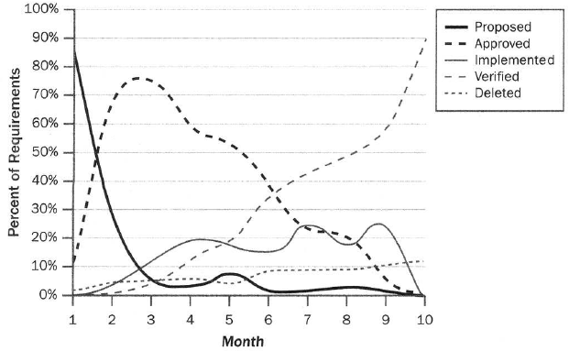
Status tracking graph
….

Slide 8
Requirements tracing
Traceability information is information which helps you assess the impact of requirements change.
It links related requirements and other system representations
Requirements are the first layer in the software development work products hierarchy – so, a change in requirements affects everything: design, code, tests.
There are also several levels of requirements: features, use cases, functional requirements – a change in an upper level affects the lower levels.
Therefore, links among requirements, as well as links between requirements and other work products must be maintained – requirements tracing.

Slide 9
Other reasons for requirements tracing
Change impact analysis – to identify all system elements affected by a change request.
Testing – when a test fails, helps to identify the likely part of the system that has a defect.
Risk reduction – to reduce the risk if a key team member with essential knowledge about the system leaves the project.
Certification – to certify that all the requirements were implemented.
Project tracking – to track the implementation status.
Maintenance – to make changes correctly and completely during maintenance.
Reuse – to facilitate reuse of the product components

Slide 10
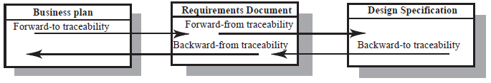
Types of traceability information
Forward-to traceability
Links other documents (which may have preceded the requirements document) to relevant requirements.
Forward-from traceability
Links requirements to the design and implementation components
Backward-from traceability
Links requirements to their sources in other documents or people
Backward-to traceability
Links design and implementation components backs to requirements

Slide 11
Types of traceability
Requirements-sources traceability
Links the requirement and the people or documents which specified the requirement
Requirements-rationale traceability
Links the requirement with a description of why that requirement has been specified.
Requirements-requirements traceability
Links requirements with other requirements which are, in some way, dependent on them. This should be a two-way link (dependants and is-dependent on).

Slide 12
Types of traceability…
Requirements-architecture traceability
Links requirements with the sub-systems where these requirements are implemented. This is particularly important where sub-systems are being developed by different sub-contractors
Requirements-design traceability
Links requirements with specific hardware or software components in the system which are used to implement the requirement
Requirements-interface traceability
Links requirements with the interfaces of external systems which are used in the provision of the requirements

Slide 13
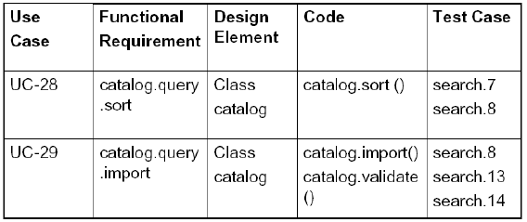
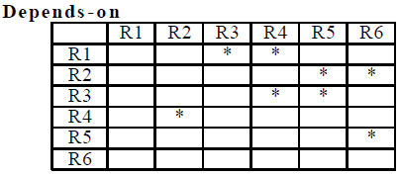
Traceability tables
Show the relationships between requirements or between requirements and design components
Requirements are listed along the horizontal and vertical axes and relationships between requirements are marked in the table cells
Traceability tables for showing requirements dependencies should be defined with requirement numbers used to label the rows and columns of the table

Slide 14
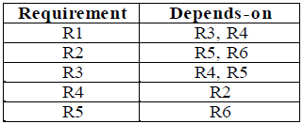
Traceability lists
If relatively small number of requirements have to be managed (up to 250, say), traceability tables can be implemented using a spreadsheet
Traceability tables become more of a problem when there are hundreds or thousands of requirements as the tables become large and sparsely populated
A simplified form of traceability table may be used where, along with each requirement description, one or more lists of the identifiers of related requirements are maintained.
Traceability lists are simple lists of relationships which can be implemented as text or as simple tables

Slide 15
Traceability policies
Traceability policies define what and how traceability information should be maintained
Traceability policies may include
The traceability information which should be maintained
Techniques, such as traceability matrices, which should be used for maintaining traceability
A description of when the traceability information should be collected during the requirements engineering and system development processes.
The roles of the people, such as the traceability manager, who are responsible for maintaining the traceability information should also be defined.
The process of managing traceability information

Slide 16
Factors influencing traceability policies
Number of requirements - The greater the number of requirements, the more the need for formal traceability policies
Estimated system lifetime - More comprehensive traceability policies should be defined for systems which have a long lifetime
Project team size and composition - With a small team, it may be possible to assess the impact of proposed informally without structured traceability information. With larger teams, however, you need more formal traceability policies.
Type of system - Critical systems such as hard real-time control systems or safety critical systems need more comprehensive traceability policies than non-critical systems.
Specific customer requirements - Some customers may specify that specific traceability information should be delivered as part of the system documentation.

Slide 17
Requirements management planning
During the requirements engineering process, you have to plan:
Requirements identification
Each requirement must be uniquely identified so that it can be cross-referenced by other requirements and so that it may be used in traceability assessment
A change management process
The process followed when analyzing a requirements change
Traceability policies
The amount of information about requirements relationships that is maintained
CASE tool support
The tool support required to help manage requirements change

Slide 18
Measuring the requirements process
Changes to the requirements of a system should be expected and encouraged early in the lifecycle as the stakeholders and development team reach a common understanding of what the system should do.
However, excessive changes to the requirements, especially later in the lifecycle, can lead to project failure.
The failure may be
spectacular; millions of dollars are spent on a project that is ultimately cancelled.
schedule slippage, reduced functionality, customer dissatisfaction, or lost business opportunities.

Slide 19
Measuring the requirements process…
Excessive requirements-related change will require corrective action and may be an indicator of a broken requirements process.
Some examples of measures related to the requirement are
Frequency of change in the total requirements set
Rate of introduction of new requirements
Number of requirements changes to a requirements baseline
Percentage of defects with requirement errors as the root cause
Number of requirements-related change requests (as opposed to defects found in testing or inspections)

Slide 20
Measures for the project manager
There are several metrics the project manager may use to get an objective measure of the state of a project and take corrective action.
Alternatively, the metrics may indicate the project is ahead of plan and may be able to deliver more business value than originally anticipated.
While the metrics in the next slides are readily extracted if the members of the project team (analysts, developers, testers, project manager, etc.) are updating information about the requirements using a requirements management tool, the metrics need to be interpreted within the context of the project and where it is in its lifecycle.

Slide 21
Measures for the project manager …
Number of requirements by owner/responsible person
These metrics indicate the workload of various people on the project.
The information can be used by the project manager to determine whether the project could benefit by shifting some of the workload.
It can also be used to determine whether the right people are assigned to specifying or implementing the most important requirements.
Number of requirements by status/total number of requirements
Having a clear understanding of exactly what the state of each requirement is and where it is in the development process enables the project manager to
effectively manage the project
avoid requirements and scope creep, and
take corrective actions to deliver the project on time and within budget while assuring that all the critical business needs are satisfied

Slide 22
Measures for the project manager …
Functional requirements allocated to a project release or iteration
Understanding exactly how many requirements, and which specific ones, are allocated to a release or iteration allows the project manager to successfully deliver the project on time with the most critical functionality.
Making this information available to the team keeps everyone focused.
It can also shorten development cycles by allowing the quality assurance (QA) team to get an early start with test planning, test development, and establishing the appropriate test environment, while the code is being developed.

Slide 23
Measures for the project manager …
Requirements growth over time
Early in the lifecycle, this metric can help the project manager determine whether adequate progress is being made gathering and specifying the requirements.
As the project progresses, unusual growth can be an indicator of scope creep. It may also be an indicator that there are opportunities to improve the way in which requirements are elicited and documented.
Number of requirements completed
This is an objective indicator of the number of requirements implemented, tested, and validated to date.
Trends of requirements completed over time can also help measure how quickly the project is moving toward completion (e.g., the velocity) and whether the project team can include more functionality or is potentially overcommitted.

Slide 24
Measures for the project manager …
Number of requirements traced or not traced
Many projects adopt various levels of formal requirements traceability to help ensure the completeness of the system and understand the impact on other requirements, designs, code, and tests should the requirements change.
Understanding this impact can help the project better understand the cost of proposed changes and control the scope of the project so it can be successful within its cost and schedule constraints.
If traceability is being adopted on a project, understanding which requirements are or are not traced can be useful indicators of progress and completeness.
For example, at certain points in the lifecycle, the number of critical business requirements not yet traced to designs and code could indicate a need for corrective action.

Slide 25
Measuring the benefits of requirements management
Several independent studies confirm that requirement errors are the most frequent project errors.
These errors precipitate defects in architecture, design, and implementation.
If the resulting software errors are not detected during testing, they most certainly will be detected post-launch, and there business impact could be severe.
In either case, they lead to costly changes for the project and can result in scrapping or reworking significant parts of the application.
Good requirements management, as part of an overall requirements process, can reduce the number of defects, reduce project costs pre- and post-launch, and improve the overall quality of the product.

Slide 26
Measuring the benefits of requirements management…
The following metrics can be indicators of the benefits from requirements management.
The first two metrics, when combined with other measures, can be used to calculate a monetary return.
Trend of post-launch defects over time
Trend of number of change requests for rework – both pre-launch and post-launch
Customer satisfaction surveys

Slide 27
Measuring Requirements Management Effort
By tracking how much effort you spend on requirements management, you can evaluate whether that was too little, about right, or too much and adjust your processes and future planning accordingly.
Tracking effort indicates
how team members spend their time
whether the team is indeed performing the intended actions to manage its requirements.
Count the effort devoted to the following activities as requirements management effort:
Submitting requirements changes and proposing new requirements
Evaluating proposed changes, including performing impact analysis
Change control board activities

Slide 28
Measuring Requirements Management Effort…
Updating the requirements documents or database
Communicating requirements changes to affected groups and individuals
Tracking and reporting requirements status
Collecting requirements traceability information
Requirements management helps to ensure that the effort you invest in gathering, analyzing, and documenting requirements isn't squandered.
For example,
failing to keep the requirements set current as changes are made makes it hard for stakeholders to know exactly what they can expect to have delivered in each release

