Slide 1
E-commerce
Week 4 & 5
Aemro B.

Slide 2
Building an E-commerce Site: A Systematic Approach
Two most important management challenges in building a successful e-commerce site are:
Developing a clear understanding of business objectives
Knowing how to choose the right technology to achieve those objectives

Slide 3
Pieces of the Site-Building Puzzle
Main areas where you will need to make decisions in building a site include:
Human resources and organizational capabilities – creating a team that has the skill set to build and manage a successful site
Hardware
Software
Telecommunications
Site design

Slide 4
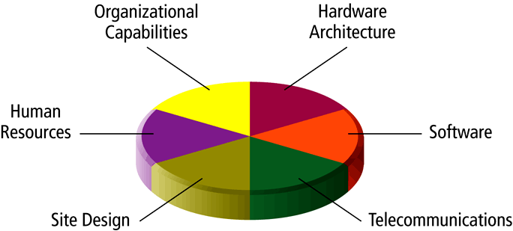
Pieces of the E-commerce Site-Building Puzzle

Slide 5
The Systems Development Life Cycle
Systems Development Life Cycle (SDLC) is a methodology for understanding the business objectives of a system and designing an appropriate solution
Five major steps in the SDLC are:
Systems analysis/planning
Systems design
Building the system
Testing
Implementation

Slide 6
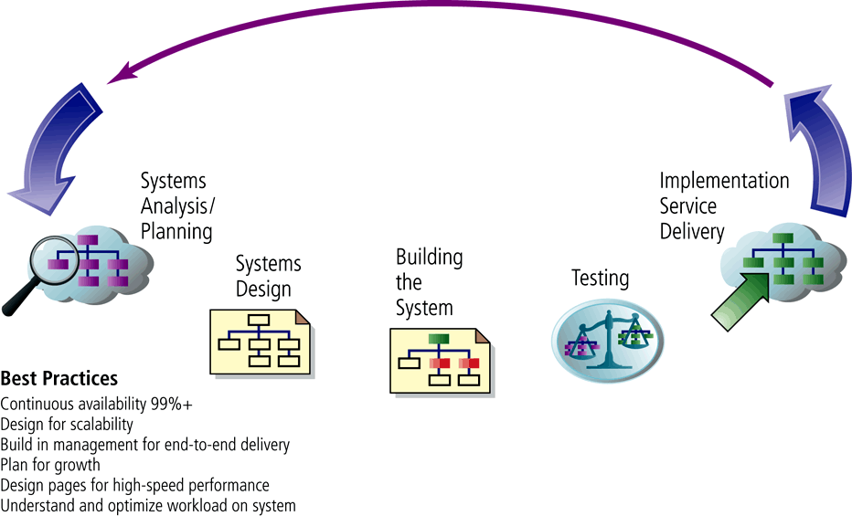
Web Site Systems Development Life Cycle

Slide 7
System Analysis/Planning: Identifying Business Objectives, System Functionality, and Information Requirements
Business objectives: a list of capabilities you want your site to have
System functionalities: a list of the types of information system capabilities you will need to achieve your business objectives
Information requirements: the information elements that the system must produce in order to achieve the business objectives

Slide 8
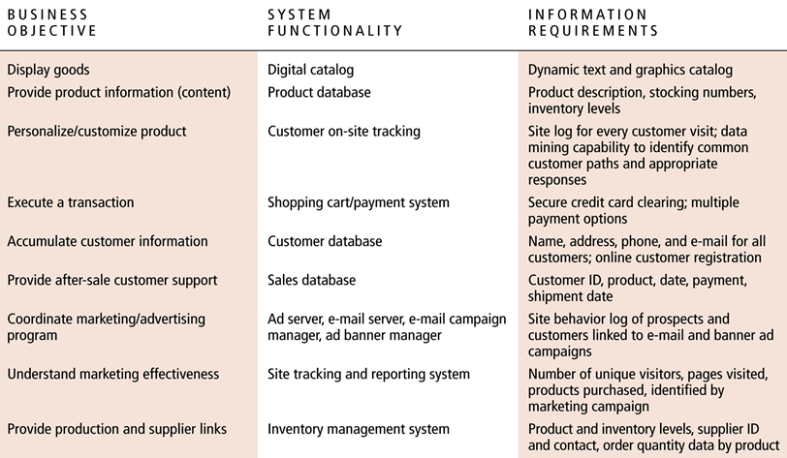
Systems Analysis: Business Objectives, System Functionality, and Information Requirements for a Typical E-commerce Site

Slide 9
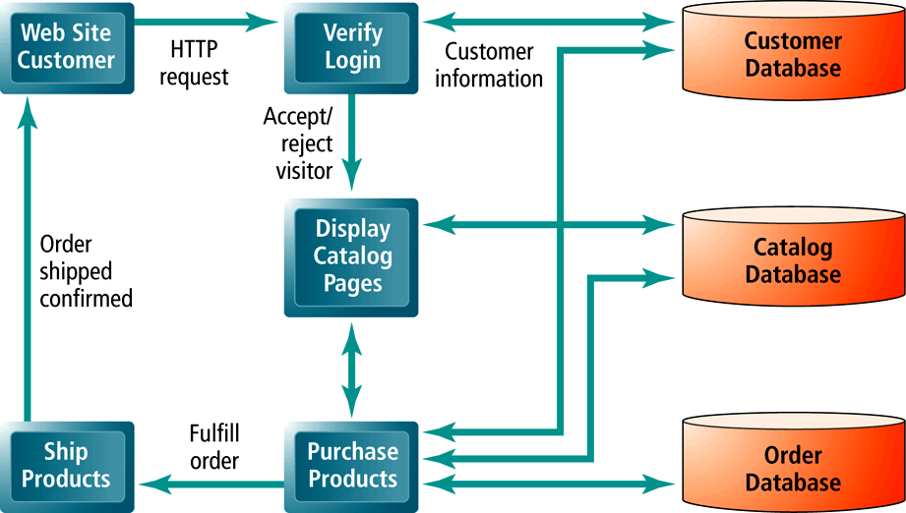
A Logical Design for a Simple Web Site

Slide 10
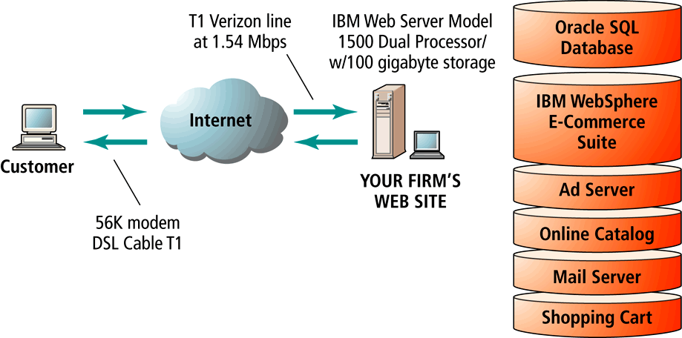
A Physical Design for a Simple Web Site

Slide 11
Building the System: In-House versus Outsourcing
Outsourcing: hiring an outside vendor to provide services involved in building the site
In-House: build your own application by your own employee :
Build your own required team with diverse skill set; choice of software tools; both risks and possible benefits
Host your own versus outsourcing
Hosting: hosting company is responsible for ensuring site is accessible 24/7, for monthly fee
Co-location: firm purchases or leases a Web server (with control over its operation), but server is located in at vendor’s physical facility

Slide 12
Testing, Implementation and Maintenance
Testing:
Includes unit testing, system testing and acceptance testing
Implementation and maintenance:
Maintenance is ongoing, with 20% of time devoted to debugging code and responding to emergency situations, 20% with changing reports, data files and links to backend databases; and 60% to general administration and making changes and enhancements to system
Benchmarking: process by which site is compared to those of competitors in terms of response speed, quality of layout and design

Slide 13
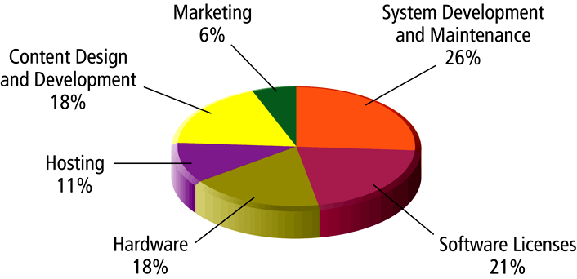
Components of a Web Site Budget

Slide 14
Simple versus Multi-tiered Web Site Architecture
System architecture: refers to the arrangement of software, machinery, and tasks in an information system needed to achieve a specific functionality
Two-tier architecture: Web server responds to requests for Web pages and a database server provides backend data storage
Multi-tier architecture: Web server is linked to a middle-tier layer that typically includes a series of application servers that perform specific tasks, as well as to a backend layer of existing corporate systems.

Slide 15
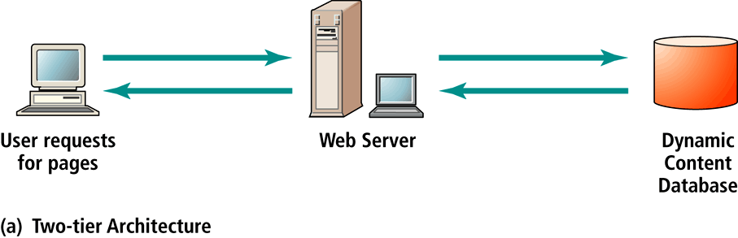
Two-Tier E-commerce Architecture

Slide 16
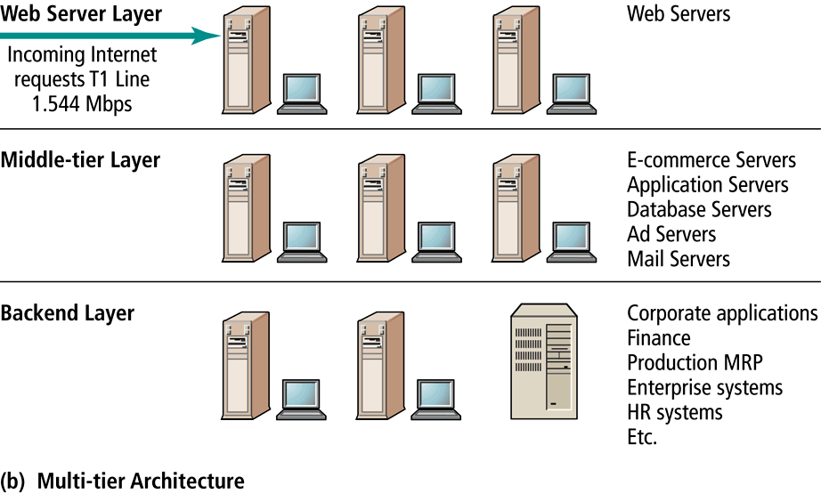
Multi-tier E-commerce Architecture

Slide 17
Web Server Software
All e-commerce sites require basic Web server software to answer HTTP requests from customers
Apache the leading Web server software; works only with UNIX operating systems
Microsoft’s Internet Information Server (IIS) the second major Web server software

Slide 18
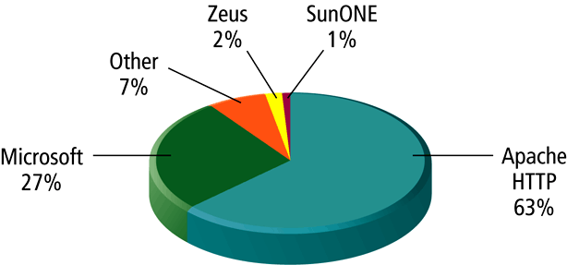
Key Players in Web Server Software

Slide 19
Dynamic Page Generation Tools
Dynamic page generation: contents of Web page are stored as objects in a database rather than being hard-coded in HTML, and are fetched when needed from database
Tools include CGI (Common Gateway Interface), ASP (Active Server Pages), JSP (Java Server Pages), PHP,etc.

Slide 20
Application Servers
Web application servers: software programs that provide specific business functionality required of a Web site
Are an example of middleware software
A number of different types available, providing a variety of functionality

Slide 21
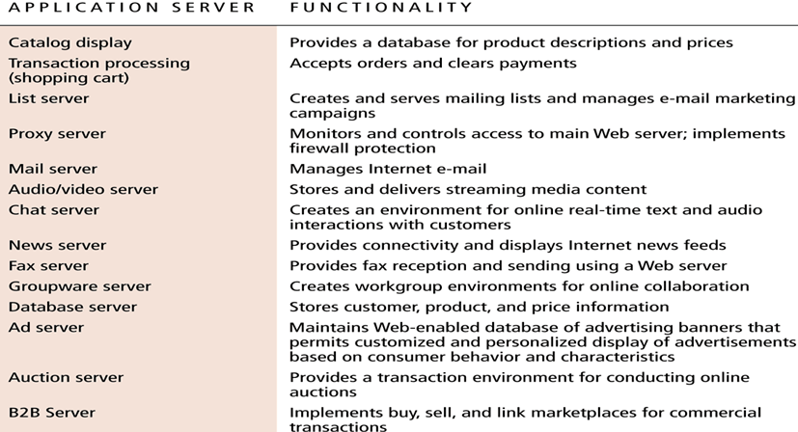
Application Servers and Their Functions

Slide 22
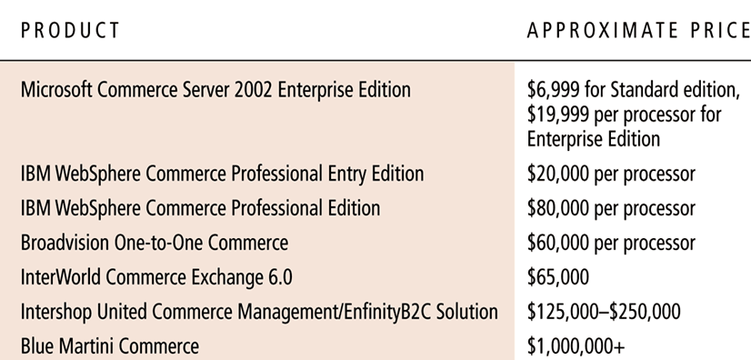
Widely Used Midrange and High-end E-commerce Suites

Slide 23
Choosing the Hardware for an E-commerce Site
Hardware platform: refers to all the underlying computing equipment that the system users to achieve e-commerce functionality
Objective to have enough platform capacity to meet peak demand but not so much that you are wasting money
Important to understand the different factors that affect speed, capacity and scalability of a site

Slide 24
Right-Sizing Your Hardware Platform: The Demand Side
The most important factor affecting the speed of a site is the demand that customers put on the site.
Factors involved in demand include:
Number of simultaneous users in peak periods
Nature of customer requests (user profile)
Type of content (dynamic versus static Web pages)
Required security
Number of unique items in inventory
Number of page requests
Speed of legacy applications

Slide 25
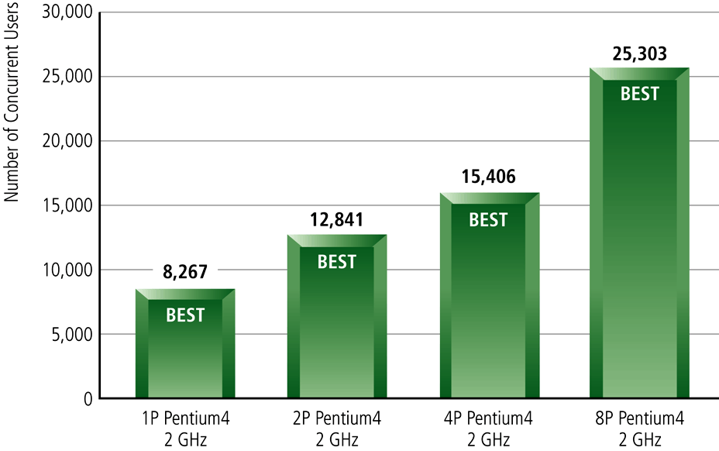
Capacity of Static Page Web Servers

Slide 26
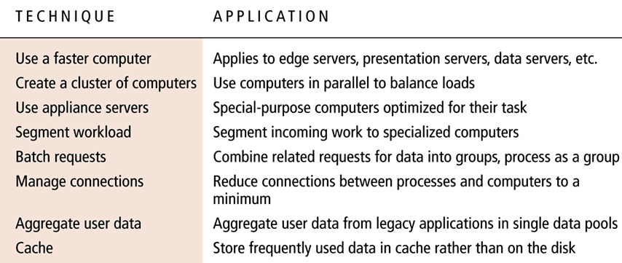
Eight Vertical and Horizontal Scaling Techniques

Slide 27
Right-Sizing Your Hardware Platform: The Supply Side
Scalability: refers to the ability of a site to increase in size as demand warrants
Ways to scale hardware:
Vertically: increase the processing power of individual components
Horizontally: employ multiple computers to share the workload
Improve processing architecture

Slide 28
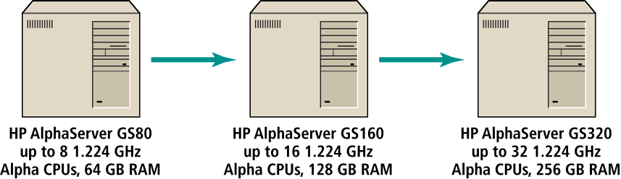
Vertically Scaling a System

Slide 29
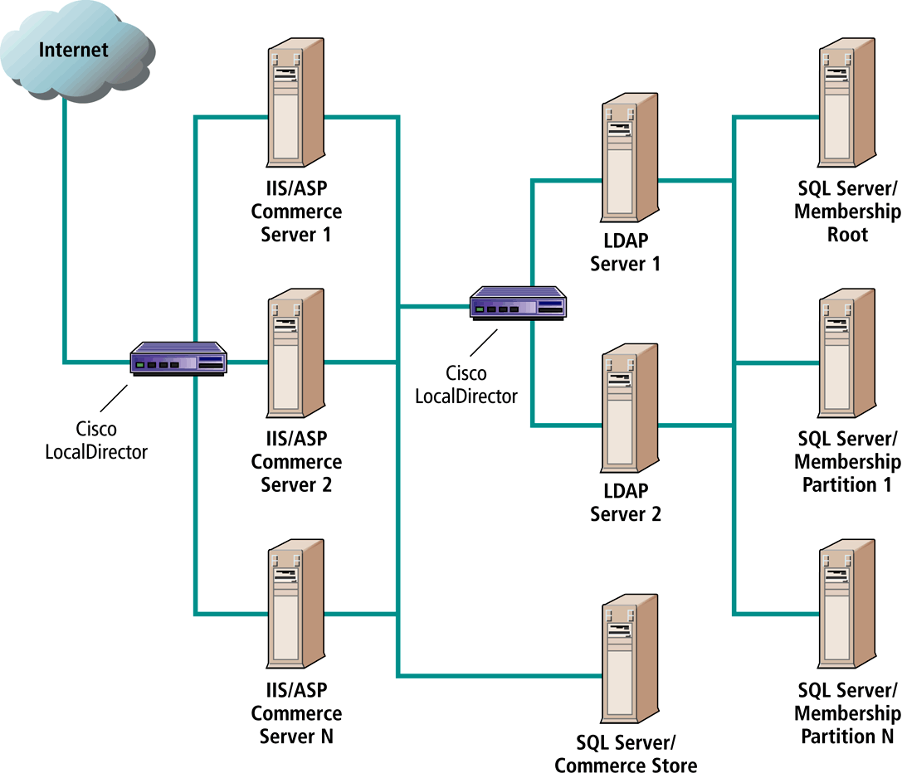
Horizontally Scaling a System

Slide 30
Web Site Design: Basic Business Considerations
To achieve basic business functionality of a Web site, need to be aware of design guidelines and software tools that can build active content and functionality
Poorly designed Web sites drive customers away

Slide 31
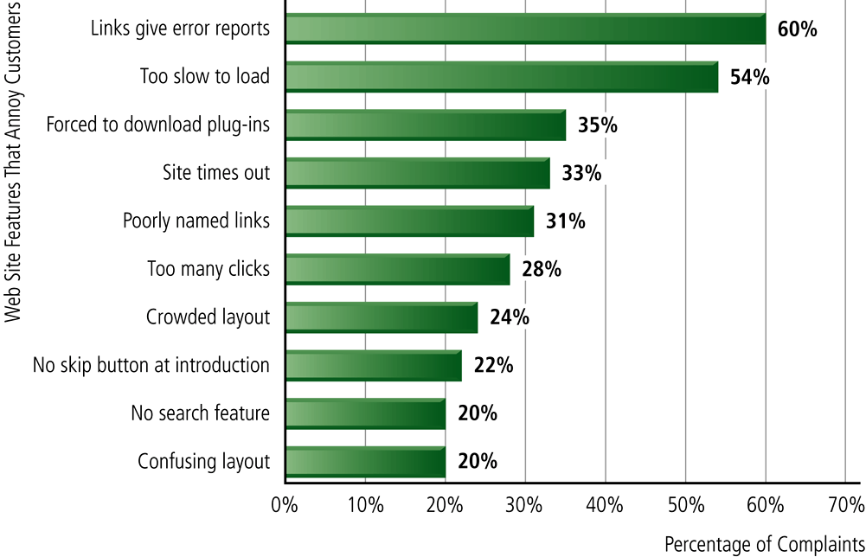
Web Site Features that Annoy Customers

Slide 32
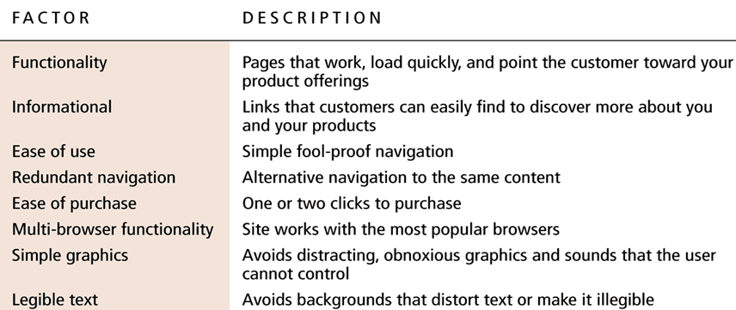
The Eight Most Important Factors in Successful E-commerce Site Design

Slide 33
Tools for Interactivity and Active Content
CGI (Common Gateway Interface): Set of standards for communication between a browser and a program running on a server that allows for interaction between the user and the server
ASP (Active Server Pages): Enables programmers using Microsoft’s IIS package to build dynamic pages
Java: Allows programmers to create interactivity and active content on the client computer
JSP (Java Server Pages) and PHP: Similar to CGI and ASP; allows developers to use a combination of HTML, JSP or PHP scripts to dynamically generate Web pages in response to user requests
JavaScript: Programming language invented by Netscape that is used to control objects on a Web page and handle interactions with browser

Slide 34
Tools for Interactivity and Active Content (cont’d)
ActiveX: Programming language invented by Microsoft to compete with Java
VBScript: Programming language invented by Microsoft to compete with JavaScript
ColdFusion: An integrated server-side environment for developing interactive Web applications

Slide 35
Personalization Tools
Personalization: Ability to treat people based on their personal qualities and prior history with your site
Customization: Ability to change the product to better fit the needs of the customer
Cookies: the primary method for achieving personalization and customization

