Slide 1
E-commerce
Week 3
Aemro B.

Slide 2
E-Commerce Business Models
Business model
  a set of planned activities designed to result in a profit in a marketplace
Business plan
  a document that describes a firm’s business model
E-commerce business model
  a business model that aims to use and leverage the unique qualities of the Internet and the World Wide Web.

Slide 3
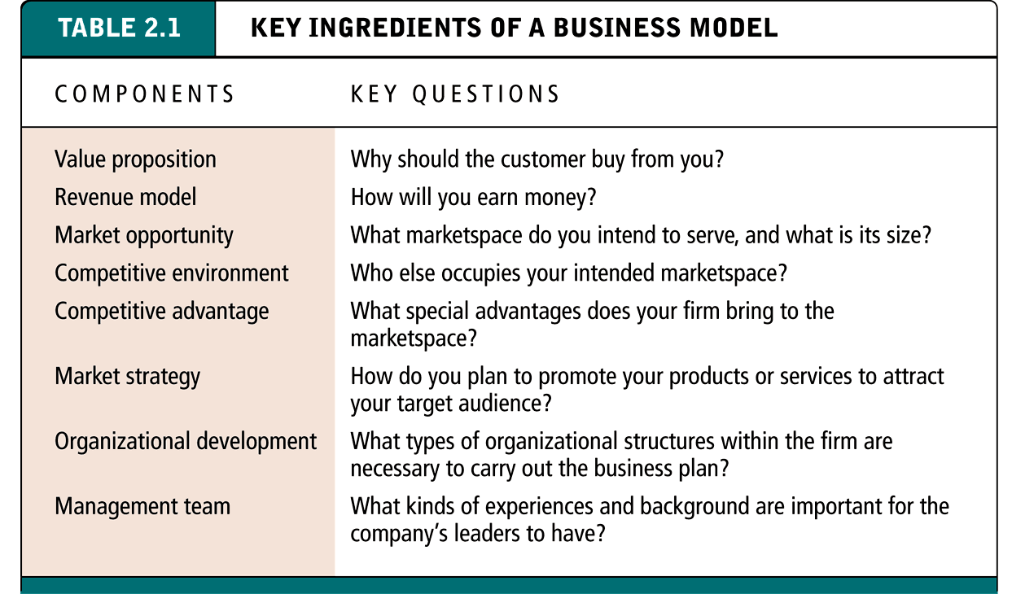
Eight Key Ingredients of a Business Model
Page 62, Table 2.1

Slide 4
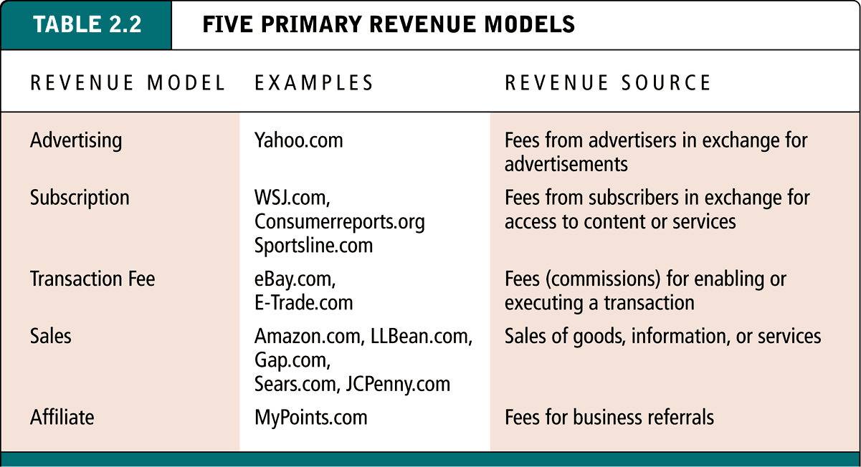
Five Primary Revenue Models
Page 66, Table 2.2

Slide 5
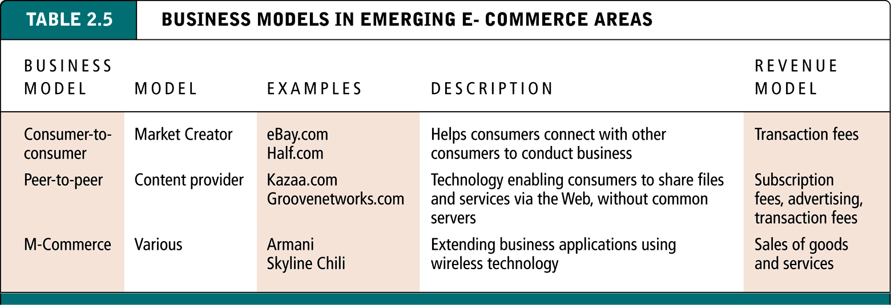
Business Models in Other Emerging Areas of E-Commerce
Page 88, Table 2.5

Slide 6
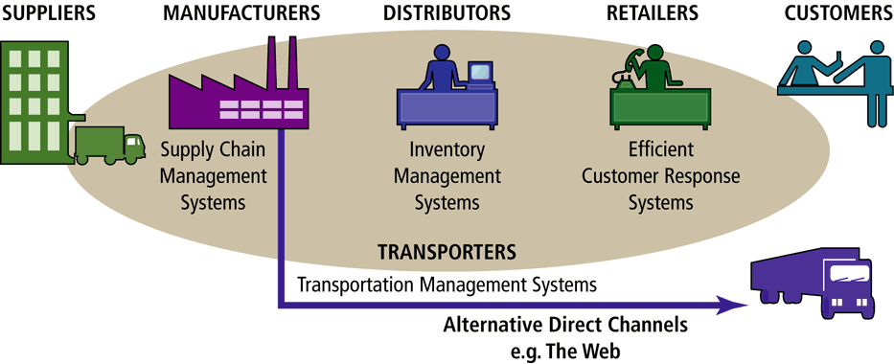
E-Commerce and Industry Value Chains
Industry Value Chains: set of activities performed in an industry by suppliers, manufacturers, transporters, distributors, and retailers that transform raw inputs into final products and services
Internet & Web Affect: reducing the cost of information and other transactional costs

Slide 7
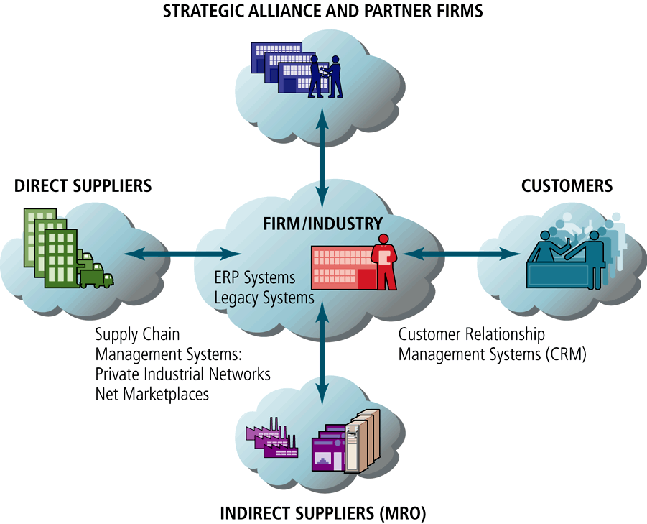
Internet-Enabled Value Web

Slide 8
E-Commerce and Business Strategy
Business Strategy
  set of plans for achieving superior long-term returns on the capital invested in a firm
  Internet & Web offers unique ways to:
    differentiate products
    obtain cost advantages
    compete globally

Slide 9
The Internet and World Wide Web: E-commerce Infrastructure
Client/Server Computing
  Client/server
    A model of computing in which very powerful personal computers are connected together in a network with one or more servers.
  Client
    A very powerful personal computer that is part of a network. They are capable of displaying rich graphics, storing large files, and processing graphics and sound files.
  Server
    Networked computer dedicated to common functions that the client machines on the network need, such as storing files, software applications, utility programs such as Web connections, and printers.

Slide 10
The Internet and World Wide Web: E-commerce Infrastructure
Web Servers
  Web server software enables a computer to deliver Web pages written in HTML to client machines on a network that request this service by sending an HTTP request
  Basic capabilities
    Security services
    File Transfer Protocol
    Search engine
    Data capture
  Types of servers on the Web
    database server -- designed to access specific information with a database
    ad server -- designed to deliver targeted banner ads
    mail server -- provides mail messages
    video server -- serves video clips

Slide 11
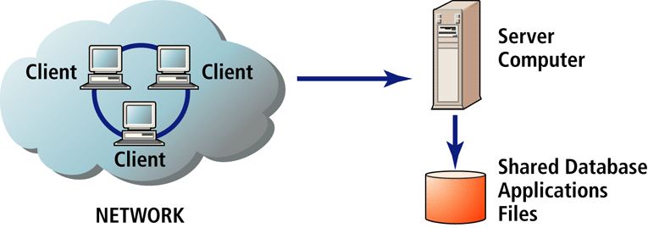
The Client/Server Computing Model

Slide 12
Other Internet Protocols and Utility Programs
HTTP is the Internet protocol used for transferring Web pages.
FTP is one of the original Internet services. Part of TCP/IP protocol that permits users to transfer files from the server to their client machine, and vice versa
SSL is a protocol that provides secure communications between the client and the server

Slide 13
Intranets and Extranets
Intranet
  a TCP/IP network located within a single organization for purposes of communications and information processing
Extranet
  formed when firms permit outsiders to access their internal TCP/IP networks

Slide 14
The Internet and the Web: Features
E-Mail
  The most-used application of the Internet. Uses a series of protocols to enable messages containing text, images, sound, and video clips to be transferred from on Internet user to another.
  Attachment is a file inserted within the e-mail message
  Spam is unsolicited e-mail

Slide 15
The Internet and the Web: Features
Search engines
  identifies Web pages that appear to match keywords, also called queries, typed by the user and provides a list of the best matches
  Intelligent agents
  software programs that gather and/or filter information on a specific topic and then provide a list of results for the user
Instant messaging
  displays words typed on a computer almost instantaneously, making the communication more like a live conversation that is possible through e-mail
Chat
  enables users to communicate via computer in real time, that is, simultaneously.

Slide 16
Music, Video, and Other Standard Files
Streaming Media
  enables music, video, and other larger files to be sent to users in chunks so that when received and played, the file comes through uninterrupted
Cookies
  a tool used by Web sites to store information about a user
  a small text file stored on the user’s computer with information about the user to more quickly load the site in the future

Slide 17
Internet II and E-commerce: Emerging Features and Services
IP Telephony
  a general term for the technologies that use VOIP and the Internet’s packet-switched network to transmit voice and other forms of audio communication over the Internet
  Voice Over Internet Protocol (VOIP)
  protocol that allows for transmission of voice and other forms of audio communication over the Internet
Digital Libraries
  Distribution of application software, multimedia, and other services on a fee basis by Application Service Providers (ASP)
Distributed Storage
  ASPs can assist both in processing data and storing it, dispersing it to multiple servers rather than having is reside on one

Slide 18
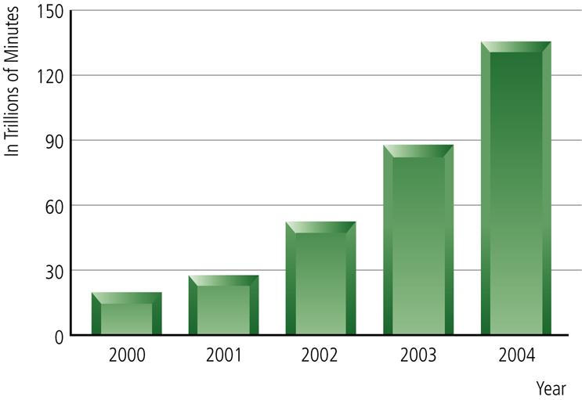
The Growth of Internet Telephony

