Slide 1
E-commerce
Week 1 and 2
Aemro B.

Slide 2
E-commerce Defined
E-commerce involves digitally enabled commercial transactions between and among organizations and individuals
Digitally enabled transactions include all transactions mediated by digital technology
Commercial transactions involve the exchange of value across organizational or individual boundaries in return for products or services

Slide 3
E-commerce vs. E-business
We use the term e-business to refer primarily to the digital enablement of transactions and processes within a firm, involving information systems under the control of the firm
E-business does not include commercial transactions involving an exchange of value across organizational boundaries

Slide 4
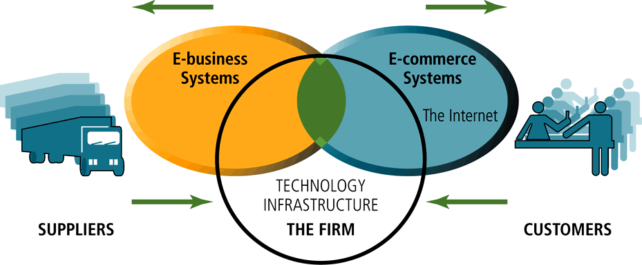
The Difference between E-commerce and E-business

Slide 5
The Reinvention of E-Commerce
1995-2000 , Innovation
Digitize business on the web
Weak business models
Liquidity bubble
2001-2008, Consolidation
Better business models, 25% growth per year
Success of social networking services

Slide 6
Where is E-Commerce Today
Trends in 2008-2009
New business models based off social technologies
Web 2.0
Growth in search engine marketing & advertising
Retail ecommerce grows in double digit rates
Fastest growth in teen, tween and older shoppers

Slide 7
Ecommerce today (cont.)
Entrepreneurs flood the net, riding on infrastructures of Amazon, eBay and Google
Large companies continue to improve multi-channel, bricks & clicks models
Growth in B2B supply chain use of the web
Revolution in telecommunications, print media, real estate, hotels, bill payments

Slide 8
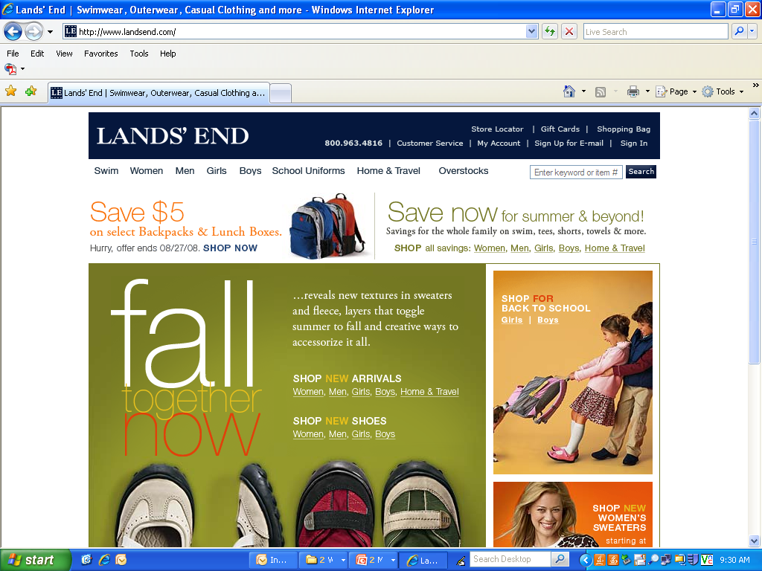
Online Retailing 2008: 120 million Americans will spend $265 on Internet products & services

Slide 9
Different from Traditional Formats
Ubiquity (anywhere/anytime)
Global Reach (no boundaries)
Universal Standards (common standards)
Richness (video/audio/text)

Slide 10
Different from Traditional Formats
Interactivity (technology interacts with user)
Information Density (reduces information cost/raises quality)
Customization (personal messages on mass level)
Social Technology (content generation/social networks)

Slide 11
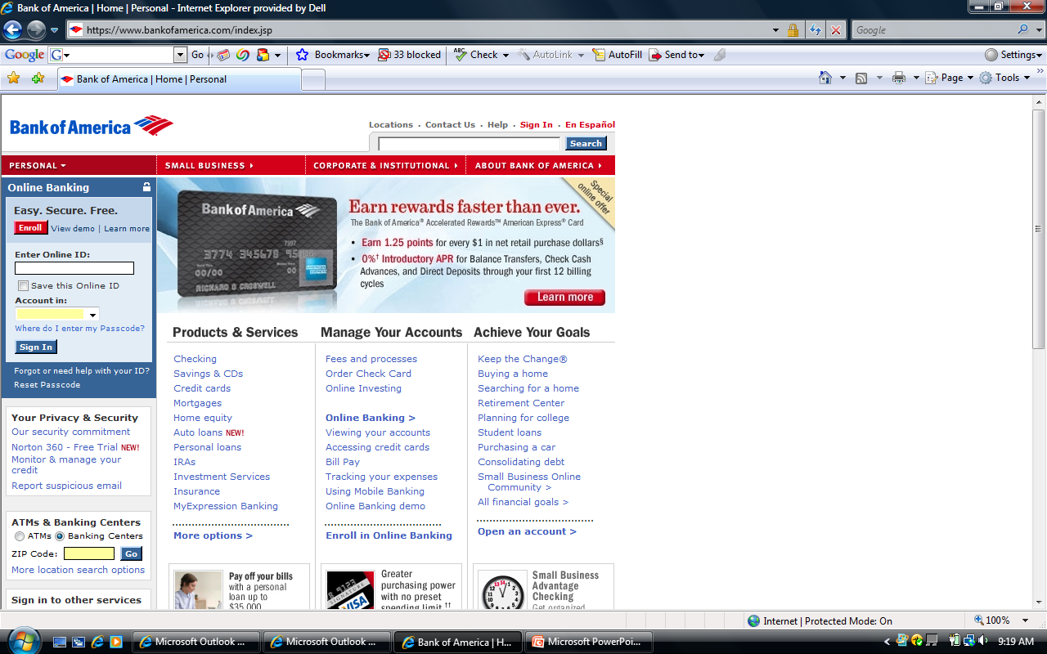
Ubiquity

Slide 12
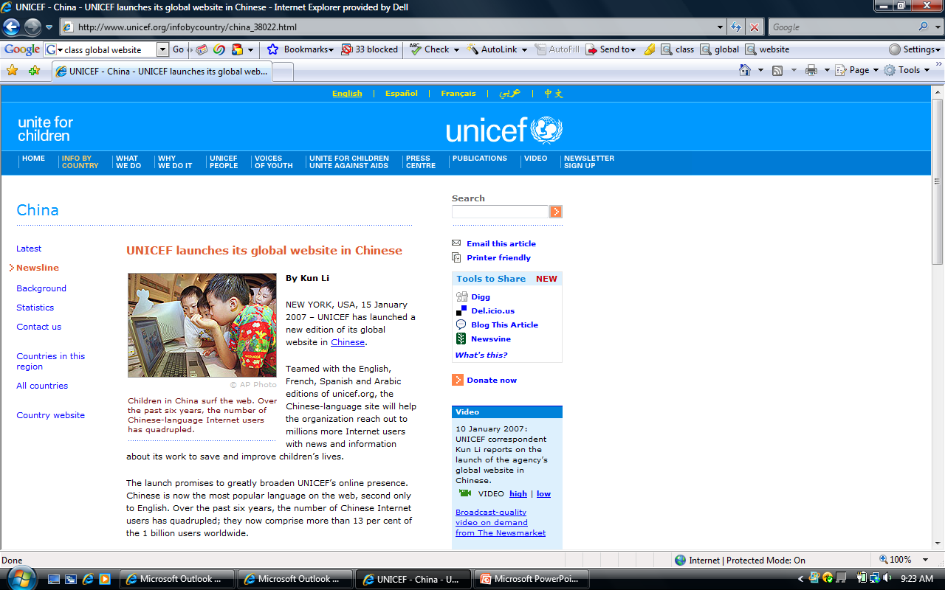
Global Reach

Slide 13
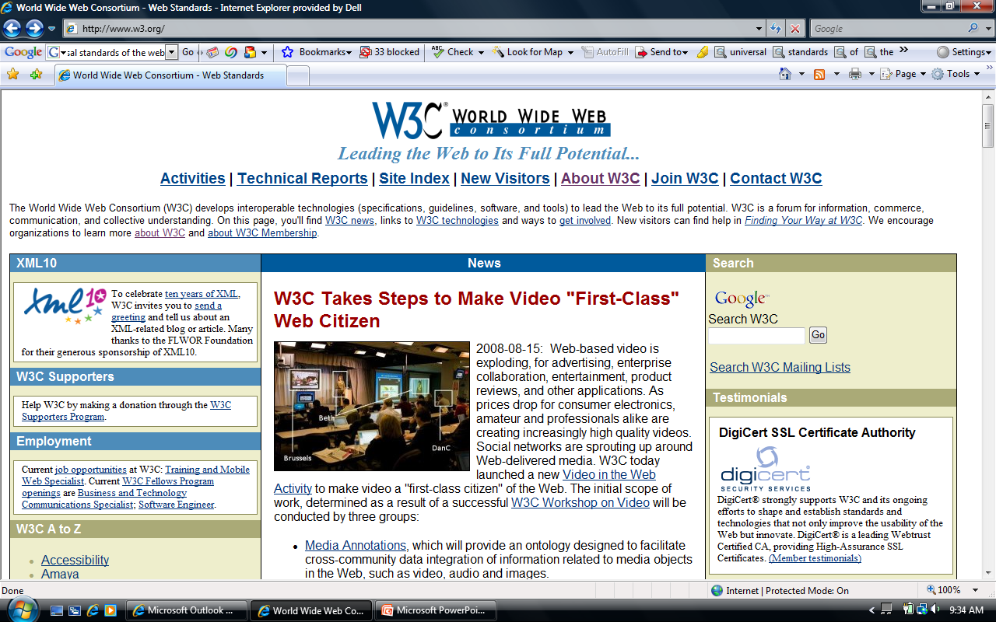
Universal Standards

Slide 14
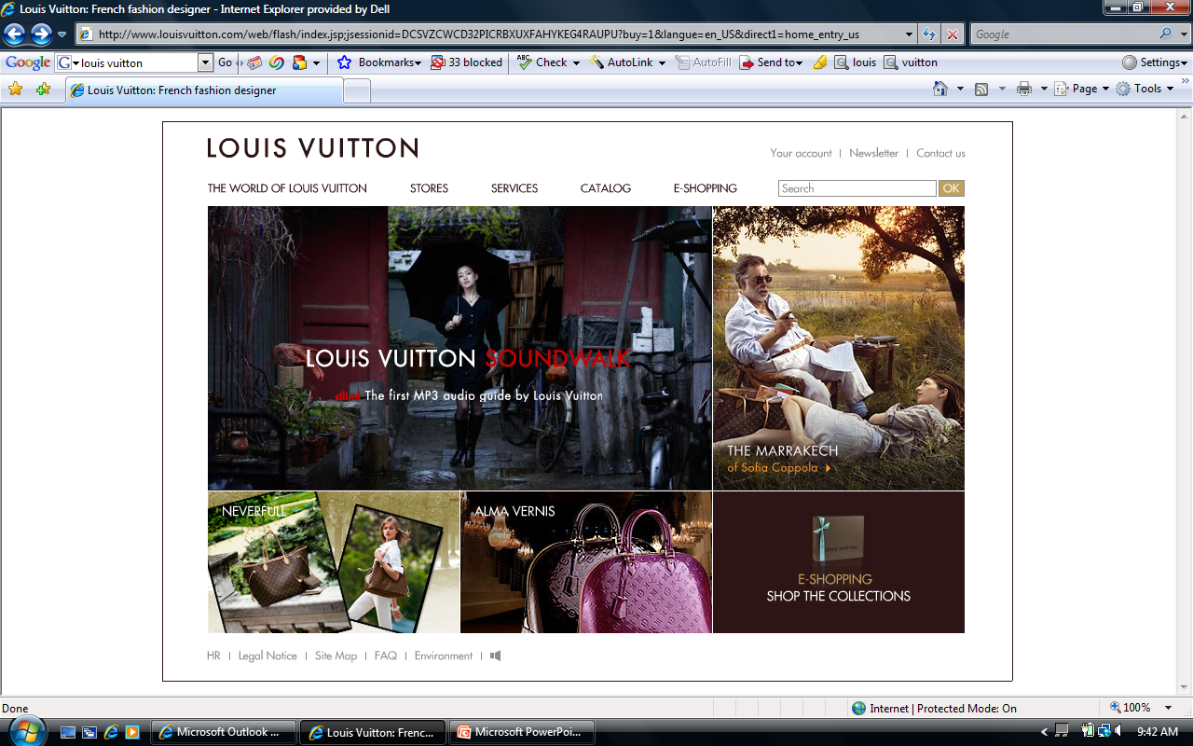
Richness

Slide 15
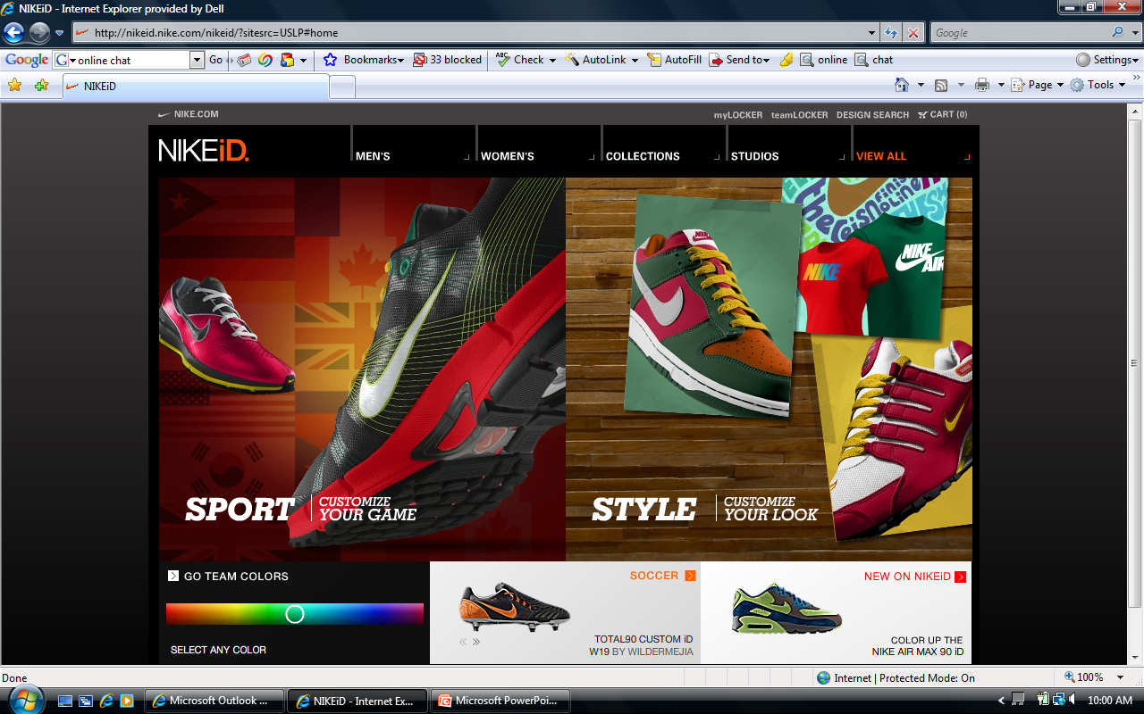
Interactivity

Slide 16
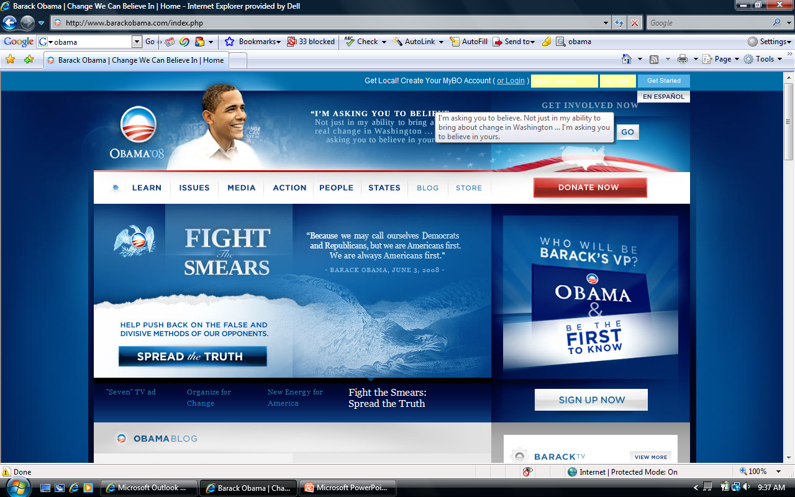
Information Density

Slide 17
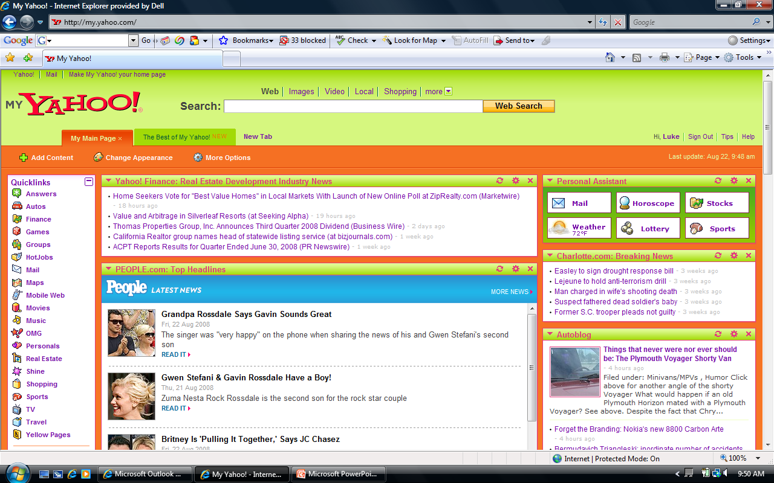
Personalization

Slide 18
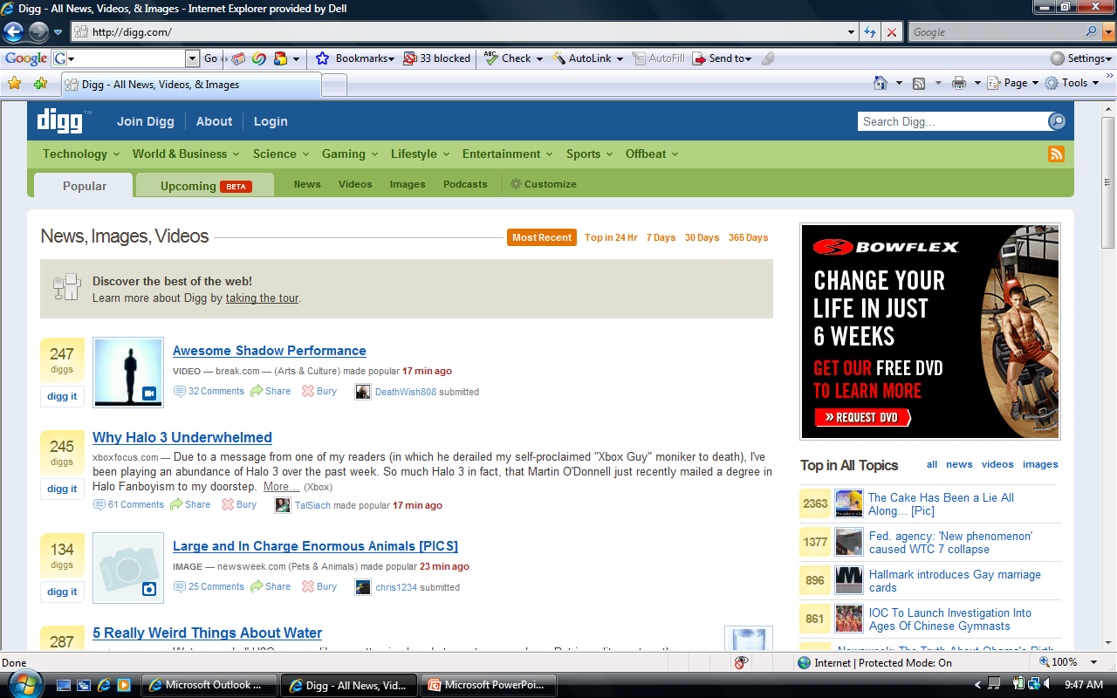
User Generated Content

Slide 19
E-Commerce Challenges
Security & privacy
Scams & Fraud
Down time & poor service
Awkward design & functionality
Lack of retail experience

Slide 20
The Impact of Social Networking Technology
How often you are on facebook?

Slide 21
Online Dating Industry
$516 million in revenues (2005)
Over 850 online dating services
Most likely place to meet people:
Work (22%), Internet (18%), Bars (18%), Clubs (11%)
Downsides: stigma & anonymity (married)

Slide 22
Types of E-commerce
Classified by nature of market relationship
Business-to-Consumer (B2C)
Business-to-Business (B2B)
Consumer-to-Consumer (C2C)
Classified by type of technology used
Peer-to-Peer (P2P)
Mobile commerce (M-commerce)

Slide 23
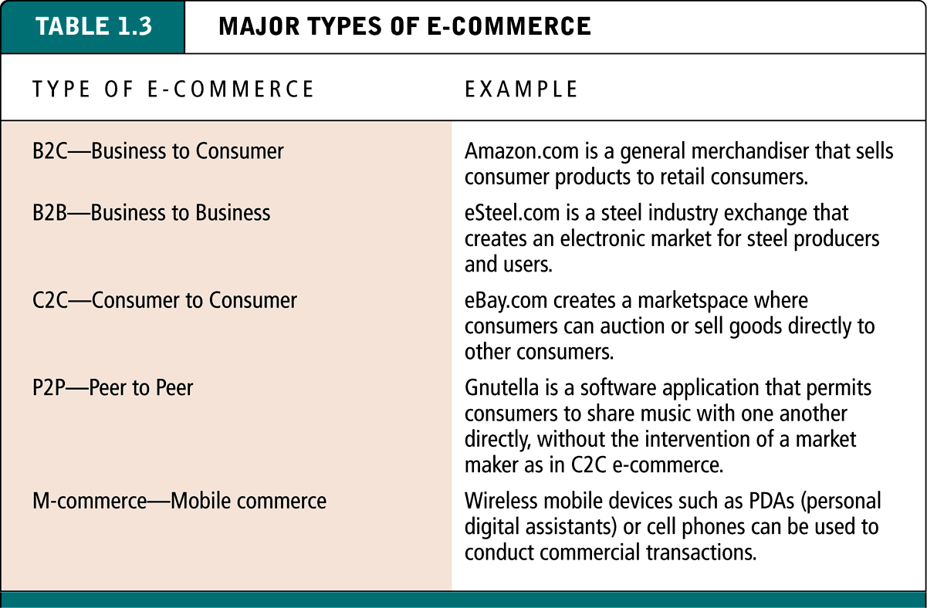
Major Types of E-commerce

Slide 24
Business-to-Consumer (B2C) E-commerce
Involves online businesses attempting to reach individual consumers
In 2002, total B2C revenues were about $72-$78 billion
Many types of business models within this category including online retailers, content providers, portals, transaction brokers, service providers, market creators and community providers

Slide 25
Business-to-Business (B2B) E-commerce
Involves businesses focusing on selling to other businesses
Largest form of e-commerce ($800 billion in 2002)
Two primary business models within B2B:
Net marketplaces (includes e-distributors, e-procurement companies, exchanges and industry consortia)
Private industrial networks (includes single firm networks and industry-wide networks)

Slide 26
Consumer-to-Consumer (C2C) E-commerce
Provides a way for consumers to sell to each other, with the help of an online market maker
eBay most well-known example
Estimated that size of C2C commerce will reach $15 billion by 2004

Slide 27
Peer-to-Peer (P2P) E-commerce
Uses peer-to-peer technology, which enables Internet users to share files and computer resources without having to go through a central Web server
Napster most well-known example until put out of business for copyright infringement
Today, Kazaa is the leading P2P software network, although also under attack for copyright infringement

Slide 28
M-commerce
Use of wireless digital devices such as cell phones and handheld devices to enable transactions on the Web
Most widely used in Japan and Europe (especially Finland)
Expected to grow rapidly in U.S. over the next five years.

Slide 29
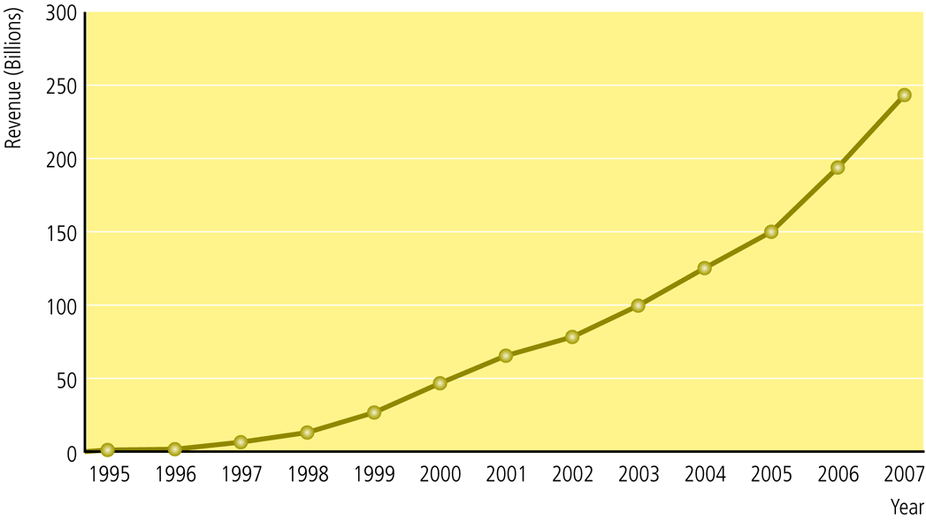
The Growth of B2C E-commerce

Slide 30
Potential Limitations on the Growth of B2C E-commerce
Expensive technology – Although currently a limitation, may become less so as prices of entry-level PCs fall
Complex software interface – Integration with television may reduce this limitation
Sophisticated skill set – This limitation may recede as PC operating system evolves, becomes more simple
Persistent cultural attraction of physical markets and traditional shopping experiences – unlikely to change
Persistent global inequality limiting access to telephones and computers – unlikely to change

Slide 31
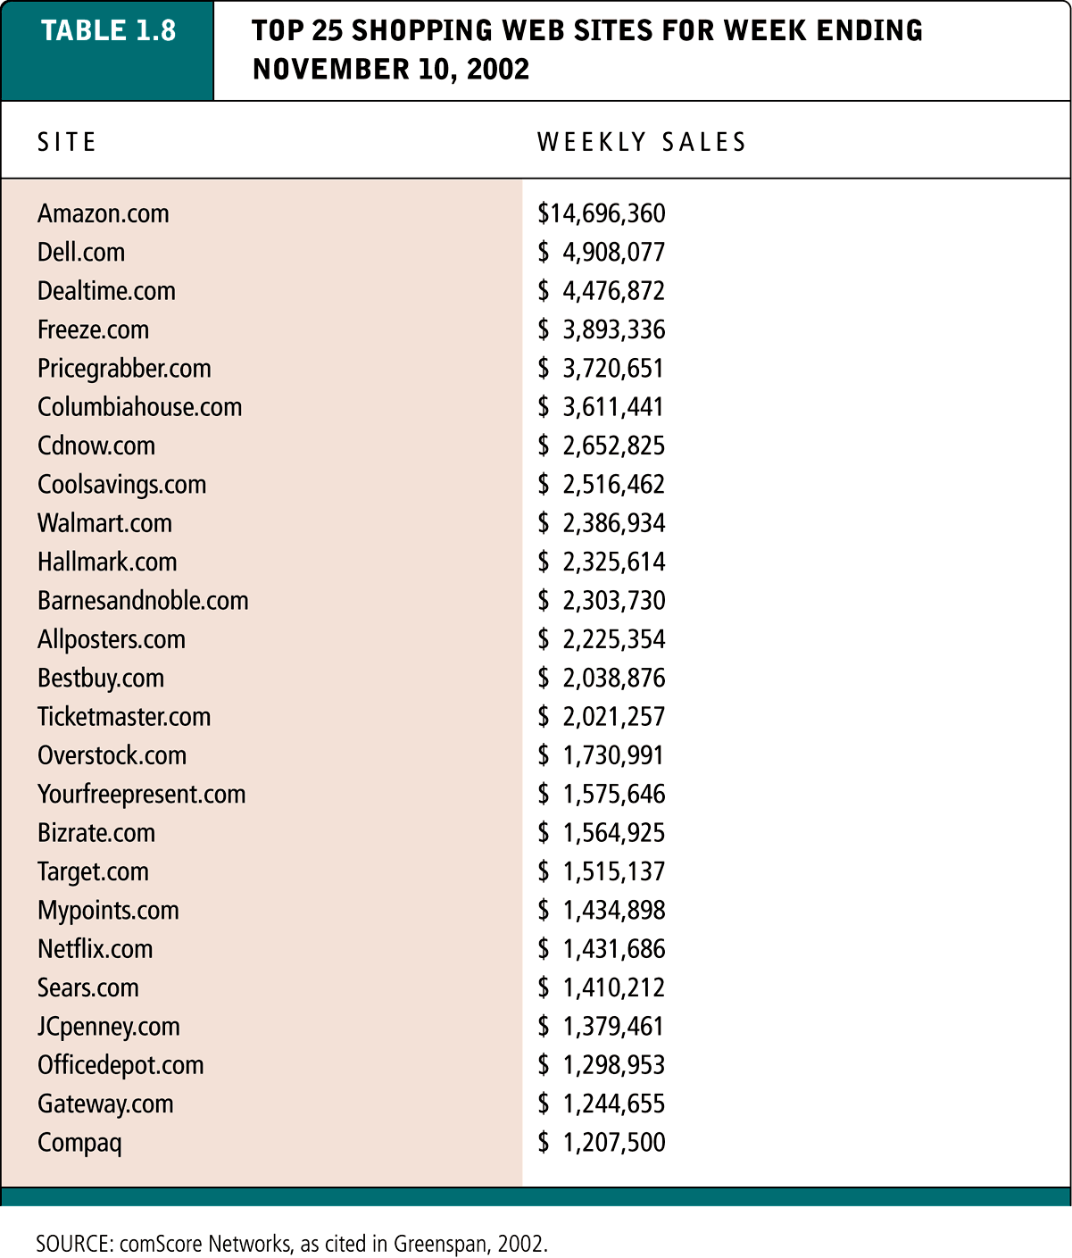
Top 25 Shopping Web Sites for Week Ending November 10, 2002

Slide 32
Academic Disciplines Concerned with E-commerce
Technical Approaches
Computer scientists and information system researchers
Management scientists
Behavioral Approaches
Information system researchers
Economists
Marketing
Management
Finance and accounting
Sociologists
Legal scholars

Slide 33
Credit Cards
Brand
e.g. VISA
Issuer
e.g. Bank
Acquirer
Merchant

Slide 34
Credit Cards
Merchant is paid for goods by acquiring bank, less merchant discount (typically 2-10%, often 4-5%)
Transactions over floor limit checked with acquirer: hot card list or credit check with issuer
Brand takes a cut; acquirer makes money from merchant discount; issuer from selling revolving credit - expensive money, often over 20% APR

Slide 35
Credit Cards 4
Originally fraud risk borne by banks
Introduction of mail order and telephone (and web) order (MOTO) risk for transactions with the cardholder not present passed to merchant.
MOTO have lower floor limits, and in delivery only to cardholder address (but not possible to be checked for e-delivery or services like Worldpay)
40% fraud fro some sites
Paypal fraud
Traditional frauds:
Stolen cards
Pre-issue
Identity theft

Slide 36
Cards 6
Overall cost of fraud
Spain 0.01%
UK 0.2%
USA 1.0%
Motivation – who gets the reward?
“Evil Hackers”
No case of fraud resulting from interception!
Getting sense from mail is hard
Real problem: hacked or crooked end systems
Overall pattern – cyclical: Best defences not always high-tech!

