Slide 1
Aemro B.
Web Auctions,
Virtual Communities,
and Web Portals

Slide 2
Learning Objectives
In this chapter, you will learn about:
Origins and key characteristics of the seven major auction types
Strategies for Web auction sites and auction-related business
Virtual communities and portals

Slide 3
Auction Overview
Online auctions provide a business opportunity that is perfect for the Web.
An auction site can charge both buyers and sellers to participate, and it can sell advertising on its page.
Web auctions can provide a general auction site that has sections devoted to specific interests.

Slide 4
Origins of Auctions
Auctions became common activities in 17th-Century England.
The 18th Century saw the birth of two British auction houses – Sotheby’s in 1774 and Christie’s in 1766.
Colonial auctions were used to sell farm equipment, animals, tobacco, etc.

Slide 5
Origins of Auctions
In an auction, a seller offers an item up for sale, but does not establish a price.
Potential buyers are given information about the item or some opportunity to examine the item; they can then offer bids.

Slide 6
English Auctions
Bidders publicly announce their successive higher bids until no higher bid is forthcoming in the English auction.
The auctioneer pronounces the item sold to the highest bidder at that bidder’s price.
An English auction is an open auction because the bids are publicly announced.

Slide 7
English Auctions
An English auction has a minimum bid or reserve price.
English auctions that offer multiple units of an item for sale and that allow bidders to specify the quantity they want to buy are called Yankee auctions.

Slide 8
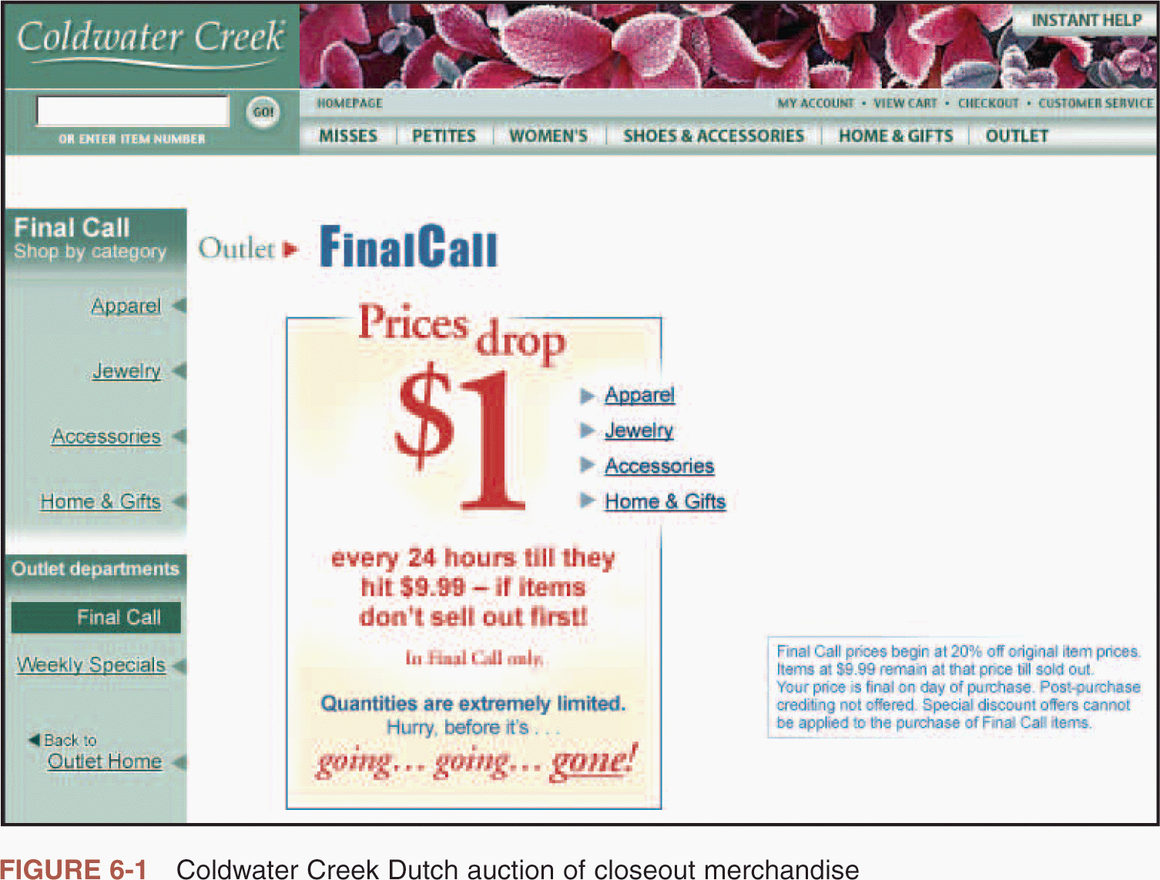
Dutch Auctions: Target Clearance

Slide 9
Dutch Auctions
The Dutch auction is a form of open auction in which bidding starts at a high price and drops until a bidder accepts the price.
Dutch auctions are also called descending-price auctions.
Dutch auctions are particularly good for moving large numbers of commodity items quickly.

Slide 10
First-Price Sealed-Bid Auctions
In sealed-bid auctions, bidders submit their bids independently and are usually prohibited from sharing information with each other.
In a first-price sealed-bid auction, the highest bidder wins.

Slide 11
Second-Price Sealed-Bid Auctions
The second-price sealed-bid auction is the same as the first-price sealed-bid auction except that the highest bidder is awarded the item at the price bid by the second-highest bidder.
Second-price sealed-bid auctions are commonly called Vickrey auctions.

Slide 12
Double Auctions
In a double auction, buyers and sellers each submit combined price-quantity bids to an auctioneer.
The auctioneer matches the sellers’ offers to the buyers’ offers until all the quantities offered for sale are sold to buyers.
Double auctions can be operated in either sealed-bid or open-outcry formats.

Slide 13
Six Auction Types

Slide 14
Web Auctions and Related Businesses
Web auctions are one of the fastest-growing segments of online business today.
Business analysts predict that Web auctions accounts for 40% of all electronic commerce by 2004.
Three broad categories of auction Web sites are emerging:
  general consumer auctions
  specialty consumer auctions
  and business-to-business auctions.

Slide 15
General Consumer Auctions
One of the most successful consumer auction Web sites is eBay.
The eBay home page includes links to categories of items.
Sellers pay eBay a listing fee and a sliding percentage of the final selling price.
Buyers pay nothing to eBay.

Slide 16
General Consumer Auctions
Most common format used on eBay
  eBay is a computerized version of the English auction
    eBay English auction
      Allows a seller to set a reserve price
      Bidders are listed
      Bid amounts are not disclosed until after the auction
      Allows sellers to specify that an auction be made private

Slide 17
Specialty Consumer Auctions
Some Web auction sites exist to meet the needs of specialty market segments.
The CNET.com technology portal site is devoted to computers.
Golf Club Exchange Web auction site is for golfers.
Coin collectors are attracted to sites, such as Coin Universe.

Slide 18
Business-to-Business Web Auctions
Business-to-business auctions evolved to meet a specific need, such as handling excess inventory.
Large companies may create their own auction sites that sell excess inventory.
A third-party Web auction site takes the place of the liquidation broker and auctions excess inventory.

Slide 19
Business-to-Business Auctions
Ingram Micro now auctions those items to its established customers through the Auction Block site.
CompUSA builds its own auction site to dispose of obsolete inventory.
Examples of third-party Web auction sites are ‘Auction IT’ for computer equipment, ‘Going, Going…Sold!’ for lab equipment, ‘FastParts.com’ for electronic components.

Slide 20
Auction-Related Services
A common concern among people bidding in Web auctions is the reliability of the sellers.
When purchasing high-value items, buyers can use an escrow(closed-account) service to protect their interests.
Escrow services, such as Escrow.ca and SafeBuyer.com, are examples.

Slide 21
Auction-Related Services
Another service offered by some firms on the Web is a directory of auctions, such as Auctionguide.com and the “Auction Watch” sites.
Auction directory and information services
  Offer guidance for new auction participants
  Offer helpful hints and tips for more experienced buyers and sellers along with directories of online auction sites

Slide 22
Auction-Related Services
Auction software
  For sellers
    Software and services that can help with or automate tasks such as image hosting (e.g., Andale)
  For buyers
    Sniping Software is designed to observe an auction’s progress and places a bid high enough to win the auction (e.g., AuctionBytes)

Slide 23
Seller-Bid Auctions and Group Purchasing Sites
Another auction model, in which sellers bid the prices at which they are willing to sell, is called a reverse auction.
On a group purchasing site, the seller posts an item with a price. As individual buyers enter bids on an item, the site can negotiate a better price with the item’s provider.
Respond.com and Priceline.com are examples.

Slide 24
Seller-Bid Auctions and Group Purchasing Sites
Many of the marketplaces that businesses are creating to conduct B2B transactions include auctions and reverse auctions.

Slide 25
Virtual Community and Portal Strategies
Three key elements are required to make a virtual community:
  Cellular-satellite (mobile) communications technology
  Software agents
  Electronic marketplaces

Slide 26
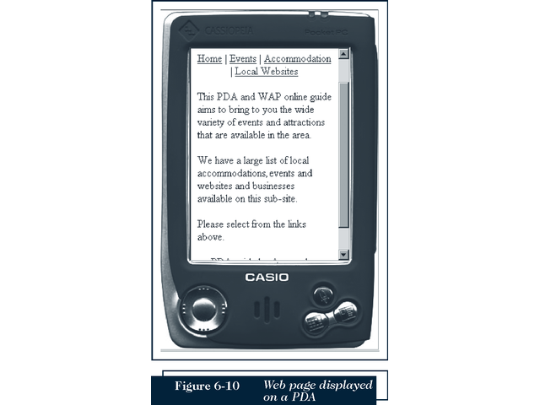
Mobile Commerce

Slide 27

Electronic Marketplace

Slide 28
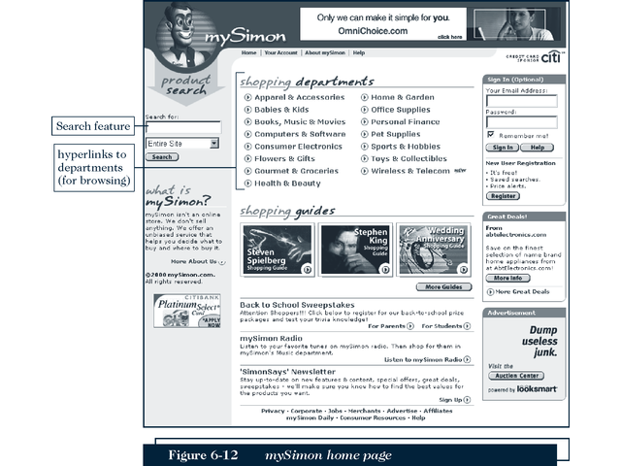
Intelligent Software Agents

Slide 29
Virtual Communities
A virtual community is a gathering place for people and businesses that does not have a physical existence
  Usenet newsgroups
  Chat rooms
  Web sites
  Virtual Worlds and Gaming Communities

Slide 30
Virtual Community and Portal Strategies
A virtual community is a gathering place for people and businesses that do not have a physical existence.
Virtual communities exist on the Internet in various forms, including Usenet newsgroups, chat rooms, and Web sites.
Virtual communities help companies, customers, and suppliers to plan, collaborate, transact business, and interact in ways that benefit all of them.

Slide 31
Virtual Communities
Most Web communities are business-to-consumer strategy implementations.
Some successful B2B virtual communities have emerged.
Distance learning platforms such as Blackboard and WebCT include bulletin boards, chat rooms, etc.

Slide 32
Early Web Communities
One of the first Web communities was the ‘WELL’ community.
Member of the WELL pay a monthly fee to participate in its forums and conferences.
In 1995, Beverly Hills Internet opened a virtual community site.

Slide 33
Web Community Consolidation
Virtual communities for consumers can continue as money-making propositions, or at least cover their expenses if they offer something sufficiently valuable to justify a charge for membership.
Most virtual communities have been unable to support themselves.
Most virtual communities have closed or been sold to companies like Yahoo!.

Slide 34
Advertising-Supported Web Portals
Many Web observers believe that Web portal sites will be the great revenue-generating businesses of the future.
Adding portal features to the existing sites is a wise business strategy.
One rough measure of stickiness is how long each user spends at the site.

Slide 35
Revenue Models for Web Portals and Virtual Communities
Web portals
  High visitor counts can yield high advertising rates
  Companies that run Web portals add sticky features such as chat rooms, e-mail, and calendar functions

Slide 36
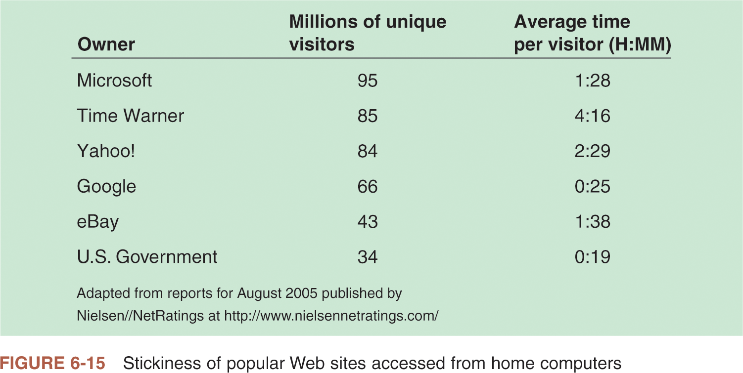

Slide 37
Web Portal Strategies
Industry observers predicting success for Web portals may be correct.
The companies that run Web portals certainly believe in the power of portals.
Many large organizations have built internal Web portals to provide information to their employees. This creates an online community and saves significant amounts of money that would normally be spent on printing and distributing memos.

Slide 38
Mixed-Model Web Portals
One of the most successful Web portals is AOL, which has always charged a fee to its users and which has always run advertising on its site.
Many Web portals that are now struggling with their advertising-supported revenue models have been moving gradually towards AOL’s strategy.
Yahoo! now charges for the Internet phone service that had been free.
Although Yahoo! still offers free e-mail accounts, it now sells other features.

Slide 39
Summary
New companies have formed that capitalize on the Web’s ability to bring together geographically dispersed people and organizations
Organizations are using mobile commerce to sell goods and services to users of handheld devices
Companies are using internal Web portals to communicate with employees

