Slide 1
Oxides
Hard, dense & refractory
Simple
(metal+O) &
multiple oxides (metal+metal+O
Ionic bonding
XO,X2O3,XO2, XY2O4
Spinel Group=XO+X2O3

Slide 2
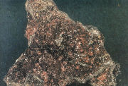
Cuprite (Cu2O)

Slide 3
Cuprite
Cubic, massive, red, streak brownish red, sub-metallic,
uneven,
H.4,Sp.Gr.6
Secondary (supergene) copper mineral due to surface oxidation
Chile, Bolivia, Zaire
Minor ore of Copper

Slide 4
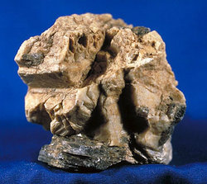
Corundum (Al2O3)

Slide 5
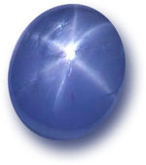
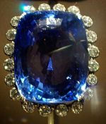
Corundum
Trigonal, barrel-shaped, red=Ruby (traces of Cr), blue=Sapphire (Traces of Fe or Ti),
adamantine to vitreous, transparent to translucent, basal parting, uneven,
H. 9, Sp.Gr. 4
In placers & in metamorphic rocks

Slide 6
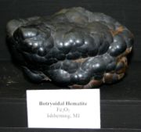
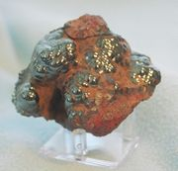
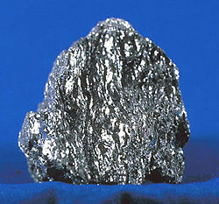

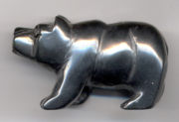
Hematite

Slide 7
Hematite (Fe2O3)
Trigonal, botryoidal, granular, earthy, micaceous (specularite), reddish brown to black, ocher=red earthy H.,
streak light to dark red, metallic to dull, uneven,
brittle, elastic in specularite,
H.6, Sp.Gr. 5

Slide 8
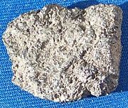
ilmenite (FeO+TiO2)=FeTiO3

Slide 9
ilmenite
Trigonal, massive, black,
streak brown or brownish black,
metallic, uneven,
H. 6, Sp. Gr. 4.7.
Surface spotted white (altered)
In mafic rocks and placers
Norway, Australia, India.
Abu Ghalaga(E.D. of Egypt)
Source of Ti used in Ti steel, aircraft & space vehicles.
Titania (TiO2) for paint

Slide 10
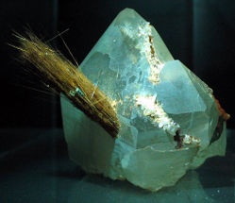

Rutile (TiO2)

Slide 11
Rutile
Tetragonal, slender acicular Xls,
red, reddish brown to black,
streak pale brown, adamantine,
011 cleavage, uneven,

Slide 12
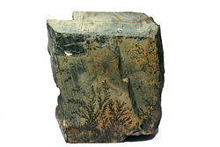
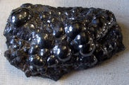
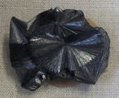
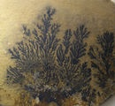
Pyrolusite (MnO2)

Slide 13
Pyrolusite
Orthorhombic, radiating fibers, massive, dendritic,
iron black, streak the same, metallic, earthy, perfect cleavage in Xls,
H. 2.5, Sp.Gr. 4.7
In sedimentary rocks, in hydrothermal veins, in residual deposits
Russia, Gabon, Brazil

Slide 14
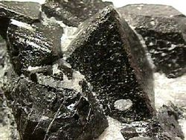
Magnetite(FeO+Fe2O3)=Fe3O4

Slide 15
Magnetite
Cubic, massive, black, streak the same,
metallic, subconchoidal,
H.6, Sp.Gr. 5
Strongly magnetic
In most igneous rocks, iron formation, in placers
Sweden, Russia, USA
Iron formation at W. Kareem ED. In placers at Rosetta
Important source of Fe

Slide 16
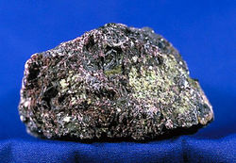
Chromite (FeO+Cr2O3)=FeCr2O4

Slide 17
Chromite
Cubic, massive, Black to brownish black, Streak dark brown, metallic, pitchy, uneven, H. 5.5, Sp.Gr. 4.6
In ultramafic rocks (serpentnites),placers
Turkey, S. Africa, India
Abu Dahr, Umm Selim, Ghadir (ED)
Source of Cr used in Cr-Steel, stainless steel, Cr+Ni resistance in electrical heating equipment

Slide 18
Chromite
Plating plumbing fixtures, automobile accessories.
A major constituent of the stainless steel (Nichrome)
K and Na chrmates are used to fix dyes
Chromite for refractory bricks for lining of metallurgical furnaces

Slide 19
Hydroxides
Presence of hydroxyl (OH)- group
Or H2O molecule
Bondage weaker than oxides

Slide 20
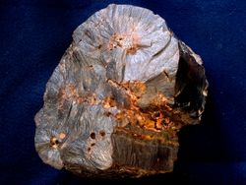
Goethite (FeO.OH)

Slide 21
Goethite
Orthorhombic, massive, reniform, radiating fibrous aggregates,
yellowish brown to dark brown, streak yellowish brown, adamantine to dull, silky,
perfect 010 cleavage, uneven,
H.5.5, Sp.Gr. 4.3
Secondary surface Fe mineral, in springs & bog deposists, possibly by organisms
France, Cuba, USA
Bahariya Oases for Fe & Steel Co.

Slide 22
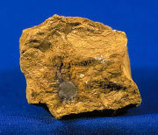
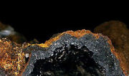
Limonite

Slide 23
Limonite
Limonite is an ore consisting in a mixture of hydrated iron(III) oxide-hydroxide of varying composition.
The generic formula is frequently written as FeO(OH)·nH2O, although this is not entirely accurate as limonite often contains a varying amount of oxide compared to hydroxide

