Slide 1
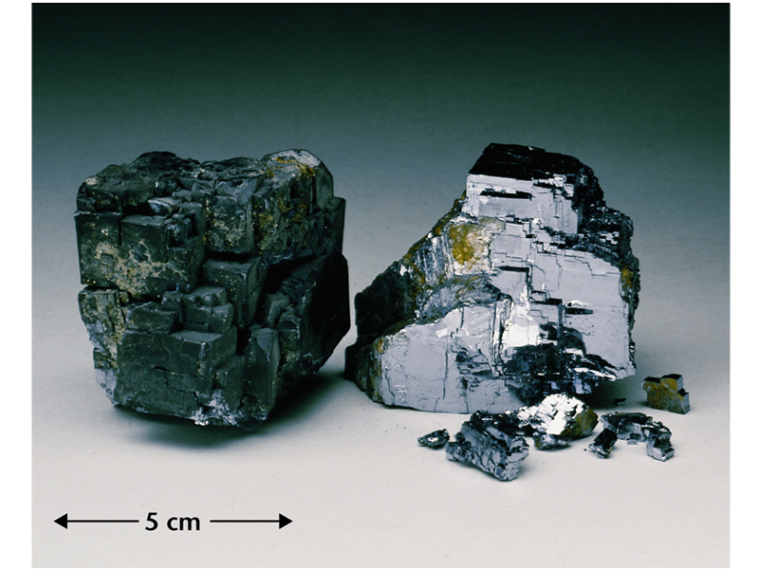
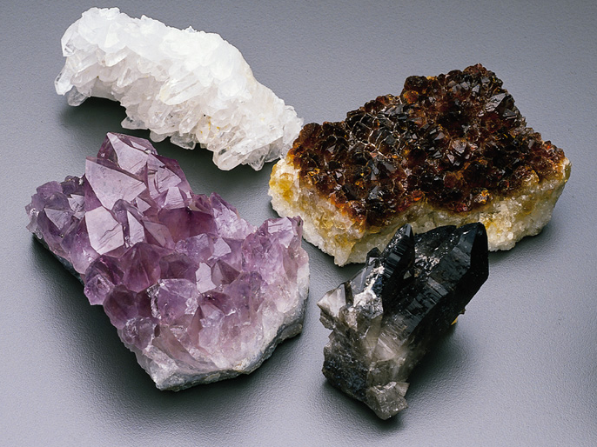
Minerals

Slide 2
The earth is made of rocks, which are in turn made of minerals. In this part of the course we'll learn how to identify common minerals and rocks.
In order for something to be classified as a mineral, it must meet five (5) criterion:
Minerals are:
· 1. Naturally occurring,
· 2. Inorganic,
· 3. Have known chemical compositions,
· 4. Have definite physical properties,
5. Solid.
·
They are usually (although not always) crystalline.

Slide 3
Bonding in Minerals
The Glue That Holds Minerals Together

Slide 4
Types of Bonds
Intramolecular
Ionic
Covalent
Metallic
Intermolecular
Hydrogen
Van der Waals

Slide 5
Definition of Bonding
A chemical bond is an attraction between atoms brought about by:
A sharing of electrons between two atoms or,
A complete transfer of electrons
When a chemical bond is formed, energy is released
Breaking chemical bonds requires energy

Slide 6
Substances Formed by Bonding
When two or more atoms of the same element bond together, a molecule is formed – example, hydrogen H₂
When 2 or more atoms of different elements combine together chemically, a compound is formed – example, water H₂O
Most minerals are compounds

Slide 7
Ionic Bonding
Ionic bonding is the result of electrostatic attraction between two oppositely charged ions
Positive ions are formed from metals (usually) and negative ions are usually formed from non-metals

Slide 8
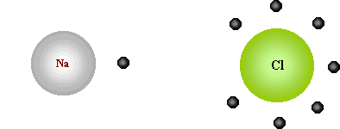
Halite
Halite, NaCl, is a classical example of an ionically bonded substance
The sodium donates an electron to chlorine to complete the eight-electron subshell on chlorine

Slide 9
Physical Properties of Ionically Bonded Crystals
Ionic bonding is non-directional
Ionically bonded minerals may yield ions to solution
Moderate hardness
Fairly high to very high melting points & boiling points
Poor thermal & electrical conductors except near the melting points

Slide 10
Covalent Bonding
Covalent bonds involve a complete sharing of electrons and occur most commonly between atoms that have partially filled outer shells or energy levels
Thus, if the atoms are similar in electronegativity then the electrons will be shared

Slide 11
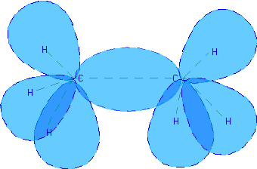
Carbon
Carbon forms covalent bonds
The electrons are in hybrid orbitals formed by the atoms involved as in this example: ethane
Diamond is strong because it involves a vast network of covalent bonds between the carbon atoms in the diamond
C₂H₆

Slide 12
Physical Properties of Covalently Bonded Crystals
Covalent bonds are directional and molecules are often formed.
Covalently bonded crystals do not yield ions to solutions, as ionically bond crystals sometimes do
Covalent crystals have very high melting points & boiling points

Slide 13
Metallic Bonding
A metallic bond occurs when positive metal ions like Cu⁺² or Fe⁺³ are surrounded by a "sea of electrons" or freely-moving valence electrons.
The valence electrons are not bound to any particular cation, but are free to move throughout the metallic crystal

Slide 14
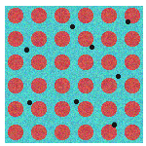
Sea of Electrons
In the picture, the red circles are metal cations packed in a crystal lattice
The black dots represent the "sea" of freely moving valence electrons

Slide 15
Minerals with Metallic Bonding
Only native metals display metallic bonding
Alkaline metals are far too reactive to be found uncombined in nature
Only a few minerals, such as gold, silver, copper and the platinum group are metallically bound

Slide 16
Intermolecular Bonds
Bonds which hold molecules together are called intermolecular bonds
In minerals, the concept of a “molecule” is often inapplicable, but the term is still used

Slide 17
Hydrogen Bonding
In some substances, hydrogen is bonded to elements which are quite electronegative, and which possess “lone pairs” of electrons
Examples include water and ammonia
Hydrogen bonding leads to the many anomalous properties of water and ammonia

Slide 18
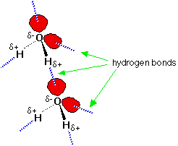
Hydrogen Bond Image
The δ+ hydrogen is so strongly attracted to the lone pair that it is almost as if you were beginning to form a co-ordinate bond
It doesn't go that far, but the attraction is significantly stronger than an ordinary dipole-dipole interaction

Slide 19
Relative Bond Strength
Hydrogen bonds have about a tenth of the strength of an average covalent bond, and are being constantly broken and reformed in liquid water
If you liken the covalent bond between the oxygen and hydrogen to a stable marriage, the hydrogen bond has "just good friends" status
On the same scale, van der Waals attractions represent mere passing acquaintances!

Slide 20
Water
Each water molecule can potentially form four hydrogen bonds with surrounding water molecules
There are exactly the right numbers of δ+ hydrogens and lone pairs so that every one of them can be involved in hydrogen bonding

Slide 21
Ammonia and Hydrogen Fluoride
In the case of ammonia, the amount of hydrogen bonding is limited by the fact that each nitrogen only has one lone pair
In a group of ammonia molecules, there aren't enough lone pairs to go around to satisfy all the hydrogens
In hydrogen fluoride, the problem is a shortage of hydrogens
In water, there are exactly the right number of each
Water could be considered as the "perfect" hydrogen bonded system

Slide 22
Van der Waals Bonding
There are two types of Van der Waals forces
Dispersion forces are also known as "London forces" (named after Fritz London who first suggested how they might arise)
Dipole-dipole interactions
Notes:
Much of the information for this section, as well as the images, comes from: http://www.chemguide.co.uk/atoms/bondingmenu.html#top

Slide 23
Electrical Attractions
Attractions are electrical in nature
In a symmetrical molecule like hydrogen, however, there doesn't seem to be any electrical distortion to produce positive or negative parts
But that's only true on average

Slide 24

Distortion of Electron Cloud
The lozenge-shaped diagram represents a small symmetrical molecule - H₂, perhaps, or Br₂
The even shading shows that on average there is no electrical distortion

Slide 25
Mobile Electrons
But the electrons are mobile, and at any one instant they might find themselves towards one end of the molecule, making that end δ-
The other end will be temporarily short of electrons and so becomes δ +

Slide 26


Temporary Fluctuating Dipoles
An instant later the electrons may well have moved up to the other end, reversing the polarity of the molecule

Slide 27
Presence of Multiple Bond Types
If a crystal has more than one type of bond the weakest bonds present determine the physical properties which may be very directional

Slide 28
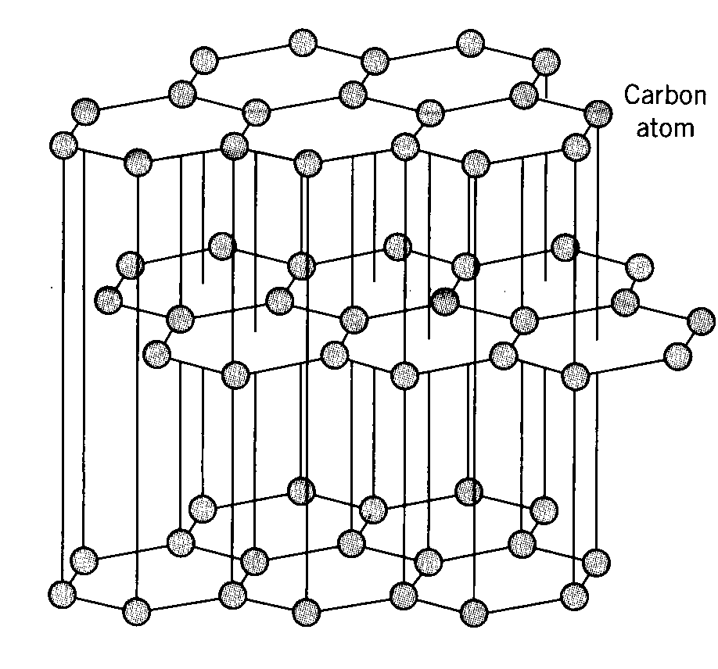
Graphite
Covalent bonding within a sheet
The sheets are held together by Van der Waals bonds – very easy to break in one direction
Thus soft with perfect cleavage
Notes:
Source: http://www.benbest.com/cryonics/graphite.gif

