Slide 1
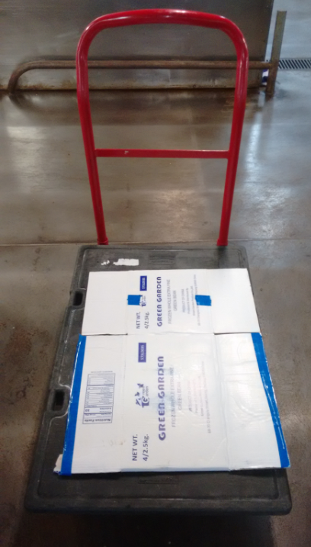
Transportation
When transporting food never use a dirty trolley.
Cardboard boxes like in the attached picture should not be used.

Slide 2
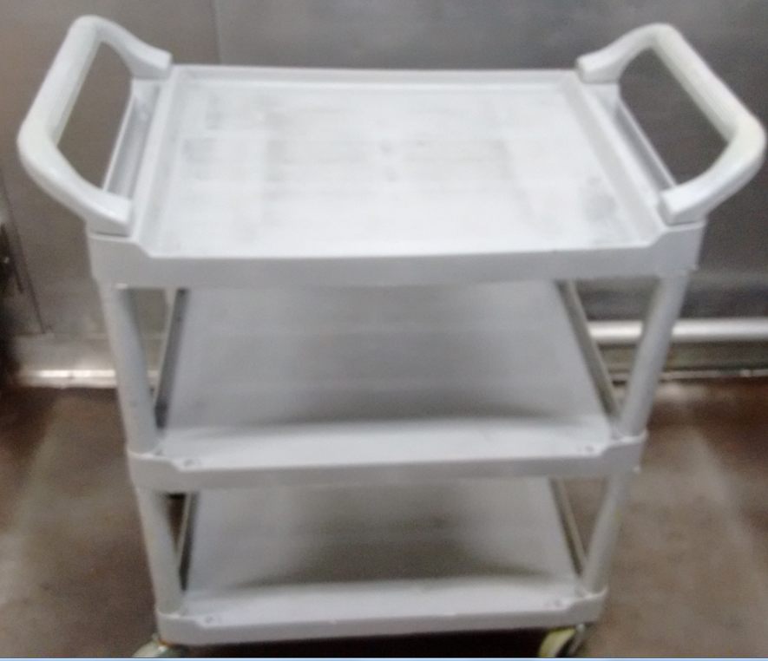
Transportation
  Always use a clean trolley and clean container when transporting food.

Slide 3
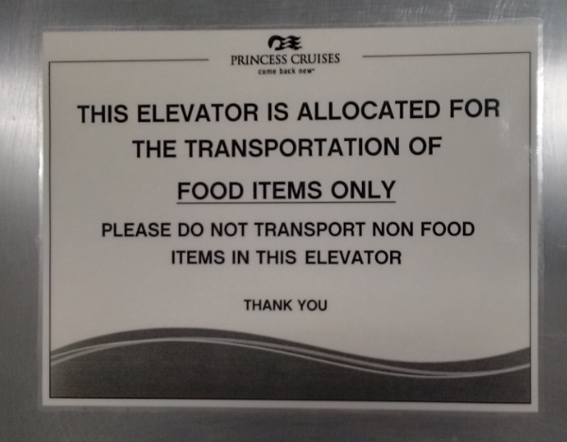
Transportation
  Food should be transported using the “Food Only” elevator. Never transport food in the garbage elevator.

Slide 4
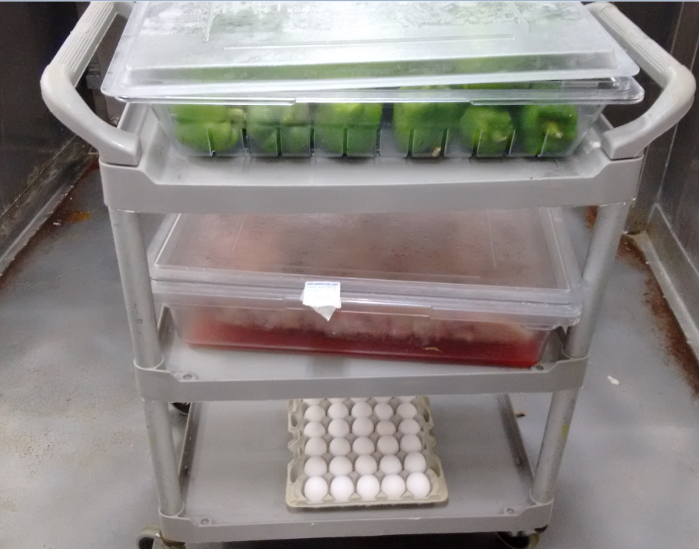
Transportation
During transportation:
  Keep food covered.
  Separate food items. Raw food should be separated from cooked food.
  Garbage should never be kept on the same trolley with food.
  Monitor for dripping.
  Fruits and vegetables should always be washed and sanitized.

Slide 5
Transportation
Food coming from the butchers should be having a production label.

Slide 6
Transportation
When food is transported from one galley to another, the above general rules should be followed.
If food is transported with a production label, the food should remain in temperature until arriving at the receiving location. At this time the food should be labeled with the TC dot of the receiving location.
If food is transported with a TC dot, the TC dot should match the time control segment (TC plan) of the receiving location.

Slide 7
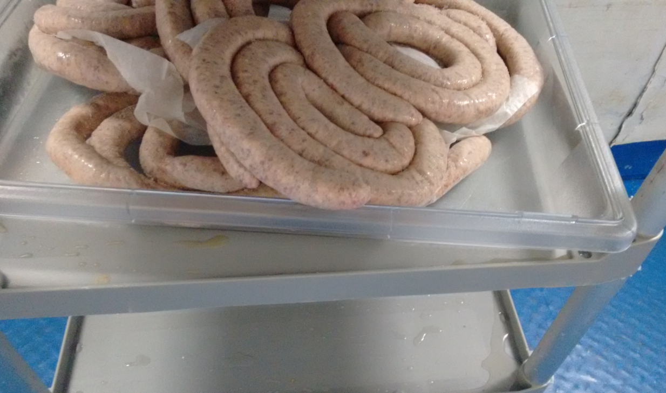
Wrong Transportation
Uncovered and transported on a dirty trolley

Slide 8
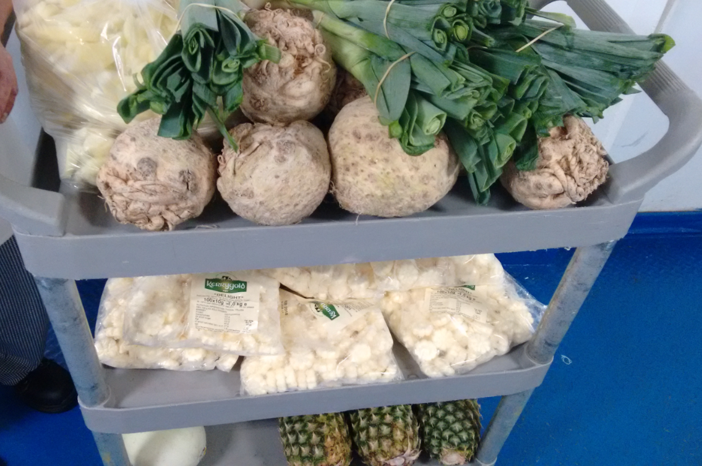
Wrong Transportation
Fruits and vegetables not washed & sanitized. Also food is uncovered and not transported in a container.

Slide 9
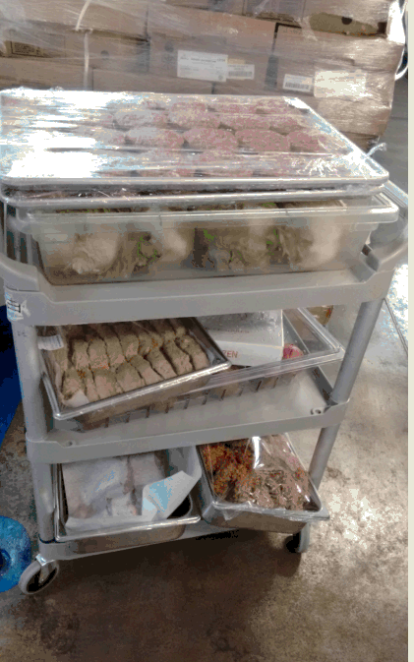
Wrong Transportation
Ground meat stored over Salmon.
Chicken stored over salmon.
Note: Raw poultry should be separated or below from raw meats & fish/shellfish.

Slide 10
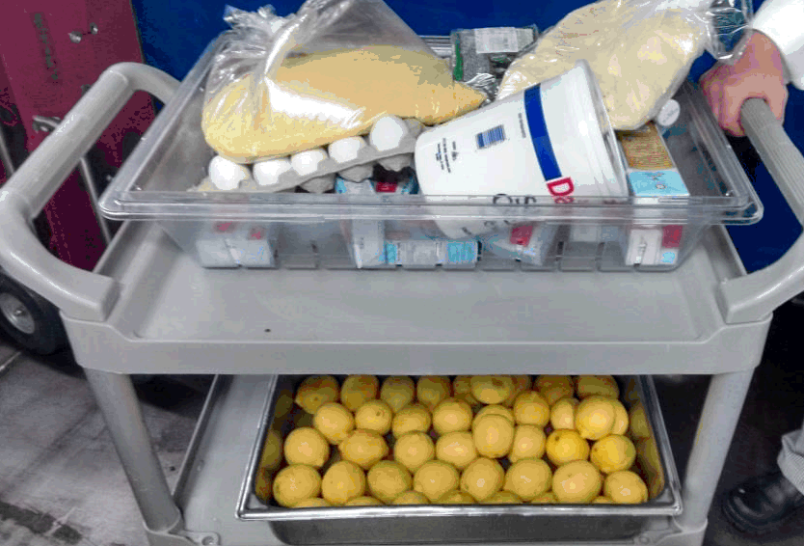
Wrong Transportation
Lemon not washed and uncovered.
Eggs, butter, cottage cheese grated cheese being transported wrongly
Note: Food should be separated when being transported.
Also eggs should be stored on the bottom to prevent cross contamination.

