Slide 1
Croissant-Doughnut
Based on a concept developed in New York City’s bakeries

Slide 2
Product Label Name:
Croissant-Doughnut
Marketing Tagline:
The Donut Goes French
Description of Product:
“It's a cross between a donut and a croissant; currently the hottest trend coming out of New York City which has thousands of people lining up for more!”
The tagline and descriptions is to be used to explain the concept to passengers

Slide 3
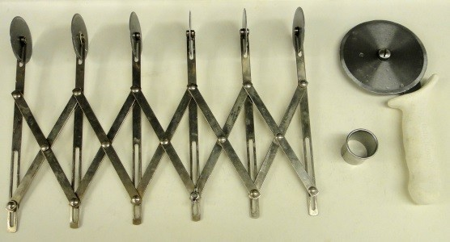
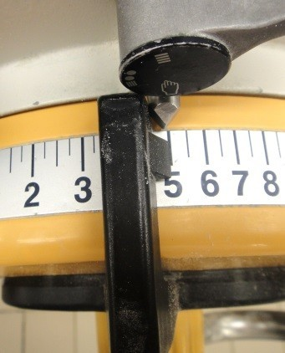
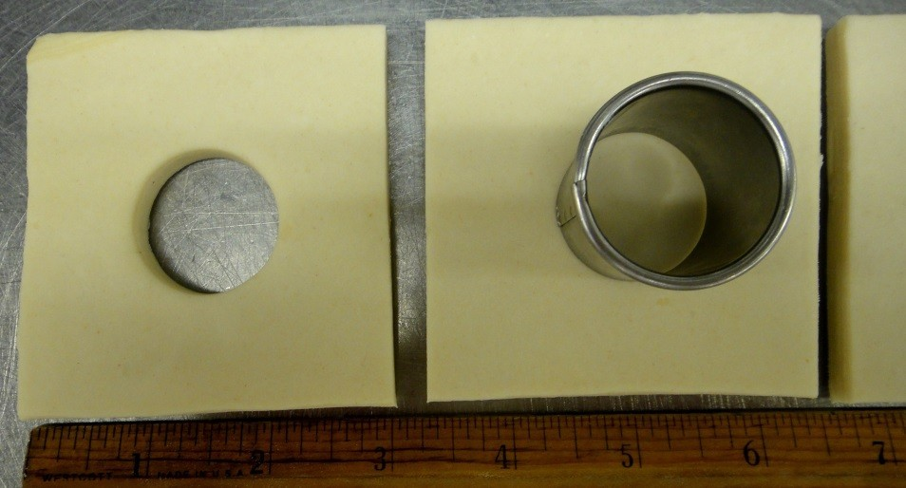
Croissant-Doughnut preparation guidelines
Equipment needed: Folding cutter to mark the dough, round cutter (3cm diameter) and pizza cutter
Roll the dough on the dough sheeter down to 5mm
Trim off all edges straight and clean.
Cut 7.5cm square pieces and cut a round hole in the center

Slide 4

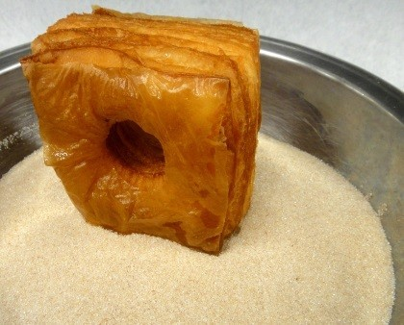


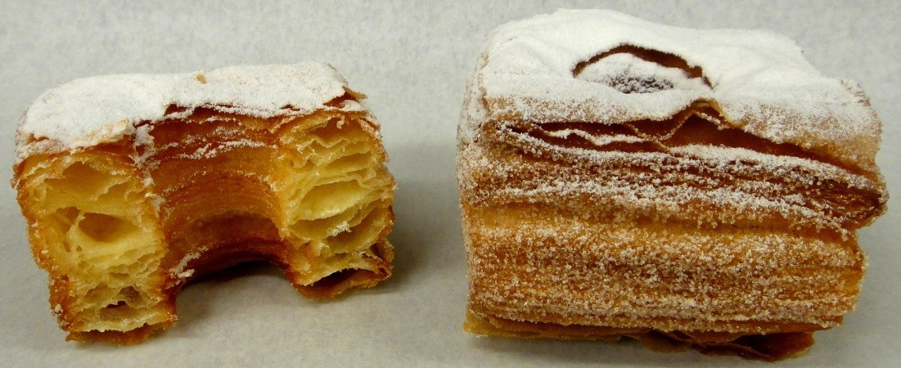
After proofing, fry the Croissant-Doughnut at 180˚C (same as donuts) for about 90 seconds on each side.
Place them on a rack to drip off excess fat.
Dip all 4 sides in Cinnamon/sugar mixture
Use “sweet snow” (dusting sugar) as topping
Serve as fresh as possible!

Slide 5
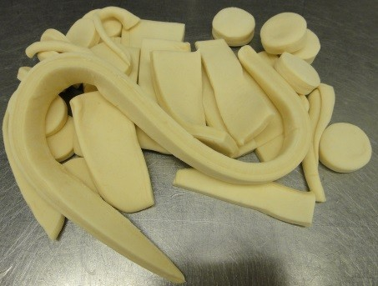
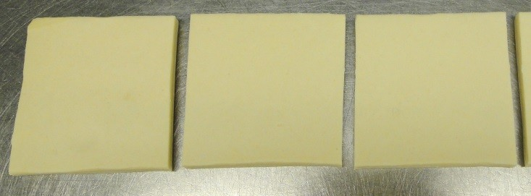

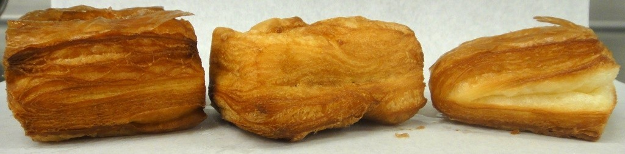
Avoid mistakes and shortcuts
Laminate the dough and roll the dough only once! Do not reuse trimmings for Croissant-Doughnuts! Trimmings have to be used as starter dough for soft rolls.
One time rolled dough assures flaky product with good volume
Trimmings will result in less volume and the fat layers are destroyed!
ALL edges have to be clean trimmed to avoid proofing inconsistencies

