Slide 1
Sabatini’s
Antipasti

Slide 2
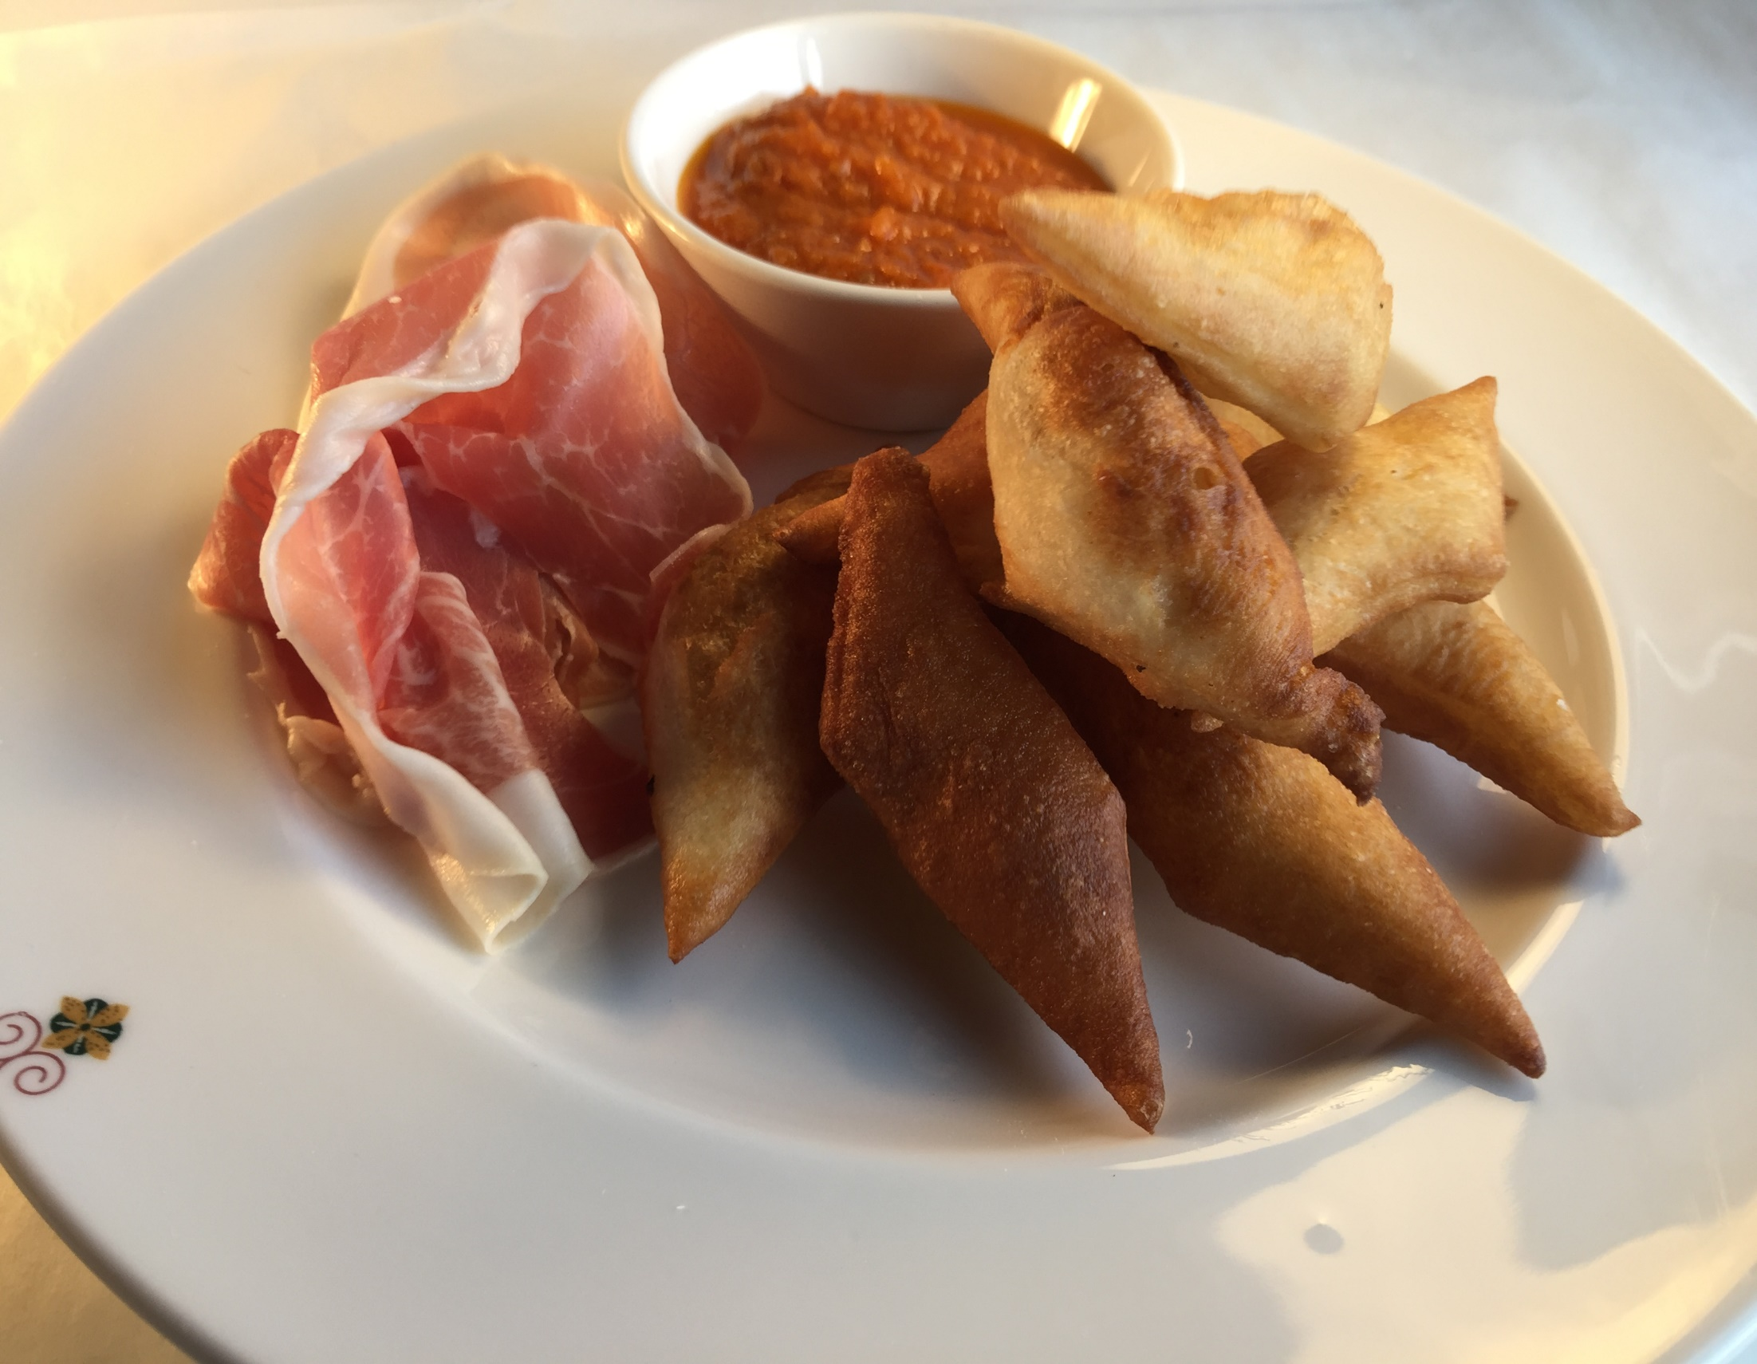
Notes:
Stuzzichino Della Casa – Zonzelle with, roasted tomato & bell pepper passata, extra virgin olive oil, balsamic vinegar

Slide 3
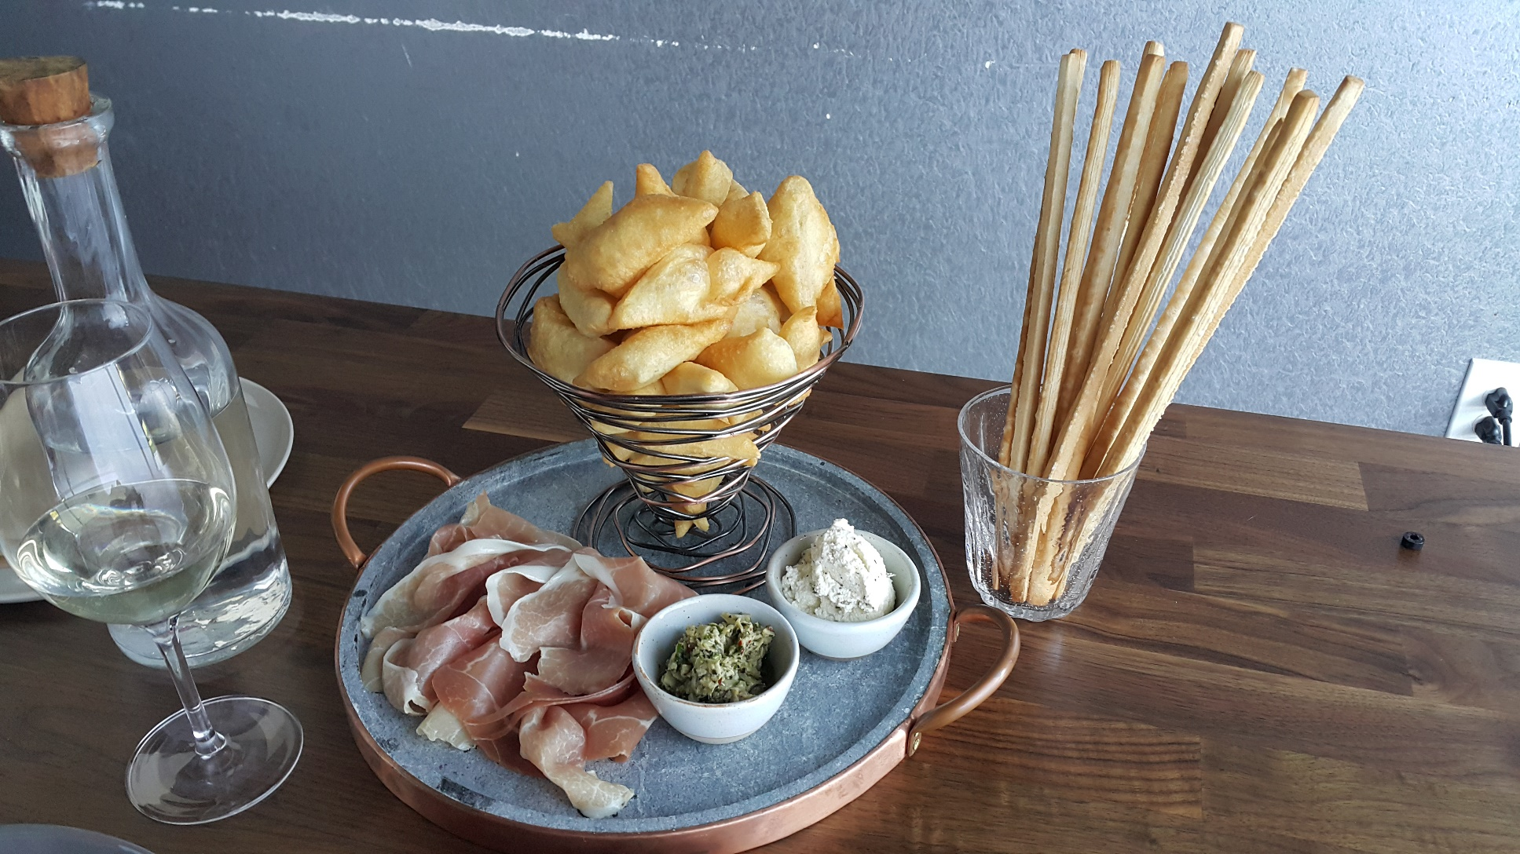

Slide 4

Notes:
Trota Salmonata ,citrus marinated ocean trout,zucchini salad,tomato water ,machè,parsley oil

Slide 5
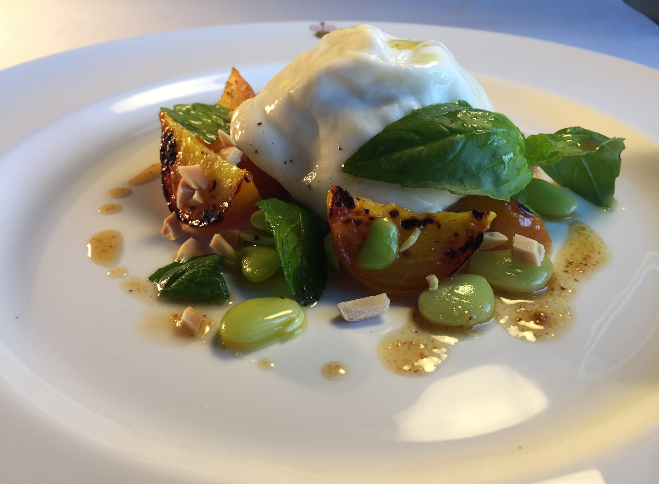
Notes:
Creamy Cow Burrata with Roast Yellon beets,fava beans salad white vine vinegar Balsamic,and Toasted hazelnuts

Slide 6
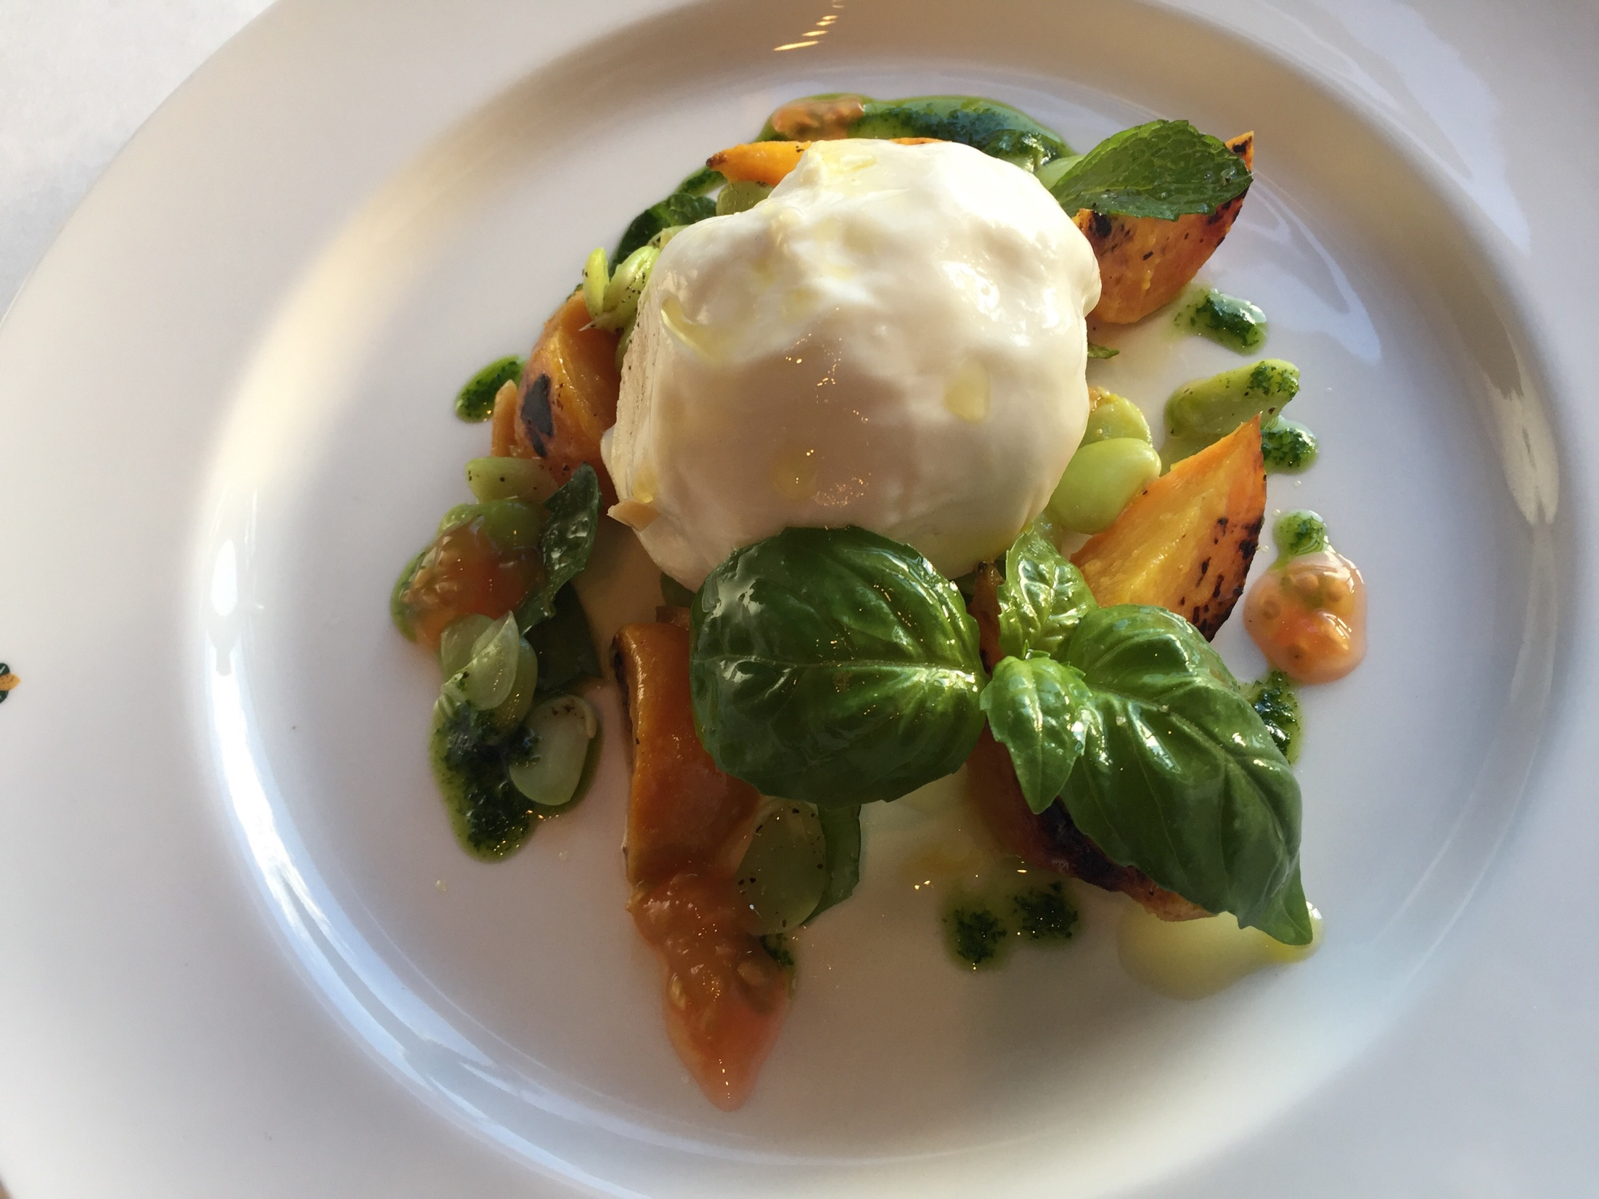
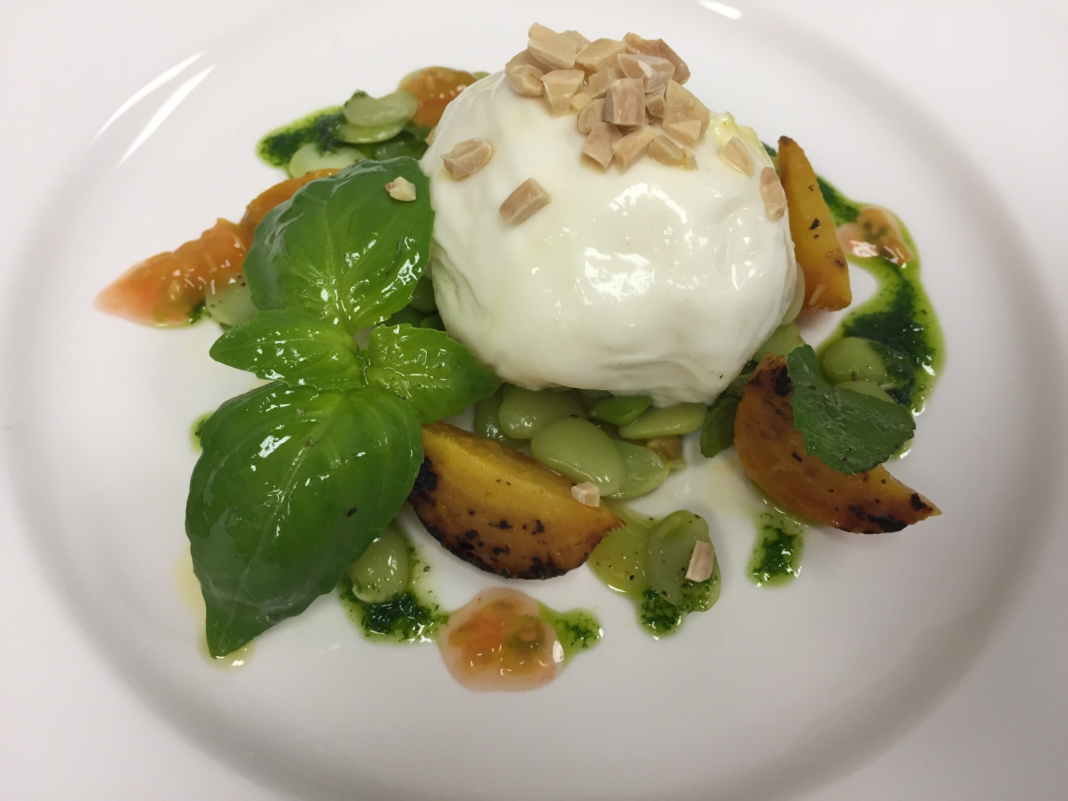
Notes:
Creamy Cow Burrata with Roast Yellon beets,fava beans salad white vine vinegar Balsamic,and Toasted hazelnuts,

Slide 7
Notes:
Spiedini di Agnello-grilled marinated Lamb skewers with oregano&extra virgin oliv oil Rucola salad

Slide 8
Notes:
Piemontesi Roasted bell peppers,capers, alici,green garlic basil vinaigrette

Slide 9
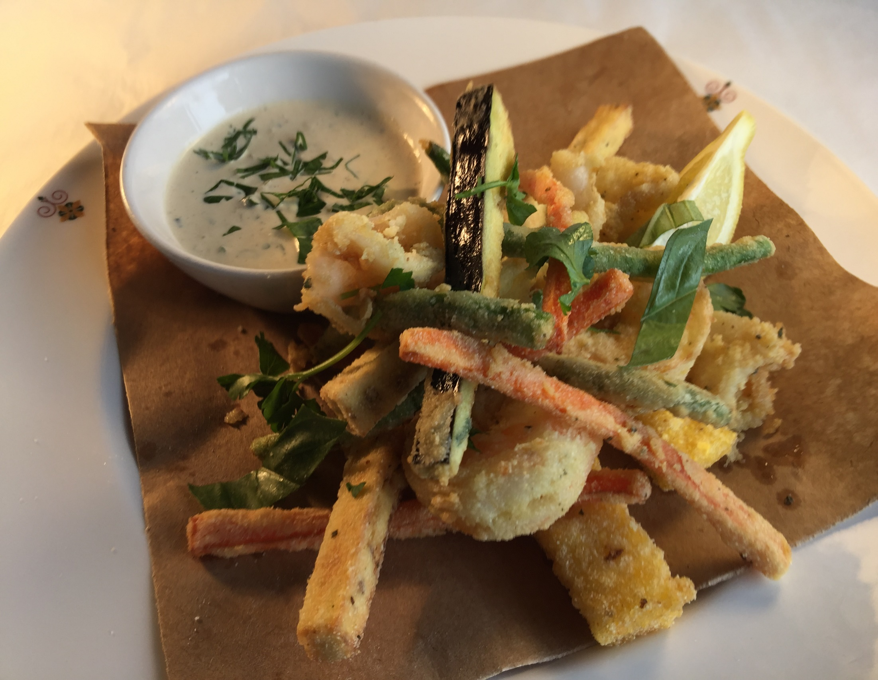
Notes:
Frittino Paranza – chickpea fritters, squid, prawns, eggplant, green beans, carrots

Slide 10
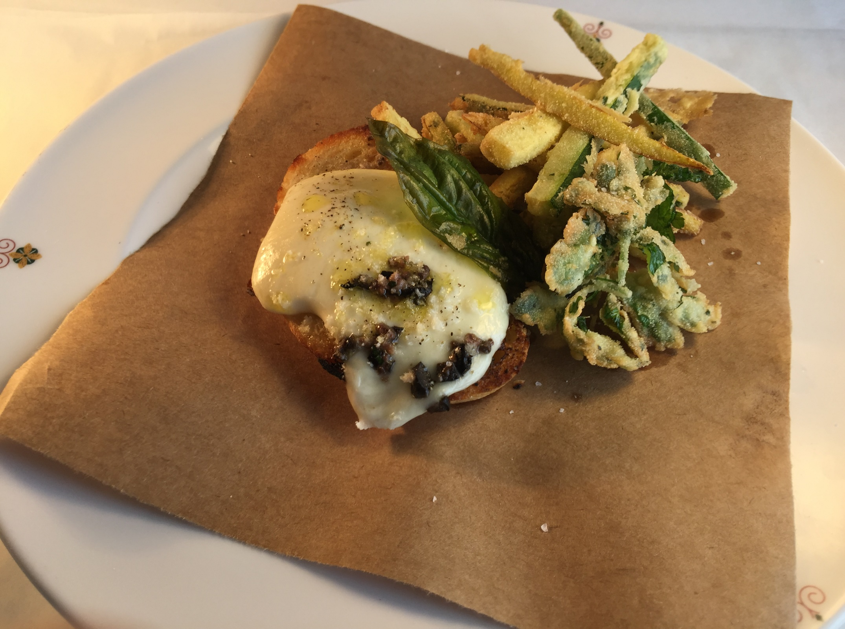
Notes:
Alici – zucchini, mozzarella, toasted house made crostini

Slide 11
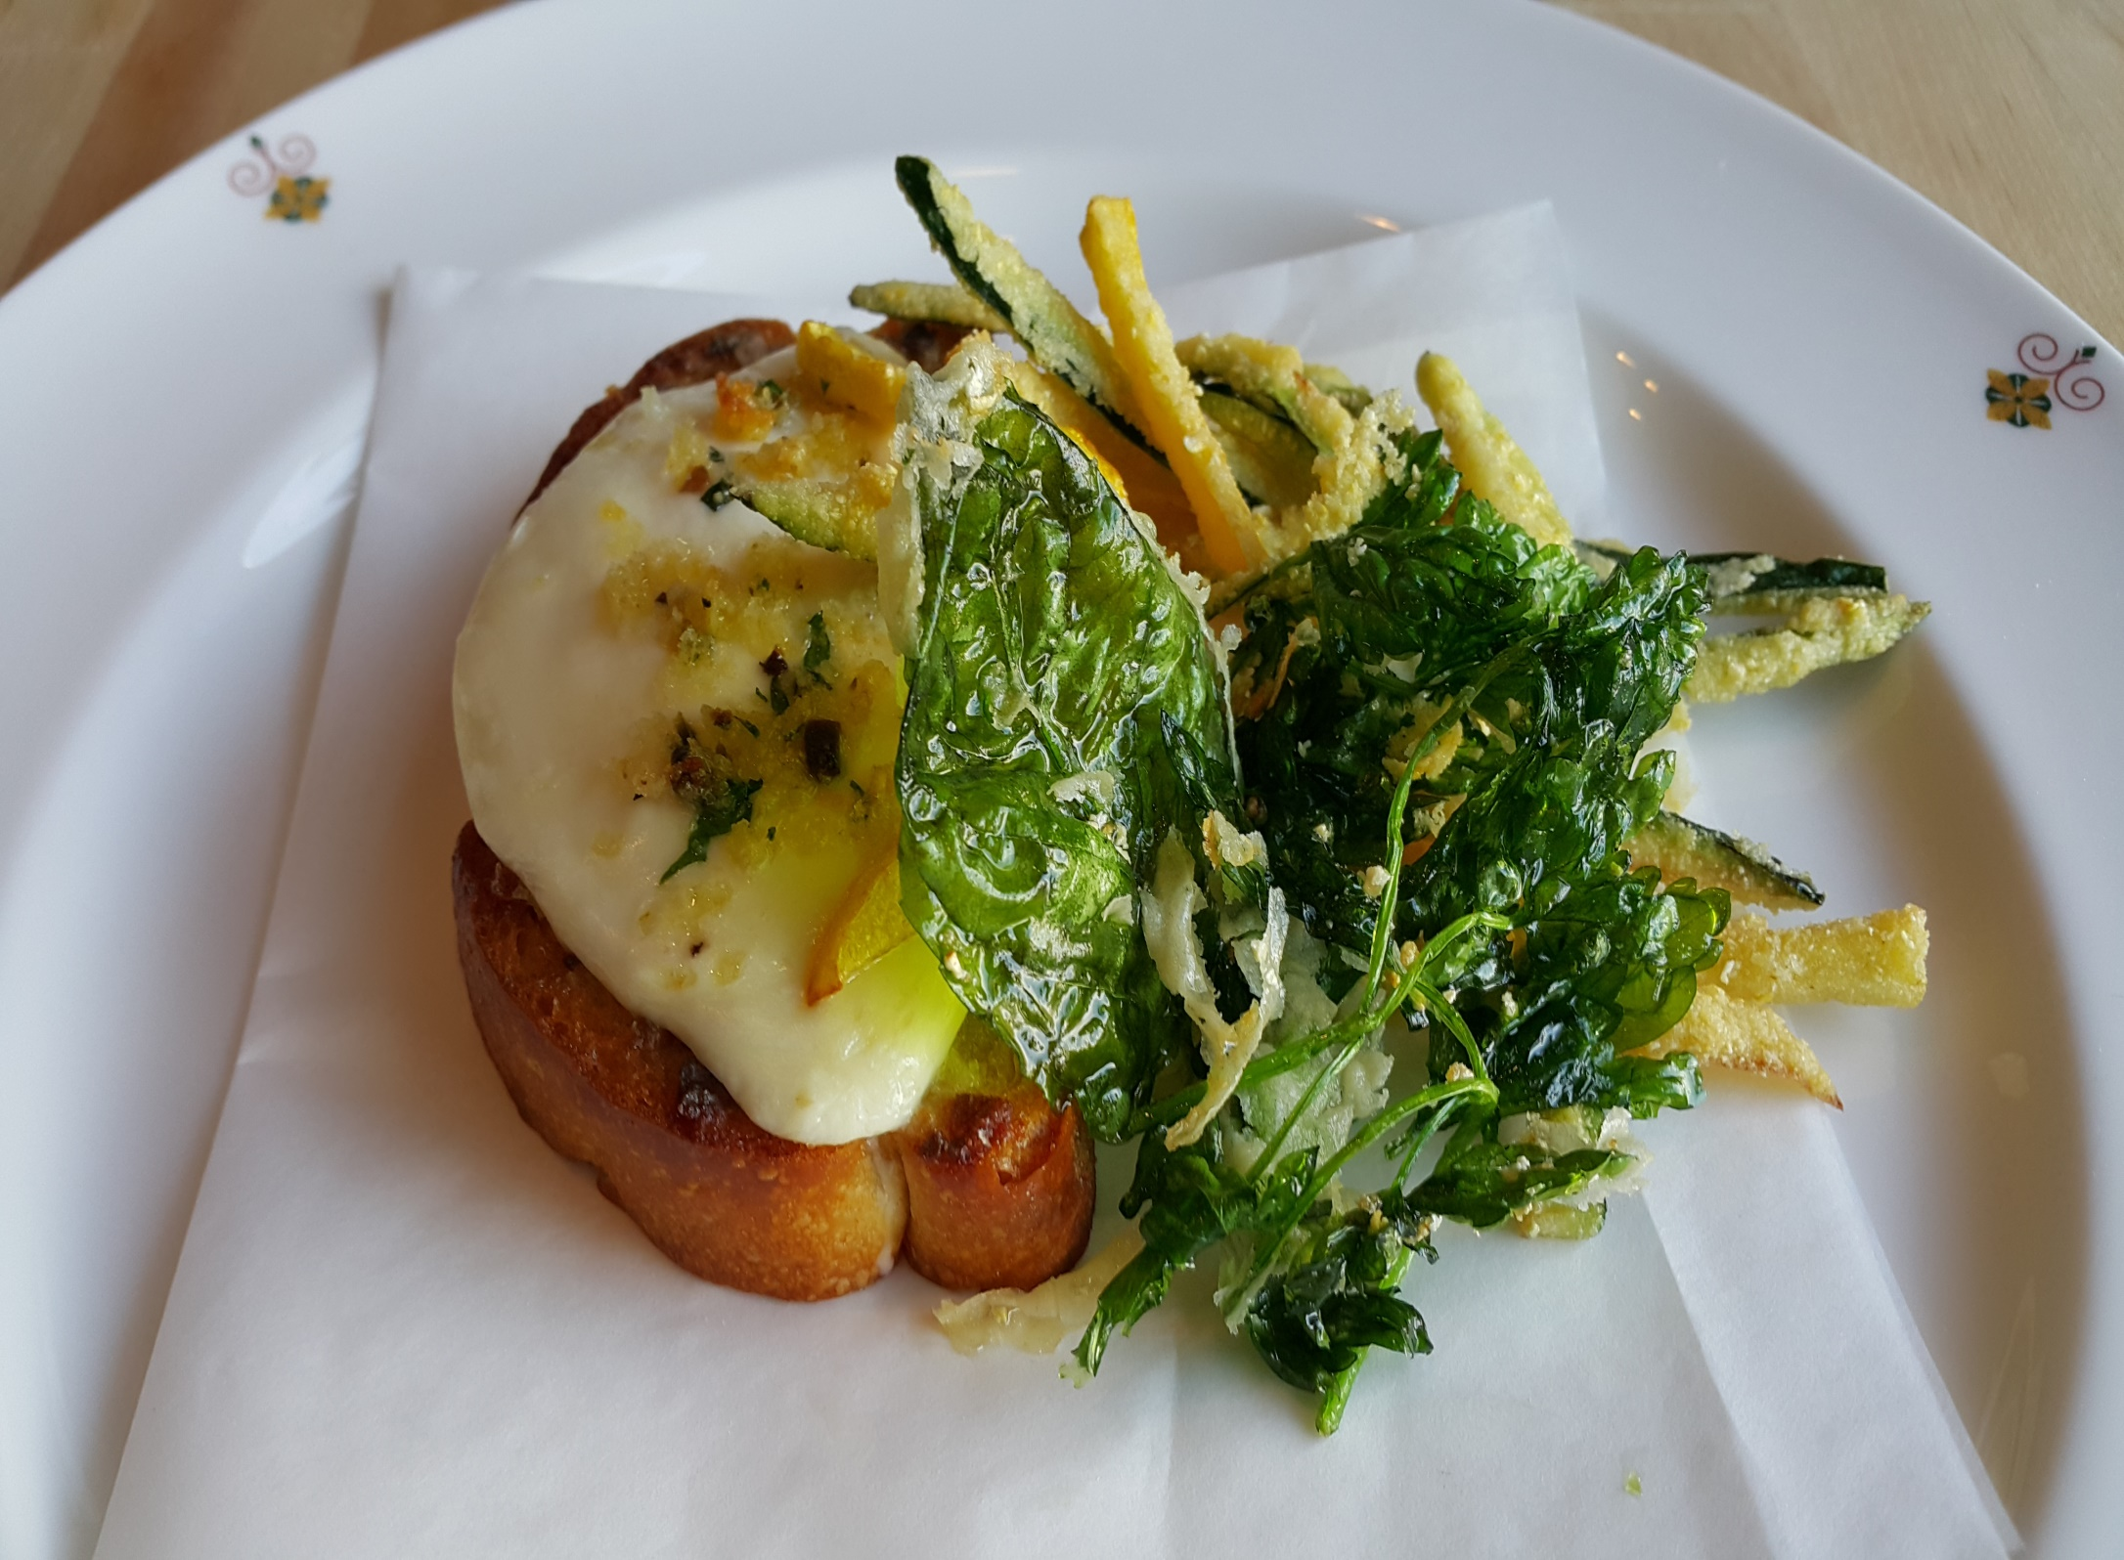
Notes:
Alici -Toasted house made bread crostini,mozzarella,zucchini

Slide 12
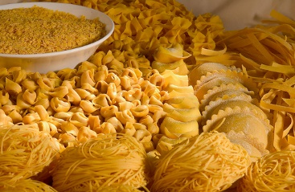
Home Made Pasta & Risotti
Notes:
Pasta e RIisotti

Slide 13
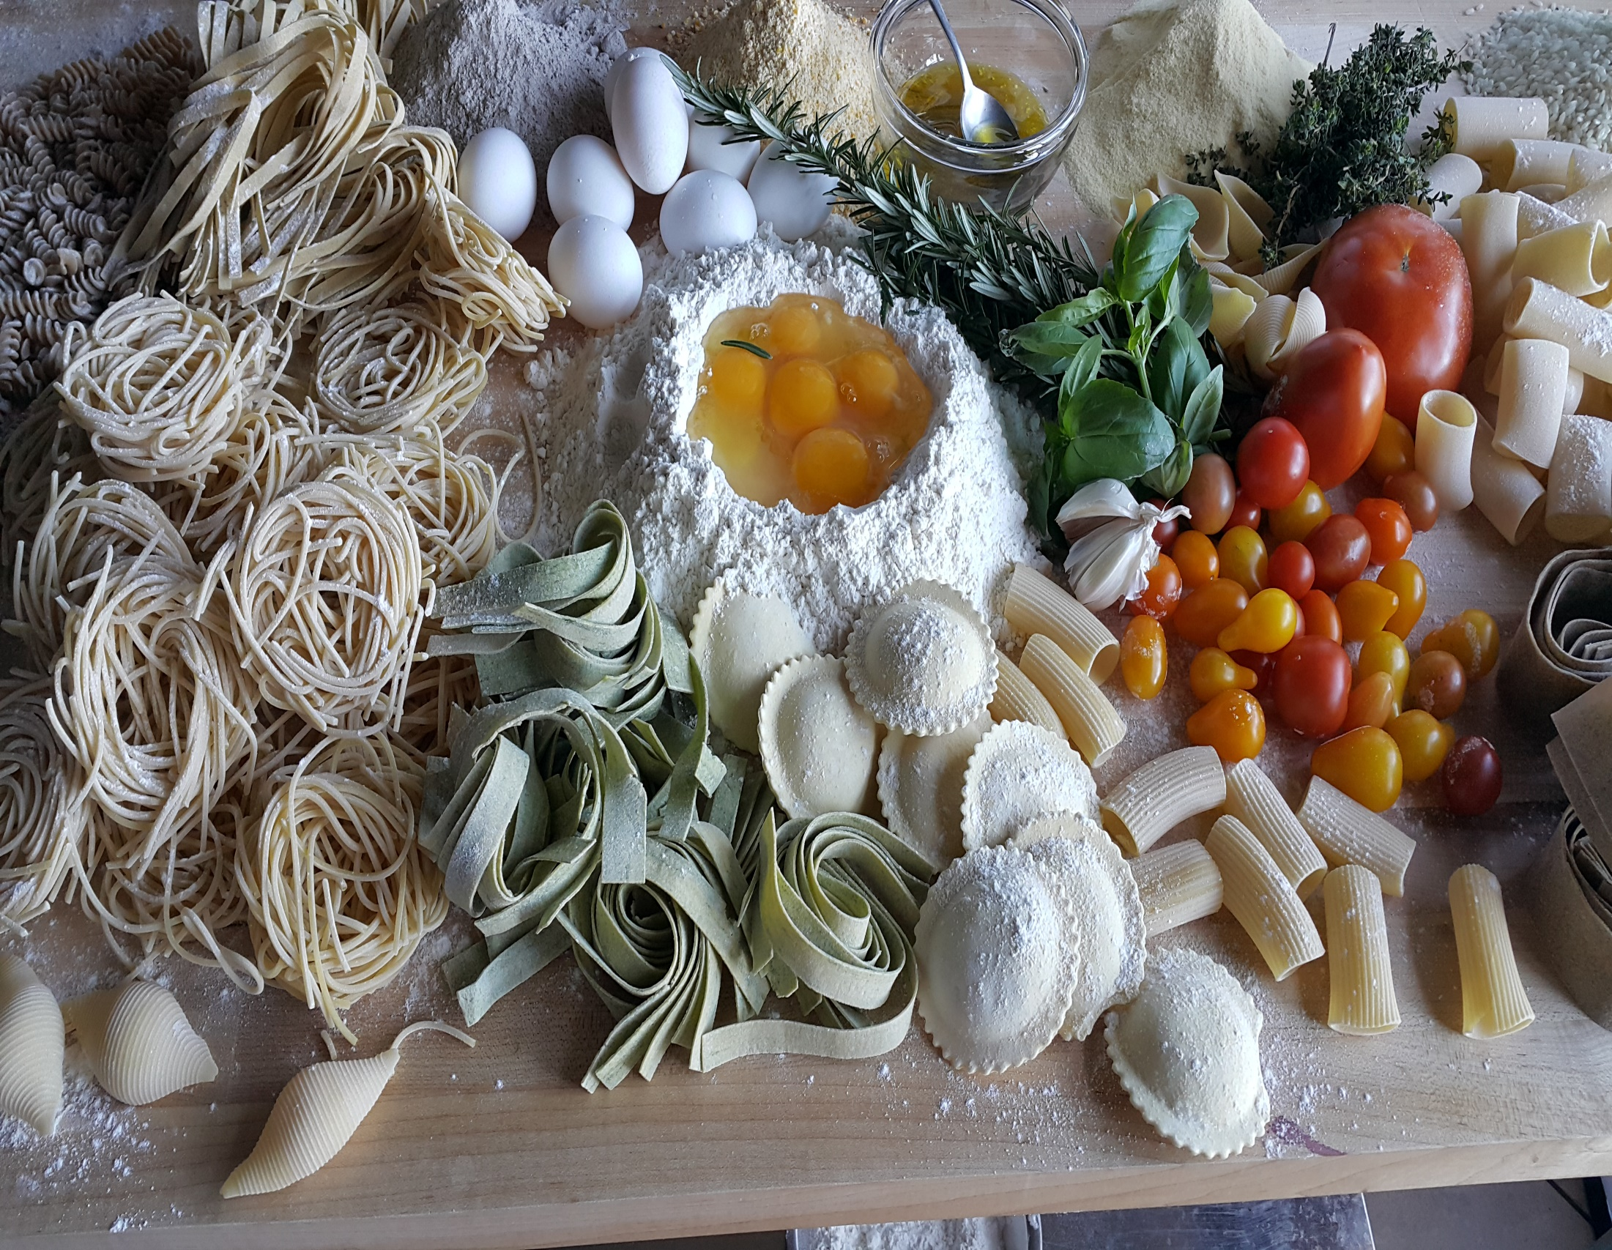

Slide 14
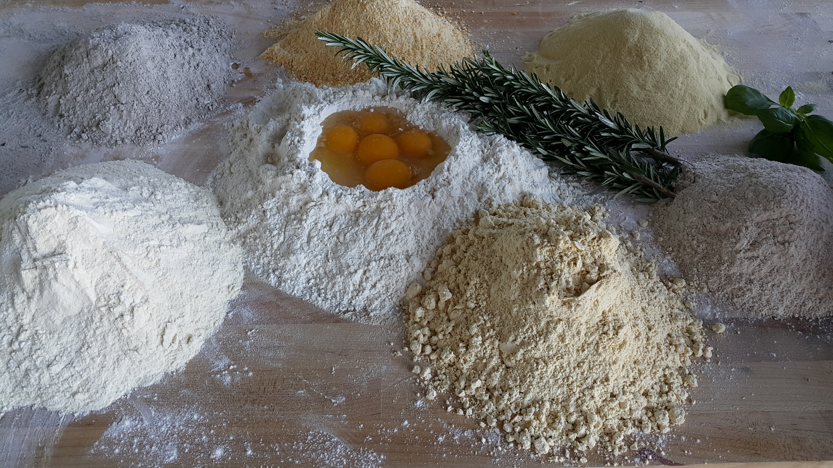

Slide 15
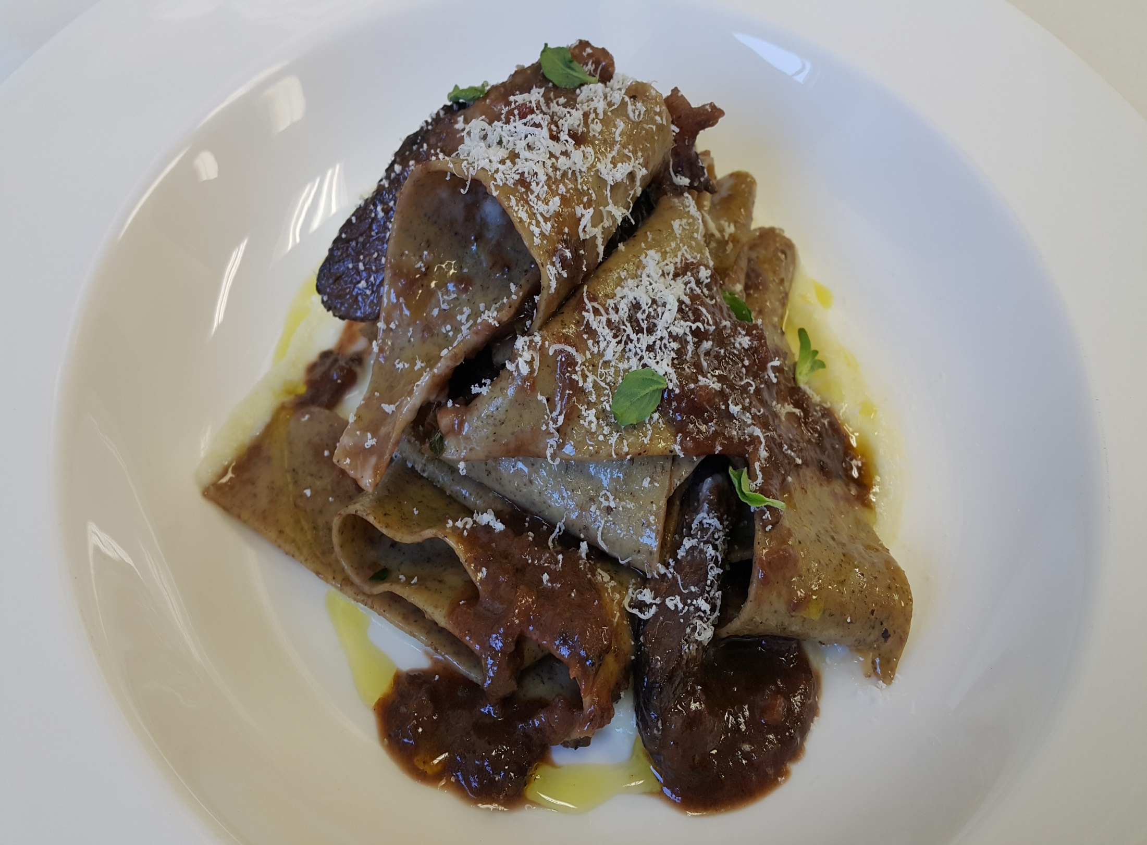
Notes:
Buck Weat wide ribbon pasta ,celeriac, Nebbiolo,Braised,Short ribs

Slide 16
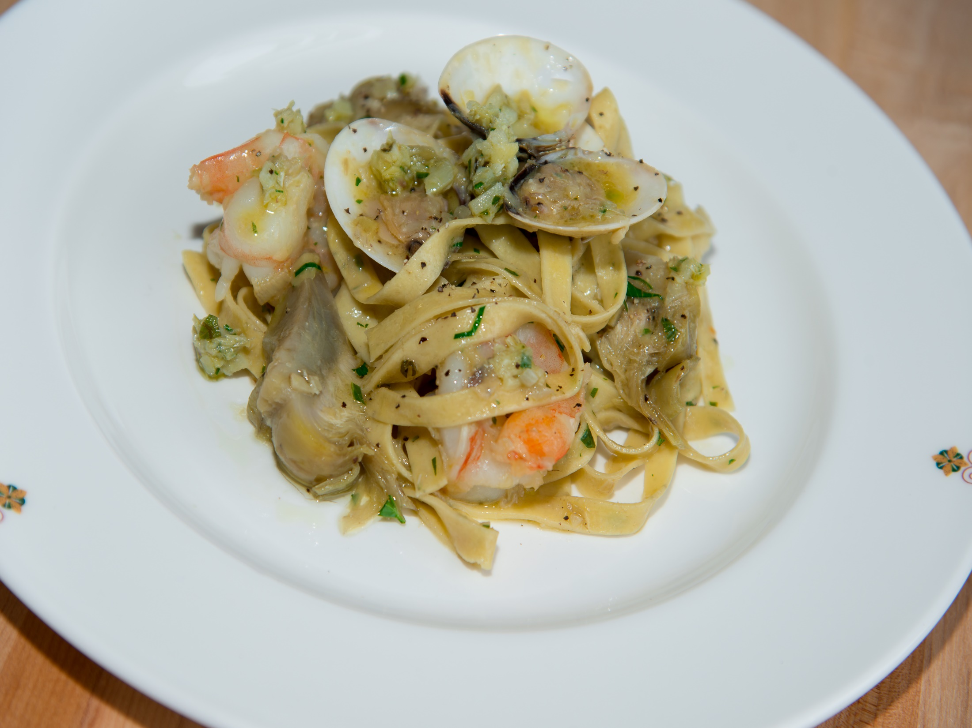
Notes:
Piccage Marjoran infused long Pasta , white prawns.artichoke pesto,Ligurian oliv oil

Slide 17
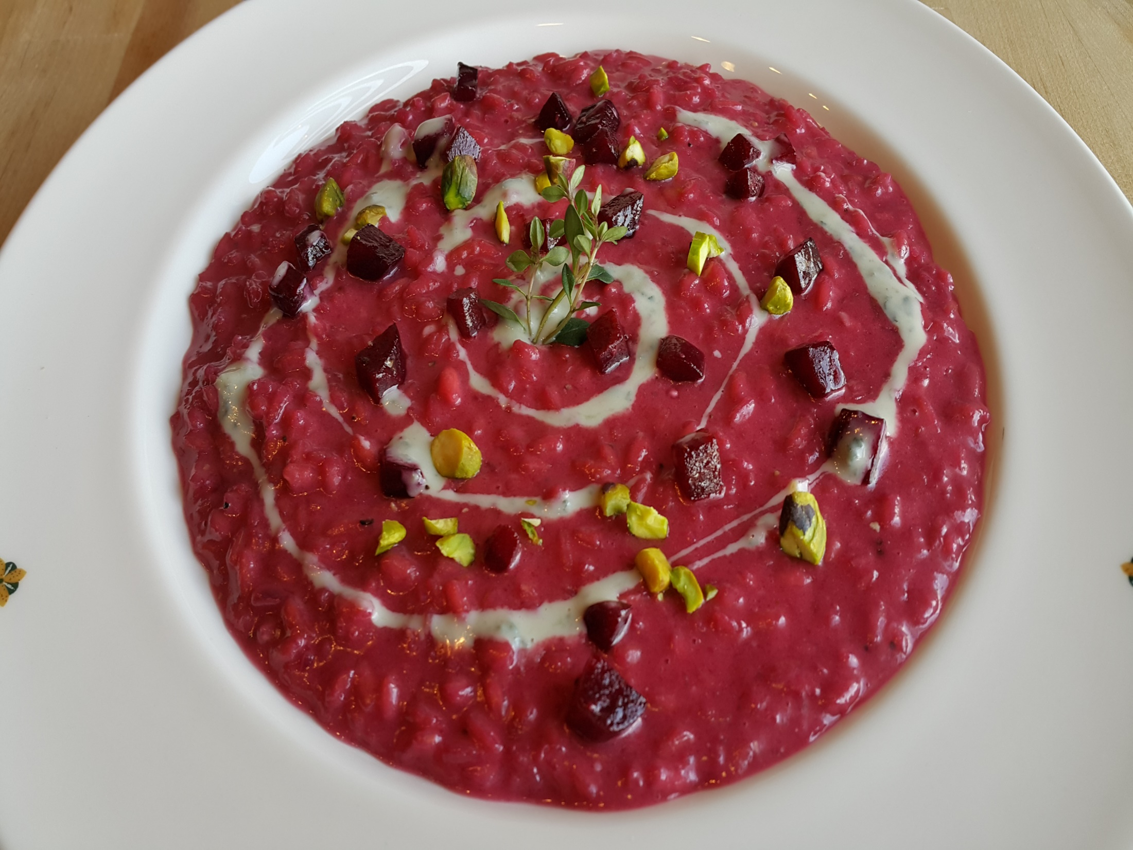
Notes:
Risotto'' Vialone Nano Rice'' Beets dolce latte,gorgonzola ,Pistacchio

Slide 18
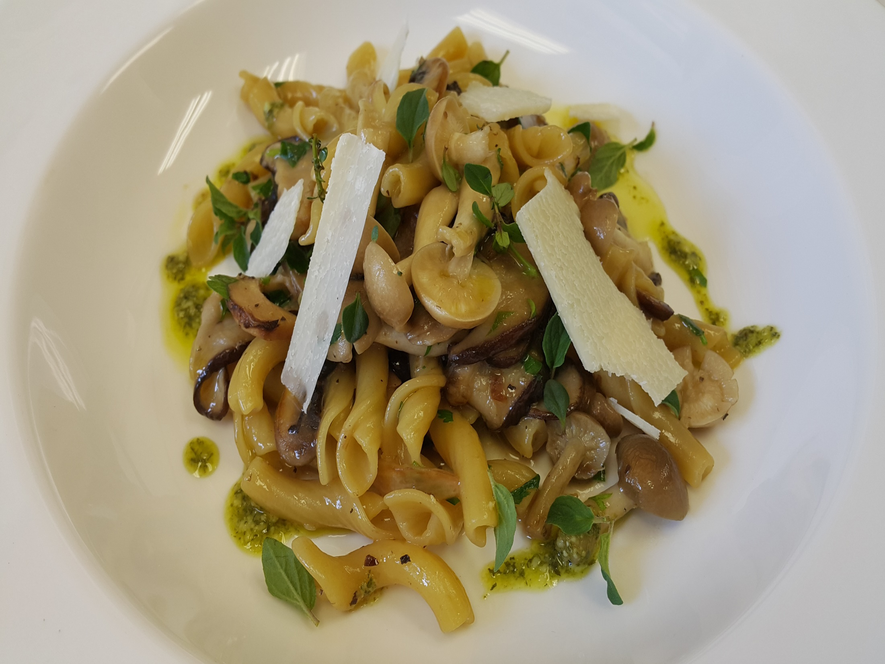
Notes:
Torchietti-whole wheat pasta ,foraged mushrooms,rosmarin

Slide 19
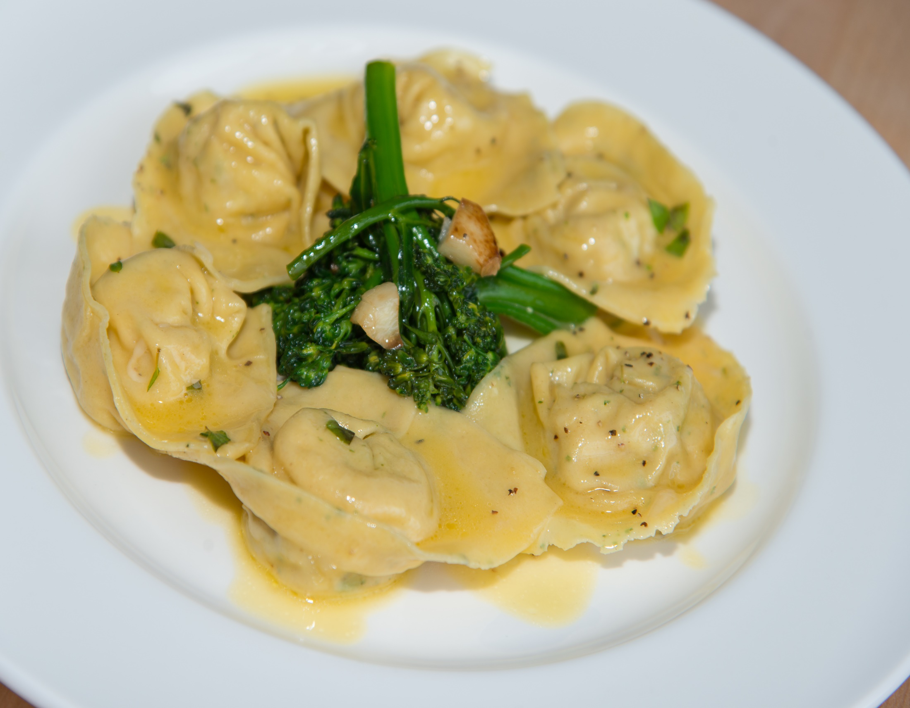
Notes:
rtelloni,Mint speckled ,roasted Lamb,crosta nera Pecorino,Broccoli rabe

Slide 20
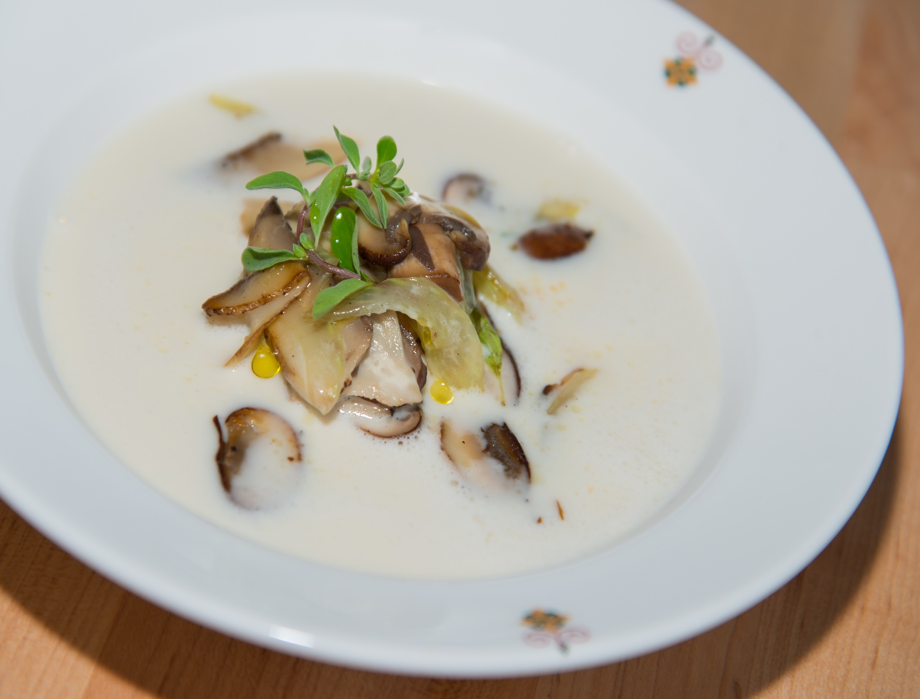
Notes:
Grana Padano Fondue,with Celery,Foraged Mushrooms,Toasted Hazelnuts

Slide 21
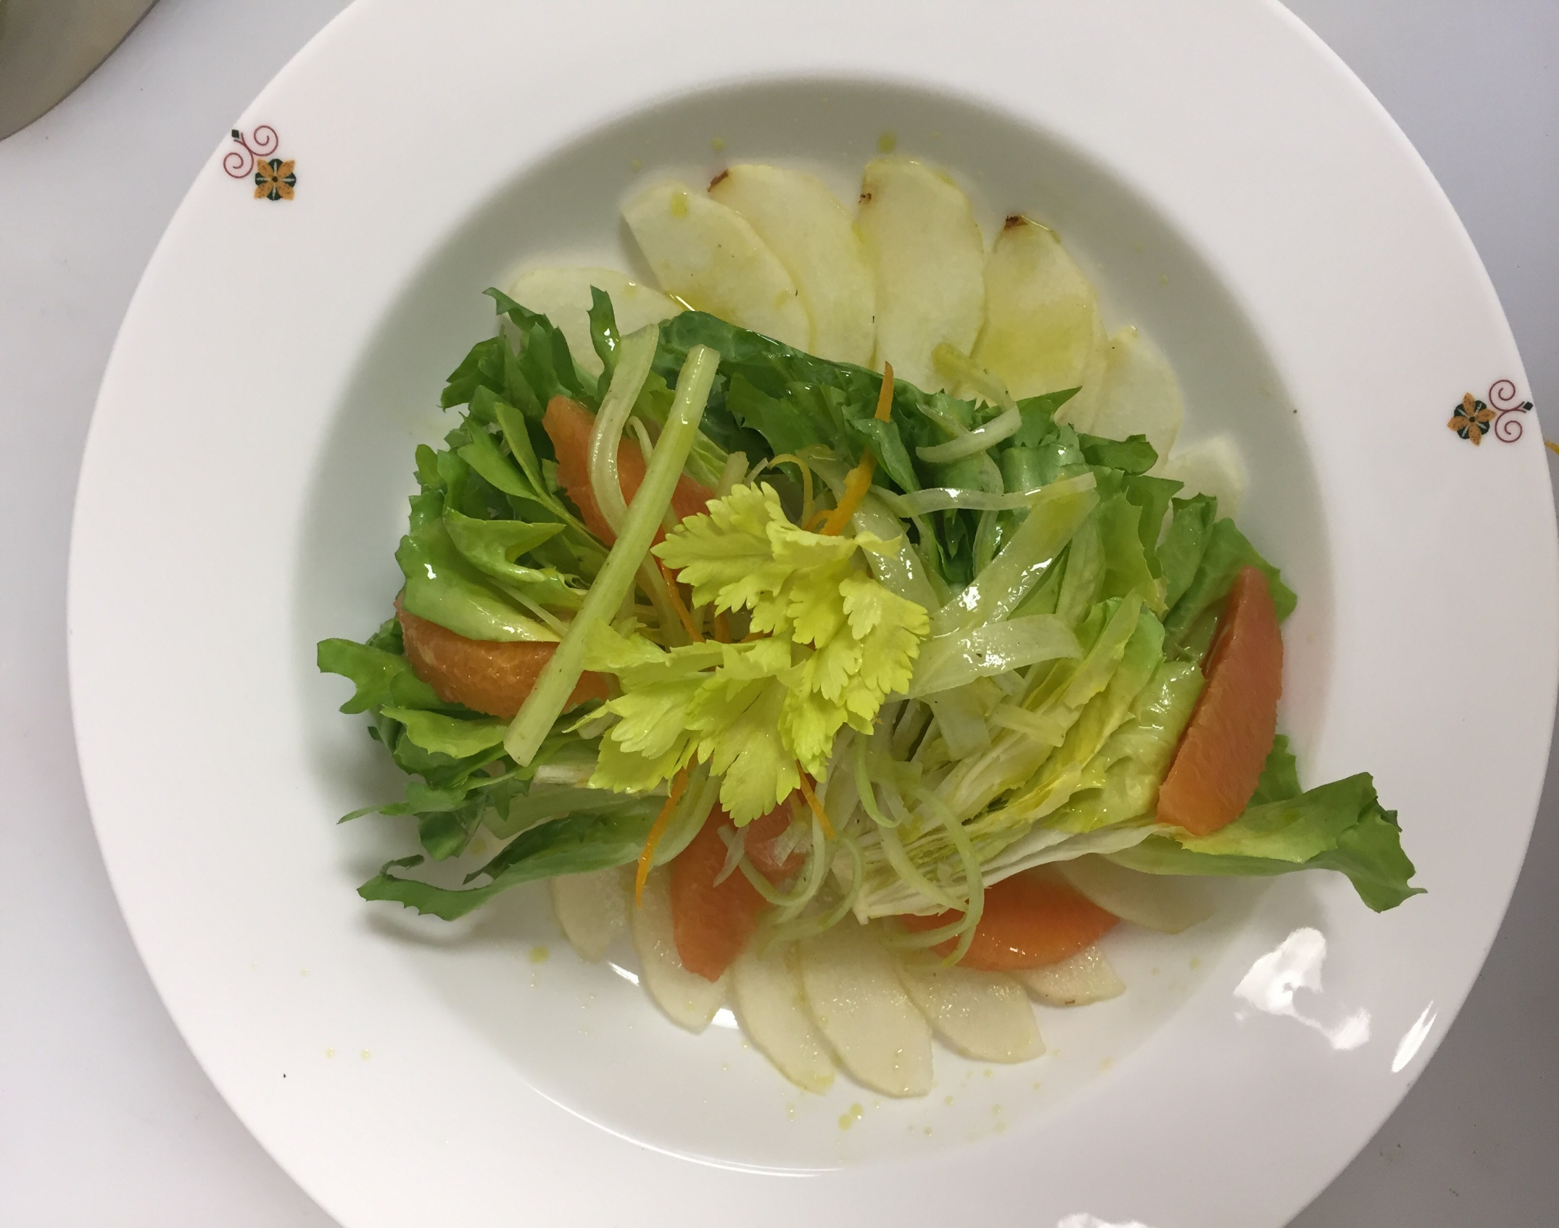
Notes:
Insalata Di Sedano, Scarola E Pere Alla Scorza D'Arancia – escarole, white celery, pear, orange zest

Slide 22
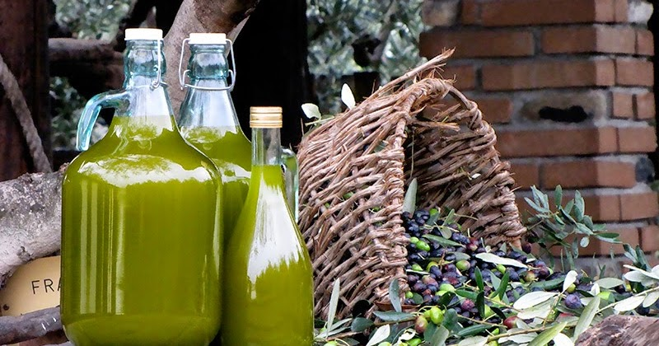
Secondi Piatti
Secondi Piatti
Meat & Fish

Slide 23
Notes:
Roman Seafood Papillote/Cartoccio
with Black Mussel, Shrimp, Grouper, scalops, Potato and Artichoke

Slide 24
Notes:
Roman Seafood Papillote/Cartoccio
with Black Mussel, Shrimp, Grouper, scalops, Potato and Artichoke

Slide 25
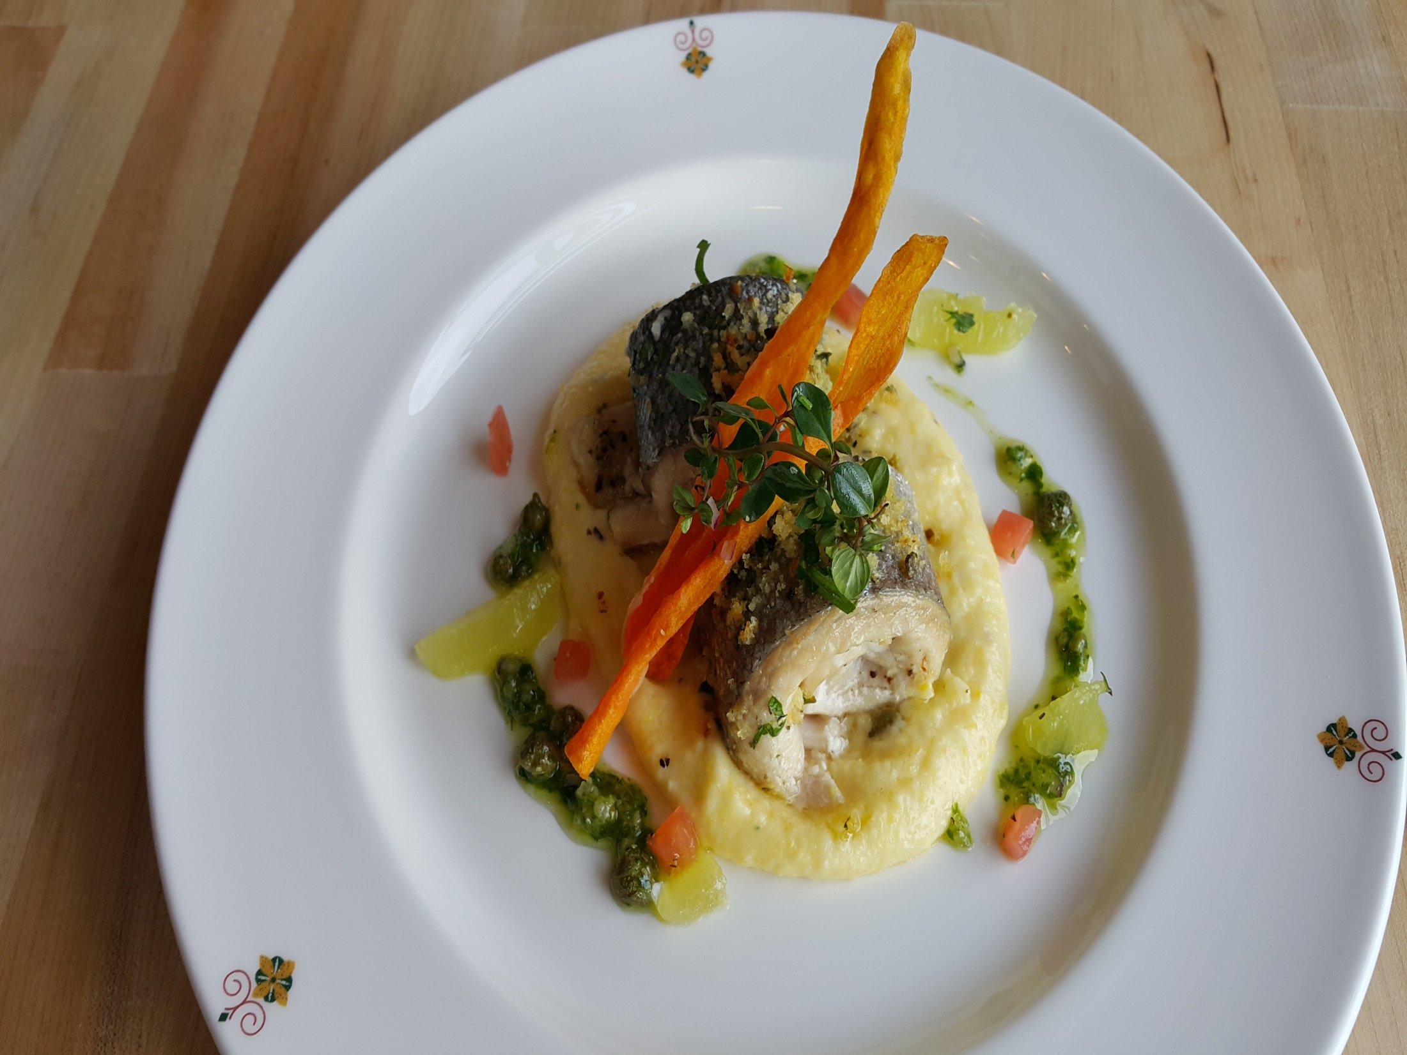
Notes:
Herb Trout Fillet ,lake Iseo a la mode di Francesco

Slide 26
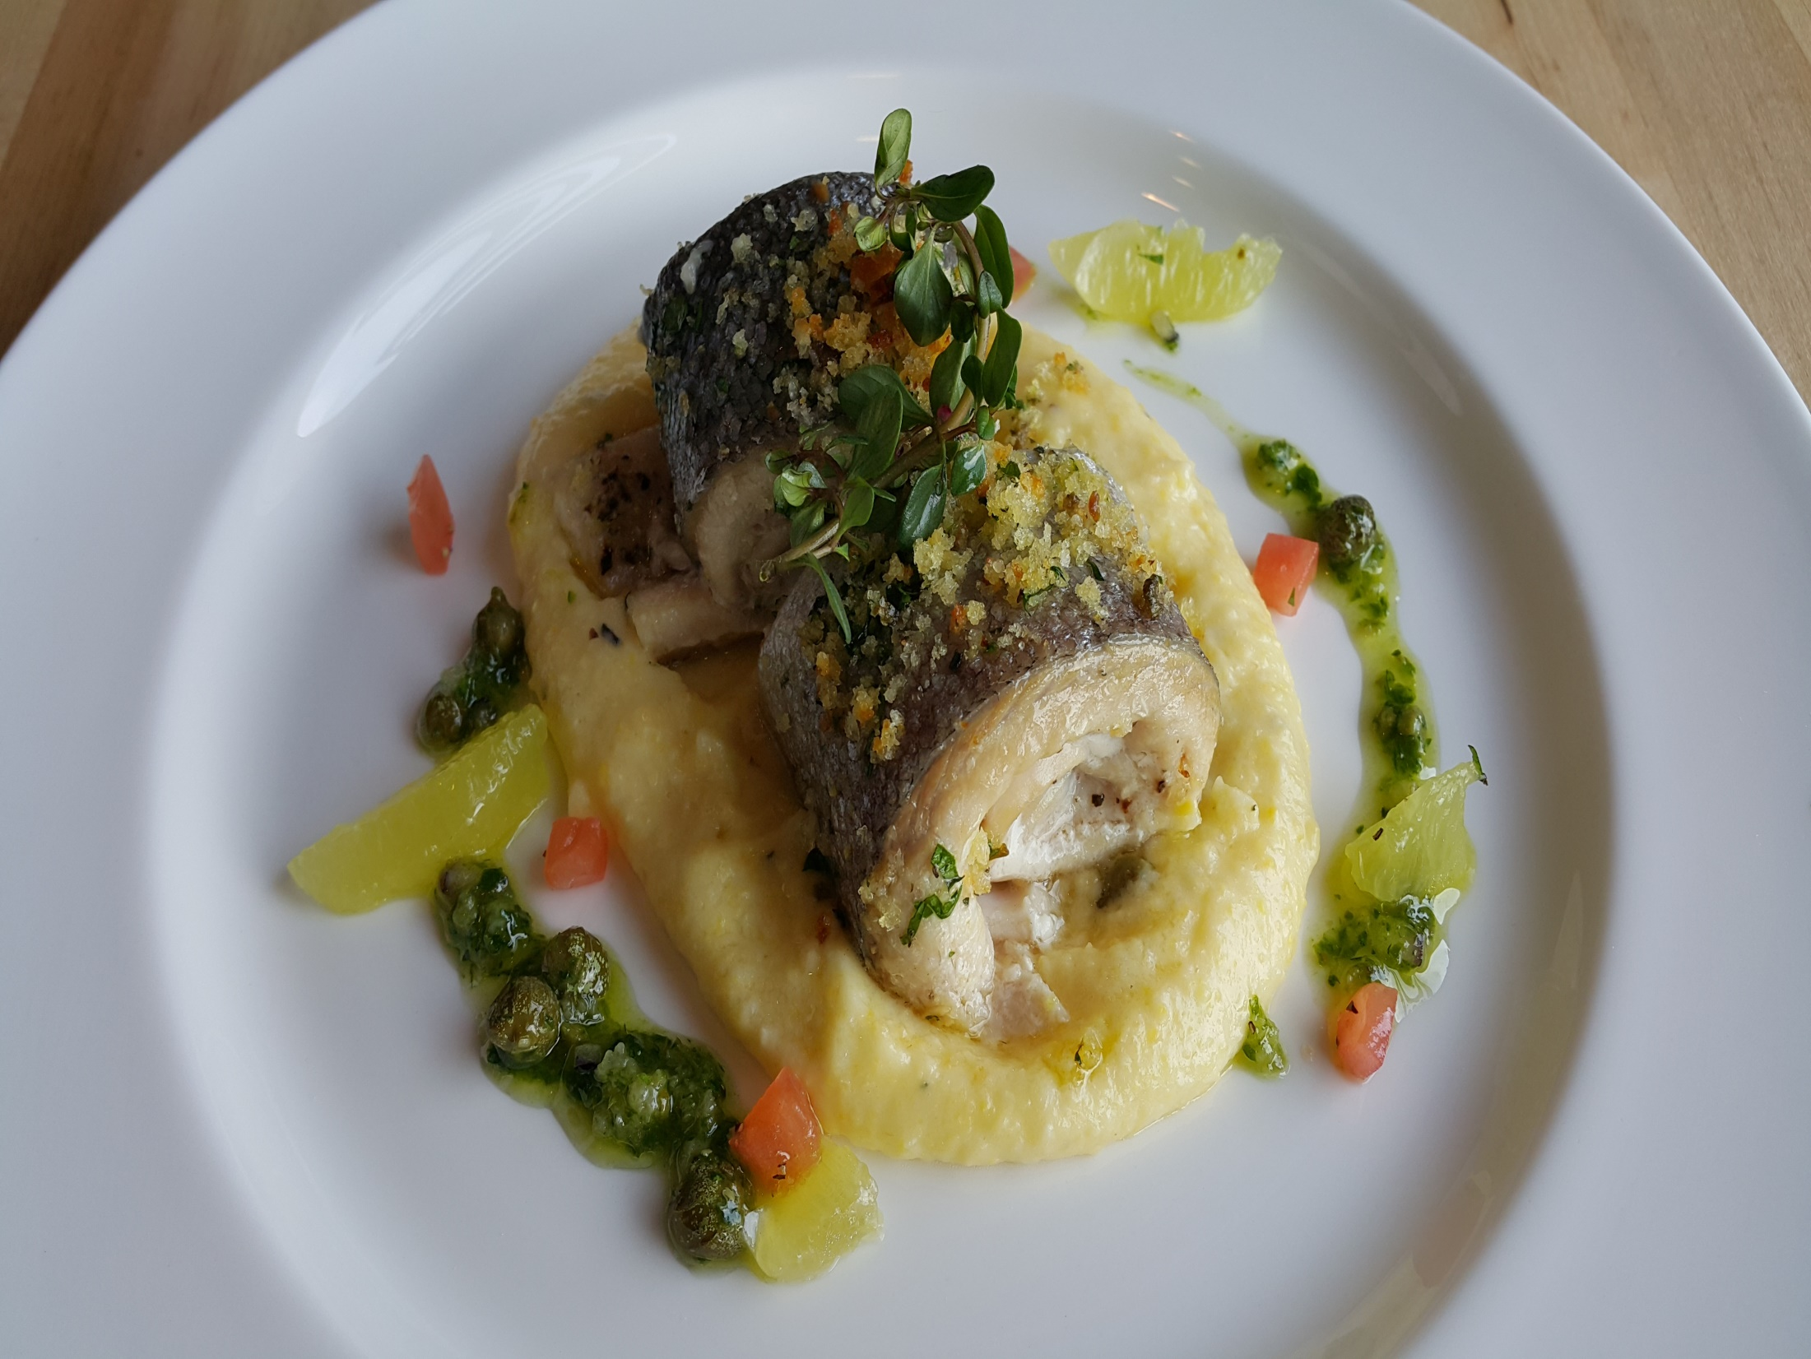
Notes:
Herb Trout Fillet ,lake Iseo a la mode di Francesco

Slide 27
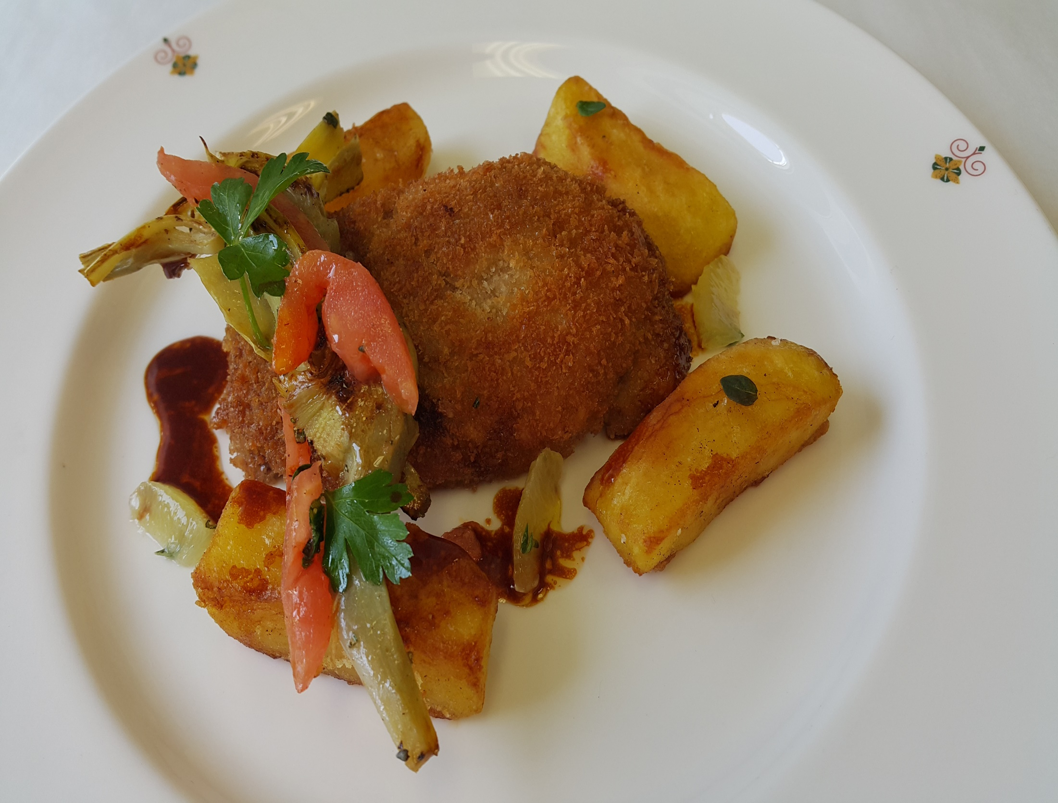
Notes:
Breaded Veal Vallet – roasted artichoke, provolone, marjoram roasted potatoes

Slide 28
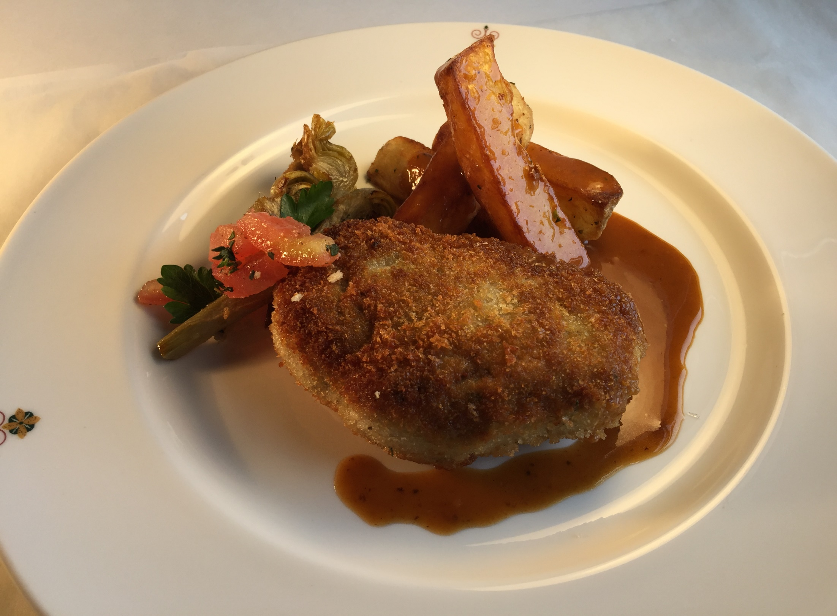
Notes:
Breaded Veal Vallet – roasted artichoke, provolone, marjoram roasted potatoes

Slide 29
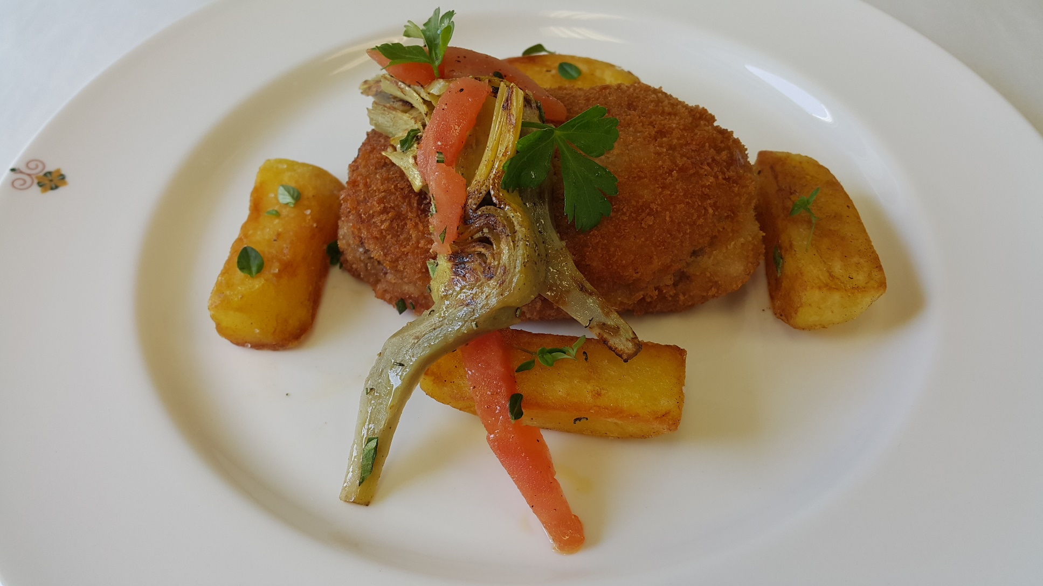
Notes:
Breaded Veal Vallet – roasted artichoke, provolone, marjoram roasted potatoes

Slide 30
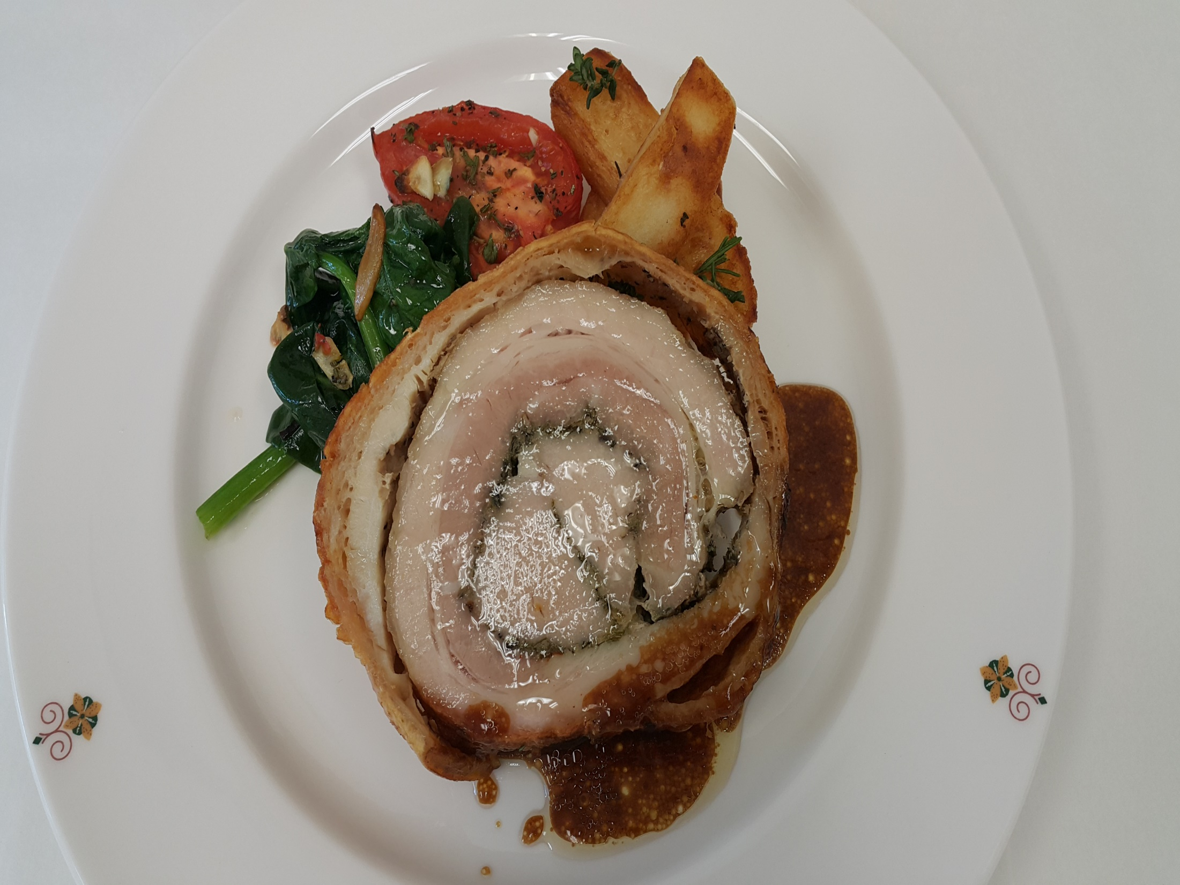
Notes:
Porchetta
Rolled pork belly Toscana with erbs ,fennel,celery served with Potatoes of the day, & spinach ,Tomato stew

Slide 31
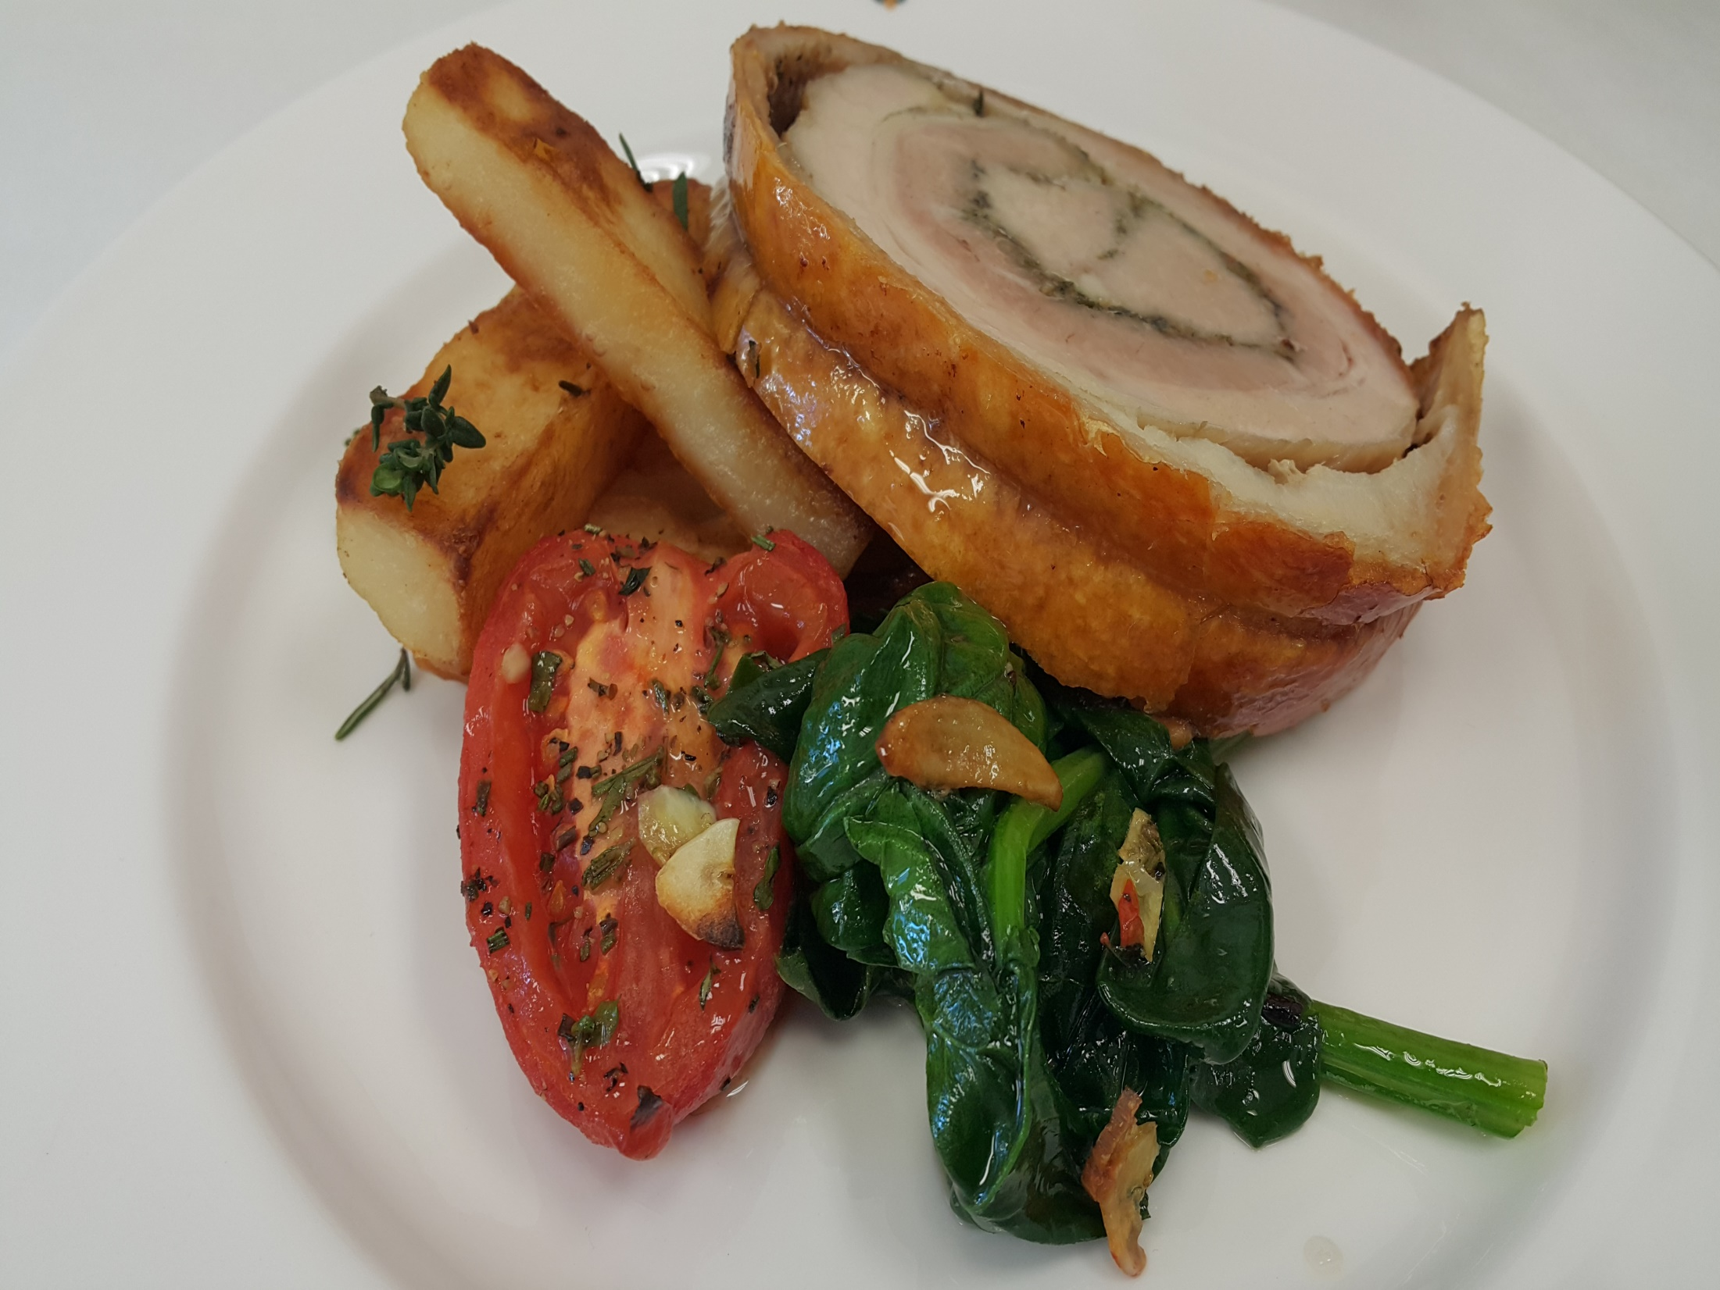
Notes:
Porchetta
Rolled pork belly Toscana with erbs ,fennel,celery served with Potatoes of the day, & spinach ,Tomato stew

Slide 32
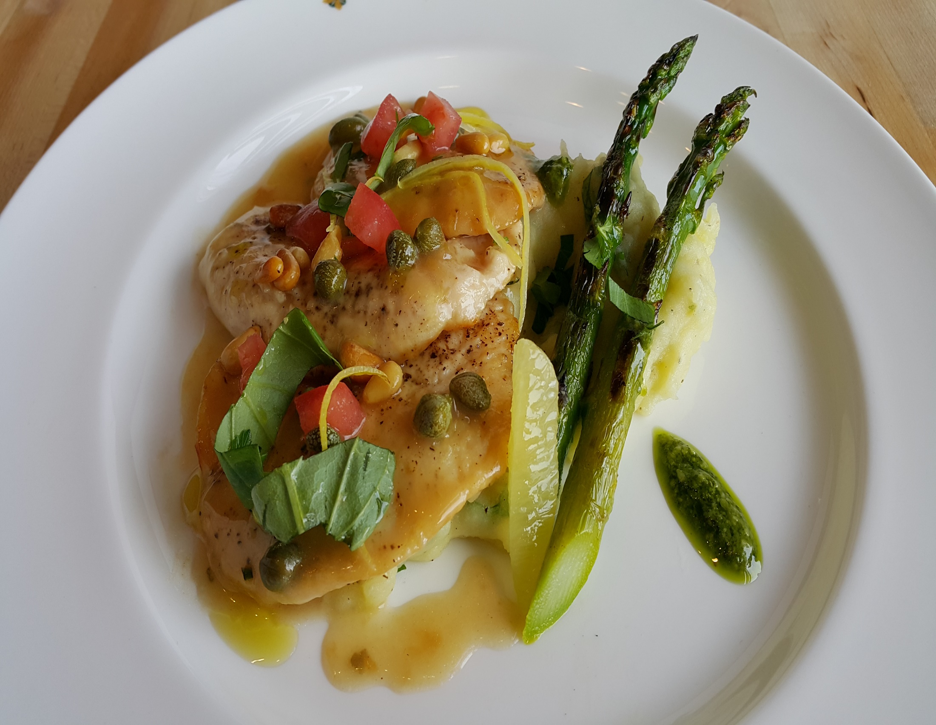
Notes:
Scallopine di Pollo , Salsa al Limoncello con Rosemarino
Seared Chicken Breast,Sorrento Lemon,Rosemary sauce,garlic,pinenuts and capers,served with Forked Potatoes

Slide 33
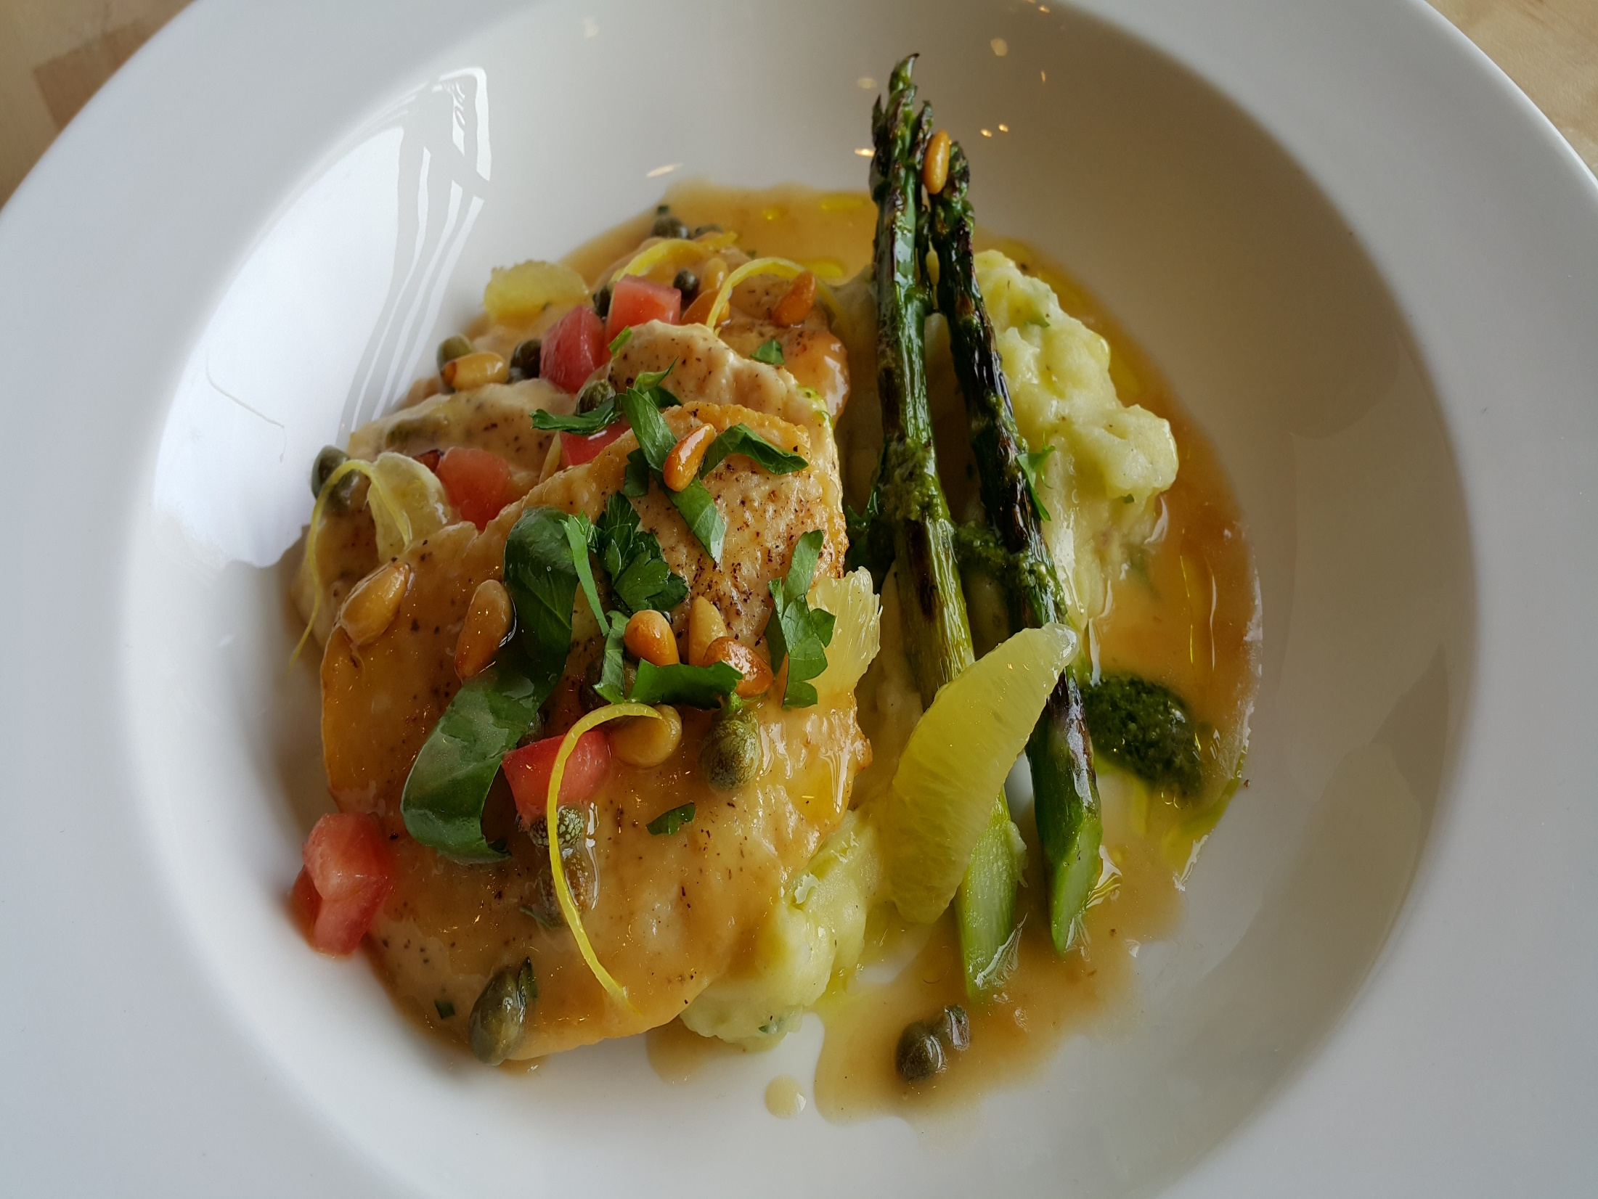
Notes:
Scallopine di Pollo , Salsa al Limoncello con Rosemarino
Seared Chicken Breast,Sorrento Lemon,Rosemary sauce,garlic,pinenuts and capers,served with( fettuccine or Forked Potatoes)

Slide 34
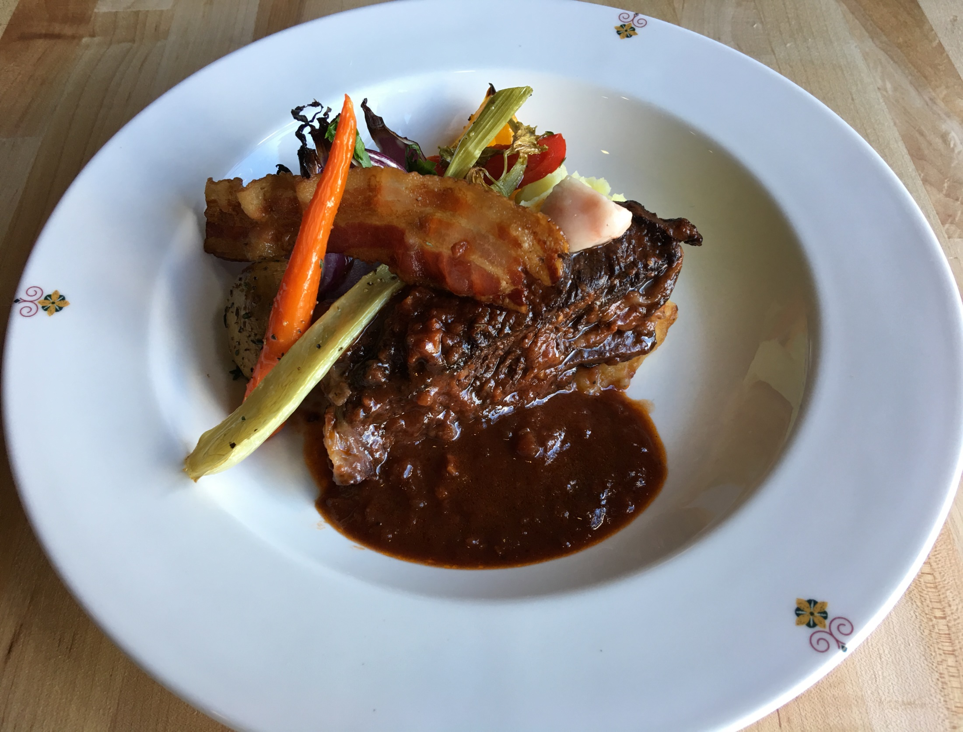
Notes:
Brasato di Manzo, Barolo & Pancetta
Slow braised Beef boneless short ribs in rich red wine sauce, Root Vegetable Casserole

Slide 35
Notes:
Polenta Soffice
Soft Polenta with Mushrooms, Fresh Mozzarella Cheese and Truffle Essence

Slide 36
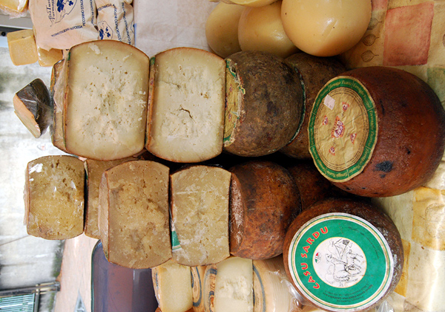
Selezione dei Formaggi Italiani,
Truffle-Honey,&Special Bread

Slide 37
(Slide 3) Deconstructed Tiramisu, espresso Sauce, Dark Chocolate Mousse and Coffee Kahlua Jelly.
(Slide 5,6) Vanilla Panna Cotta, Blueberry Compote, Almond Biscuit, Lemon Cream and Whipped Cream
(Slide 7,8) Fresh Berries Zabaglione
(Slide 9,10) Surprise
(Slide 11,12) Chocolate Rocher (Norman Love)

Slide 38
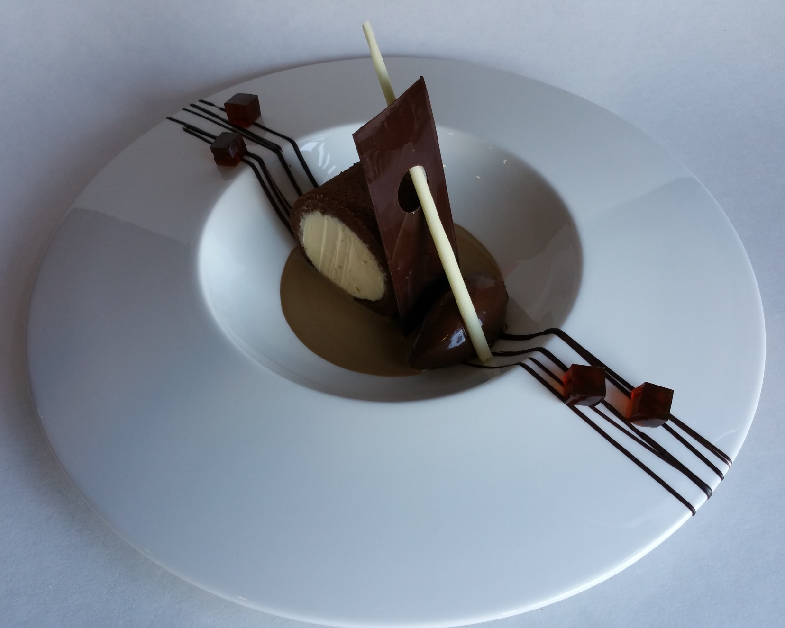

Slide 39
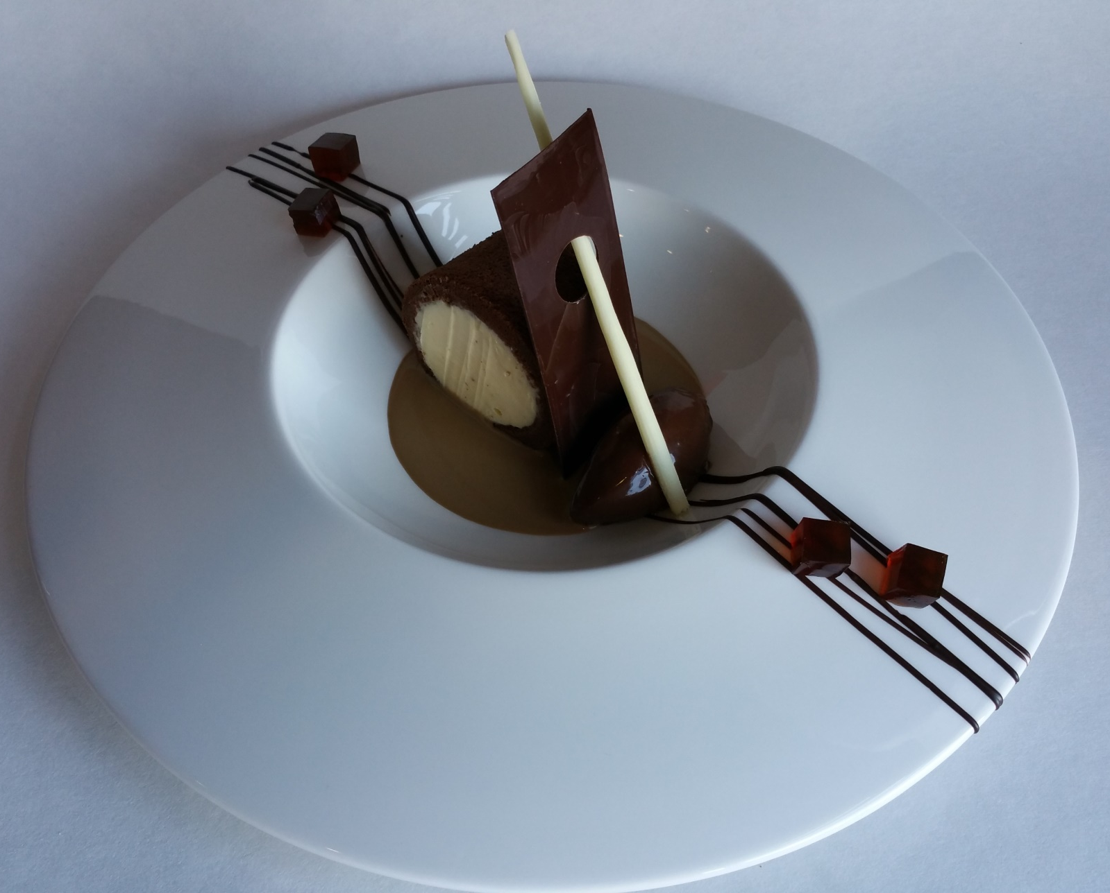
COFFEE KAHLUA JELLY
CHOCOLATE BISCUIT
CHOCOLATE DECOR
MASCARPONE
CREAM
ESPRESSO SAUCE
CHOCOLATE MOUSSE

Slide 40
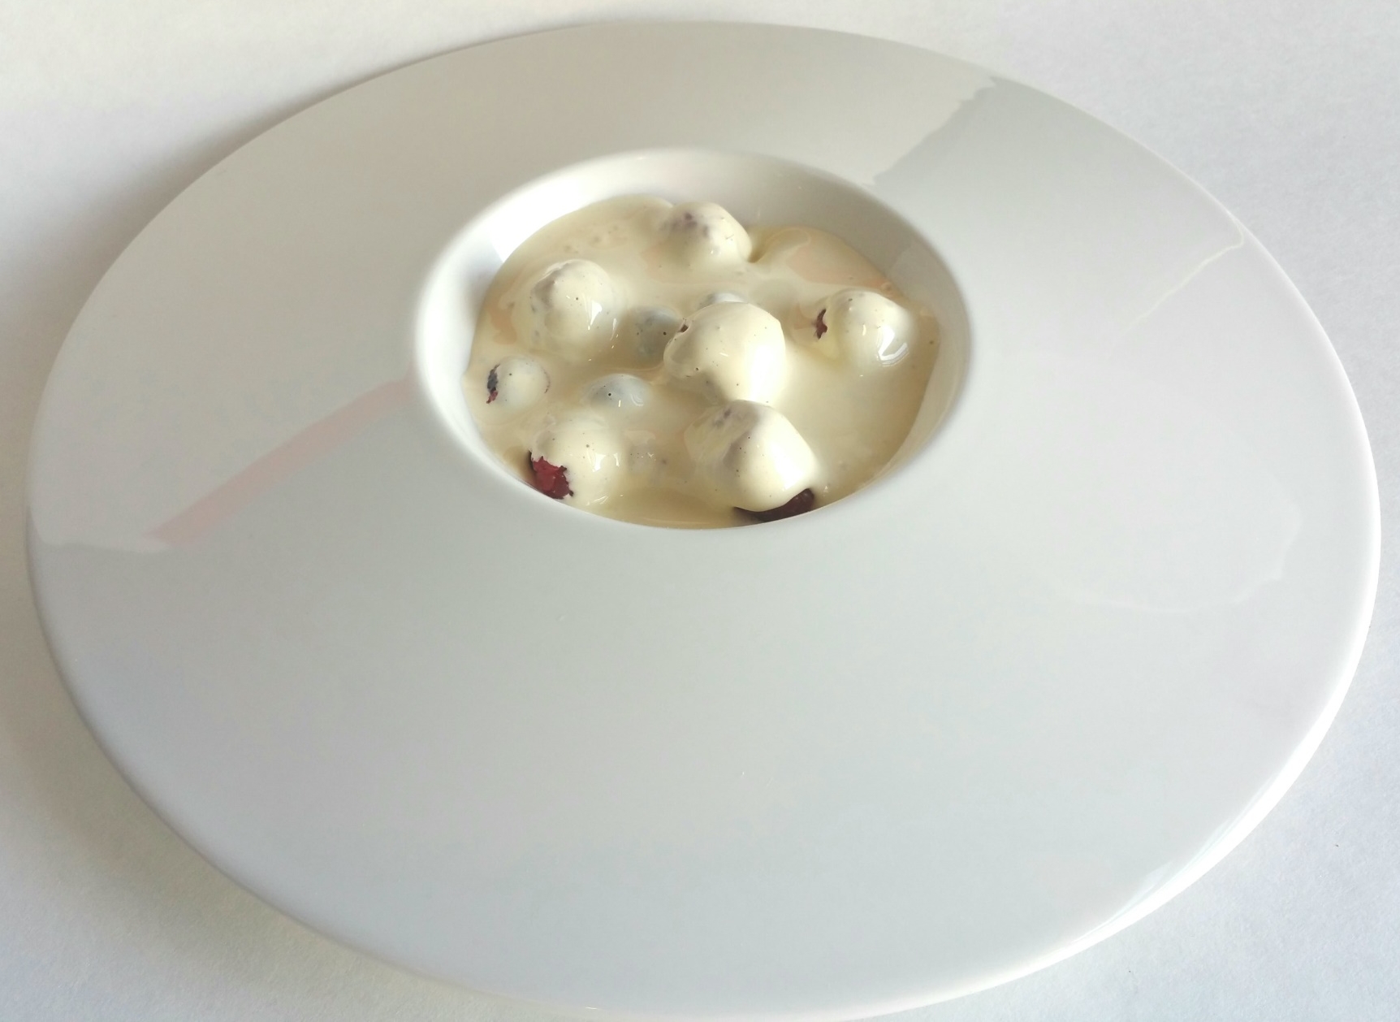

Slide 41

MARSALA
SABAYON
STRAWBERRIES
BLUEBERRIES
RASPBERRIES

Slide 42
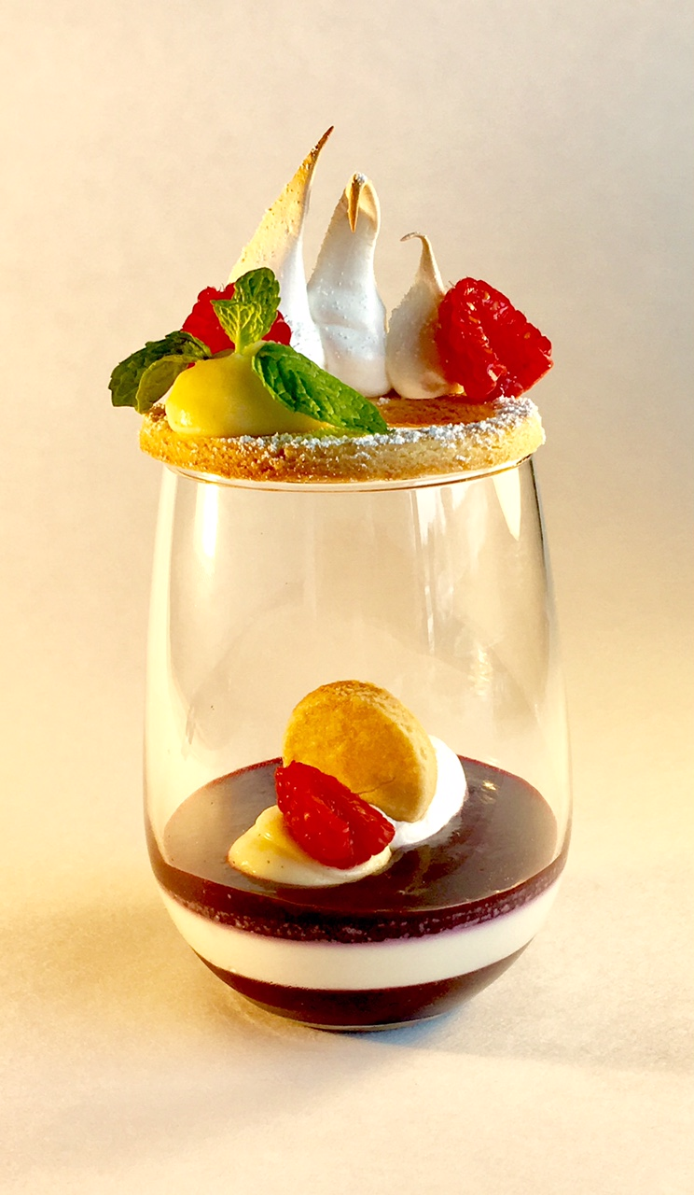

Slide 43


Slide 44
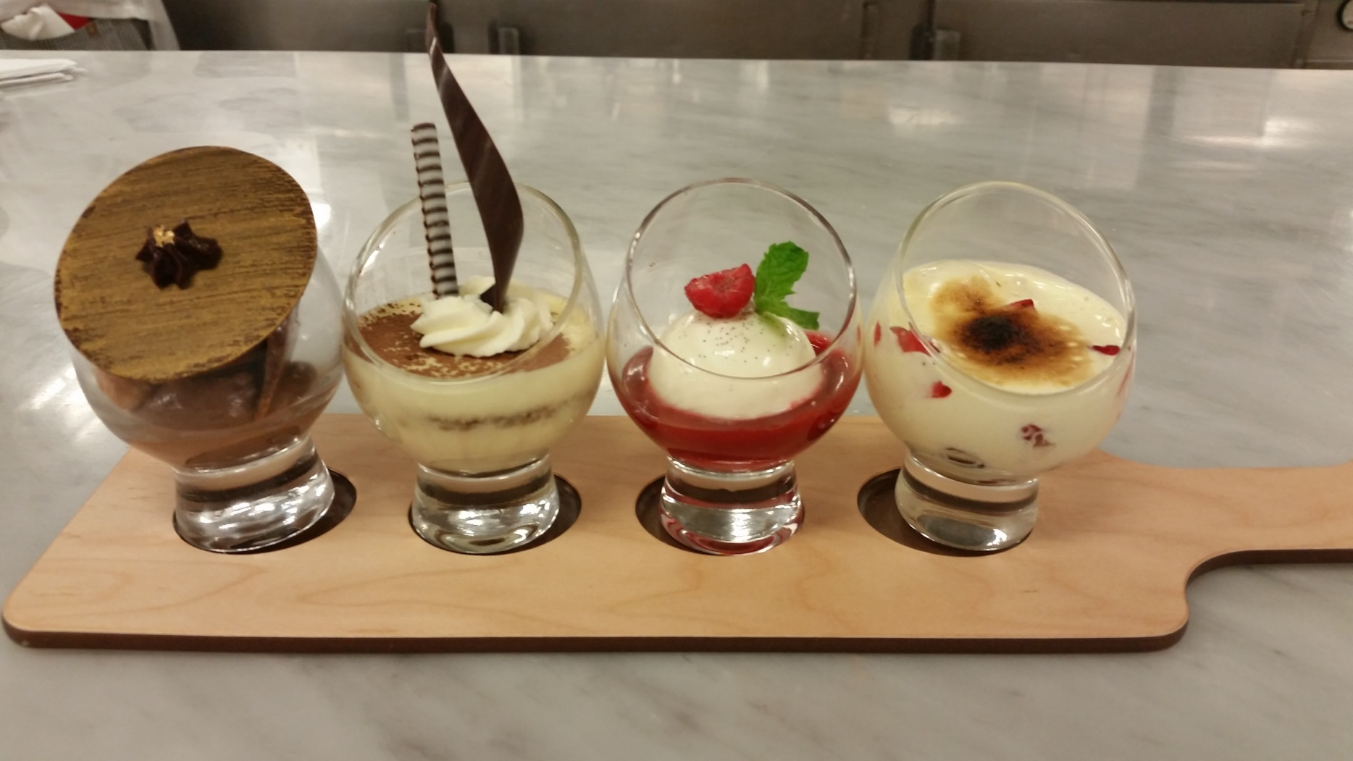

Slide 45
VANILLA PANNA COTTA
STRAWBERRY COULIS
RED BERRIES SABAYON
CHOCOLATE
ROCHER
TIRAMISU

Slide 46
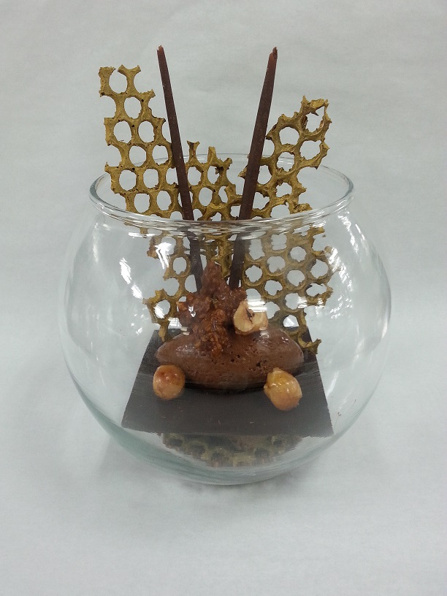

Slide 47
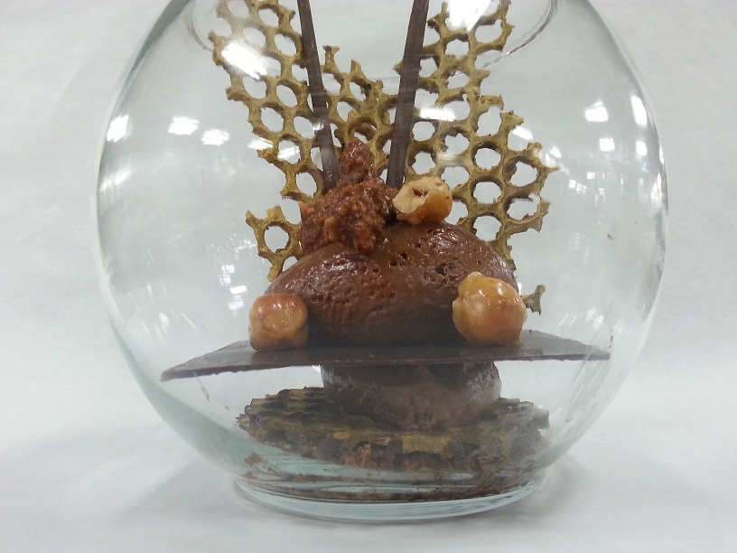
CHOCOLATE DECOR
CARAMELIZED
HAZELNUT
DARK CHOCOLATE
MOUSSE
DARK
CHOCOLATE
HAZELNUT CHOCOLATE
FEUILLENTINE

