Slide 1
SABATINI’S

Slide 2
(Slide 3) Deconstructed Tiramisu, espresso Sauce, Dark Chocolate Mousse and Coffee Kahlua Jelly.
(Slide 5,6) Vanilla Panna Cotta, Blueberry Compote, Almond Biscuit, Lemon Cream and Whipped Cream
(Slide 7,8) Fresh Berries Zabaglione
(Slide 9,10) Surprise
(Slide 11,12) Chocolate Rocher (Norman Love)

Slide 3
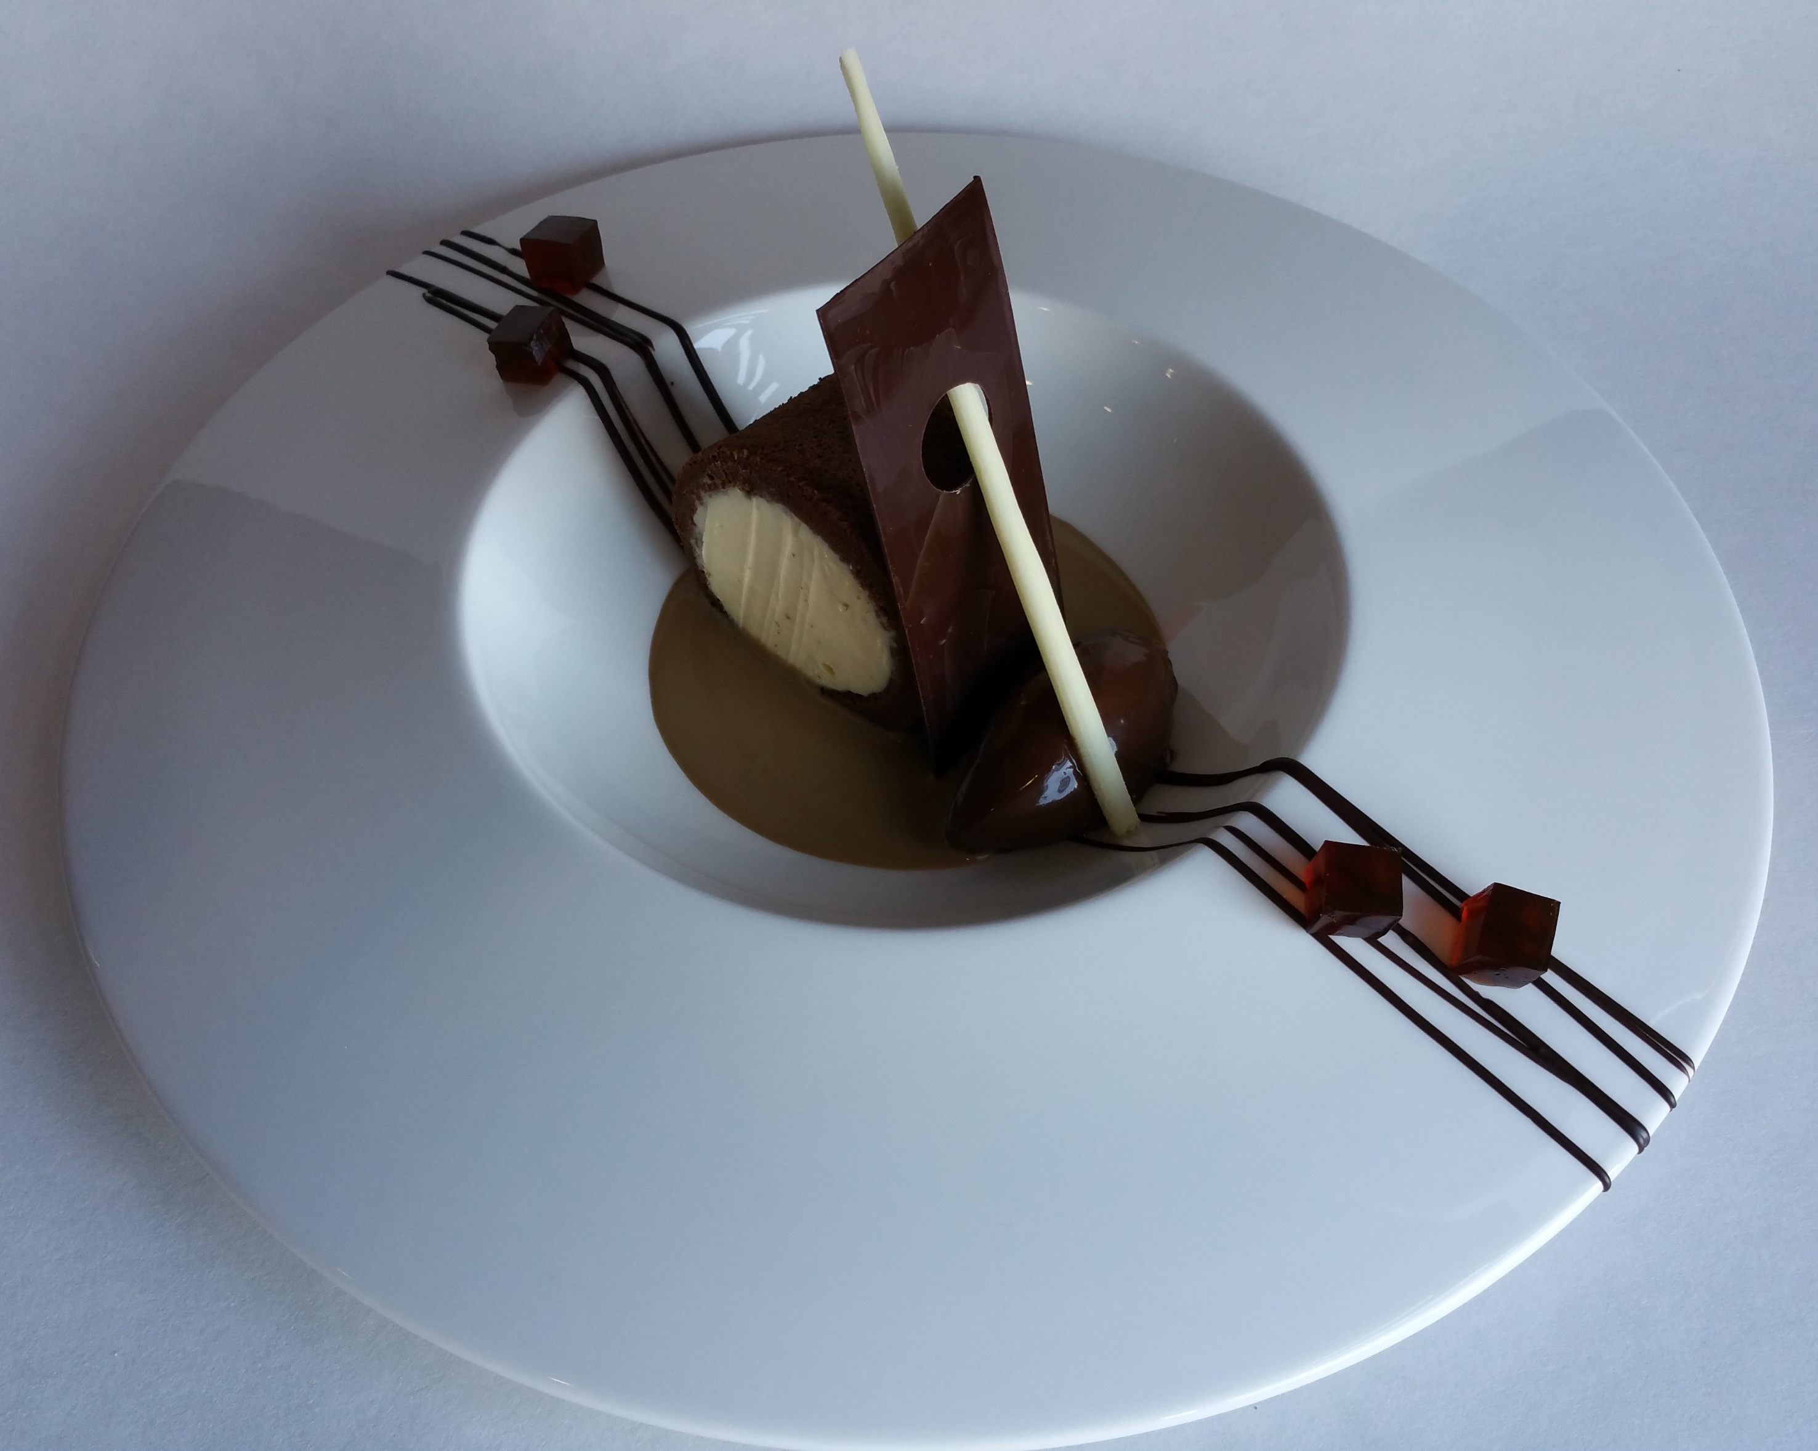

Slide 4

COFFEE KAHLUA JELLY
CHOCOLATE BISCUIT
CHOCOLATE DECOR
MASCARPONE
CREAM
ESPRESSO SAUCE
CHOCOLATE MOUSSE

Slide 5
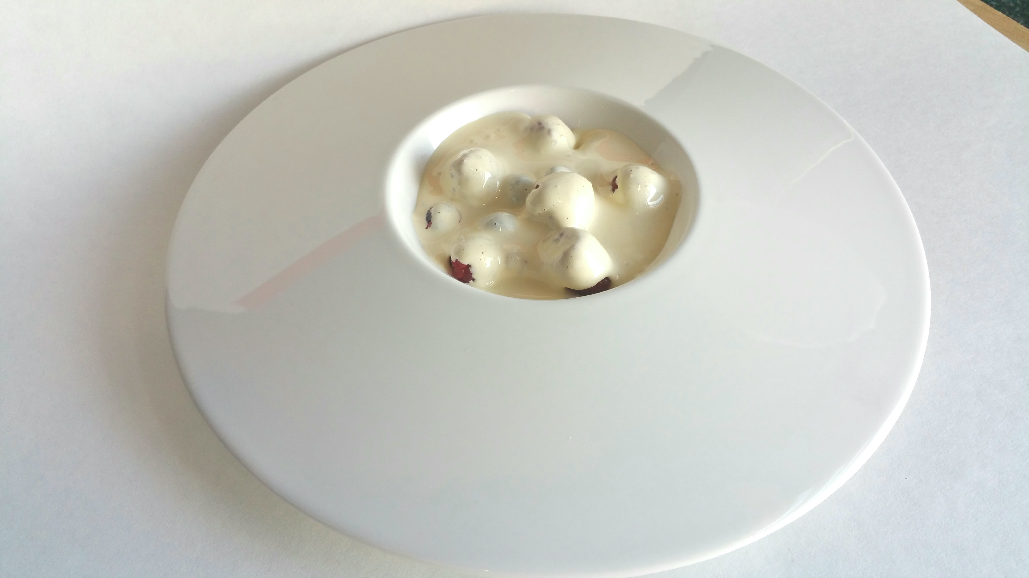

Slide 6
MARSALA
SABAYON
STRAWBERRIES BLUEBERRIES RASPBERRIES

Slide 7
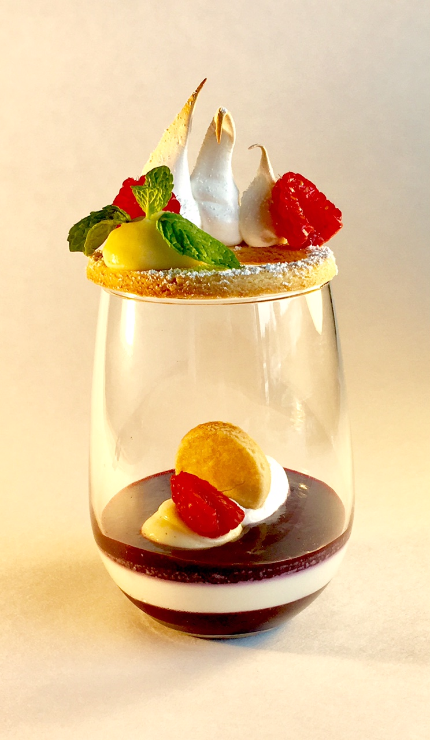

Slide 8
ITALIENNE MERINGUE
FRESH RASPBERRIES
MINT LEAF
ALMOND SUGAR COOKIE
LEMON CREAM
WHIPPED CREAM
BLUEBERRY COMPOTE
VANILLA PANNA COTTA

Slide 9
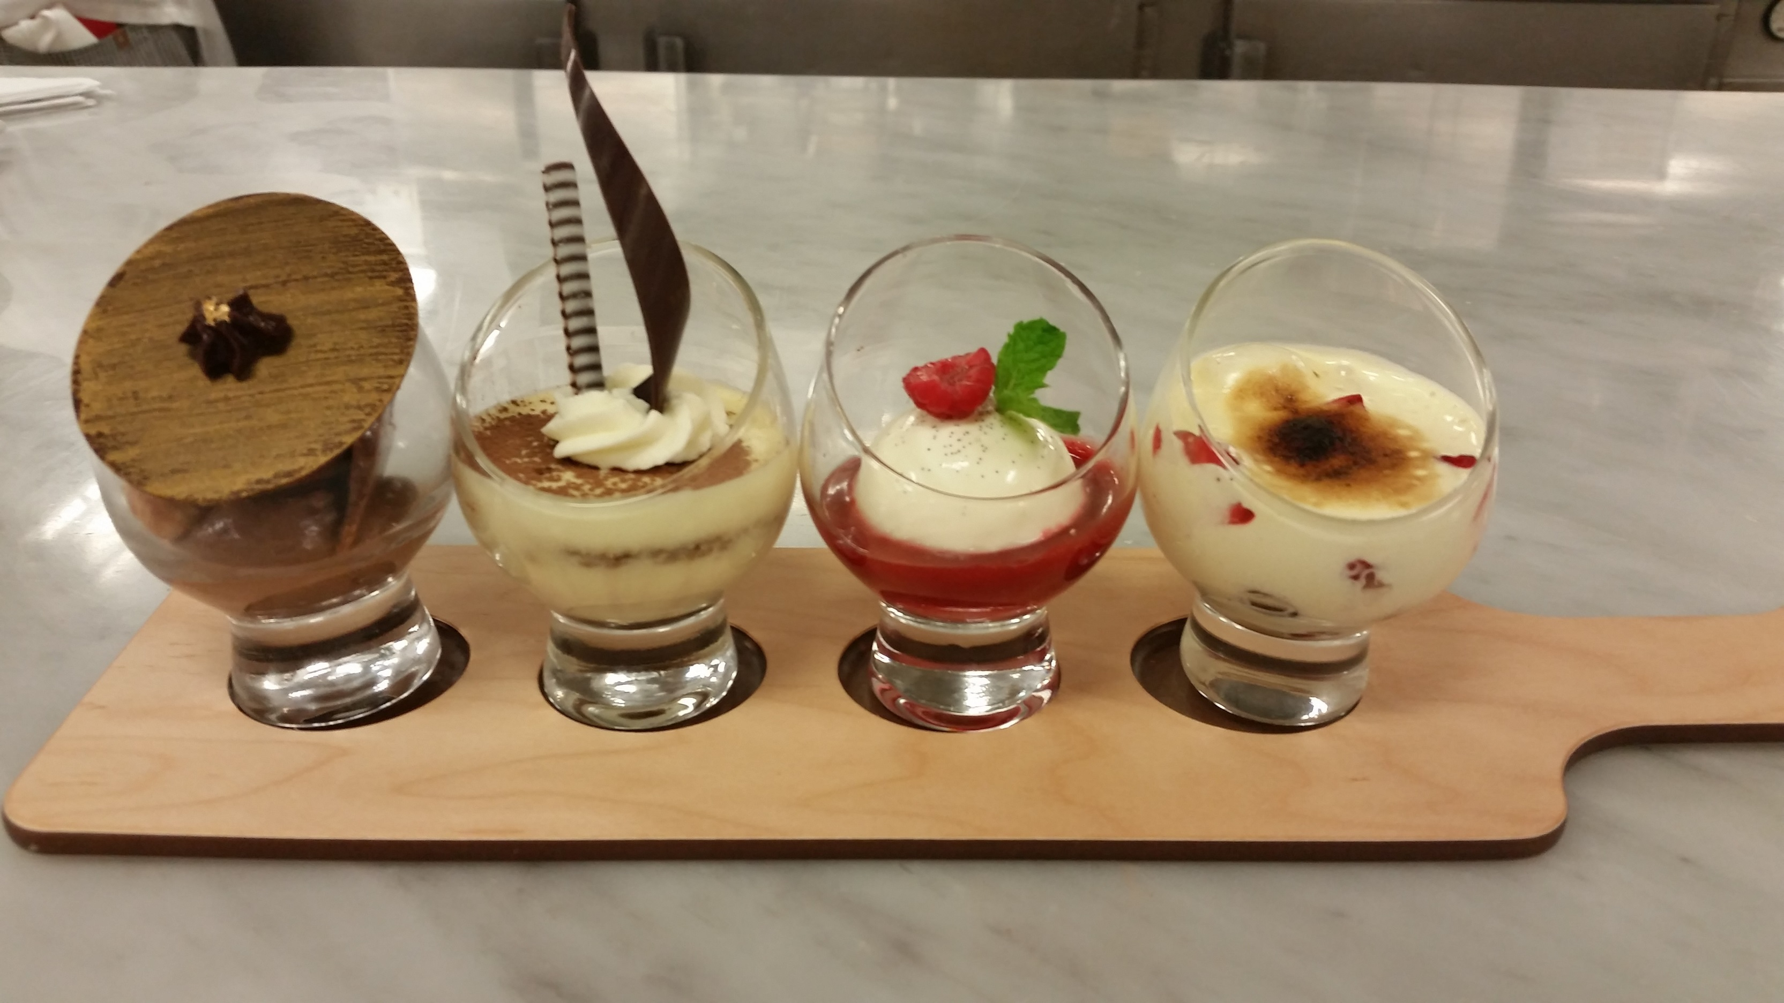

Slide 10
VANILLA PANNA COTTA STRAWBERRY COULIS
RED BERRIES SABAYON
CHOCOLATE
ROCHER
TIRAMISU

Slide 11
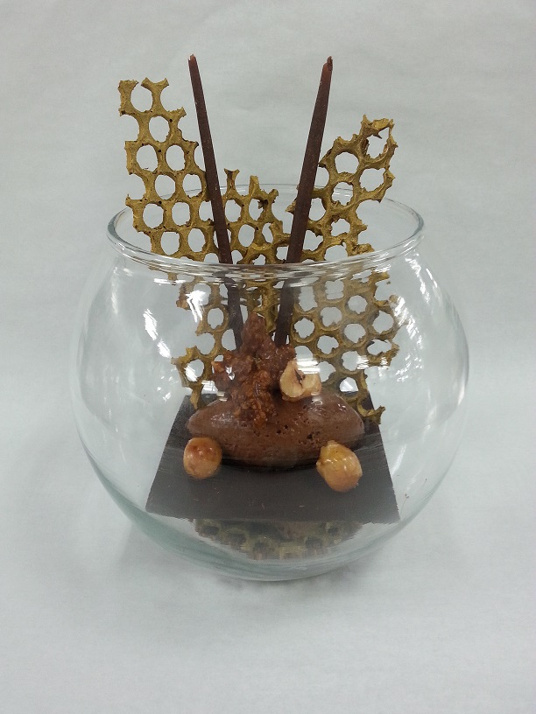

Slide 12
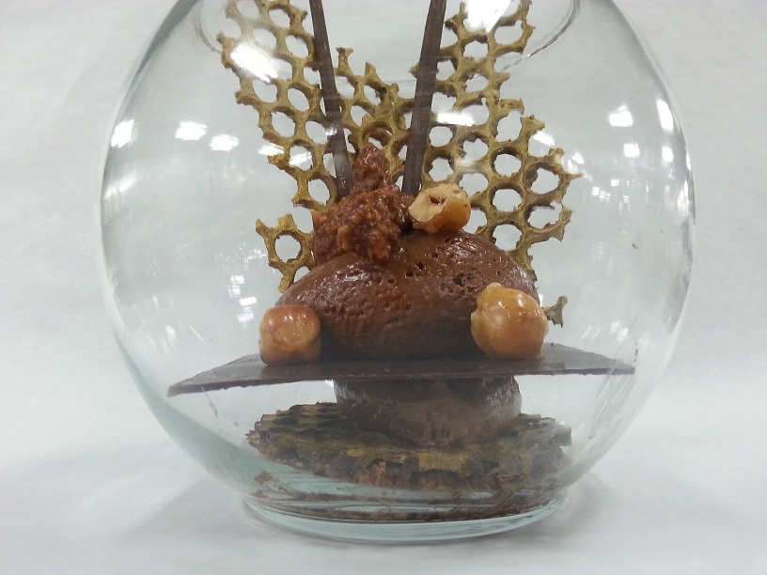
CHOCOLATE DECOR
CARAMELIZED
HAZELNUT
DARK CHOCOLATE
MOUSSE
DARK
CHOCOLATE
HAZELNUT CHOCOLATE
FEUILLENTINE

