Slide 1
Sabatini’s
Antipasti

Slide 2
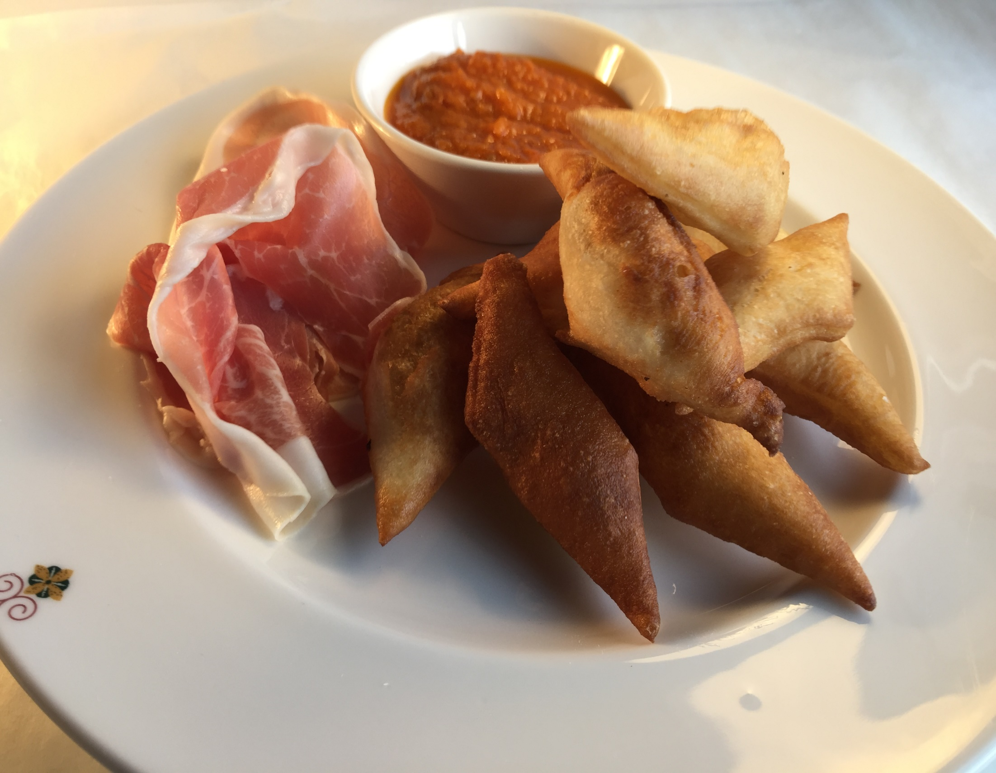
Notes:
Stuzzichino Della Casa – Zonzelle with, roasted tomato & bell pepper passata, extra virgin olive oil, balsamic vinegar

Slide 3
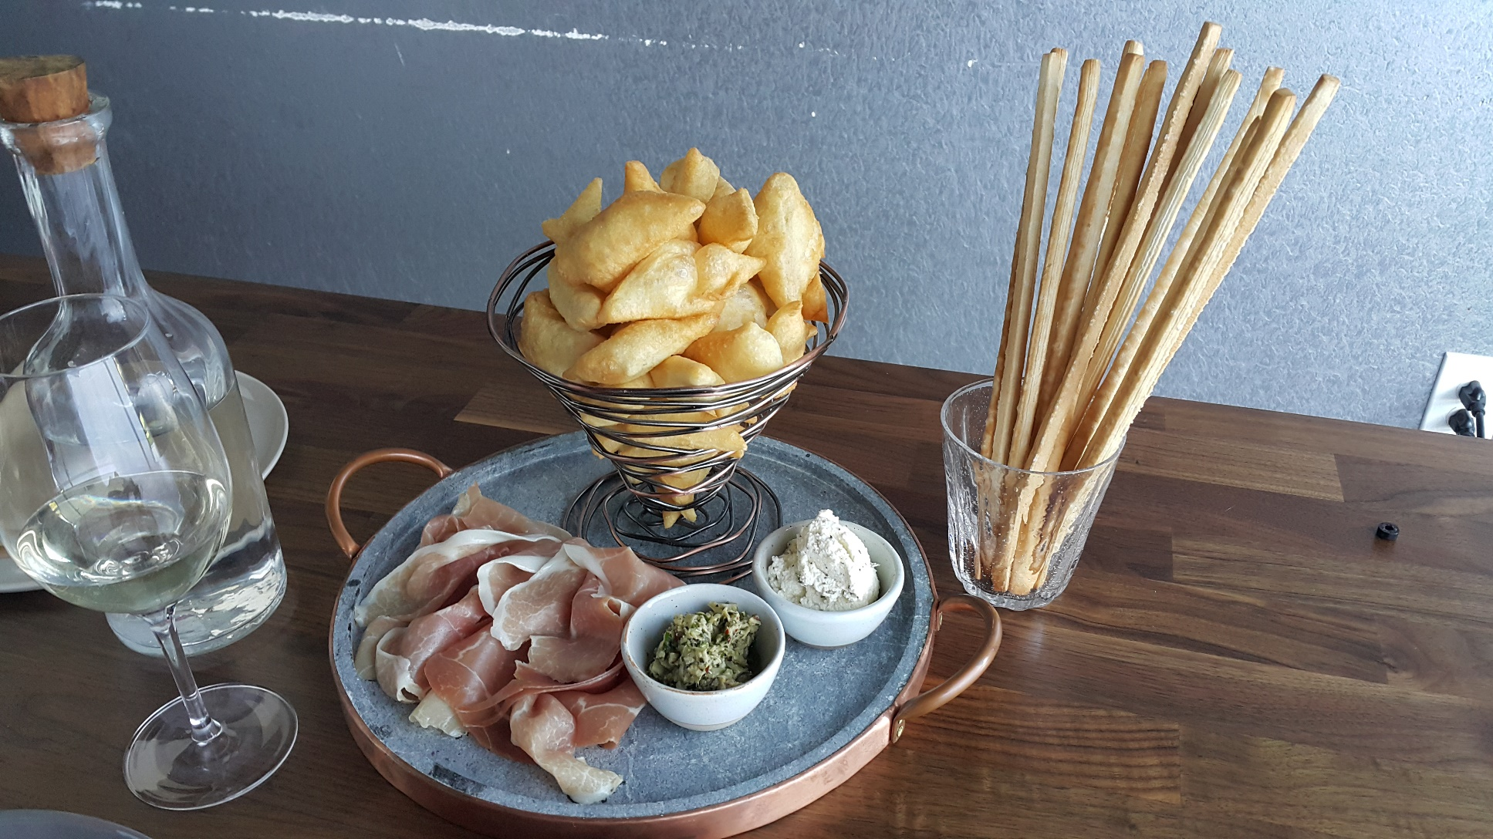

Slide 4

Notes:
Trota Salmonata ,citrus marinated ocean trout,zucchini salad,tomato water ,machè,parsley oil

Slide 5
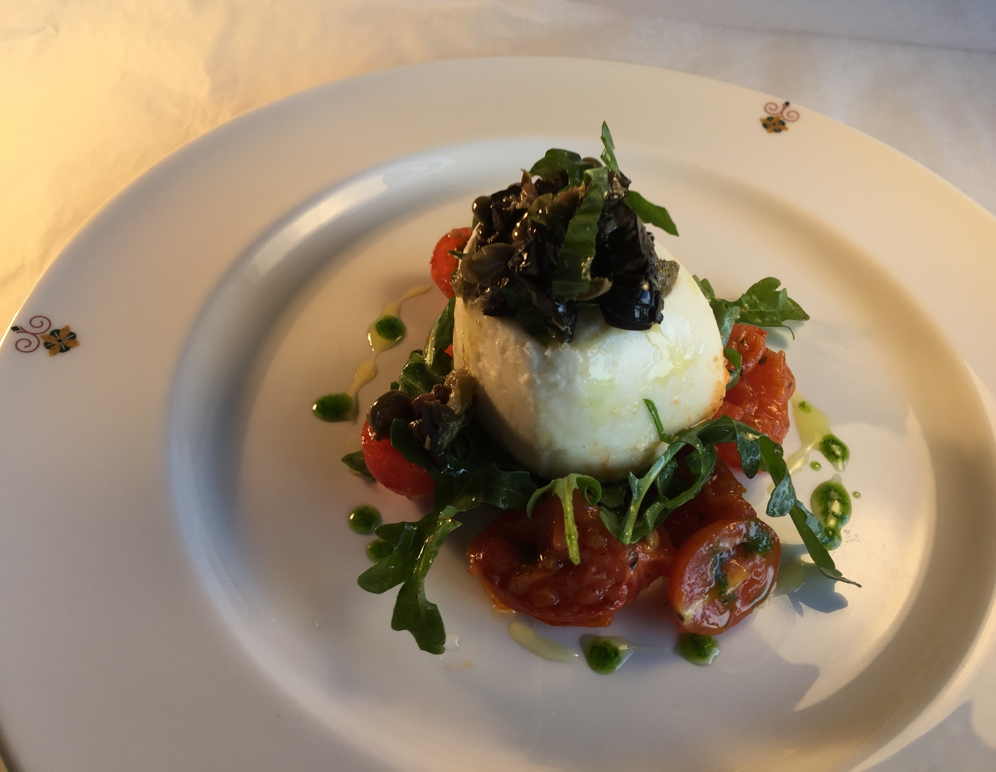
Notes:
Creamy Cow Burrata with sun blast tomato basil salad ,extra virgin oliv oil and balsamic reduction

Slide 6
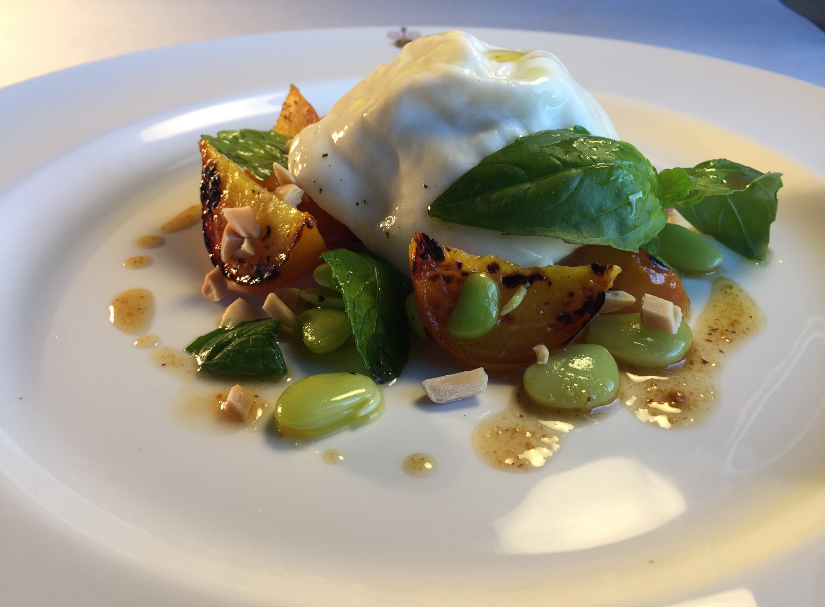
Notes:
Creamy Cow Burrata with Roast Yellon beets,fava beans salad white vine vinegar Balsamic,and Toasted hazelnuts

Slide 7
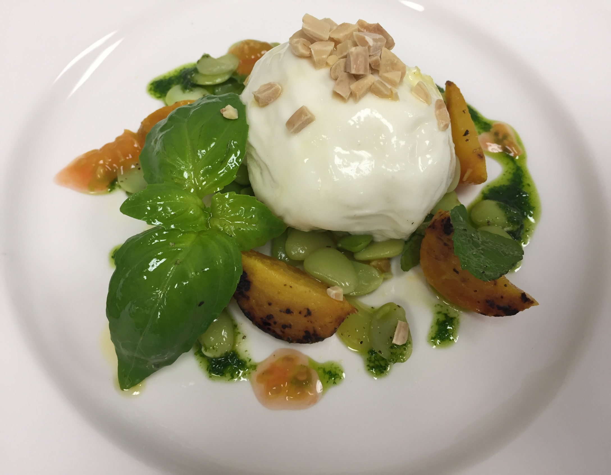
Notes:
Creamy Cow Burrata with Roast Yellon beets,fava beans salad white vine vinegar Balsamic,and Toasted hazelnuts,

Slide 8
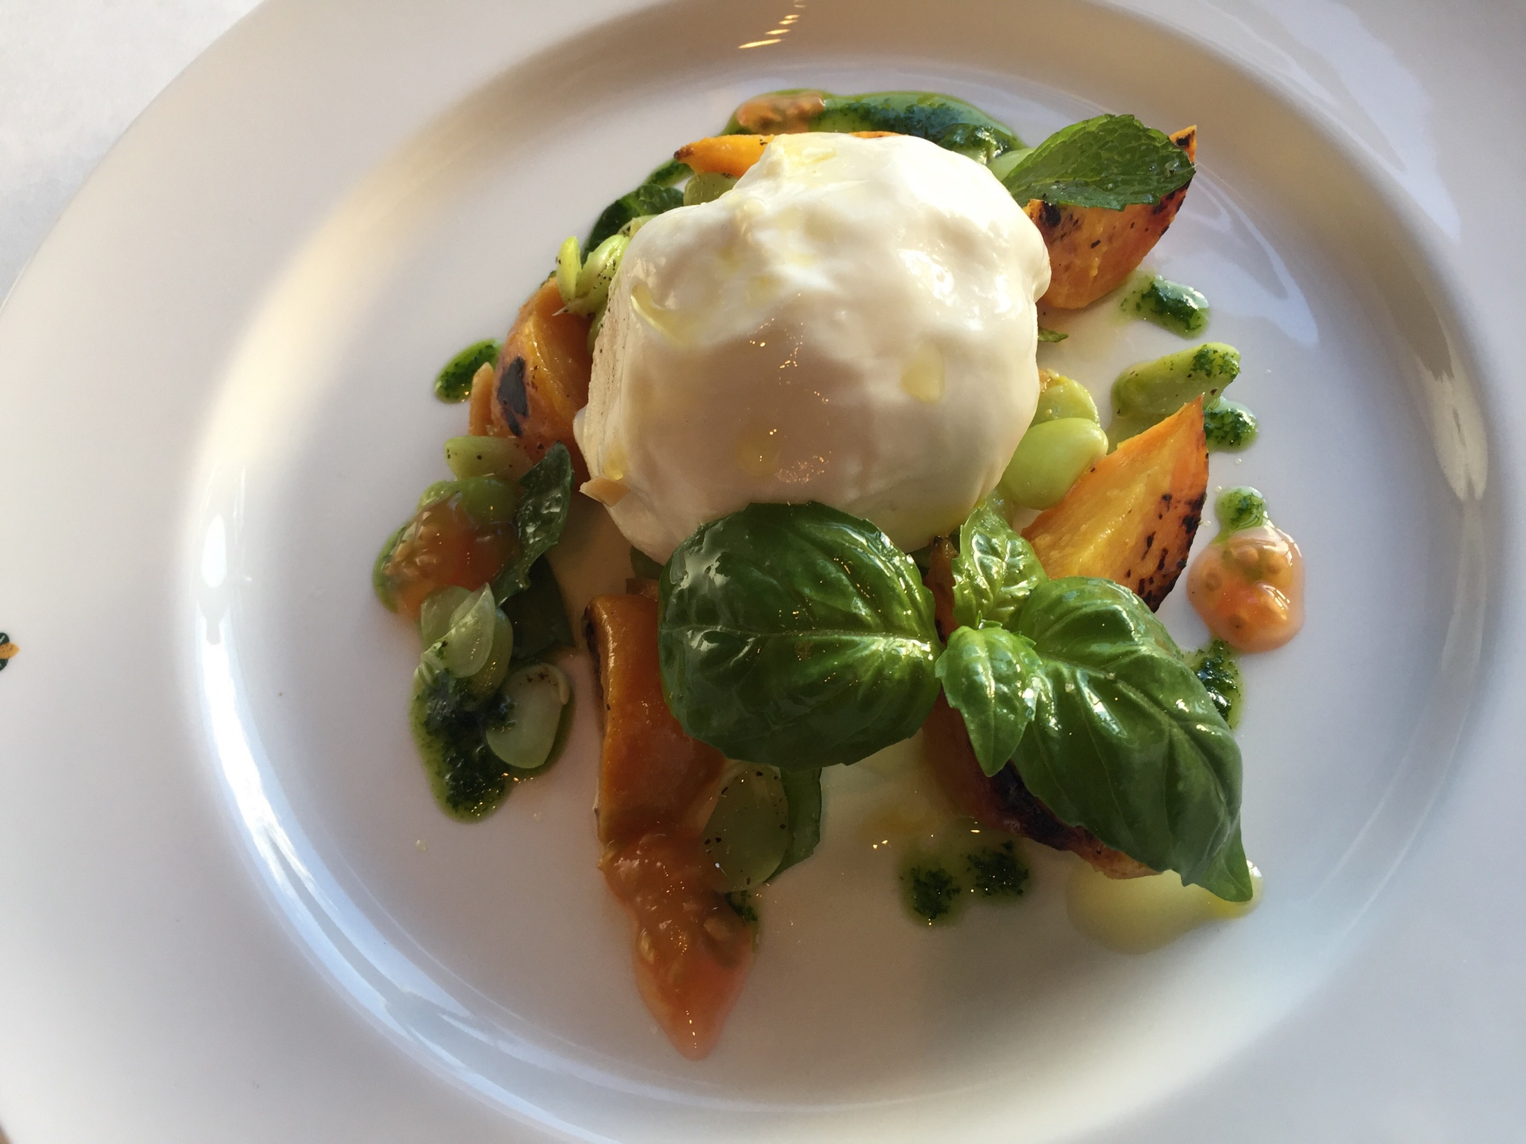
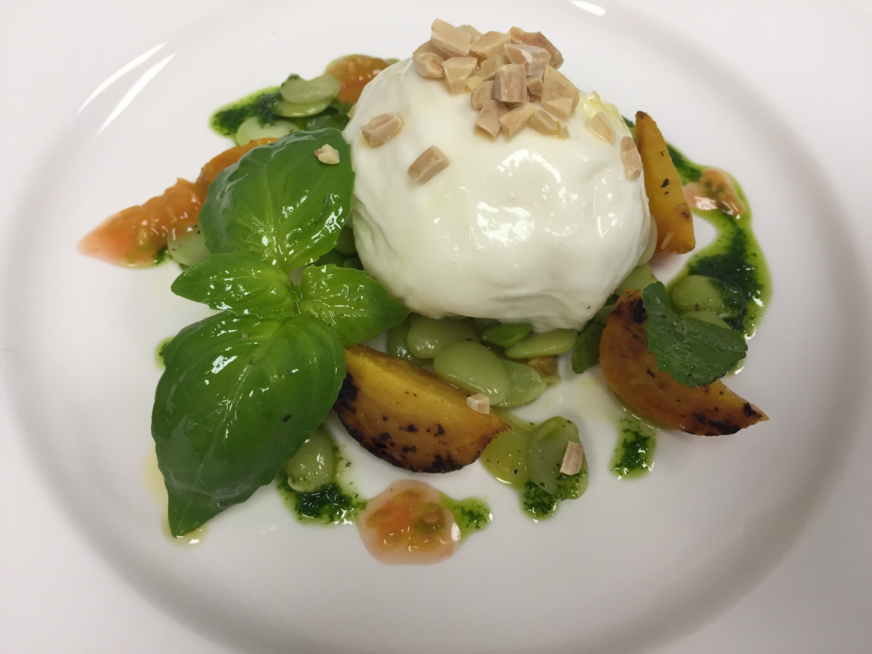
Notes:
Creamy Cow Burrata with Roast Yellon beets,fava beans salad white vine vinegar Balsamic,and Toasted hazelnuts,

Slide 9
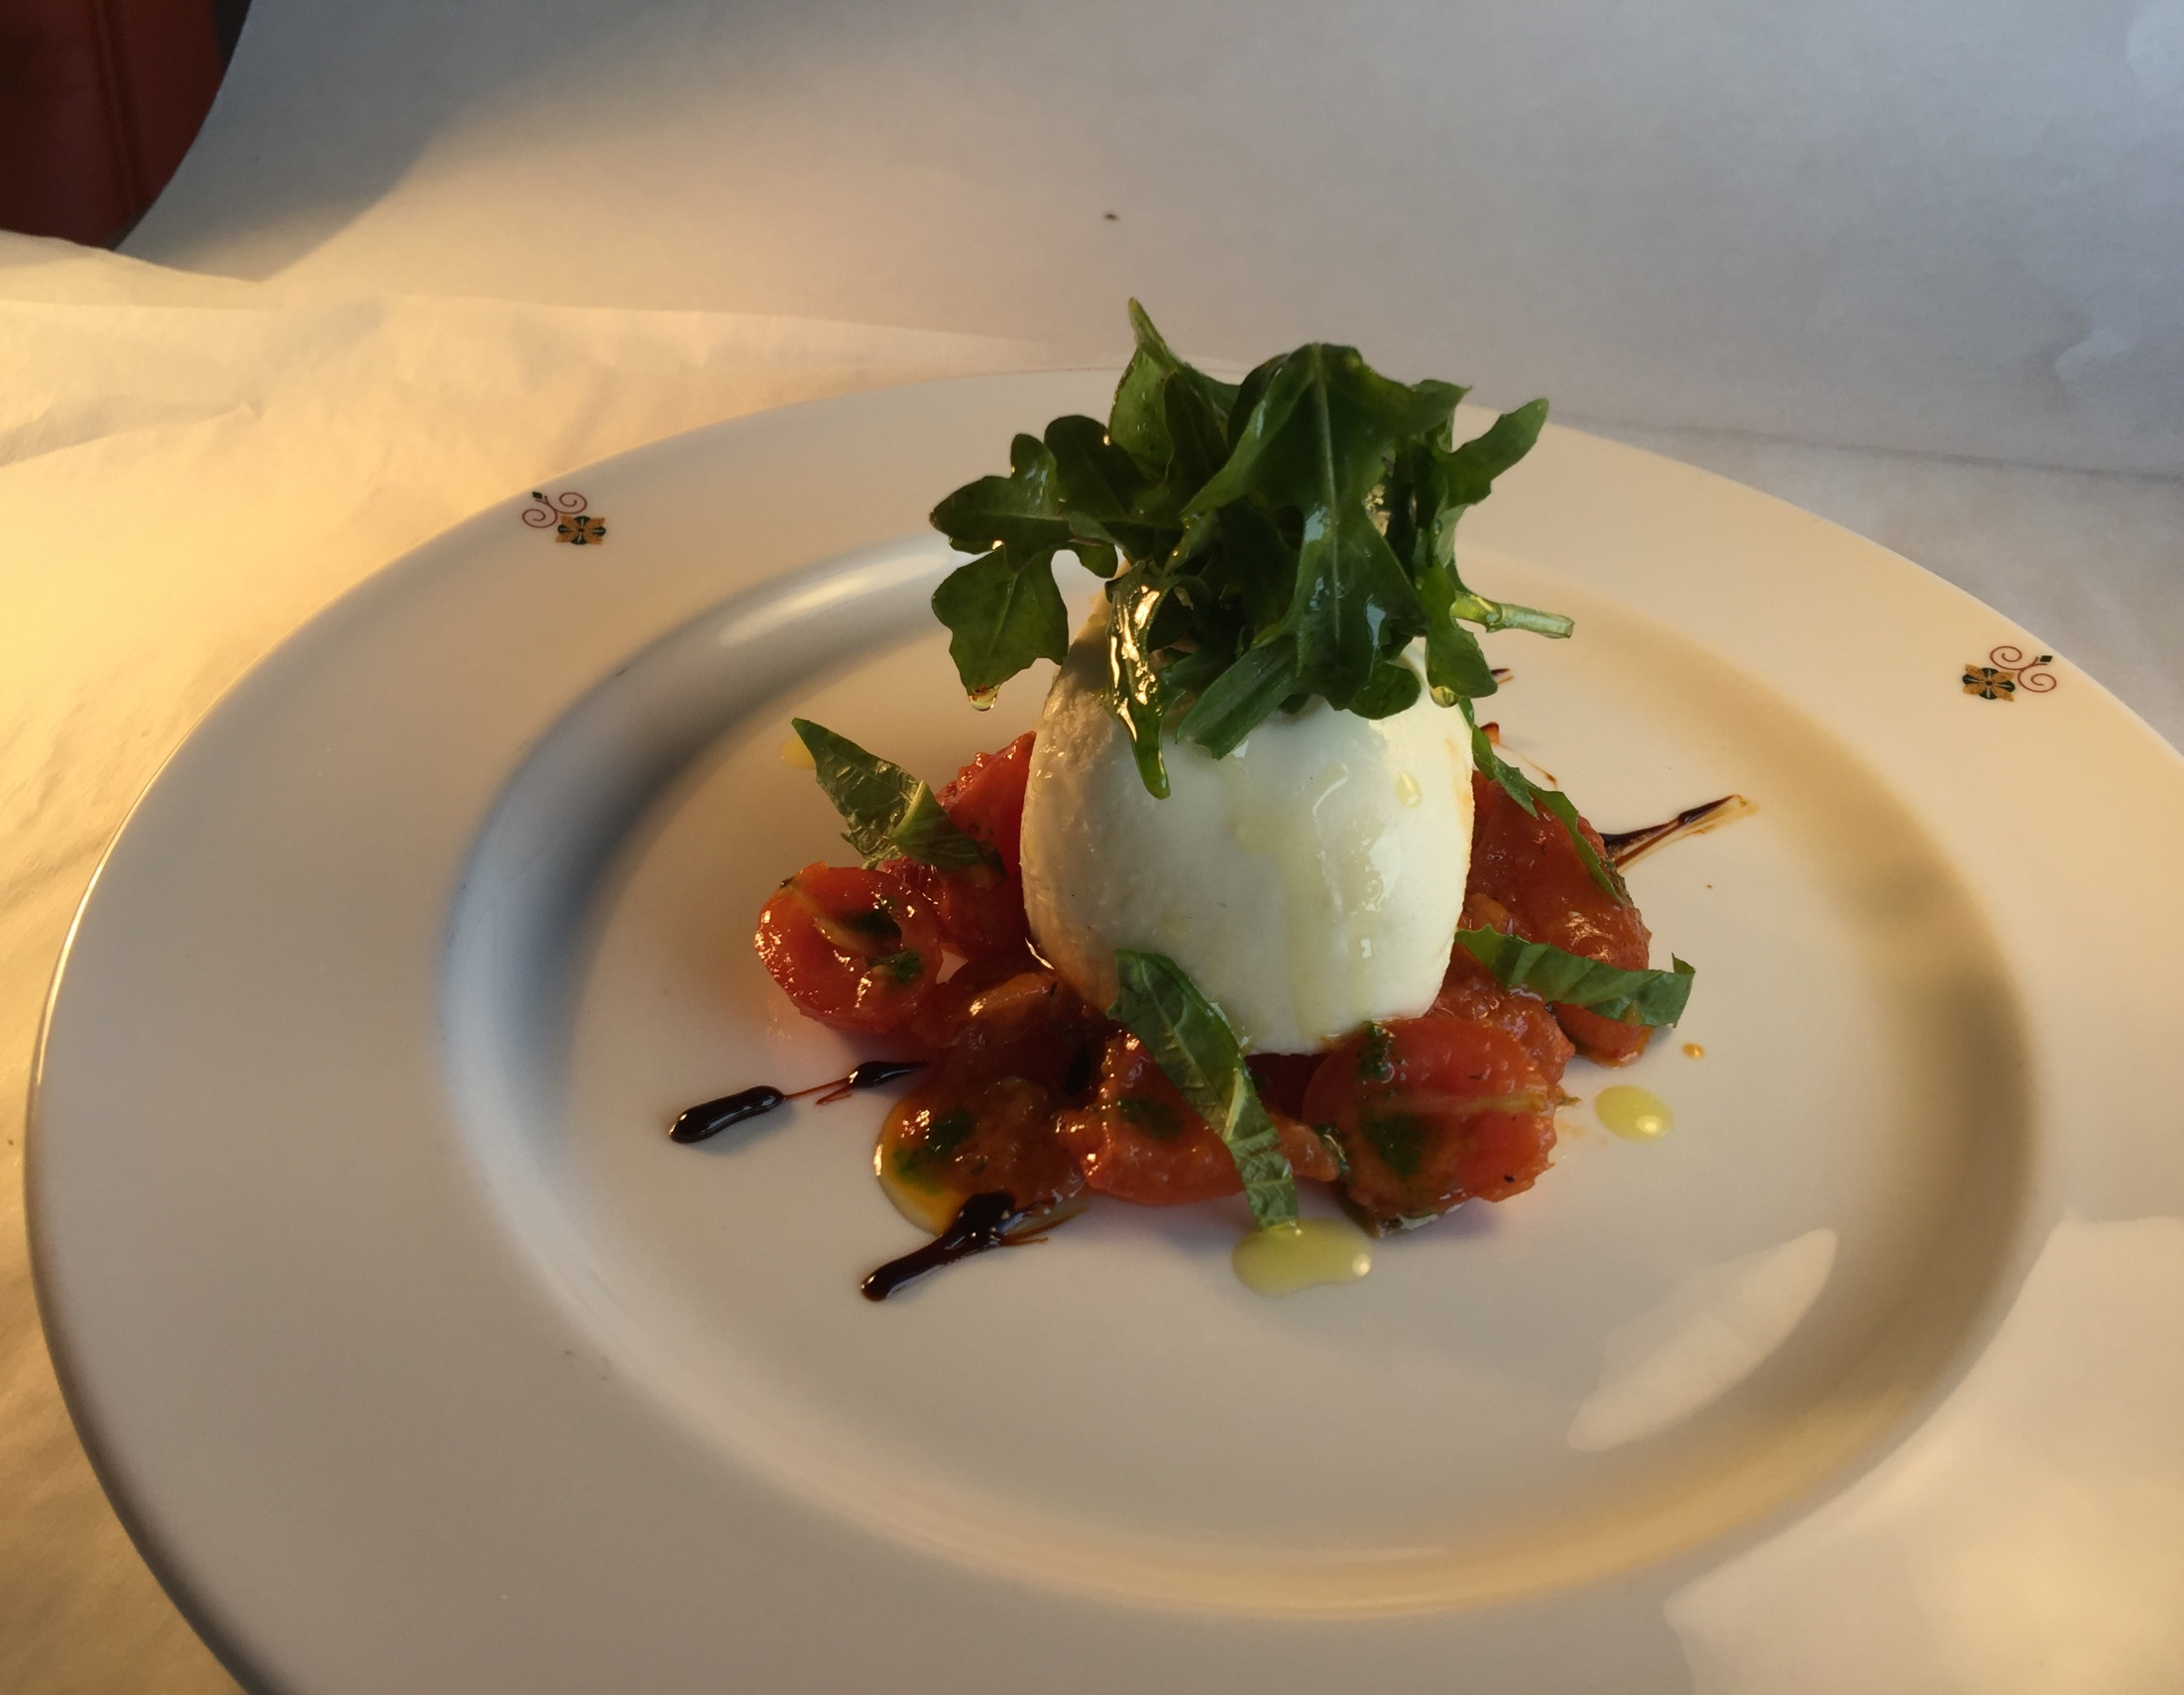
Notes:
Creamy Cow Burrata with sun blast tomato basil salad ,extra virgin oliv oil and balsamic reduction

Slide 10
Notes:
Spiedini di Agnello-grilled marinated Lamb skewers with oregano&extra virgin oliv oil Rucola salad

Slide 11
Notes:
Piemontesi Roasted bell peppers,capers, alici,green garlic basil vinaigrette

Slide 12
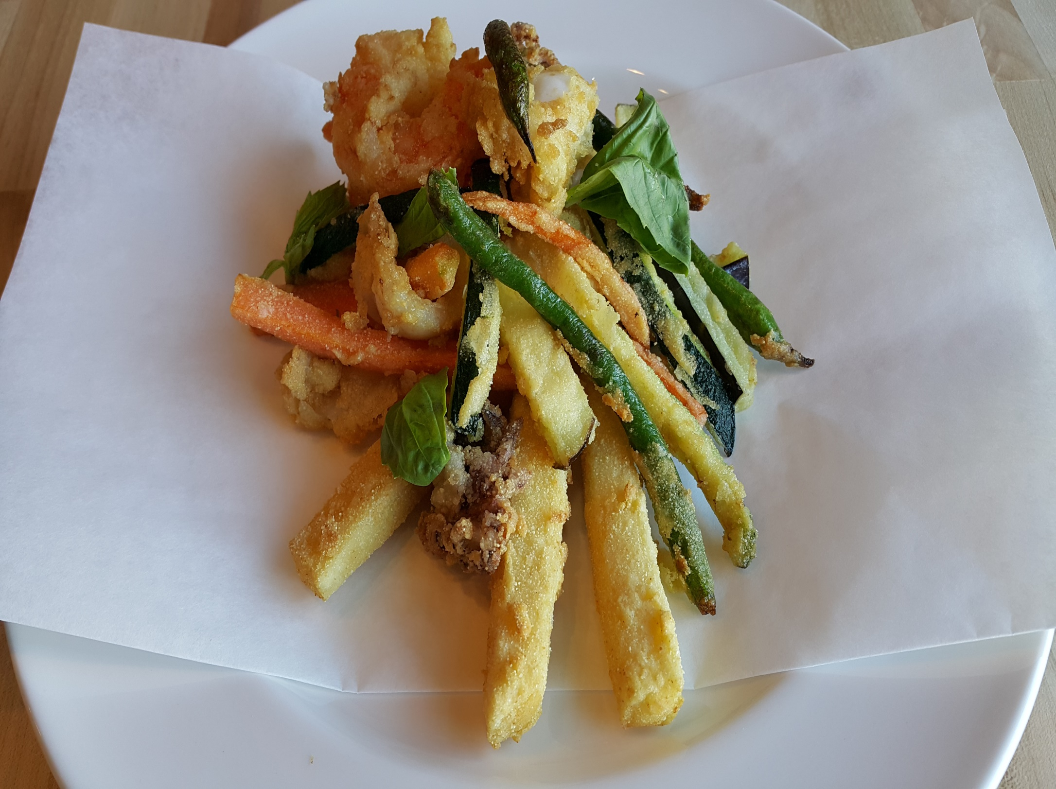
Notes:
Frittino( Parranza) Chickpea fritters,Squid,Prawns,Eggplant

Slide 13
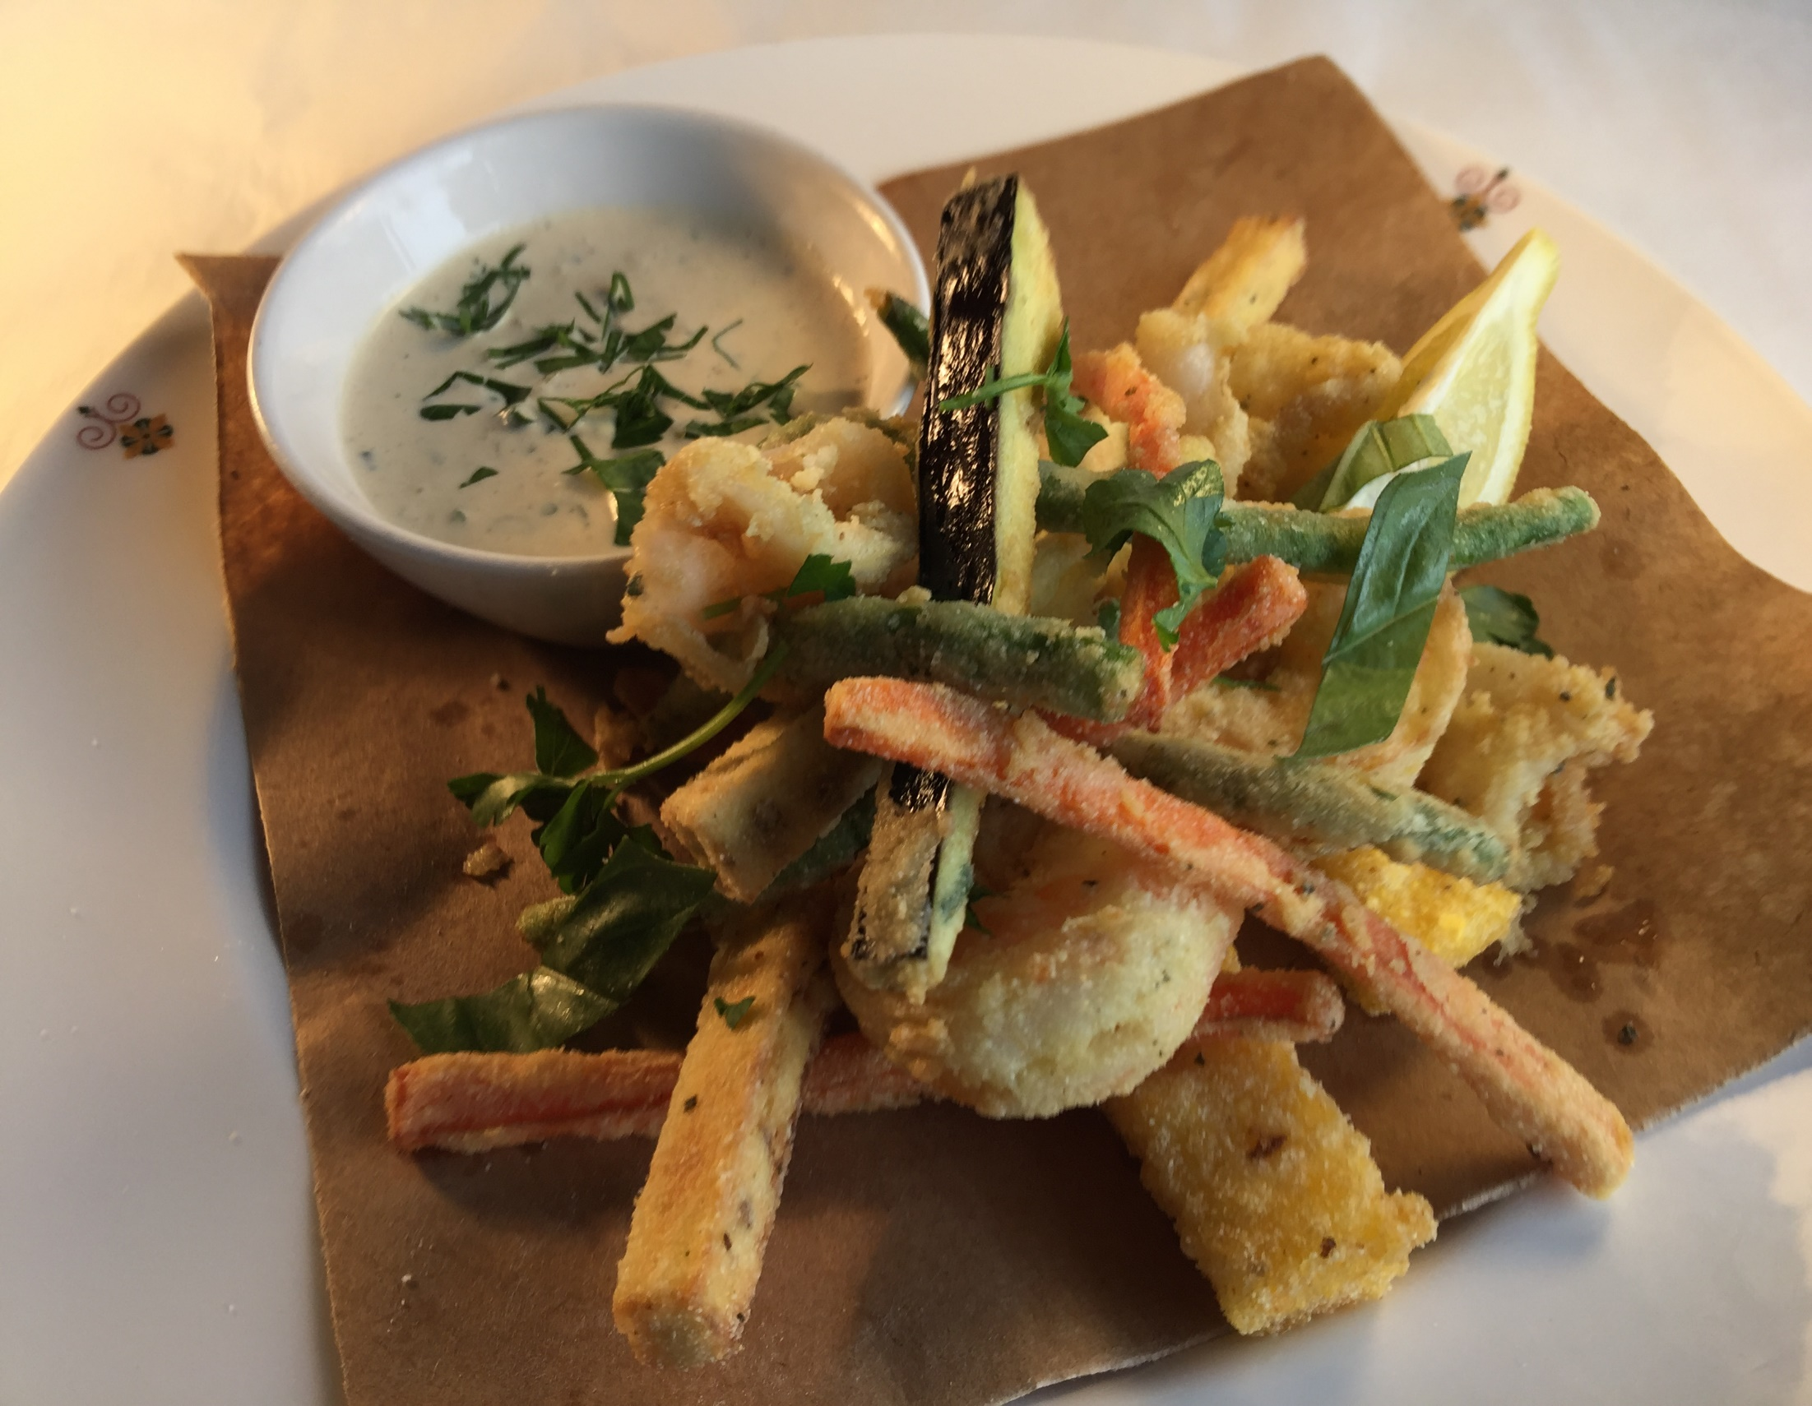
Notes:
Frittino Paranza – chickpea fritters, squid, prawns, eggplant, green beans, carrots

Slide 14
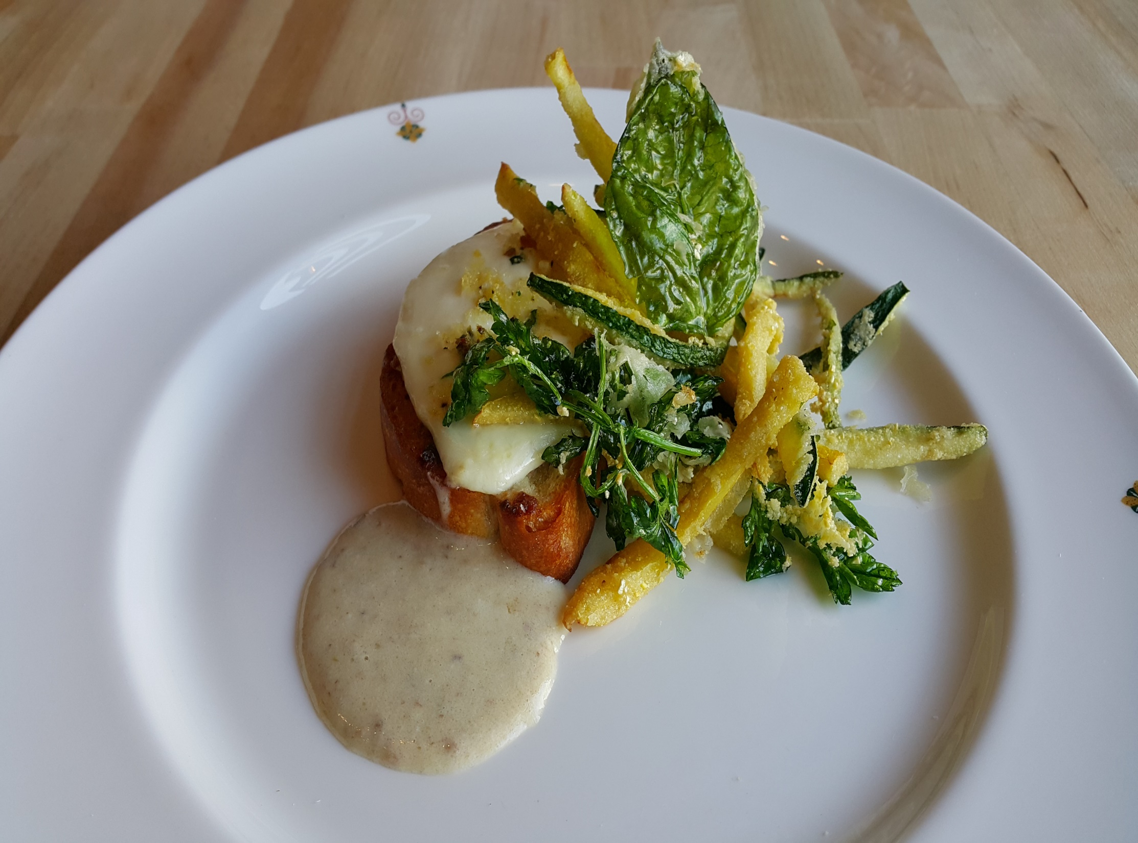
Notes:
Trota Salmonata ,citrus marinated ocean trout,Zucchini salad,tomato water ,machè,parsley oil

Slide 15
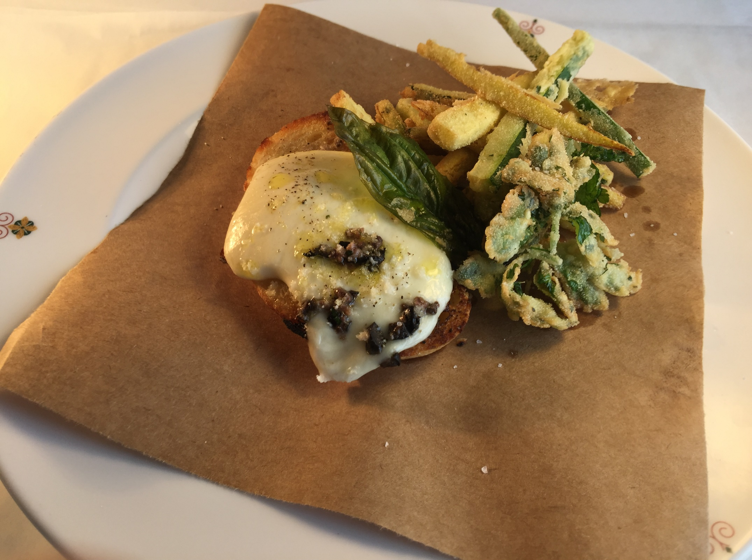
Notes:
Alici – zucchini, mozzarella, toasted house made crostini

Slide 16
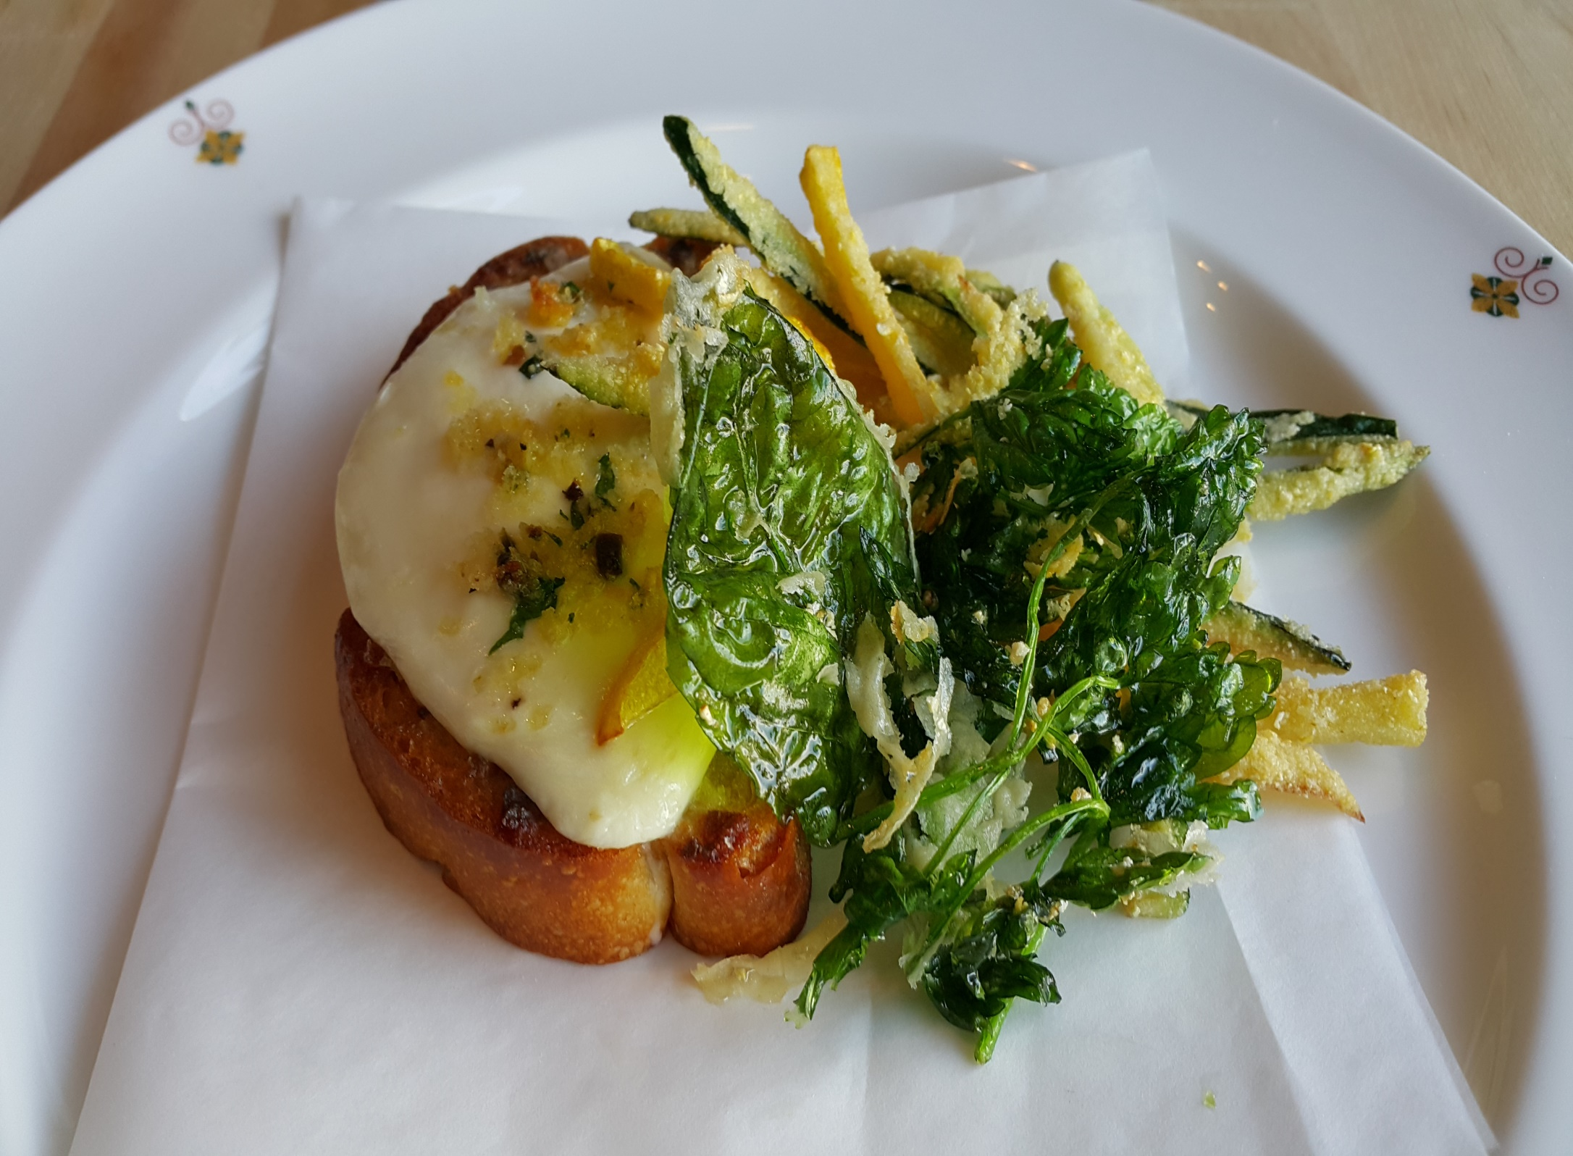
Notes:
Alici -Toasted house made bread crostini,mozzarella,zucchini

Slide 17
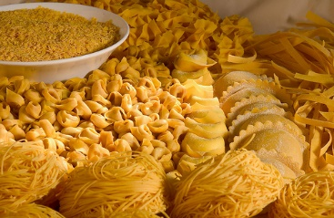
Home Made Pasta & Risotti
Notes:
Pasta e RIisotti

Slide 18
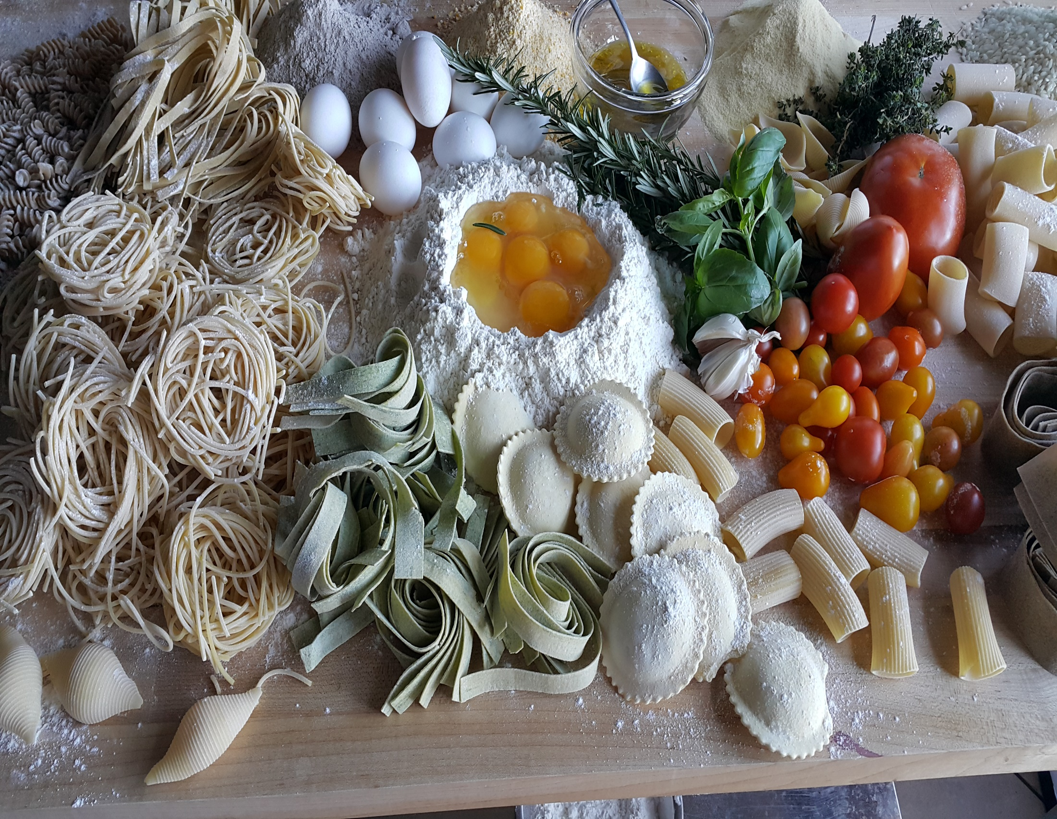

Slide 19
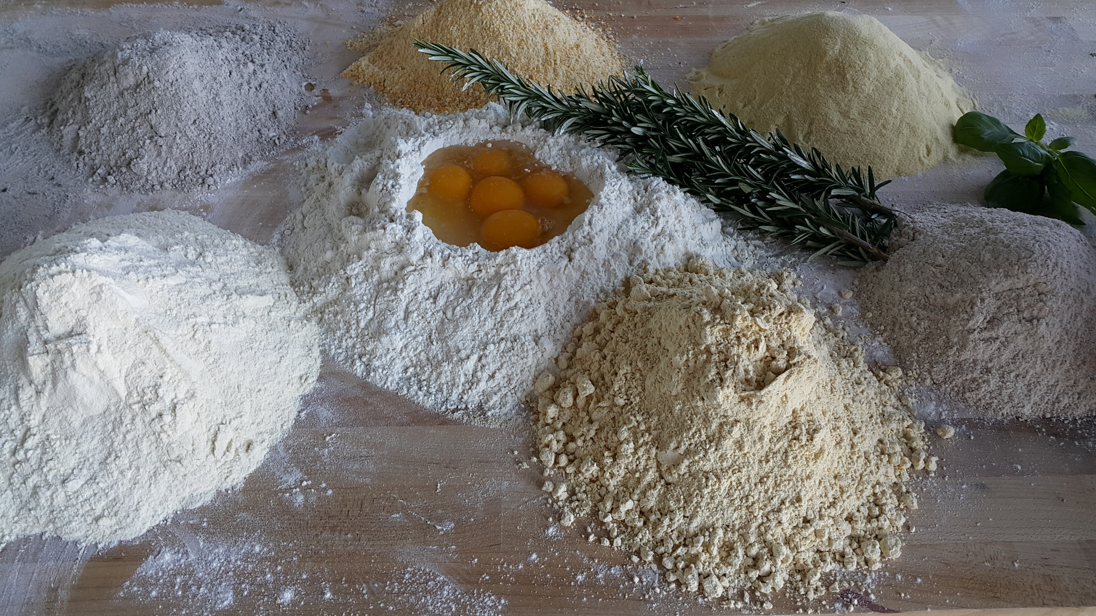

Slide 20
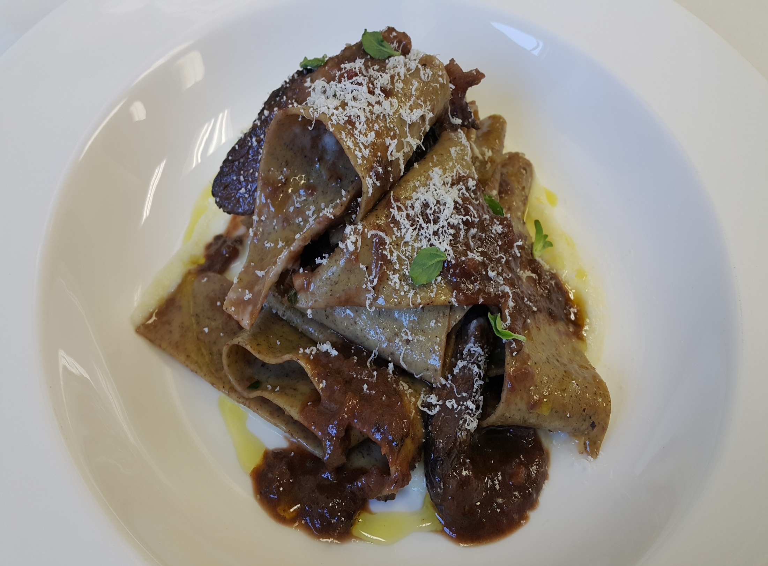
Notes:
Buck Weat wide ribbon pasta ,celeriac, Nebbiolo,Braised,Short ribs

Slide 21
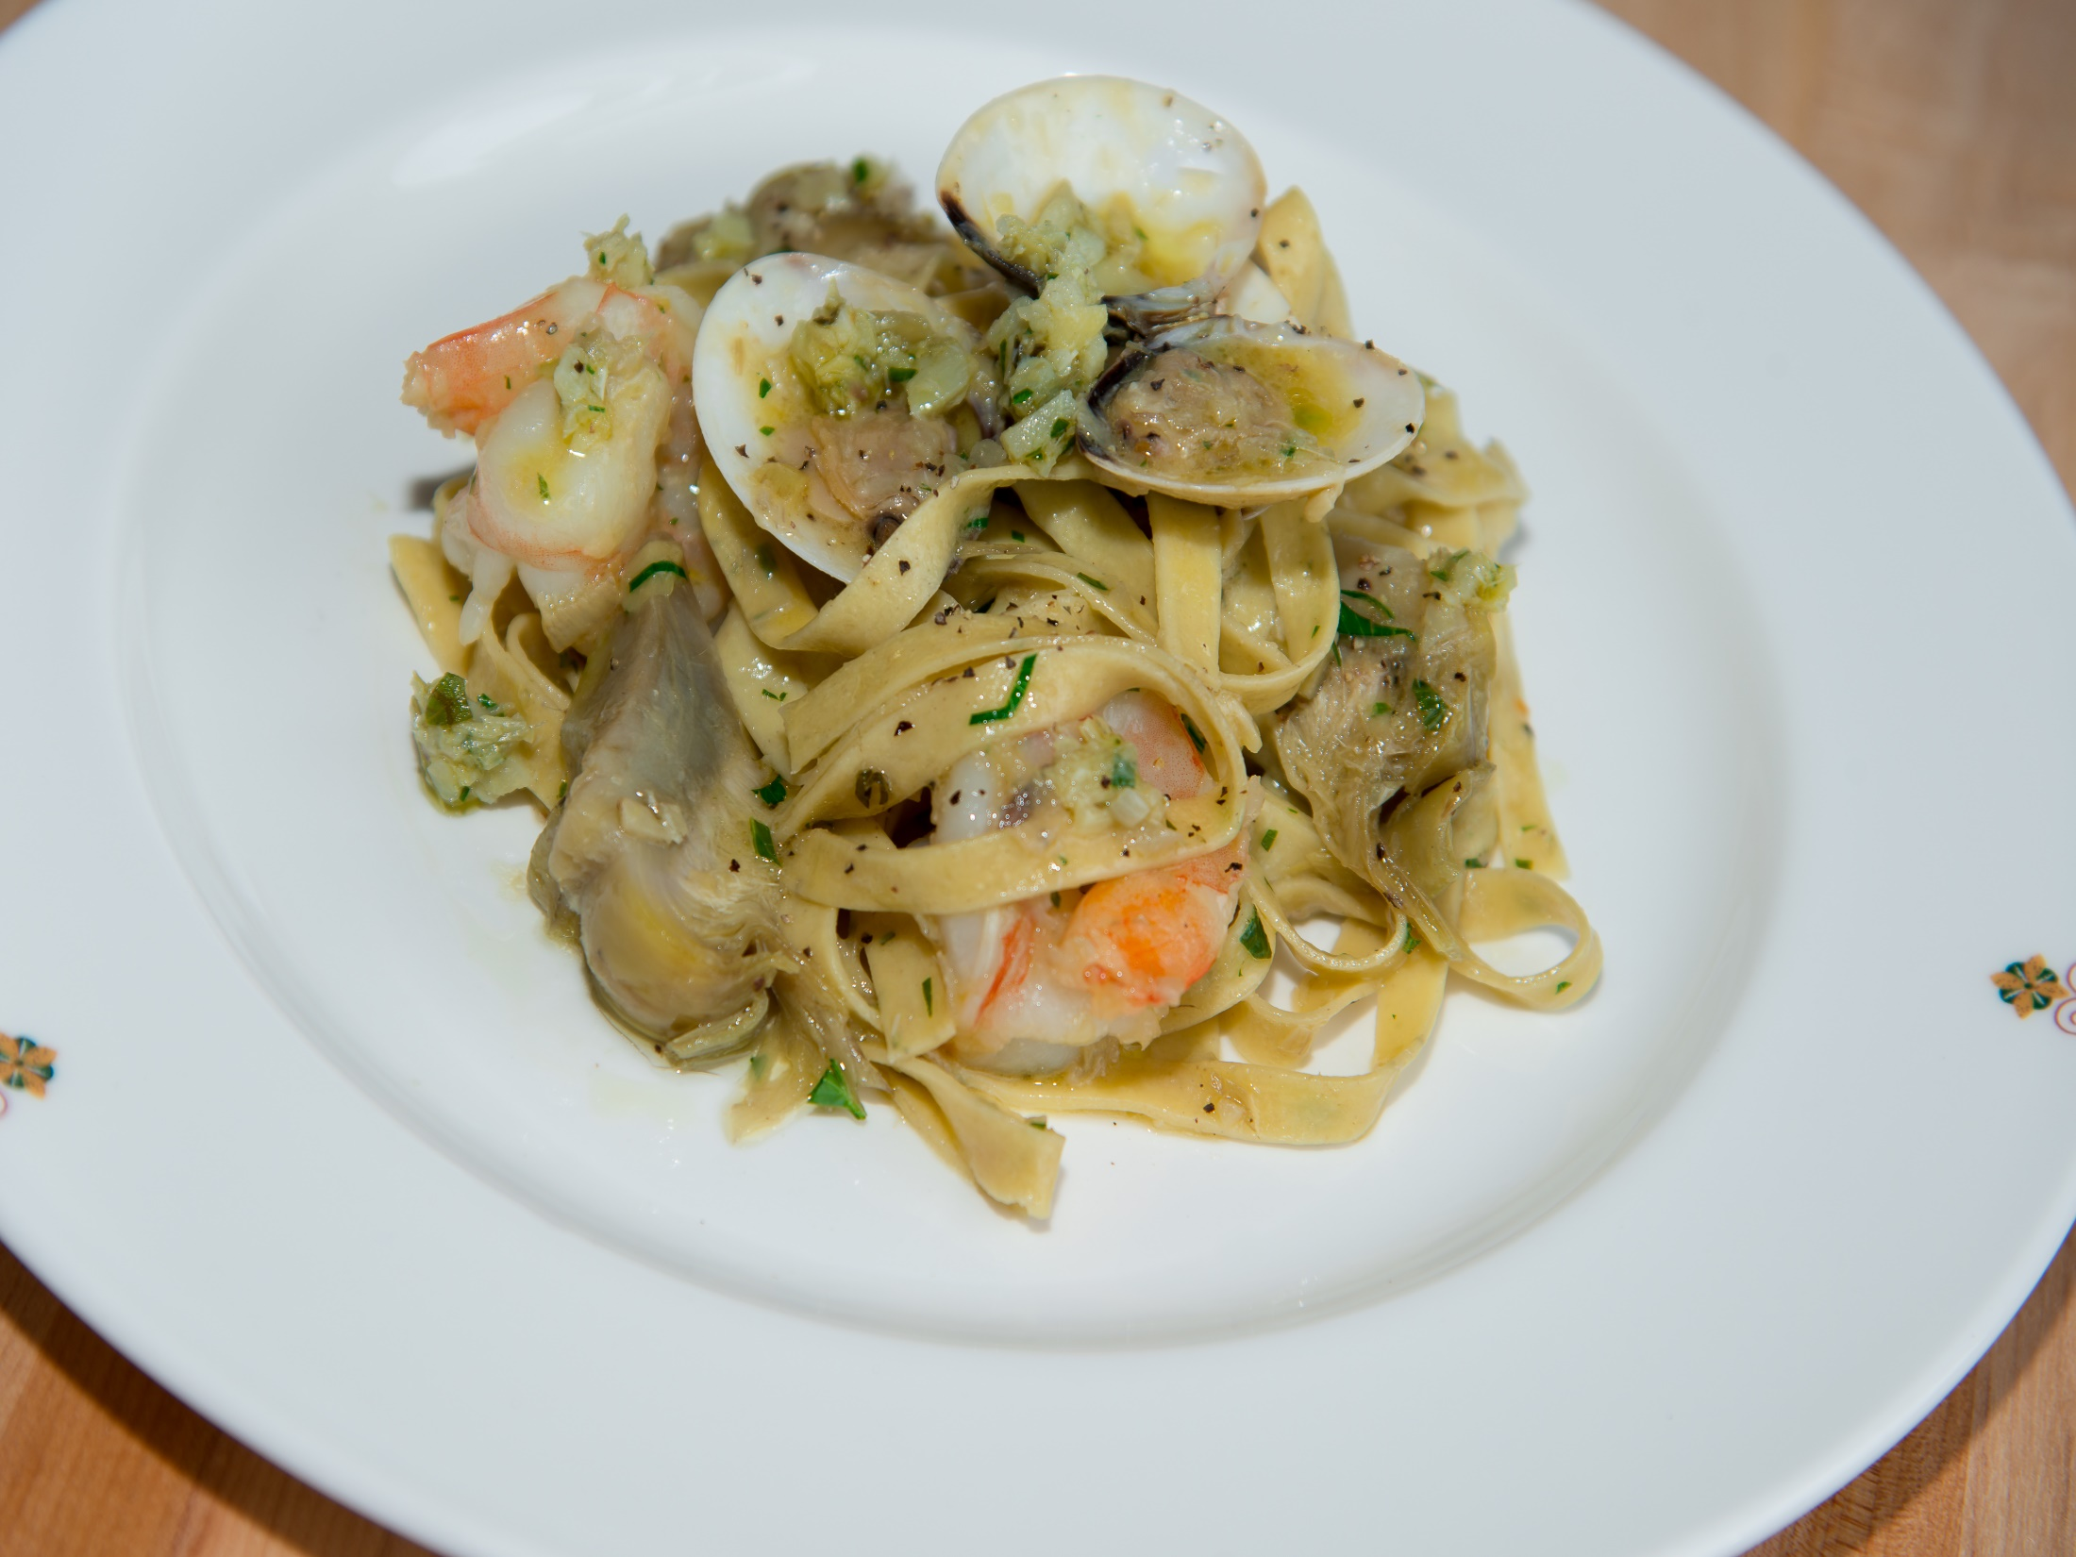
Notes:
Piccage Marjoran infused long Pasta , white prawns.artichoke pesto,Ligurian oliv oil

Slide 22
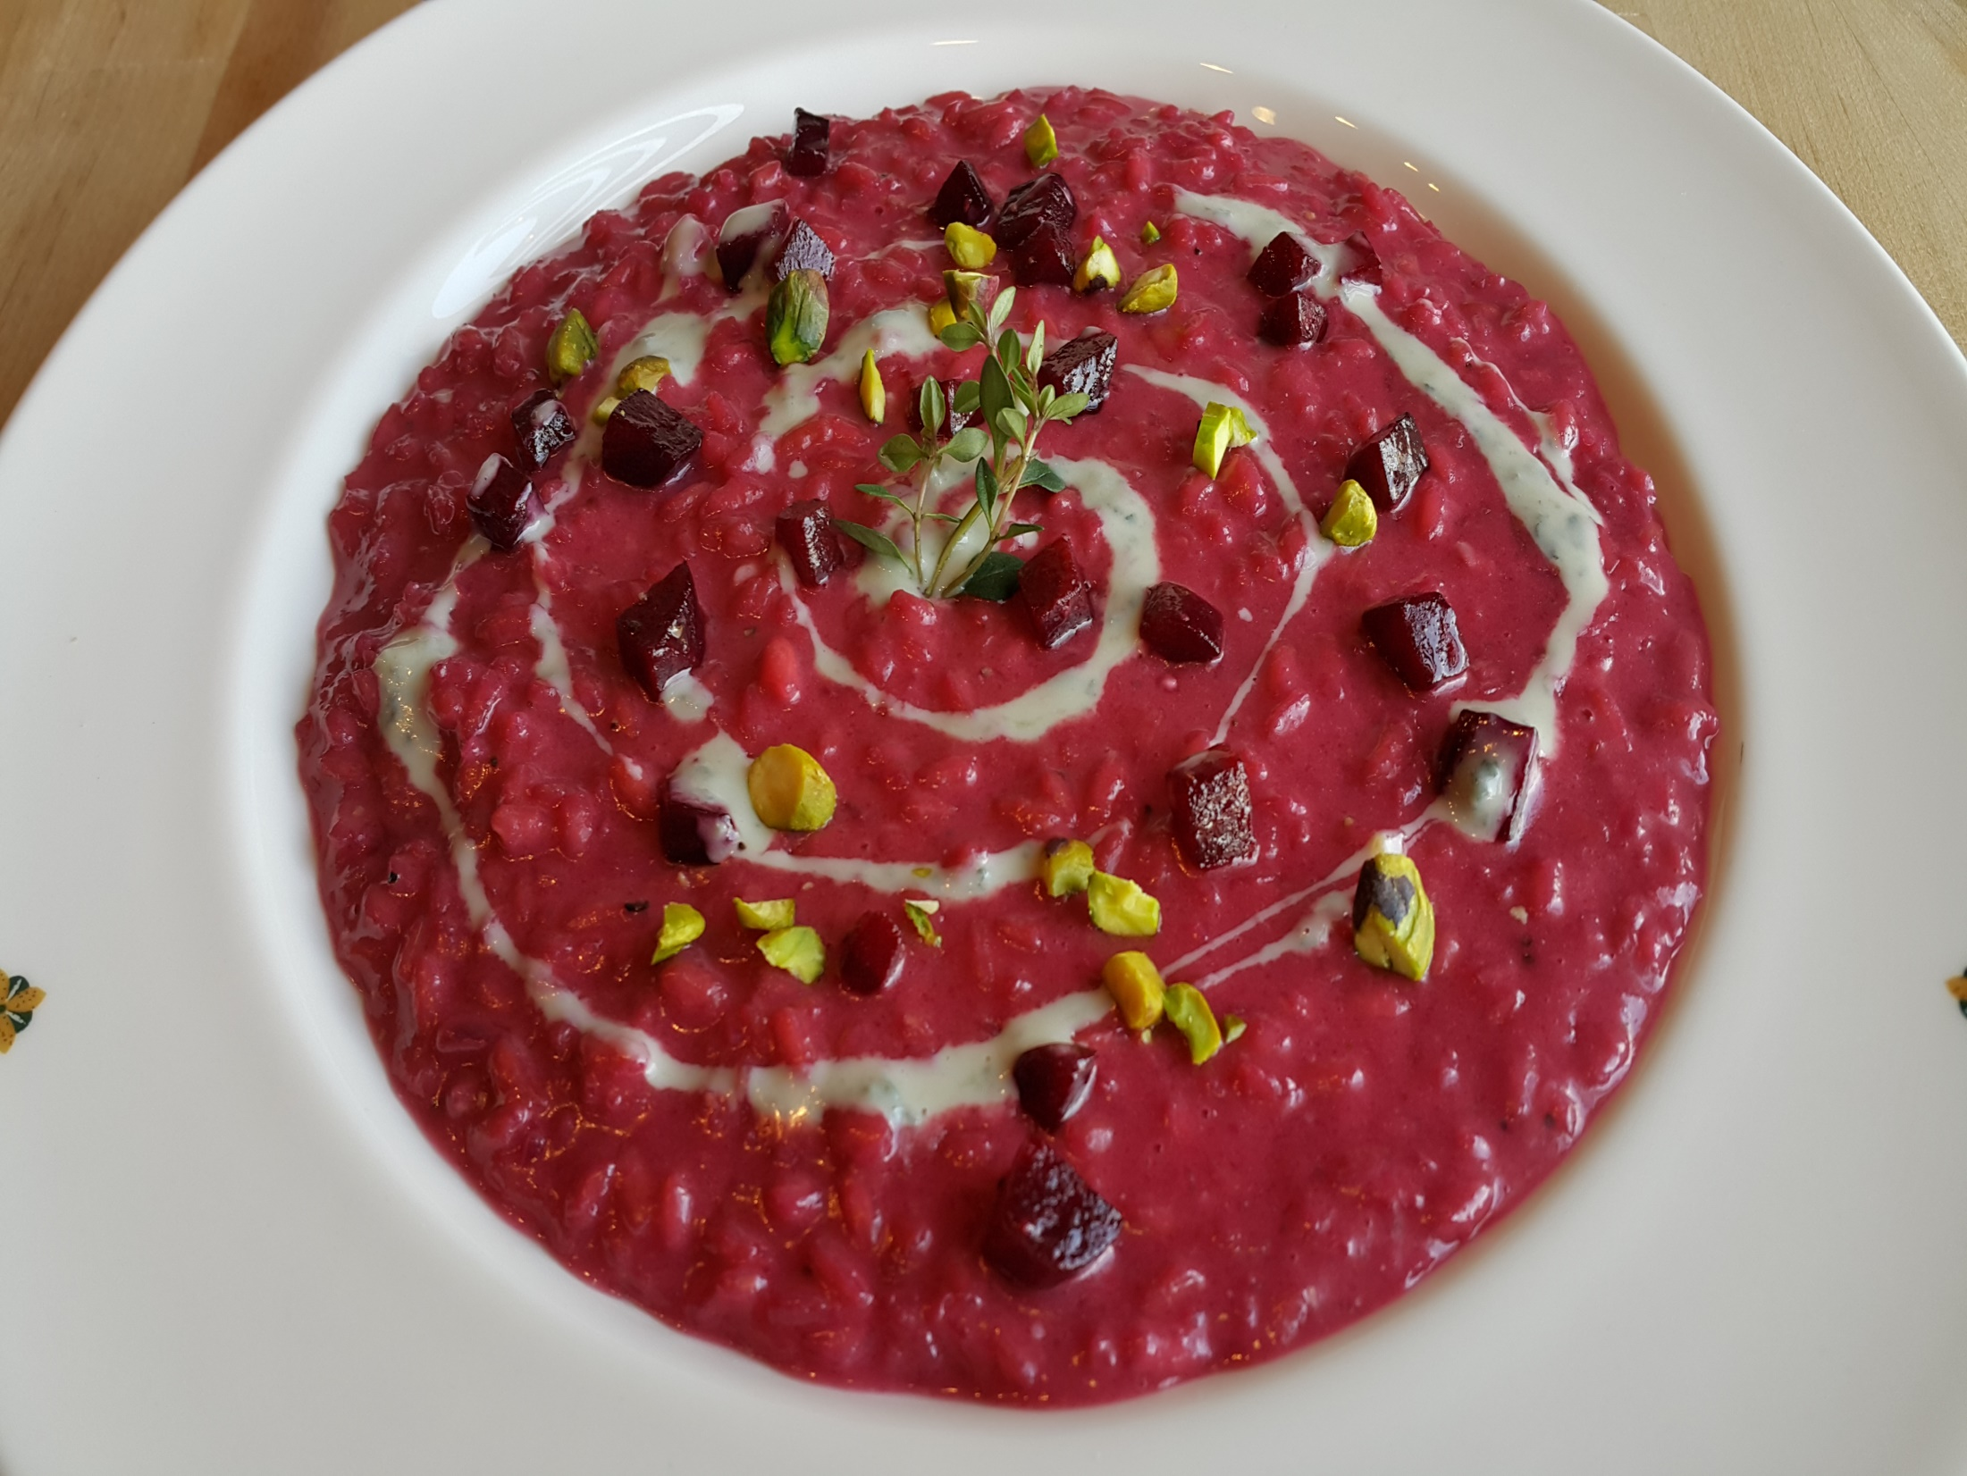
Notes:
Risotto'' Vialone Nano Rice'' Beets dolce latte,gorgonzola ,Pistacchio

Slide 23
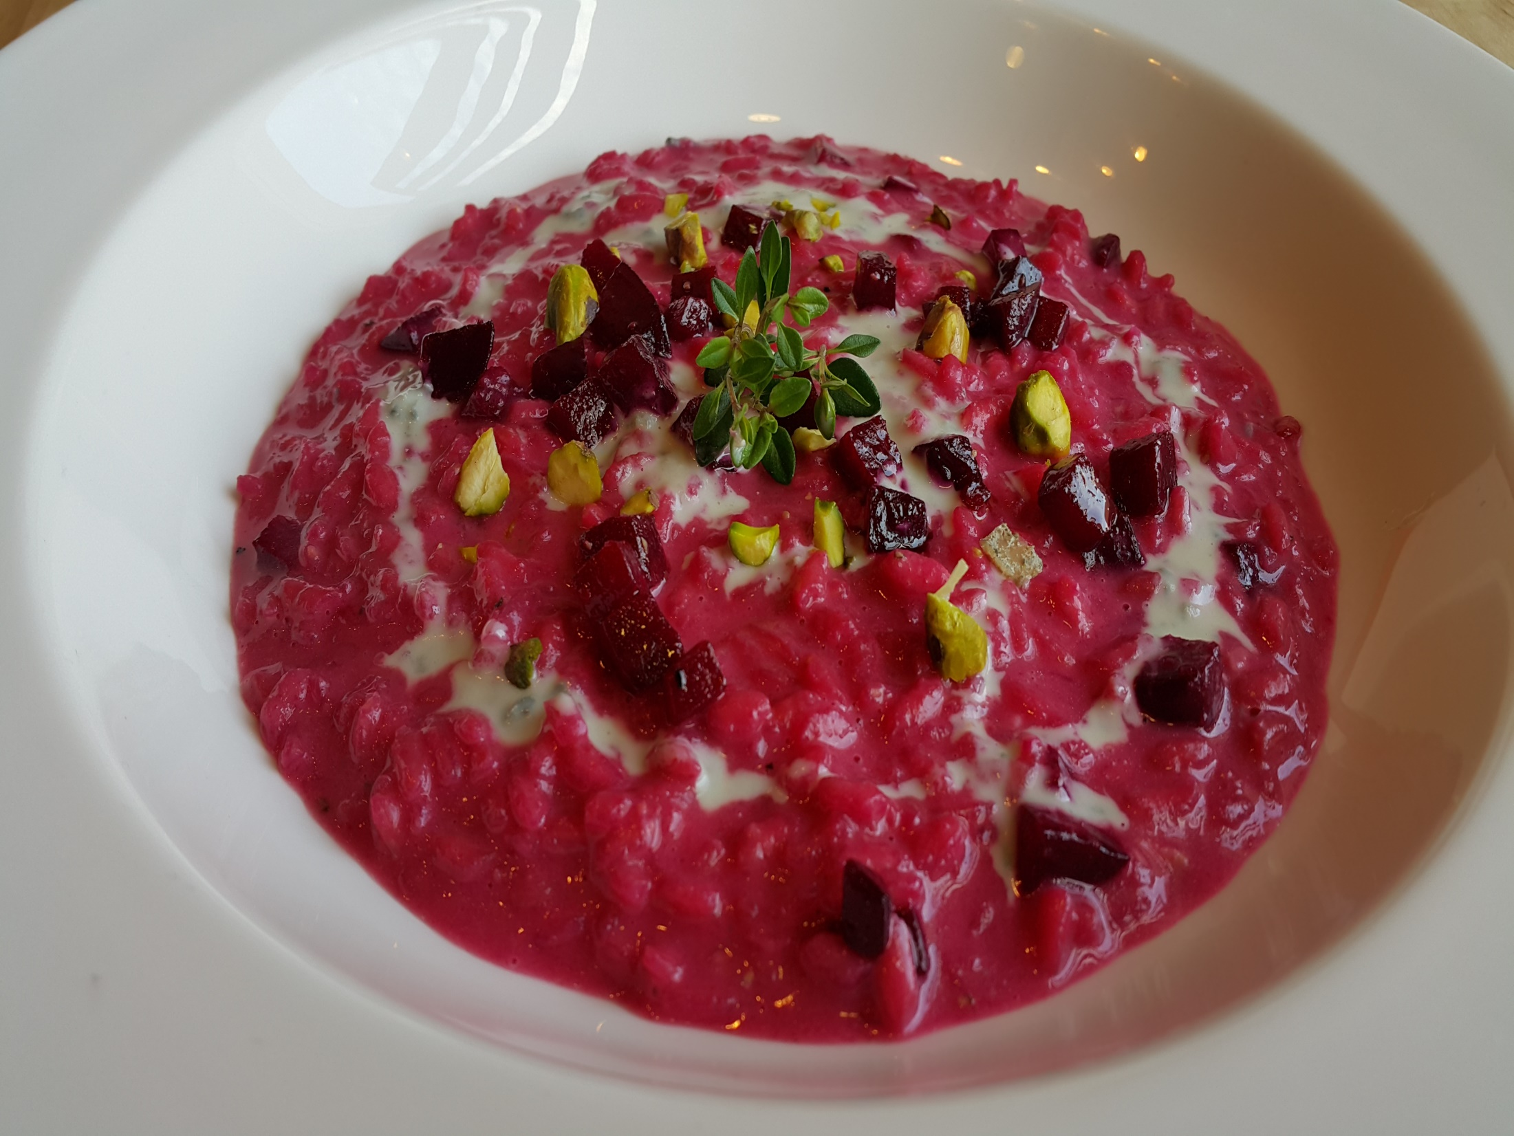
Notes:
Risotto'' Vialone Nano Rice'' Beets dolce latte,gorgonzola ,Pistacchio

Slide 24
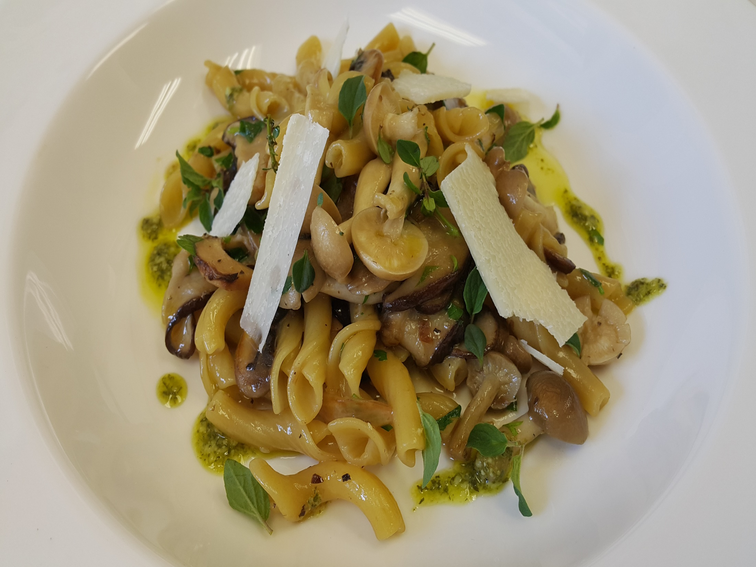
Notes:
Torchietti-whole wheat pasta ,foraged mushrooms,rosmarin

Slide 25
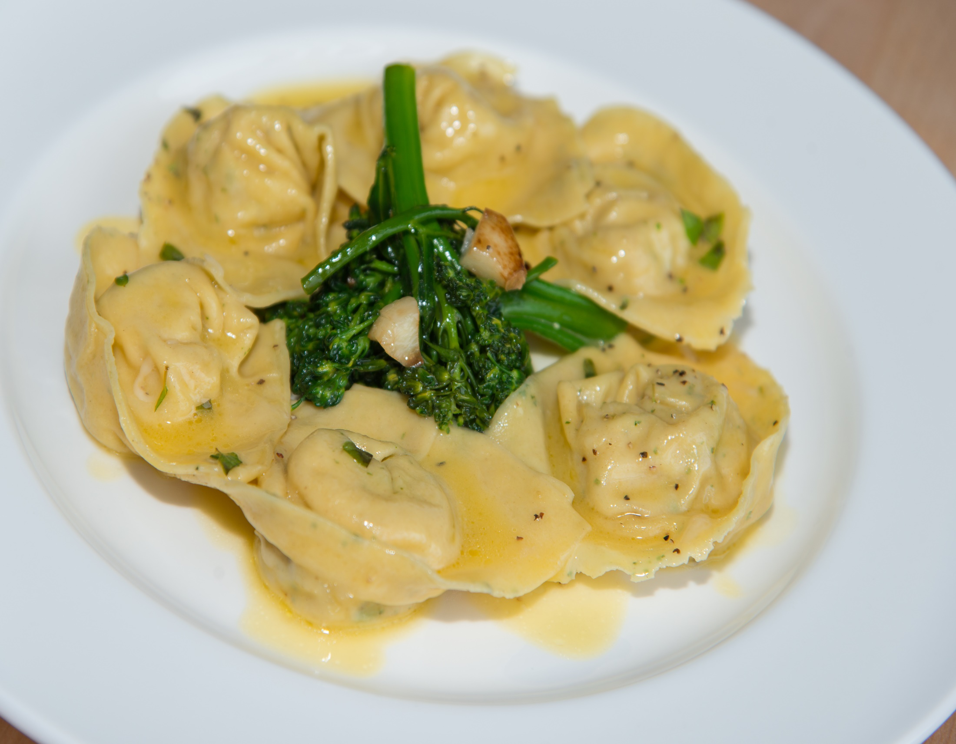
Notes:
rtelloni,Mint speckled ,roasted Lamb,crosta nera Pecorino,Broccoli rabe

Slide 26
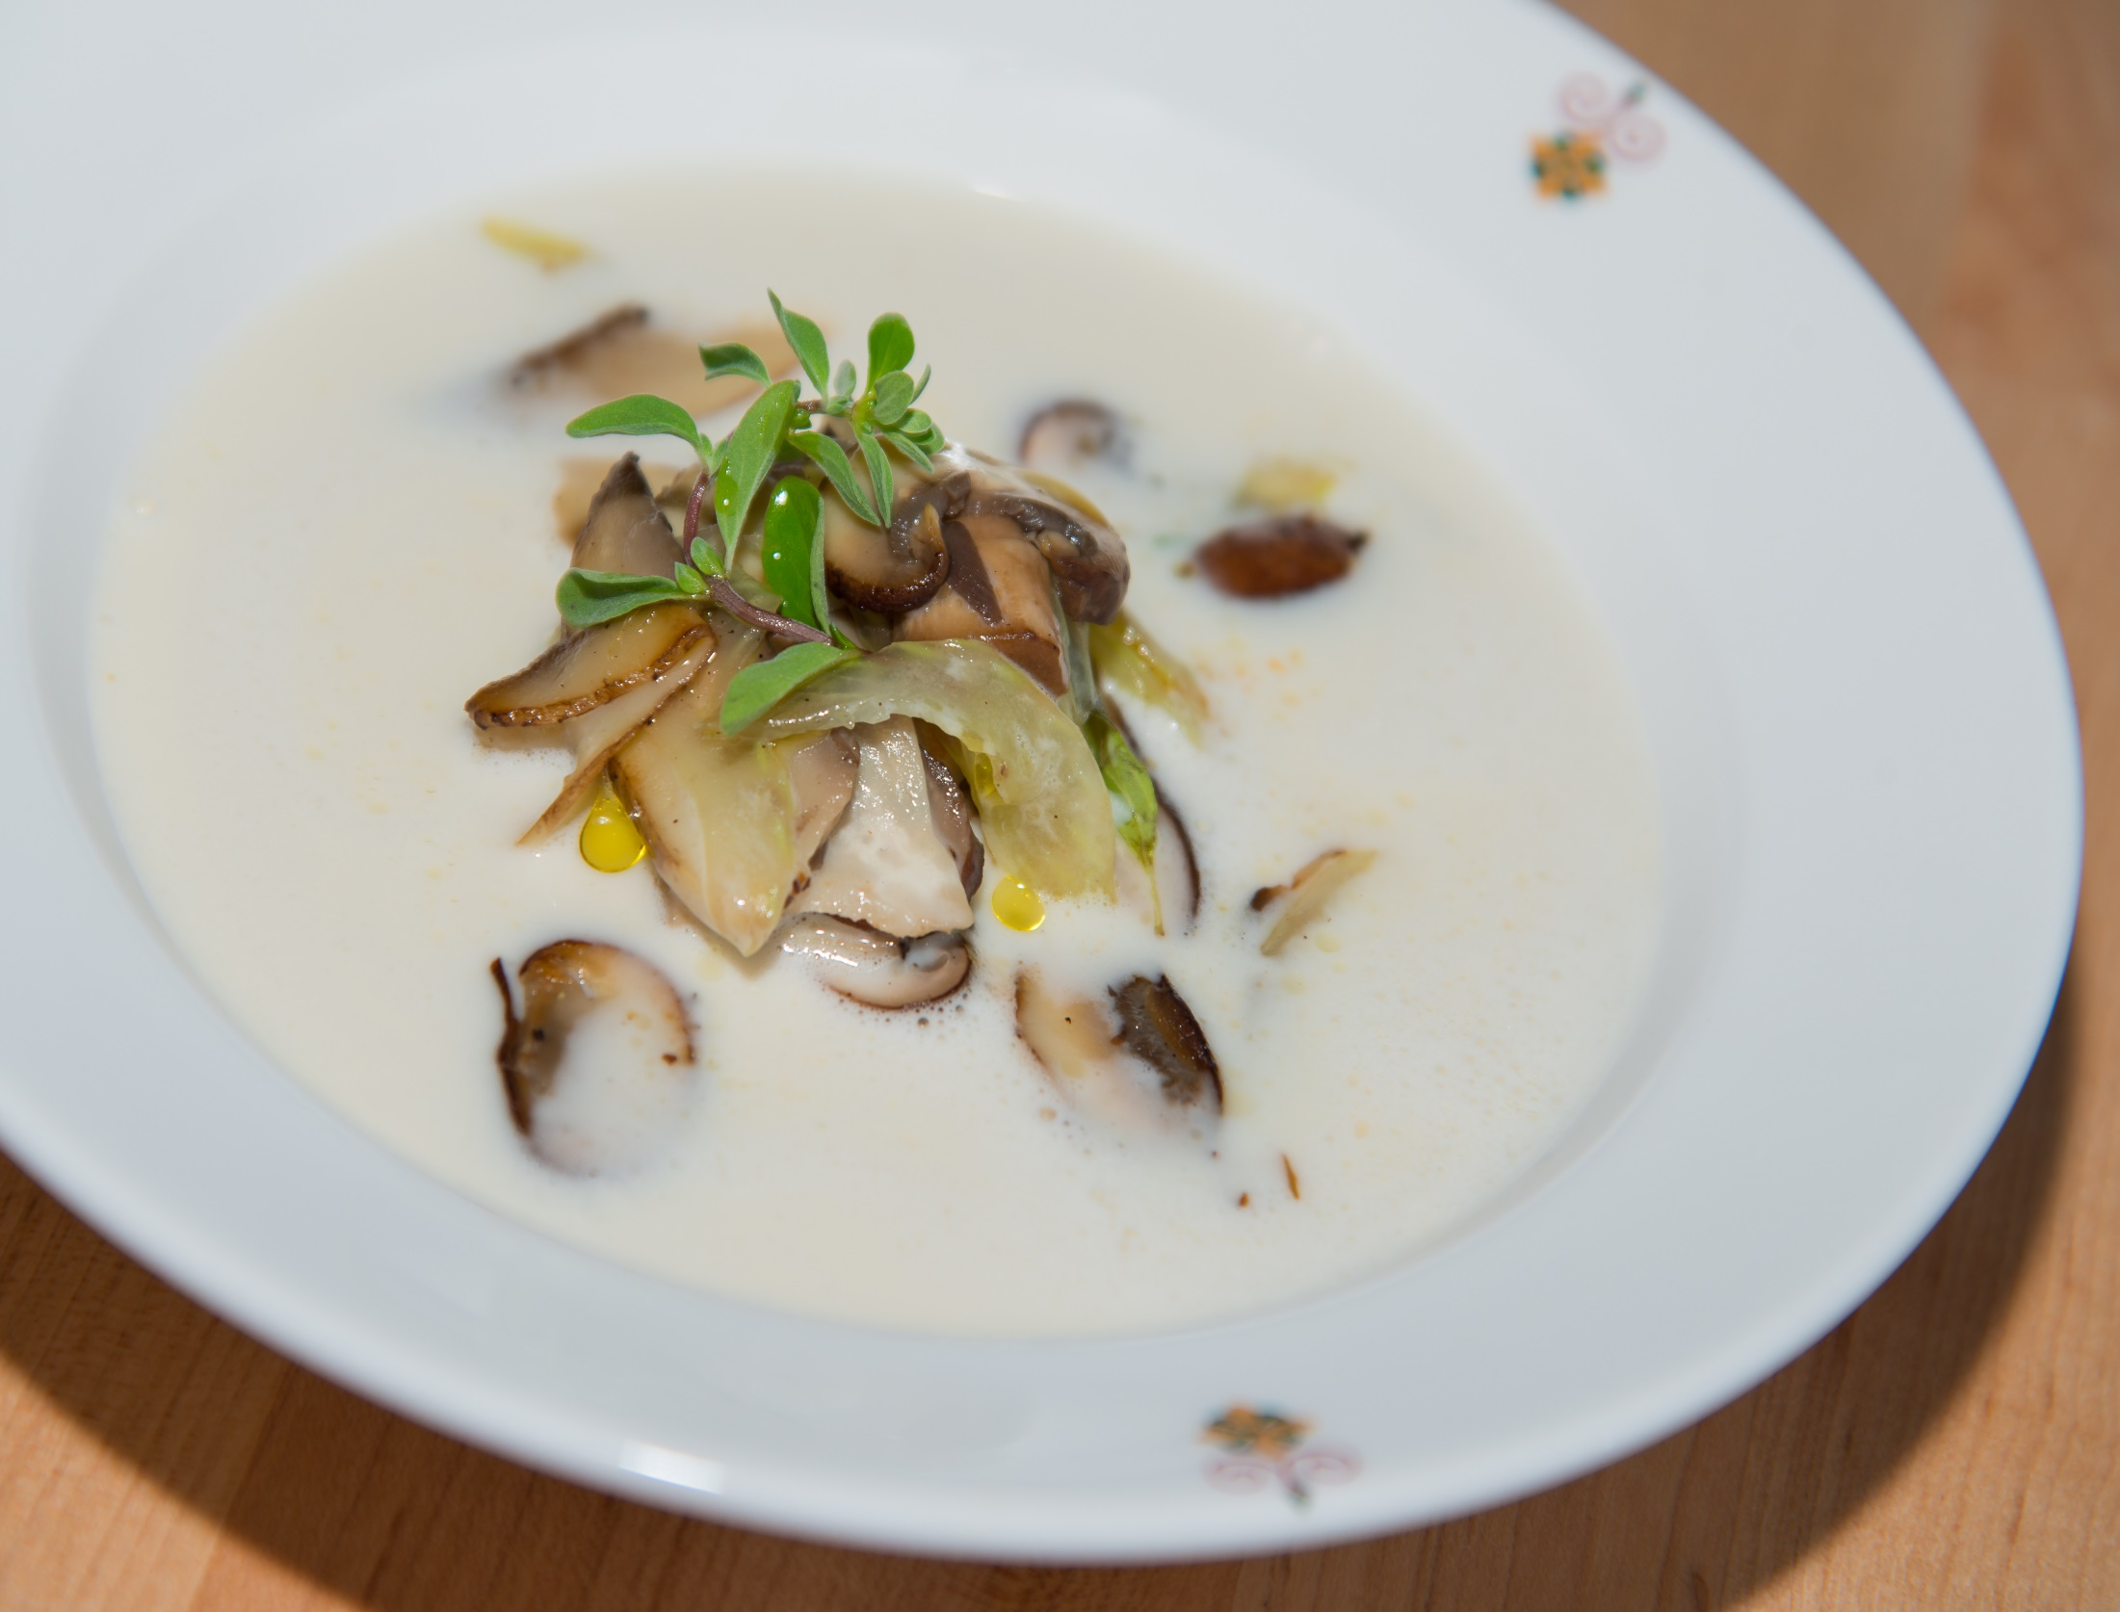
Notes:
Grana Padano Fondue,with Celery,Foraged Mushrooms,Toasted Hazelnuts

Slide 27
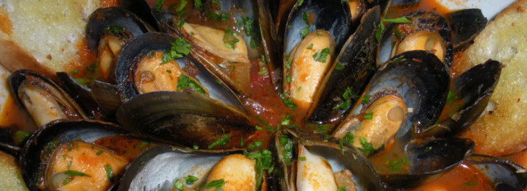
Mussel &Calamari with garlic fresh Tomato ,served with garlic Bread
Notes:
ZUPPA DI CALAMARI E COZZE

Slide 28
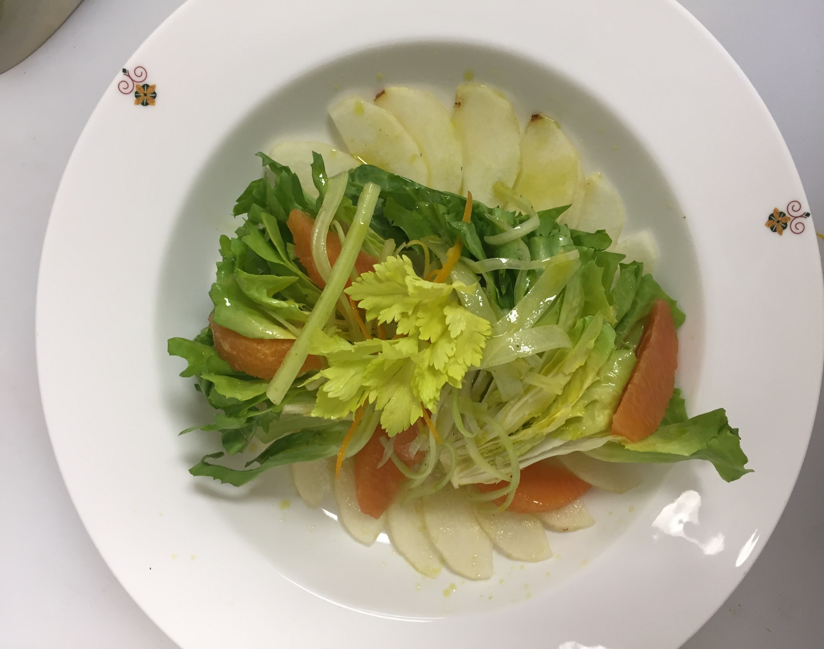
Notes:
Insalata Di Sedano, Scarola E Pere Alla Scorza D'Arancia – escarole, white celery, pear, orange zest

Slide 29
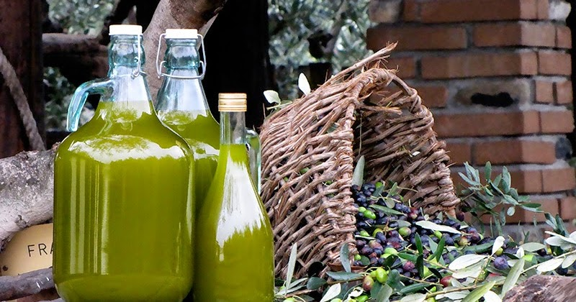
Secondi Piatti
Secondi Piatti
Meat & Fish

Slide 30
Notes:
Roman Seafood Papillote/Cartoccio
with Black Mussel, Shrimp, Grouper, scalops, Potato and Artichoke

Slide 31
Notes:
Roman Seafood Papillote/Cartoccio
with Black Mussel, Shrimp, Grouper, scalops, Potato and Artichoke

Slide 32
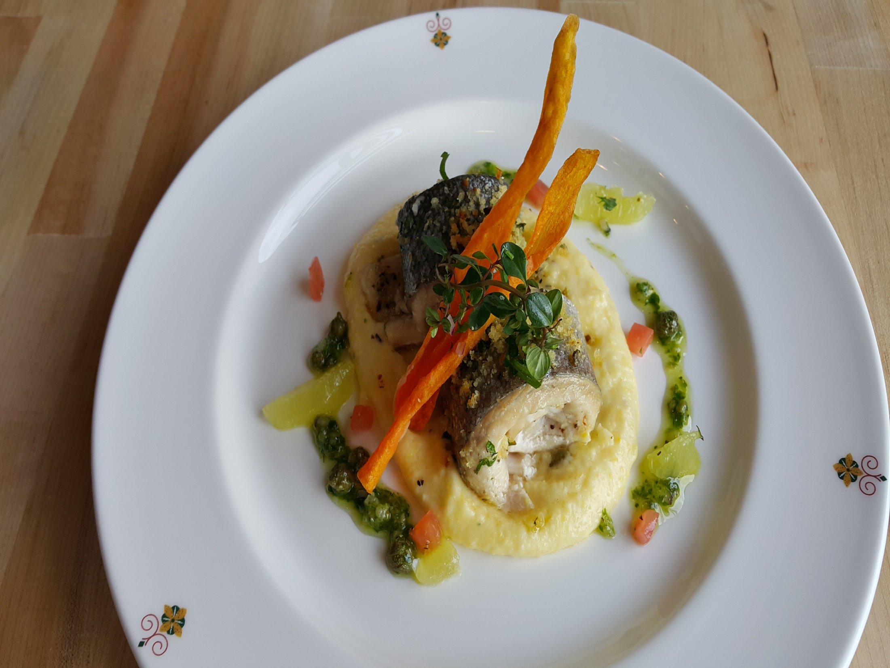
Notes:
Herb Trout Fillet ,lake Iseo a la mode di Francesco

Slide 33
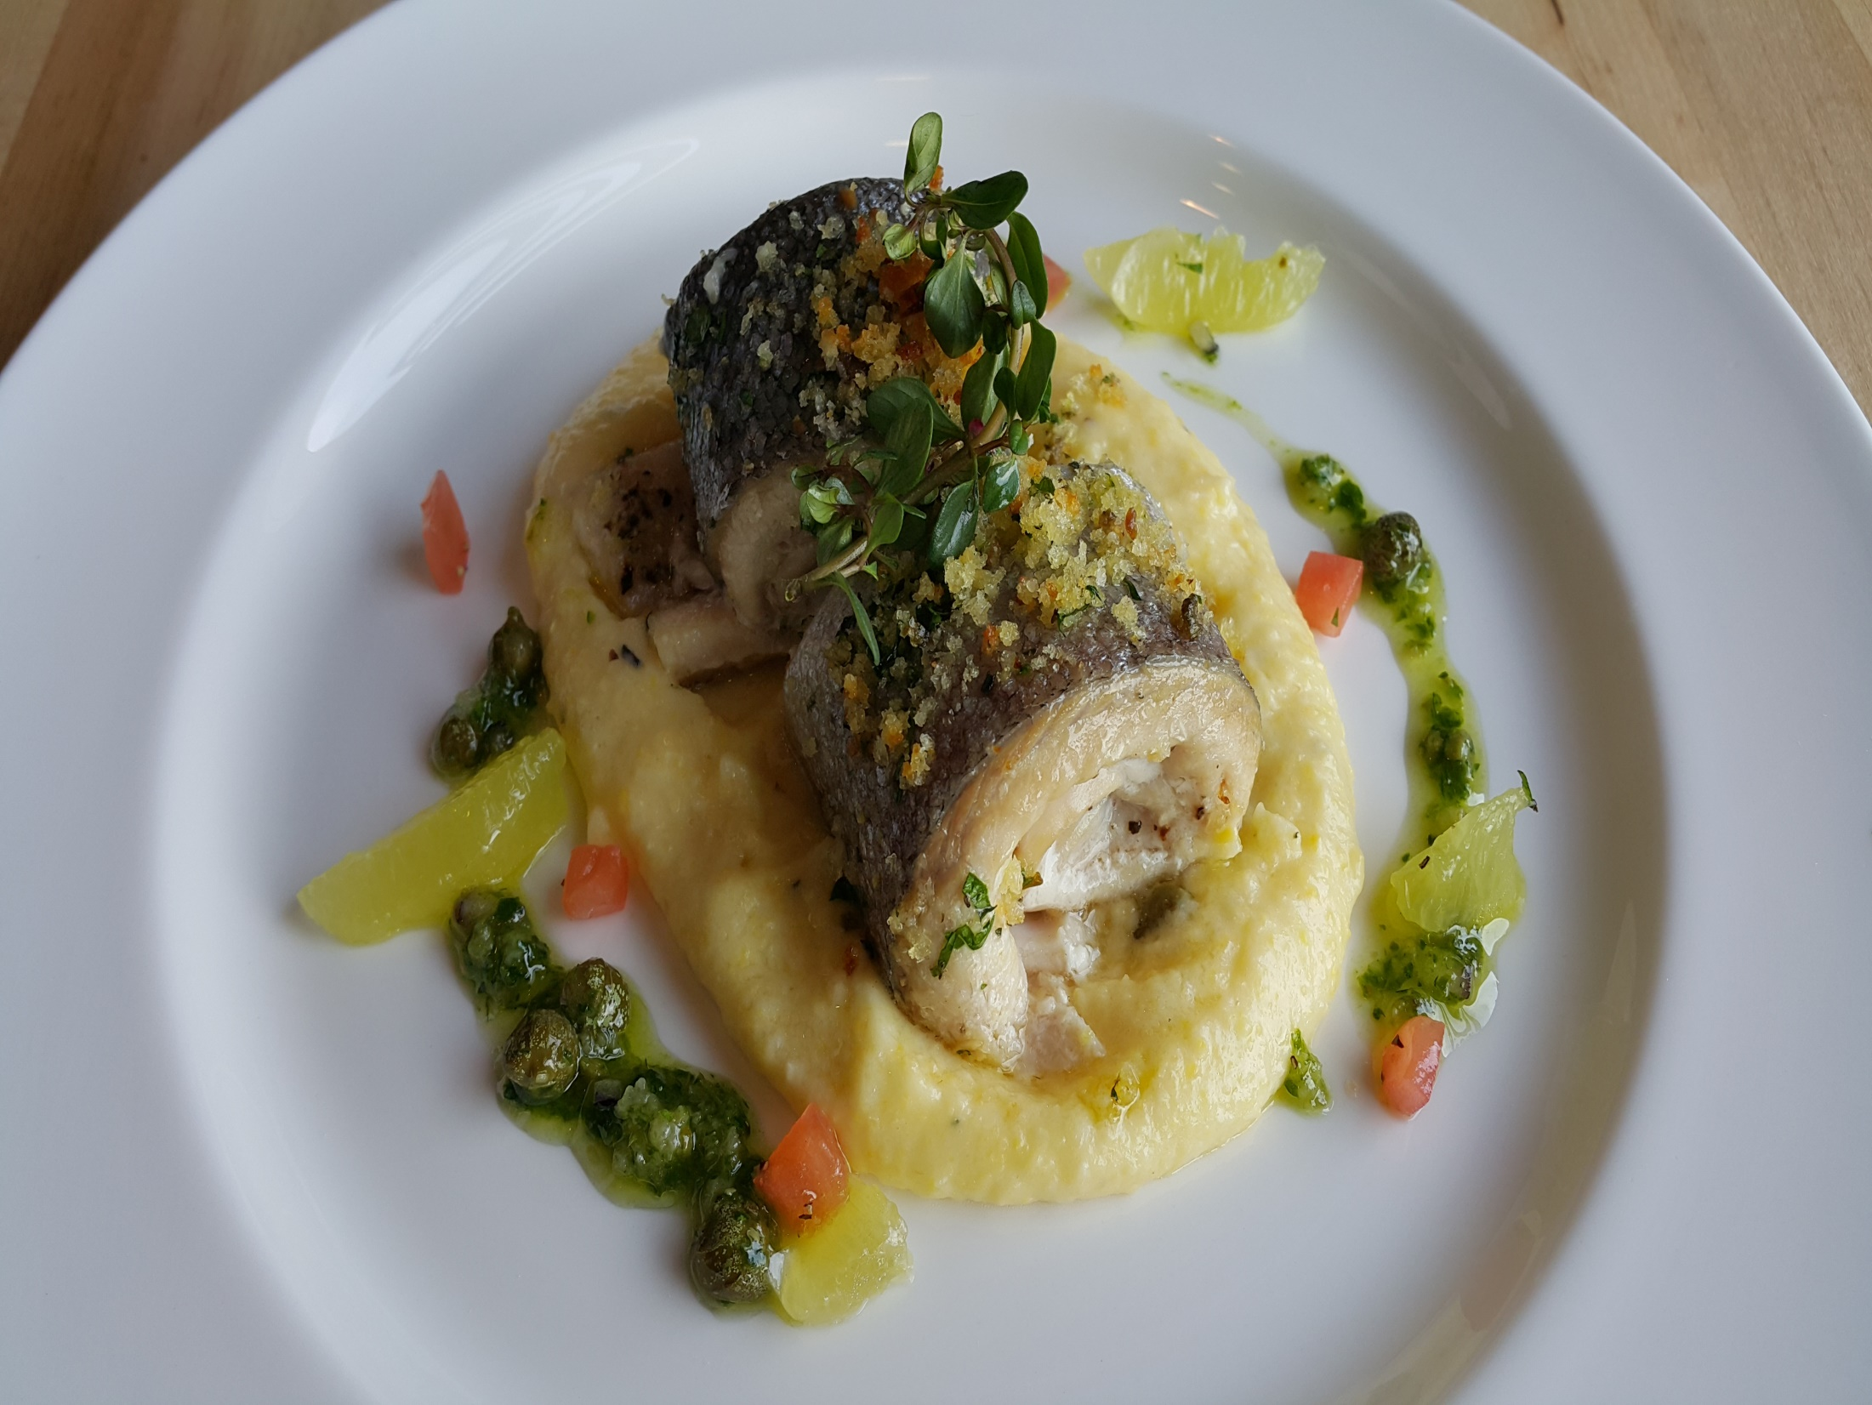
Notes:
Herb Trout Fillet ,lake Iseo a la mode di Francesco

Slide 34
Notes:
Breaded Veal Vallet
Roasted Artichoke, Provolone, Marjoram roasted Potato

Slide 35
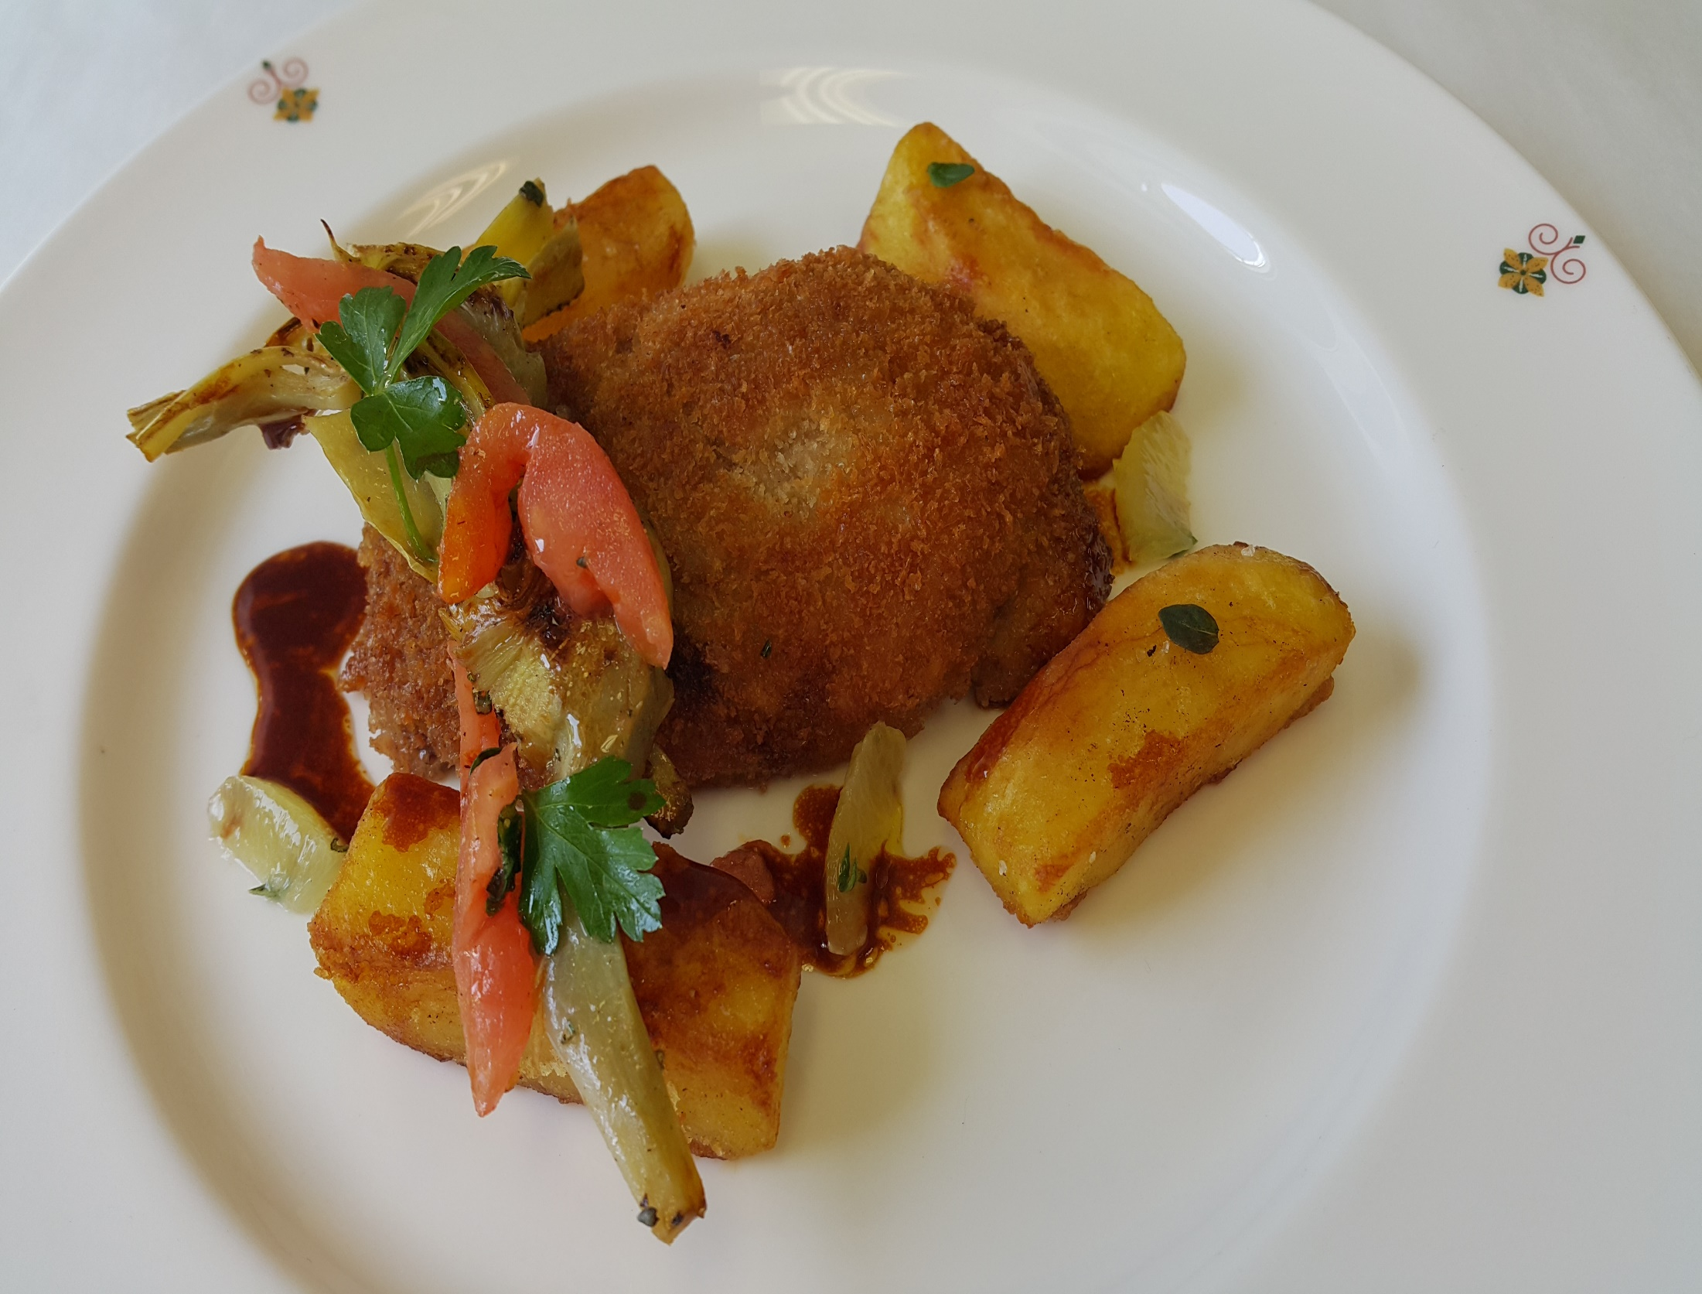
Notes:
Breaded Veal Vallet – roasted artichoke, provolone, marjoram roasted potatoes

Slide 36
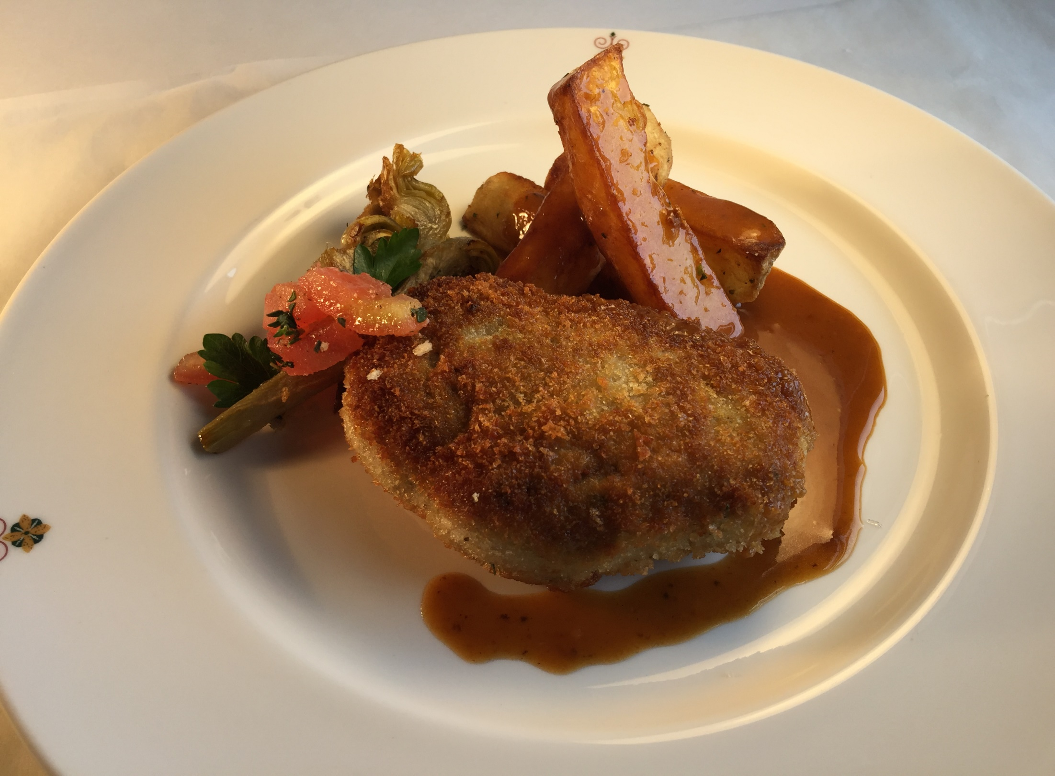
Notes:
Breaded Veal Vallet – roasted artichoke, provolone, marjoram roasted potatoes

Slide 37
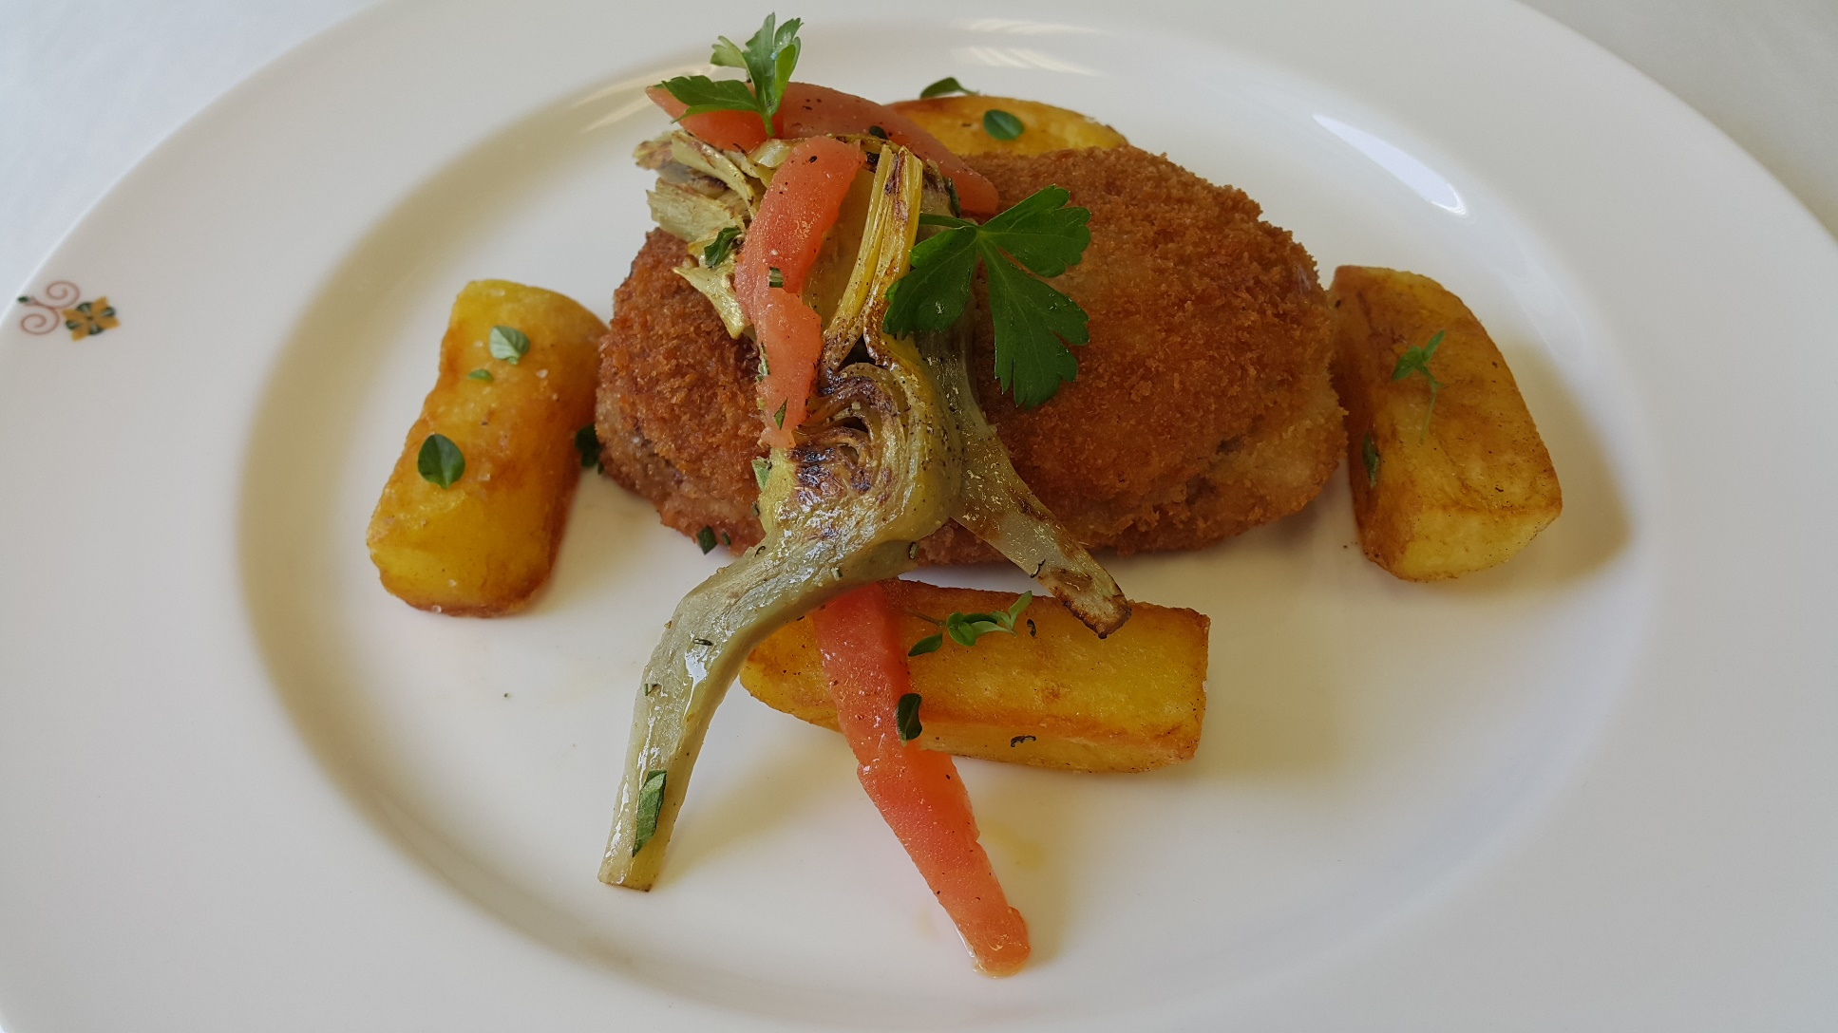
Notes:
Breaded Veal Vallet – roasted artichoke, provolone, marjoram roasted potatoes

Slide 38
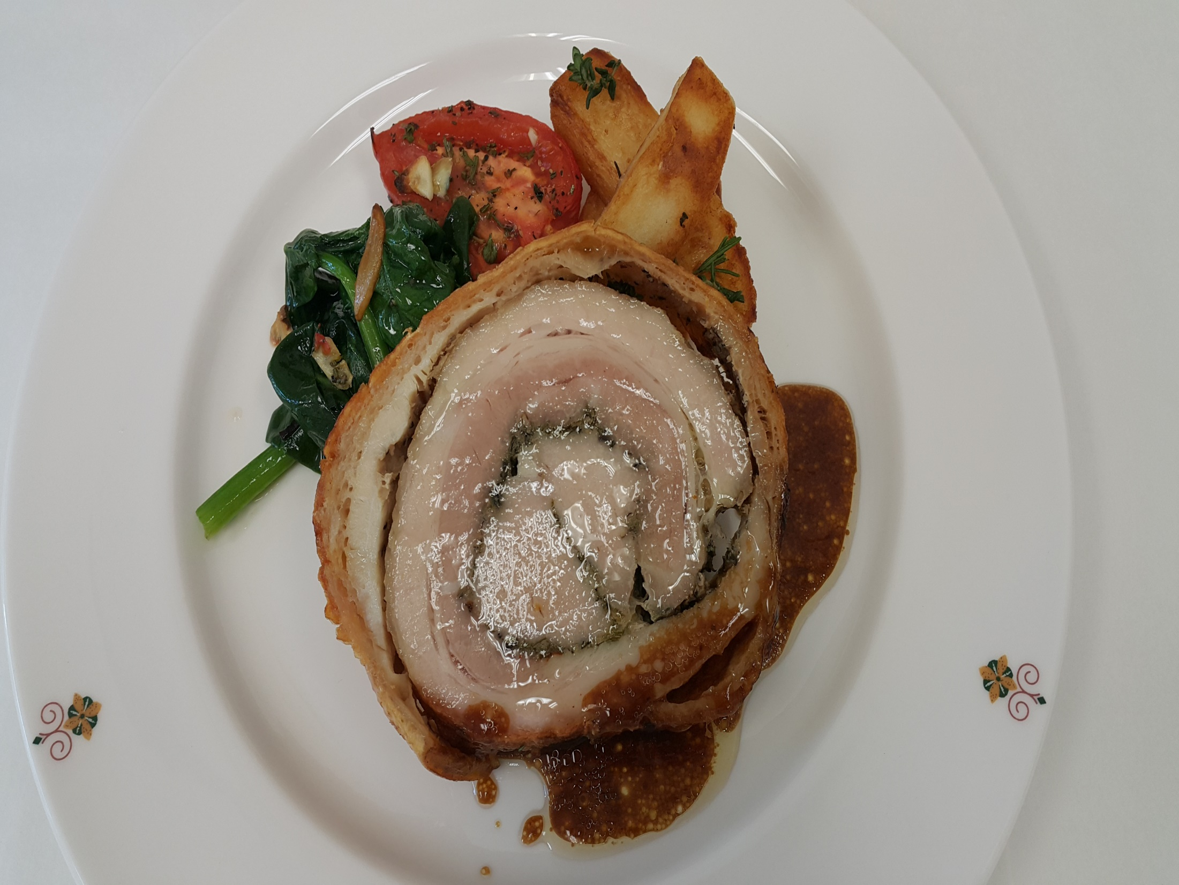
Notes:
Porchetta
Rolled pork belly Toscana with erbs ,fennel,celery served with Potatoes of the day, & spinach ,Tomato stew

Slide 39
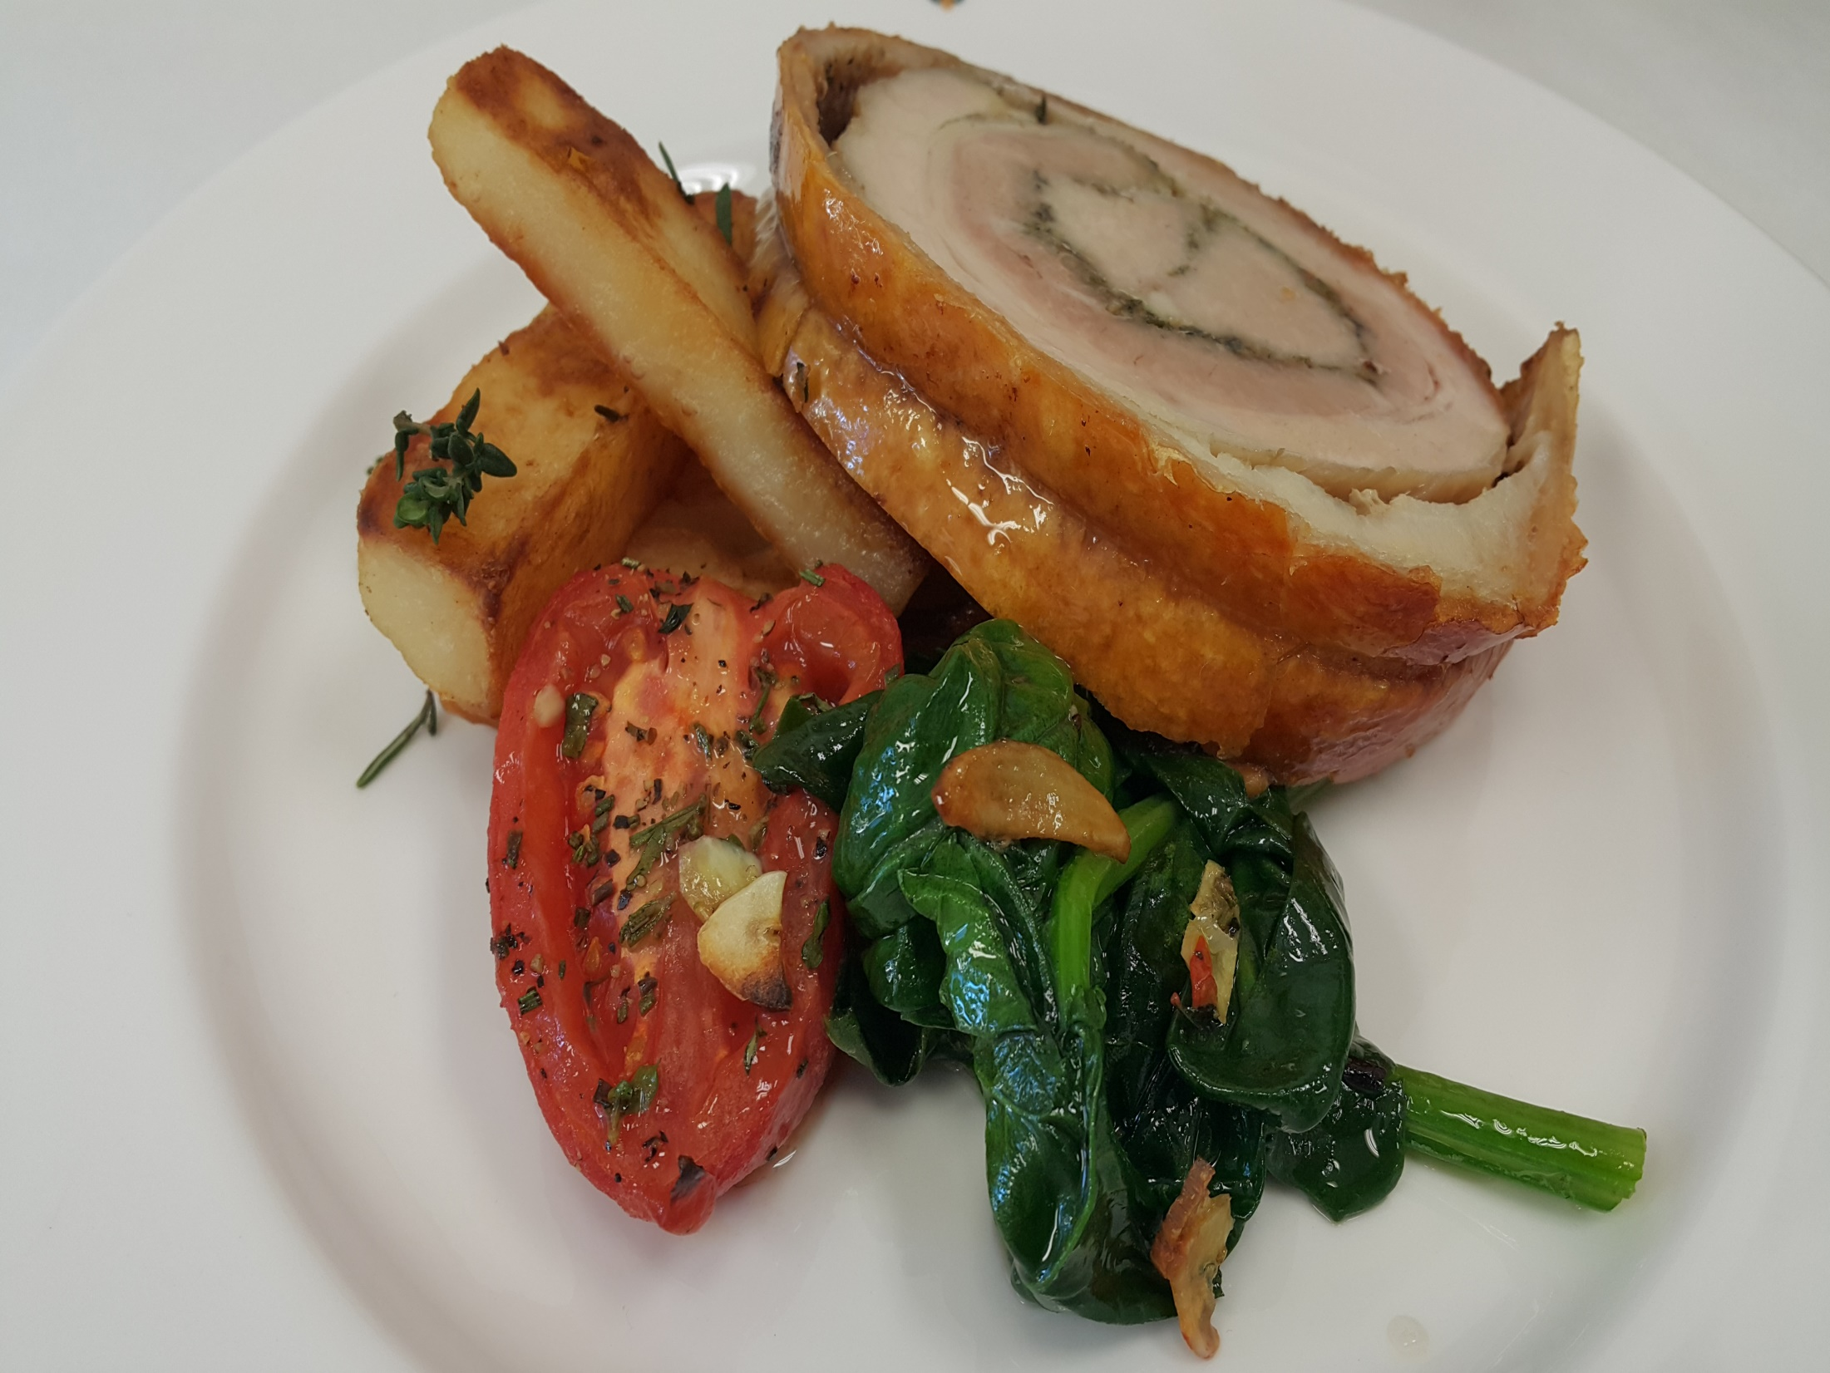
Notes:
Porchetta
Rolled pork belly Toscana with erbs ,fennel,celery served with Potatoes of the day, & spinach ,Tomato stew

Slide 40
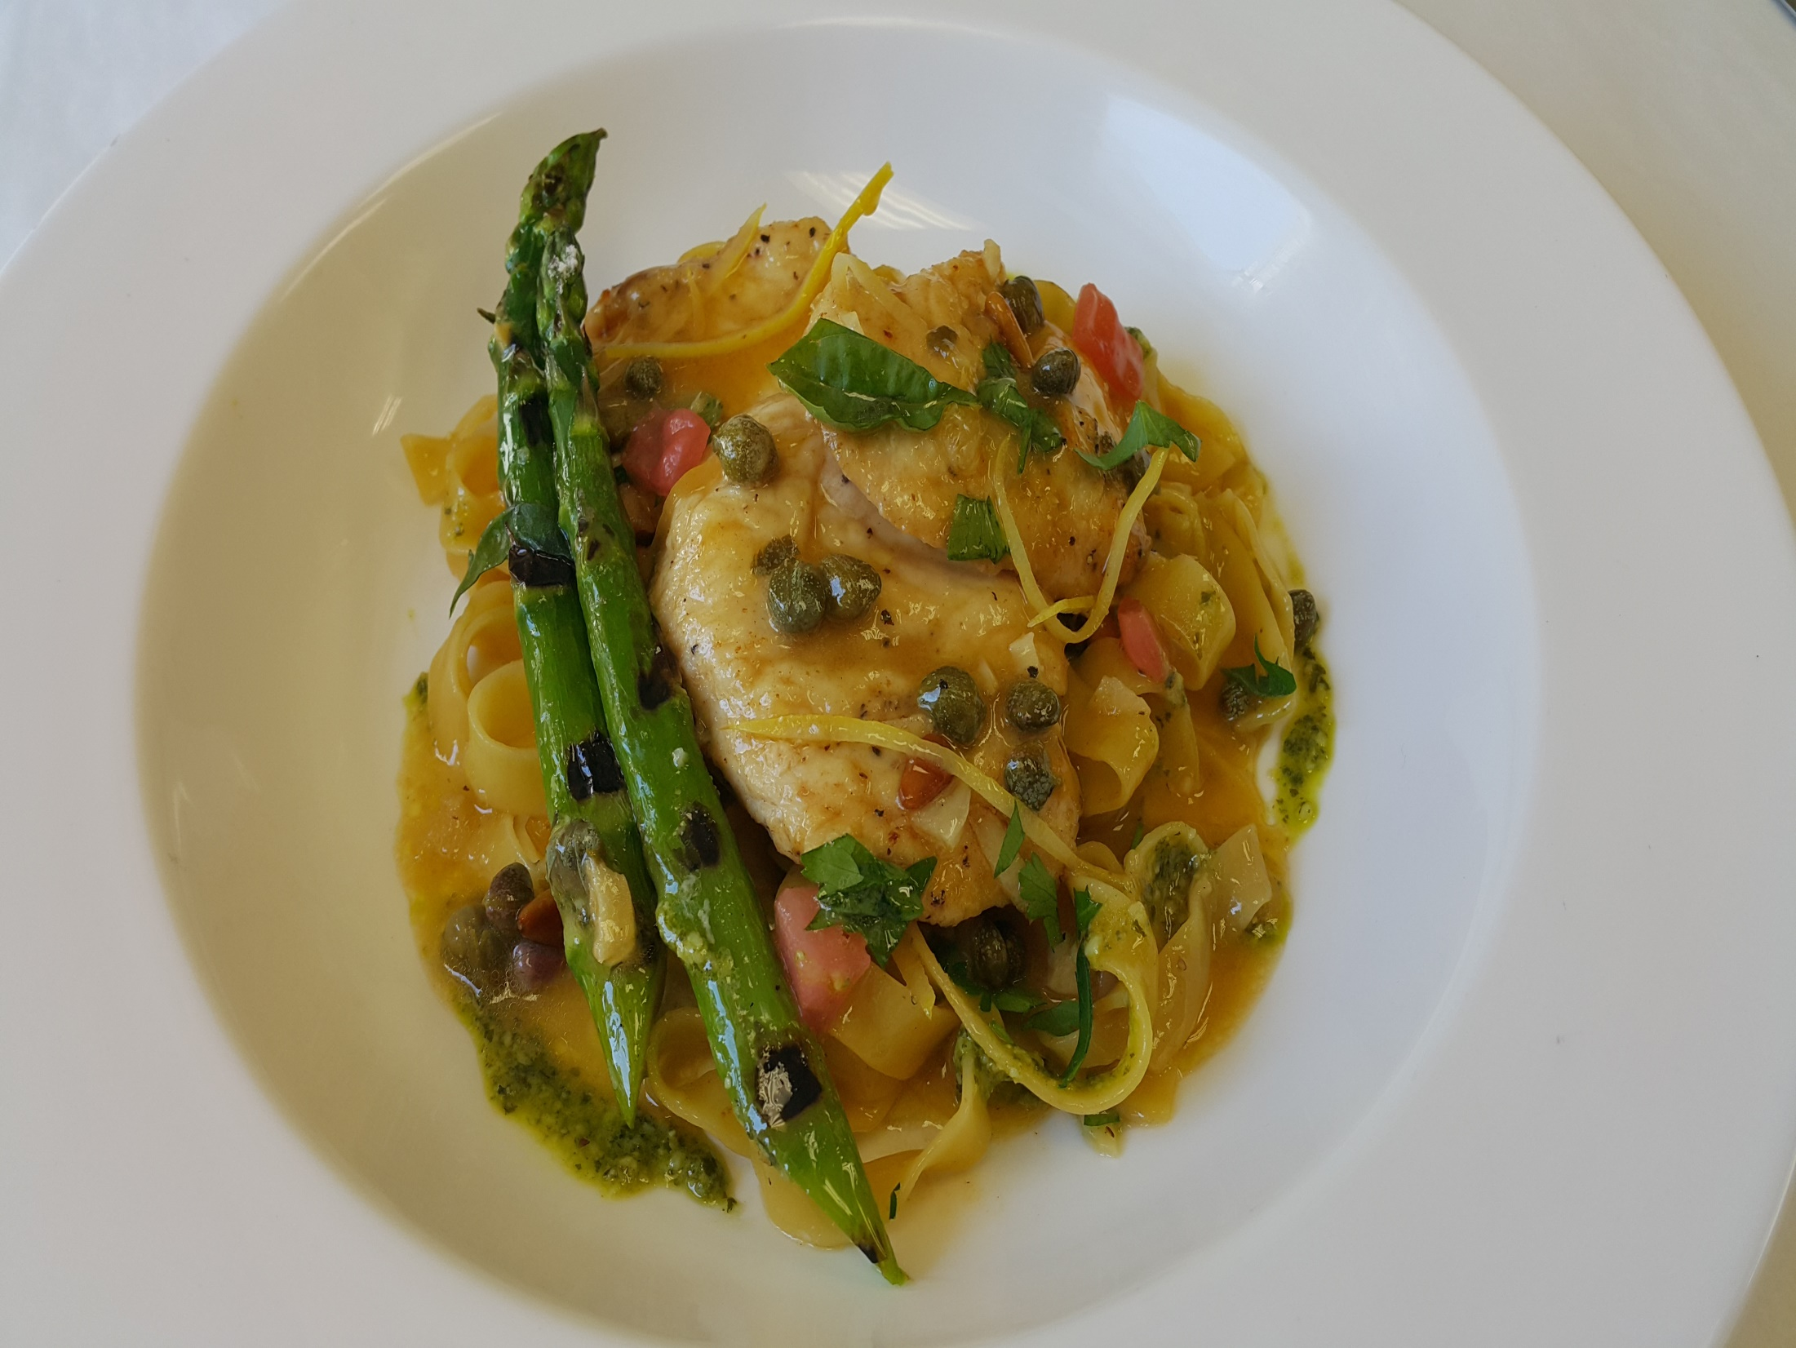
Notes:
Scallopine di Pollo , Salsa al Limoncello con Rosemarino
Seared Chicken Breast,Sorrento Lemon,Rosemary sauce,garlic,pinenuts and capers,served with fettuccine

Slide 41
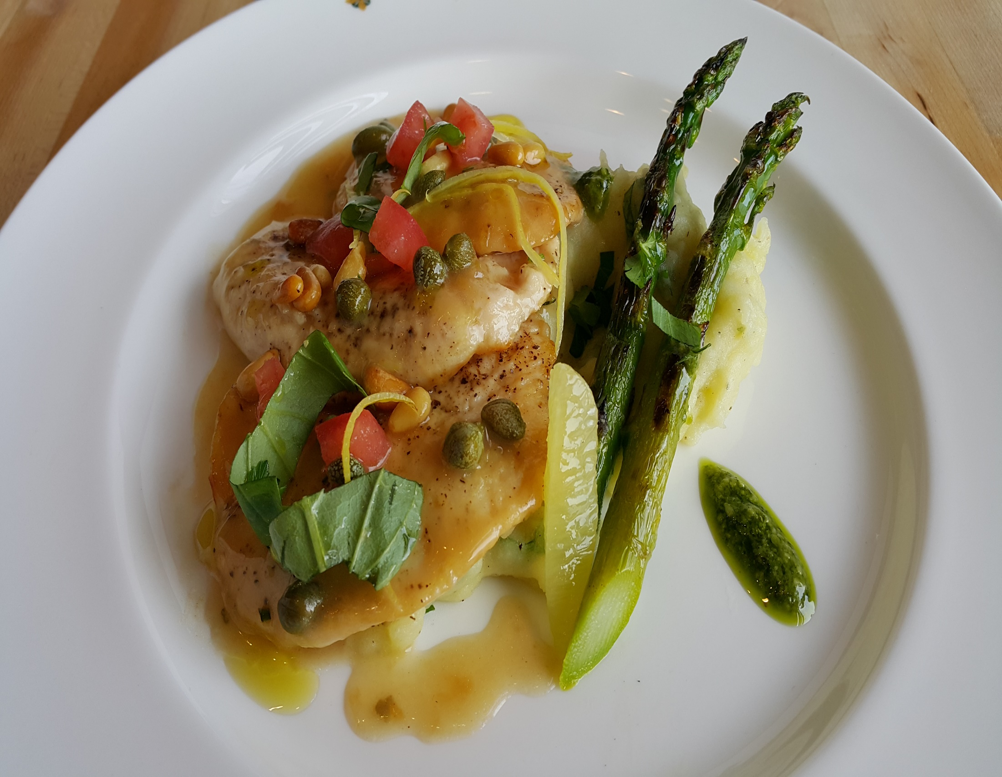
Notes:
Scallopine di Pollo , Salsa al Limoncello con Rosemarino
Seared Chicken Breast,Sorrento Lemon,Rosemary sauce,garlic,pinenuts and capers,served with Forked Potatoes

Slide 42
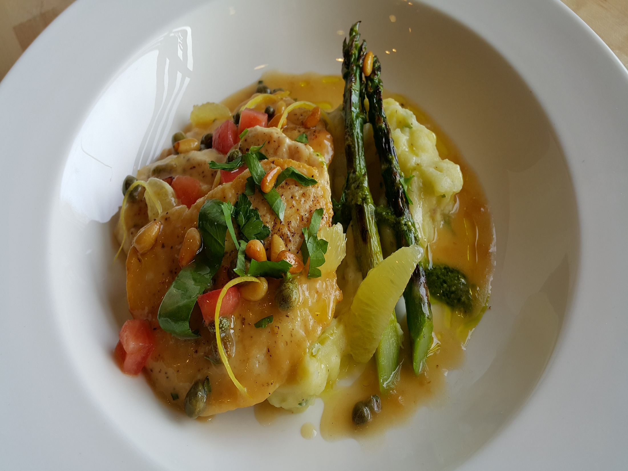
Notes:
Scallopine di Pollo , Salsa al Limoncello con Rosemarino
Seared Chicken Breast,Sorrento Lemon,Rosemary sauce,garlic,pinenuts and capers,served with( fettuccine or Forked Potatoes)

Slide 43
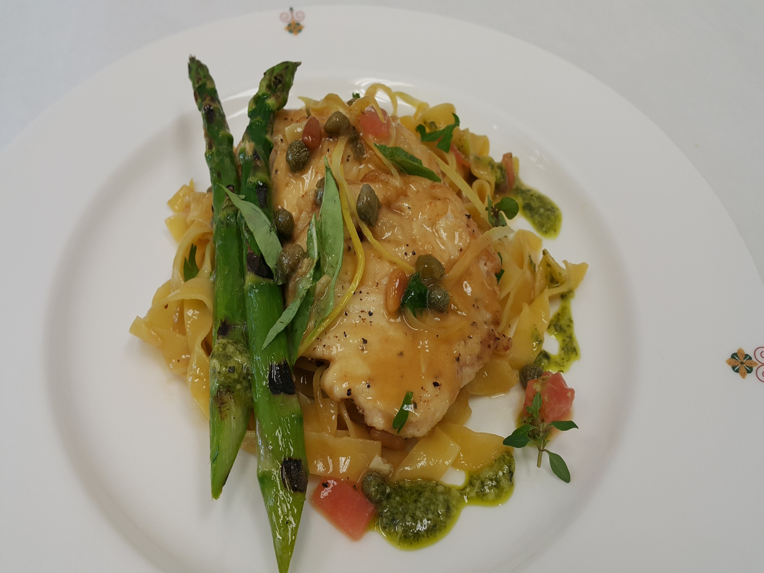
Notes:
Scallopine di Pollo , Salsa al Limoncello con Rosemarino
Seared Chicken Breast,Sorrento Lemon,Rosemary sauce,garlic,pinenuts and capers,served with fettuccine

Slide 44
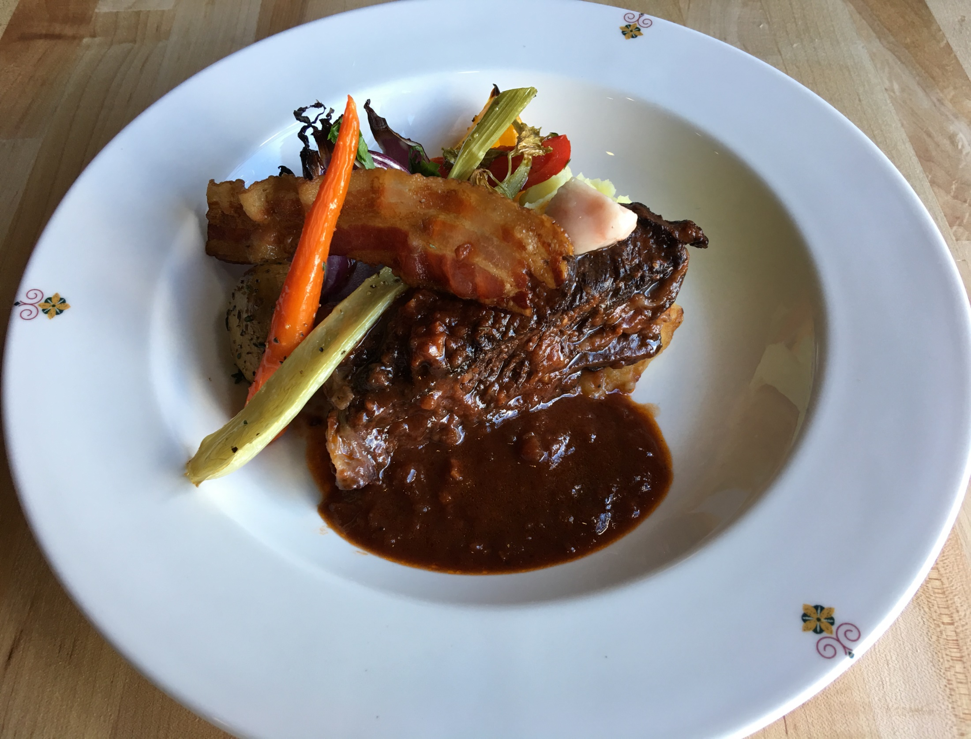
Notes:
Brasato di Manzo, Barolo & Pancetta
Slow braised Beef boneless short ribs in rich red wine sauce, Root Vegetable Casserole

Slide 45
Notes:
Polenta Soffice
Soft Polenta with Mushrooms, Fresh Mozzarella Cheese and Truffle Essence

Slide 46
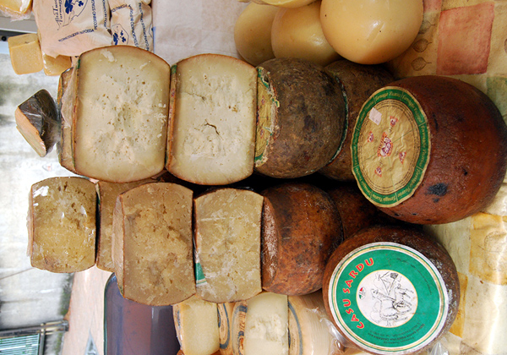
Selezione dei Formaggi Italiani,
Truffle-Honey,&Special Bread

Slide 47
(Slide 3) Deconstructed Tiramisu, espresso Sauce, Dark Chocolate Mousse and Coffee Kahlua Jelly.
(Slide 5,6) Vanilla Panna Cotta, Blueberry Compote, Almond Biscuit, Lemon Cream and Whipped Cream
(Slide 7,8) Fresh Berries Zabaglione
(Slide 9,10) Surprise
(Slide 11,12) Chocolate Rocher (Norman Love)

Slide 48
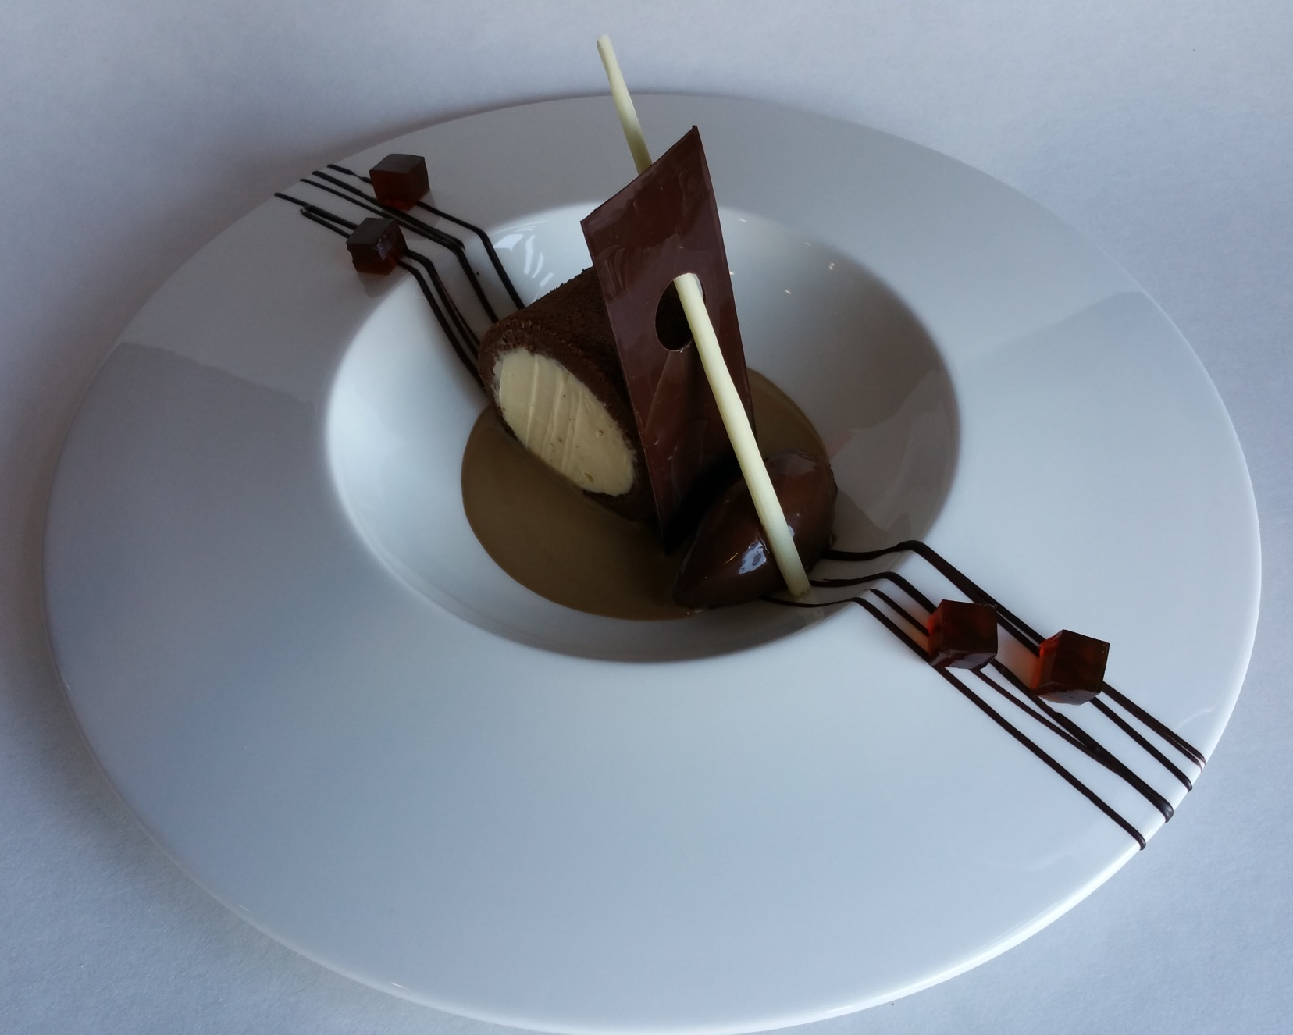

Slide 49
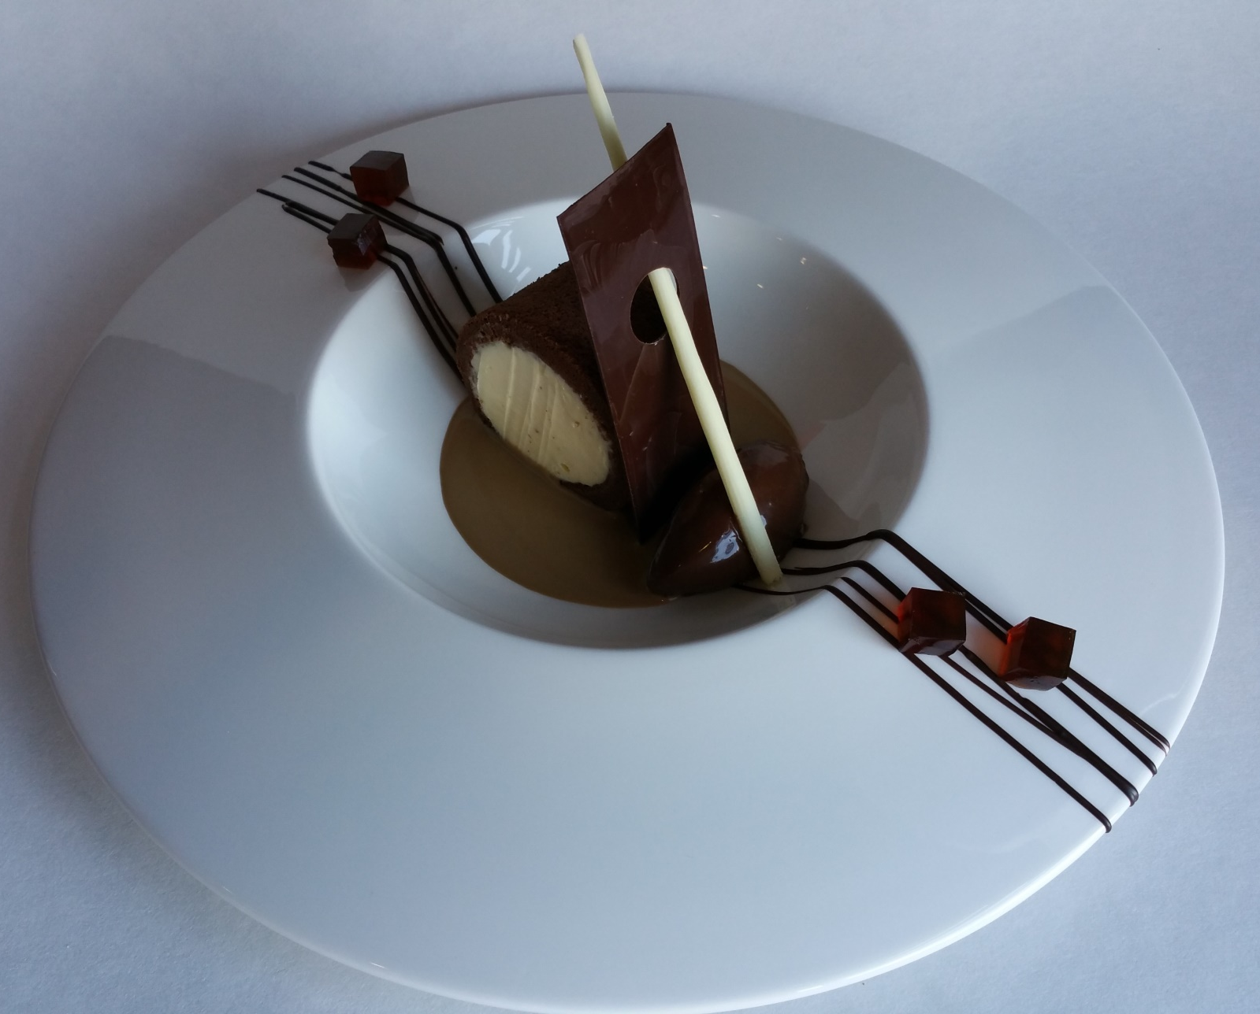
COFFEE KAHLUA JELLY
CHOCOLATE BISCUIT
CHOCOLATE DECOR
MASCARPONE
CREAM
ESPRESSO SAUCE
CHOCOLATE MOUSSE

Slide 50
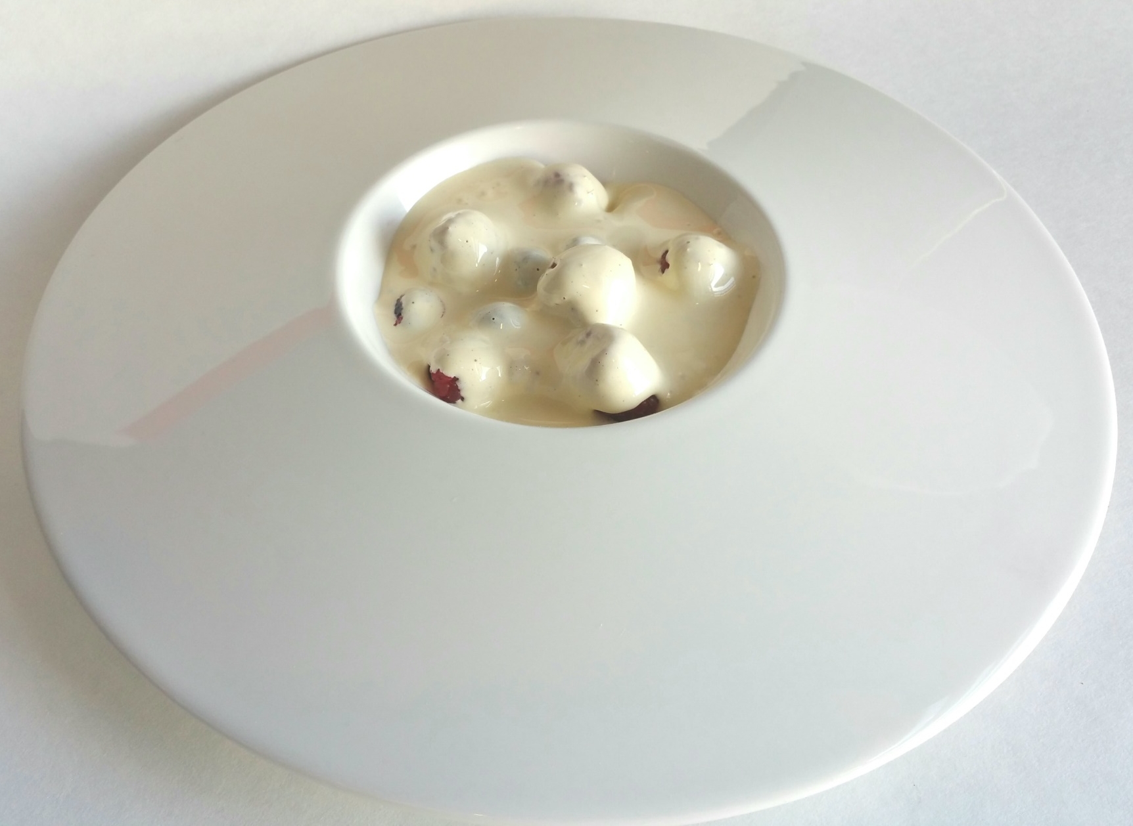

Slide 51

MARSALA
SABAYON
STRAWBERRIES
BLUEBERRIES
RASPBERRIES

Slide 52
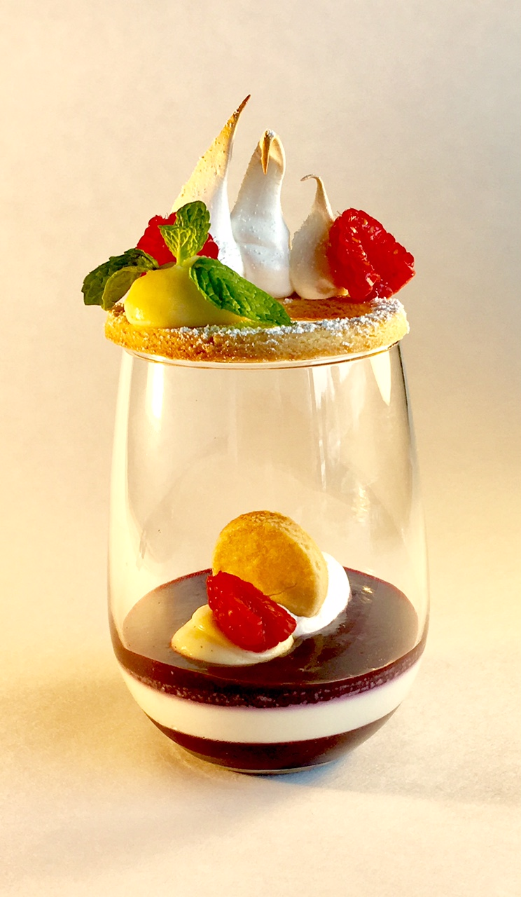

Slide 53


Slide 54
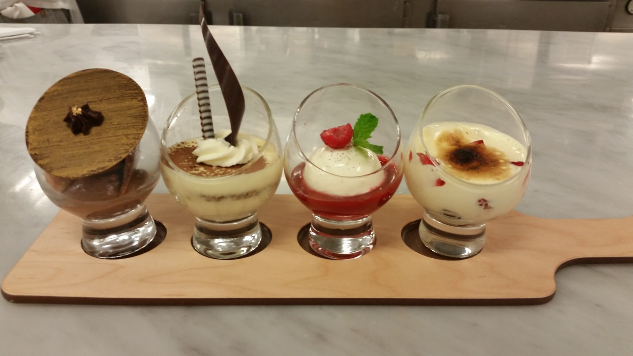

Slide 55
VANILLA PANNA COTTA
STRAWBERRY COULIS
RED BERRIES SABAYON
CHOCOLATE
ROCHER
TIRAMISU

Slide 56
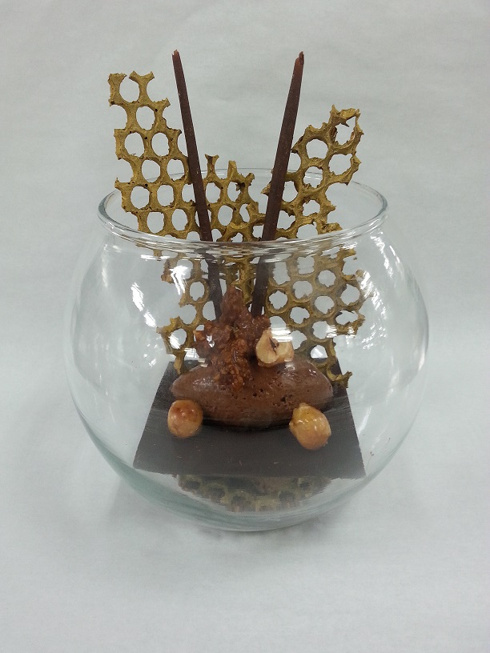

Slide 57
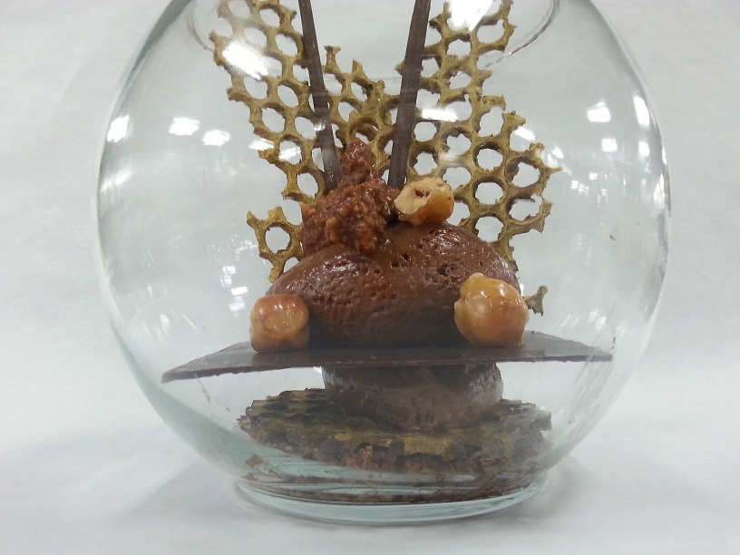
CHOCOLATE DECOR
CARAMELIZED
HAZELNUT
DARK CHOCOLATE
MOUSSE
DARK
CHOCOLATE
HAZELNUT CHOCOLATE
FEUILLENTINE

